Slide 1
It’s in the Blood
Understanding Complete Blood Counts (CBC)

Slide 2
Essential Question
How is complete blood count (CBC) used in patient diagnosis?

Slide 3
Lesson Objectives
Conduct a complete blood count (CBC) on “patient samples”
Diagnose patient samples based on CBC indicators
Discover new career options

Slide 4
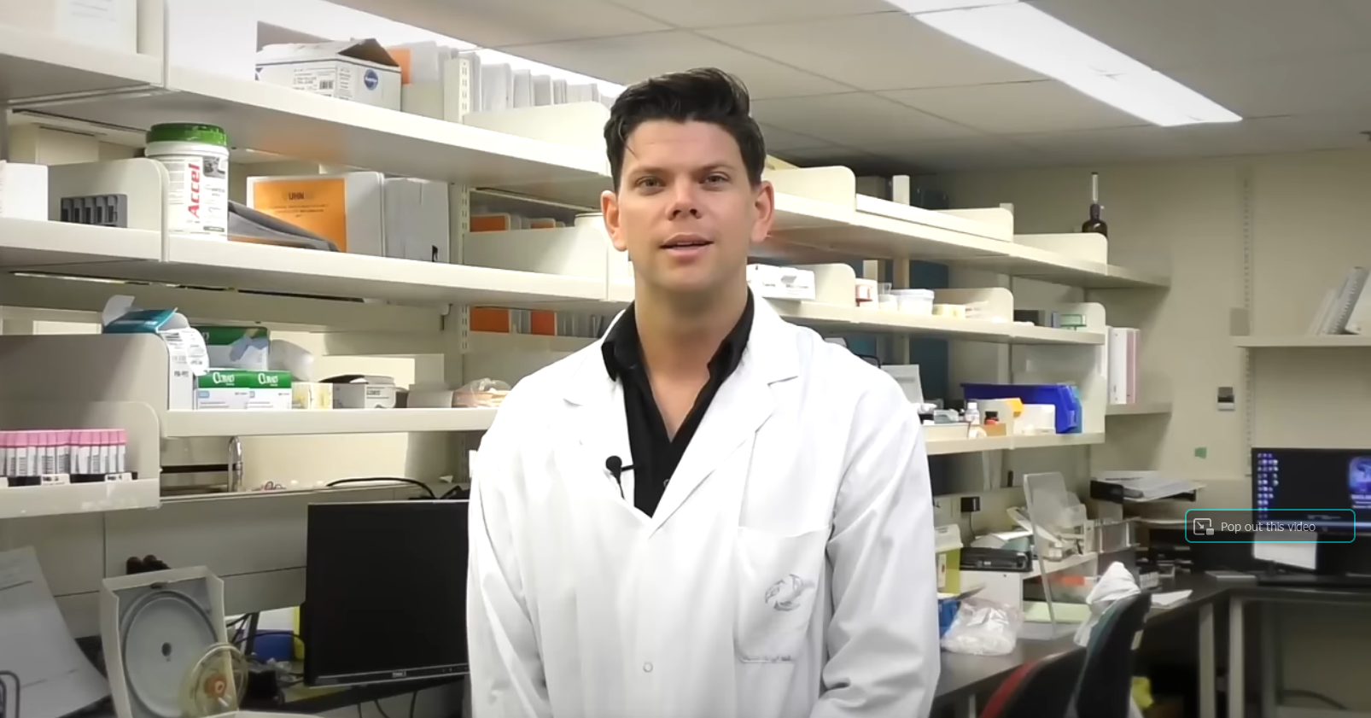
What’s a complete blood count (CBC)?
Notes:
In The Lab - Complete Blood Count (CBC)
https://youtu.be/7kqpOz5VfU0?si=662qRCyuU0QHqe5N

Slide 5
Conducting a CBC Part 1: Indicators
Station # | Indication (How is it different than the control?)
1 | Control
2
3
4
5
6
7
8
9

Slide 6
Conducting a CBC
Plasma
Red blood cell (RBC)
White blood cell (WBC)
Platelet

Slide 7
Conducting a CBC Part 1: Indicators
Add your classroom-specific lab procedures on this slide.

Slide 8
Scavenger Hunt Notes
Add your classroom-specific station procedures on this slide.

Slide 9
Conducting a CBC Part 2: Diagnosis
Pair up with a new partner.
Work together to compare your station notes to your indicators from Part 1 of the investigation.
From the list of disorders, diagnose each patient sample.

Slide 10
Conducting a CBC Part 2: Diagnosis
Station # | Indication (How is it different than the control?) | Proposed Diagnosis
1 | Control | Normal
2 | High WBC, Low Plasma | Infection + Dehydration
3 | High Platelets | Thrombocytosis
4 | High RBC, Low Plasma | Polycythemia + Dehydration
5 | Low RBC | Anemia
6 | Low WBC | Leukopenia
7 | Low Platelets | Thrombocytopenia
8 | High WBC | Leukemia
9 | Low RBC, Sickle-shaped | Sickle Cell Anemia

Slide 11
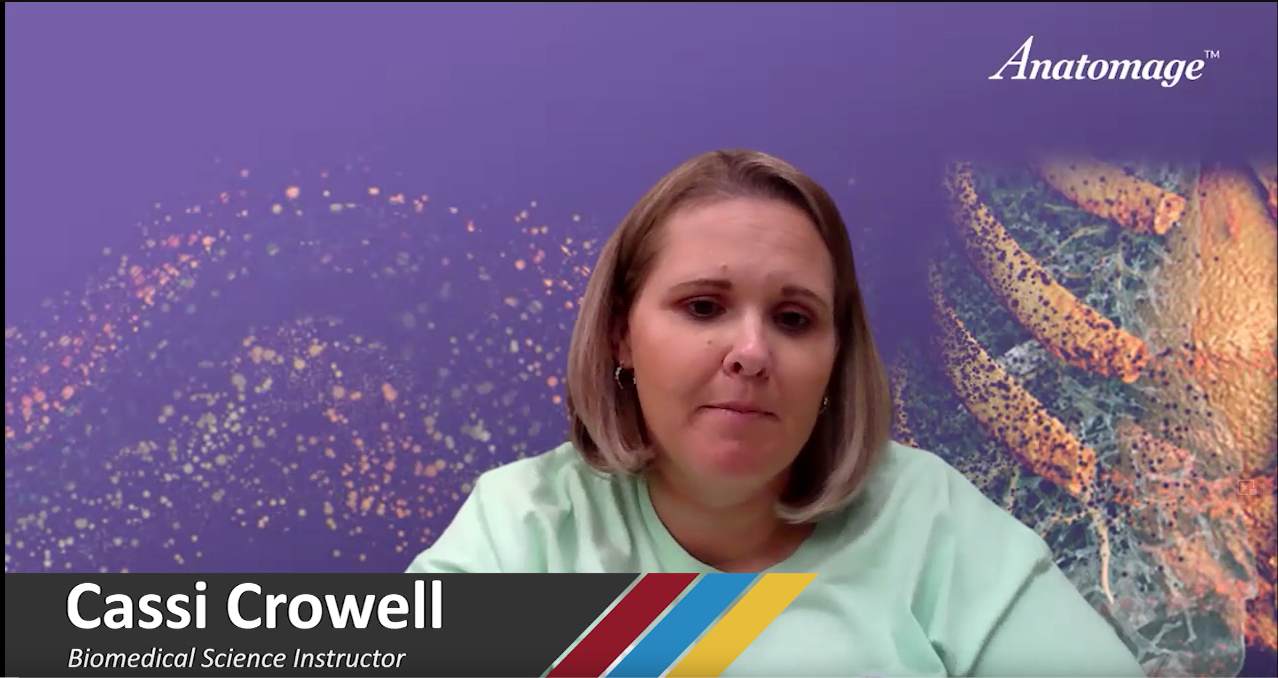
Biomedical Education and Phlebotomy
Notes:
K20 ICAP - Biomedical Educator - It's in the Blood
https://www.youtube.com/watch?v=k86D4vBfo7I

Slide 12
Video Reflection
WHAT I LEARNED | WHAT I FIND INTERESTING
What I Find Confusing Or Have Questions About | How This Relates To What I’ve Learned In The Lesson

Slide 13
Exit Ticket
You conduct a complete blood count on a patient sample and determine the patient has low platelet and high white blood cell counts.
What tentative diagnosis would you report to their doctor? Explain your reasoning.

