Slide 2
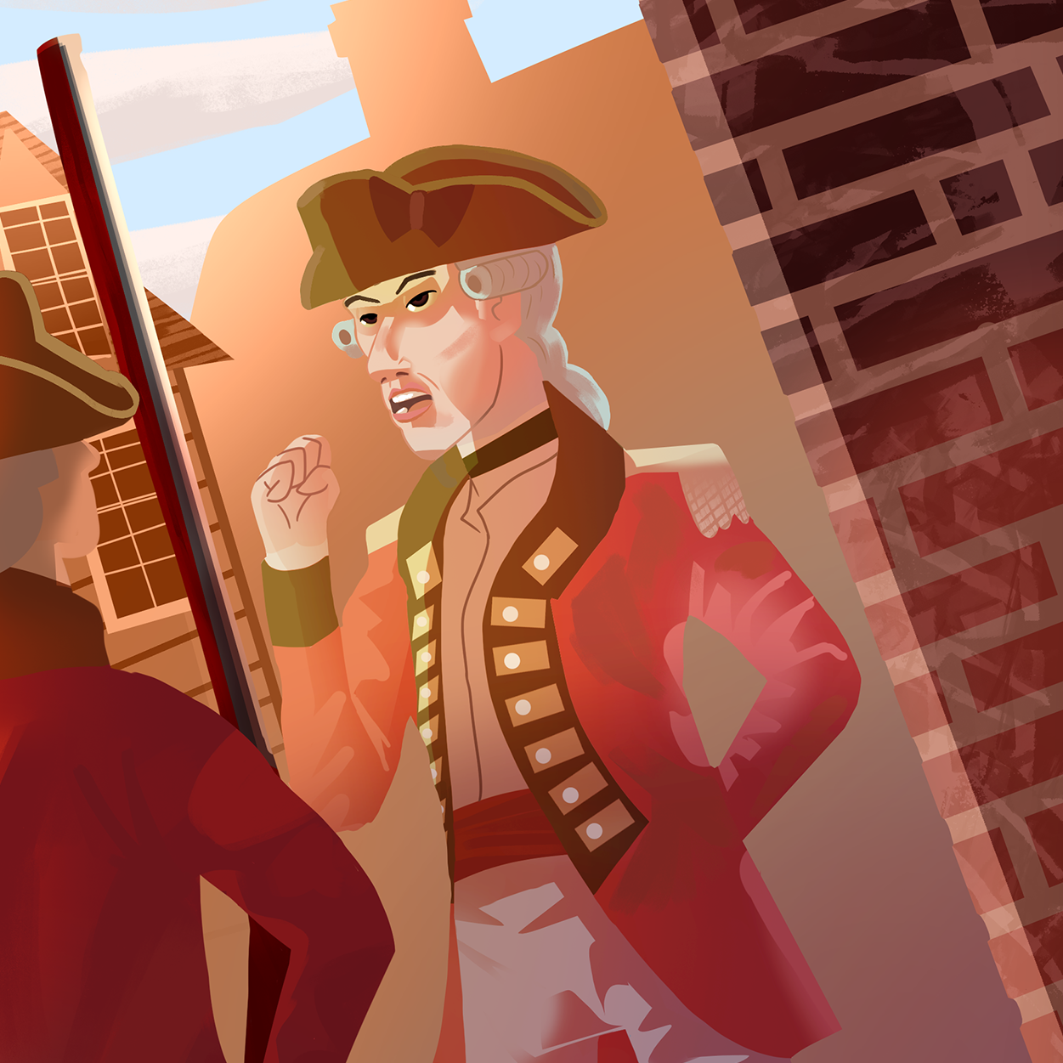
Resistance and Rebellion
Colonial Resistance and Movement Toward Revolution

Slide 3
Learning Objectives
Explain how propaganda shaped colonial attitudes toward independence.
Describe the key ideas that inspired the colonists to rebel against British rule.
Consider the forms of resistance that are commonly used in the world today.

Slide 4

Bell Ringer
Respond to the following question on your handout:
  What are some common examples of resistance or rebellion?
Notes:
K20 Center. (n.d.). Bell ringers and exit tickets. Strategies. https://learn.k20center.ou.edu/strategy/125

Slide 5
Bell Ringer
Respond to the following question on your handout:
  Why would the colonists want to resist British rule?
Notes:
K20 Center. (n.d.). Bell ringers and exit tickets. Strategies. https://learn.k20center.ou.edu/strategy/125

Slide 6
Essential Questions
How does conflict create change?
How can resistance movements influence revolution?

Slide 7
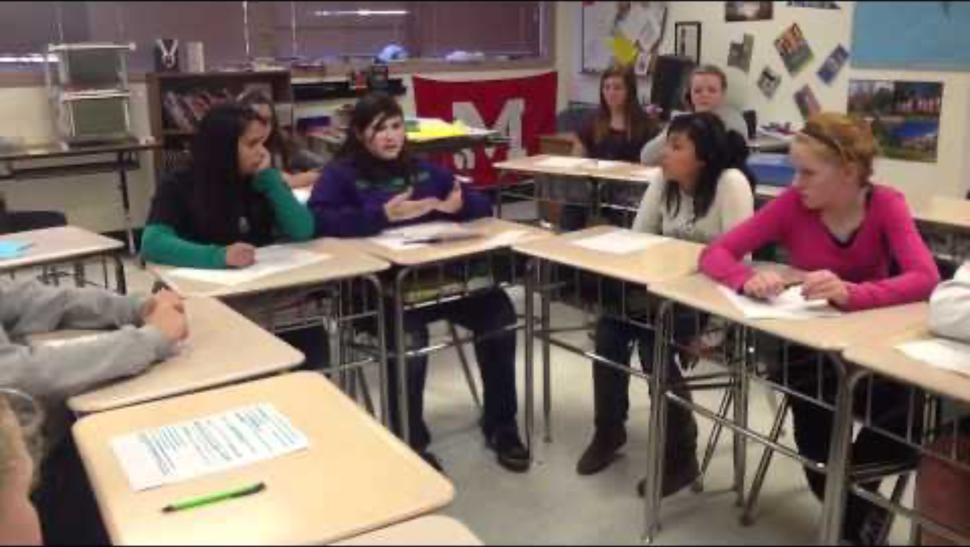
Notes:
Madland, J. (2012, February 1). Walker Middle School Socratic seminar [Video]. YouTube. https://www.youtube.com/watch?v=6pGVR6ZF_2M

Slide 8

Socratic Seminar: Roles
Inner circle partners will:
  Speak, ask, and respond to questions.
Outer circle partners will:
  Observe, take notes, and evaluate.
The Hot Seat is for:
  Anyone to quickly jump in and offer a response.
Notes:
K20 Center. (n.d.). Socratic seminar. Strategies. https://learn.k20center.ou.edu/strategy/781

Slide 9
Socratic Seminar: Handouts
As you participate in the Socratic seminar, you should complete the Peer Evaluation and Self-Evaluation handouts.
  Evaluate your peers using the Peer Evaluation handout when you are in the outer circle.
  After the seminar, evaluate yourself using the Self-Evaluation handout.
Use the question to drive discussion.
Notes:
K20 Center. (n.d.). Socratic seminar. Strategies. https://learn.k20center.ou.edu/strategy/781

Slide 10

H.I.P.P
Analyze the following elements of the image and speech:
  Historical context
  Intended audience
  Point of view
  Purpose
Write your thoughts in the graphic organizer.
Notes:
K20 Center. (n.d.). H.I.P.P. Strategies. https://learn.k20center.ou.edu/strategy/1618

Slide 11
Question Types
Level 1: Recall and remember
  Who wrote the Declaration of Independence?
Level 2: Apply knowledge and make inferences
  Why did the U.S. want independence from Britain?
Level 3: Critical thinking and reflection
  What ideas did the colonists use to justify their rebellion?
Notes:
K20 Center. (n.d.). DOK question stems. Strategies. https://learn.k20center.ou.edu/strategy/170

Slide 12
Socratic Seminar Day
Participate in the discussion about the colonists’ resistance to British rule.
Spend half of the discussion as a speaker and half as an observer. Participation is expected in both roles.
Lead the discussion along with your peers.
  Your teacher will serve as a moderator.
Notes:
K20 Center. (n.d.). Socratic seminar. Strategies. https://learn.k20center.ou.edu/strategy/781

Slide 13
Socratic Seminar Reflection
Define resistance. Explain why some of the colonists resisted the British government.
Explain how the engraving and the speech are examples of colonial resistance. Use evidence to support your answer.
How is the concept of resistance still relevant today? Explain using an example.
Notes:
K20 Center. (n.d.). Socratic seminar. Strategies. https://learn.k20center.ou.edu/strategy/781

