Slide 2
Greeks or Romans?
A World History Lesson

Slide 3
Essential Questions:
Who had the greater contribution of political ideas, the Greek philosophers or Roman philosophers?
Who has had the greater impact on later political thought in Western society?

Slide 4
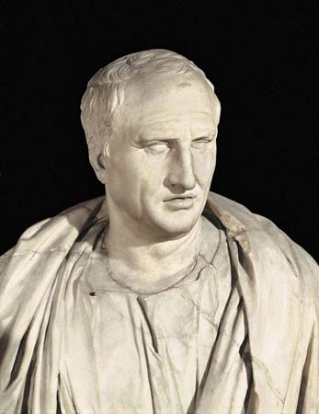
Watch the video:
Law and Justice: Cicero and Roman Republicanism

Slide 5
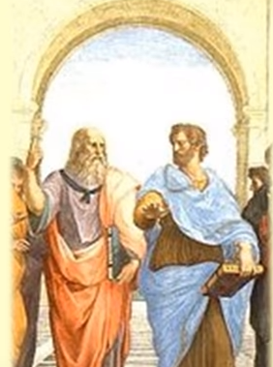
Watch the video:
Plato vs. Aristotle

Slide 6
CER Example
CLAIM: I believe that the Romans were the greater philosophers and made a greater impact on Western society than the Greeks.
EVIDENCE: From the videos, it stated that the Romans… From the readings, the Romans were superior to the Greeks because…
REASONING: When you think about modern society today, we owe a lot to the Romans. From the information, the Romans gave us a rich legacy that included…

Slide 7
Tug of War!
Choose a side of who you think is more influential on Western society– Greeks or Romans!
Using information learned, discuss with your team what are the MOST important ideas that support your side.
Write these down on a sticky note—one idea per sticky note.
When it is your team’s turn, place your sticky note on the board.
The judges will determine the winner based upon the quality of the sticky note ideas.

