Slide 2
A Visual Exploration of Theme
Picture the Theme

Slide 3
Essential Question
How do literary elements contribute to the theme of a text?

Slide 4
Lesson Objectives
Identify and analyze how setting, imagery, diction, and characterization contribute to a work’s theme.
Create a multimodal product to express the theme of a work and the elements used to create it.

Slide 5
Universal Theme Sets
There are four themes:
Courage/Fear
Acceptance/Isolation
Love/Hate
Loyalty/Betrayal
Write the theme that matches the following pictures in the corresponding petal on your handout.

Slide 6
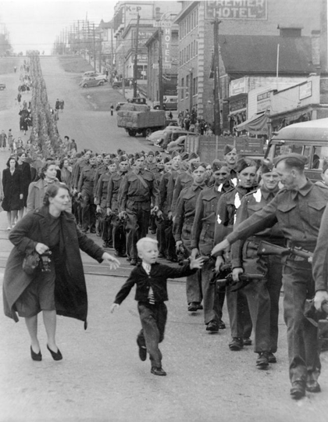
Picture #1
Notes:
Dettloff., C. P. (1940). R/PICS - wait for me, daddy. https://www.reddit.com/r/pics/comments/uhf5h/wait_for_me_daddy/

Slide 7
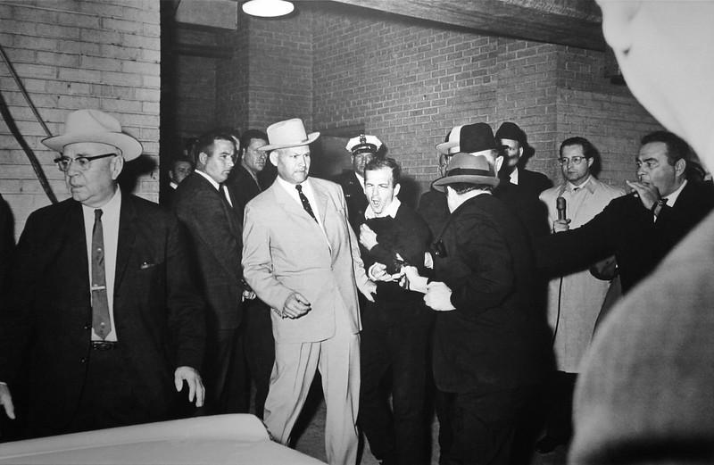
Picture #2
Notes:
Jackson, R. H. (2022, August 18). Jack Ruby shoots Lee Harvey Oswald. Flickr. https://www.flickr.com/photos/nostri-imago/4428684060

Slide 8
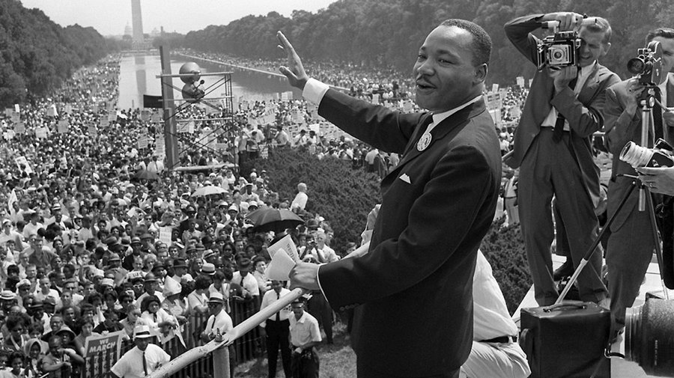
Picture #3
Notes:
Nick Erickson, & by:, A. (n.d.). Remembering the March on Washington 60 years later: GW today: The George Washington University. GW Today. https://gwtoday.gwu.edu/remembering-march-washington-60-years-later

Slide 9
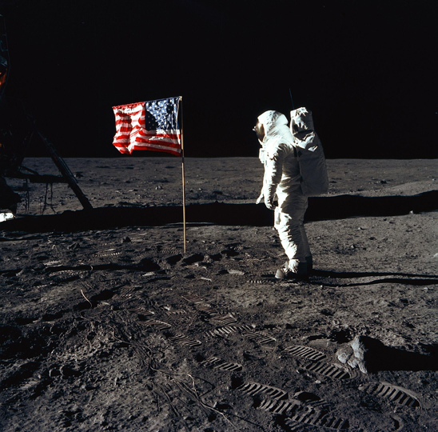
Picture #4
Notes:
Buzz Aldrin. National Air and Space Museum. (2021, August 17). https://airandspace.si.edu/explore/stories/buzz-aldrin

Slide 10
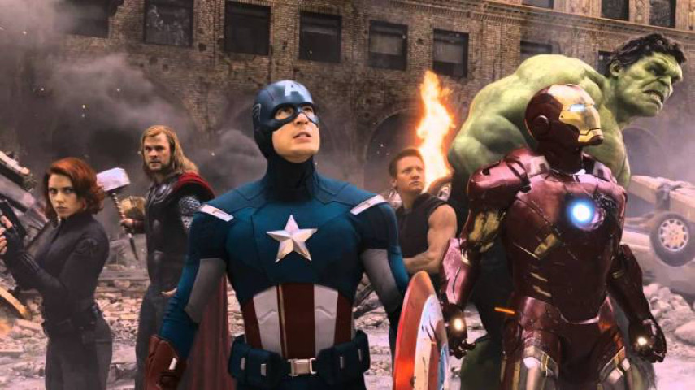
Picture #5
Notes:
Sophie Butcher | Published on26 04 2022, By, Butcher, S., 2022, P. on26 04, & on, P. (n.d.). How the Avengers changed Hollywood. Empire. https://www.empireonline.com/movies/features/how-avengers-changed-hollywood/

Slide 11
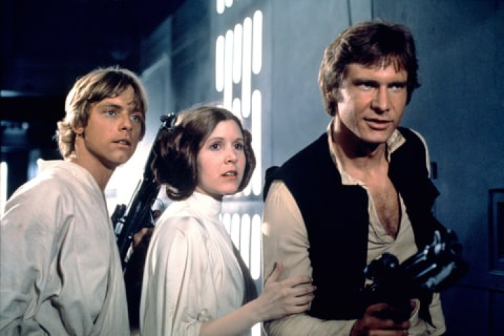
Picture #6
Notes:
Star wars: Episode IV - A new hope. The Roxy Theater. (2024, July 25). https://www.theroxytheater.org/show/star-wars-episode-iv-a-new-hope/

Slide 12
Four Corners
For each picture:
Stand by the corresponding theme on the wall that your recorded on your handout.
Discuss with your group why you decided on the theme set.
Choose a spokesperson to share your discussion with the class.
Notes:
K20 Center. (n.d.). Four Corners. Strategies. https://learn.k20center.ou.edu/strategy/138

Slide 13
Picture #1
Notes:
Dettloff., C. P. (1940). R/PICS - wait for me, daddy. https://www.reddit.com/r/pics/comments/uhf5h/wait_for_me_daddy/

Slide 14
Picture #2
Notes:
Jackson, R. H. (2022, August 18). Jack Ruby shoots Lee Harvey Oswald. Flickr. https://www.flickr.com/photos/nostri-imago/4428684060

Slide 15
Picture #3
Notes:
Nick Erickson, & by:, A. (n.d.). Remembering the March on Washington 60 years later: GW today: The George Washington University. GW Today. https://gwtoday.gwu.edu/remembering-march-washington-60-years-later

Slide 16
Picture #4
Notes:
Buzz Aldrin. National Air and Space Museum. (2021, August 17). https://airandspace.si.edu/explore/stories/buzz-aldrin

Slide 17
Picture #5
Notes:
Sophie Butcher | Published on26 04 2022, By, Butcher, S., 2022, P. on26 04, & on, P. (n.d.). How the Avengers changed Hollywood. Empire. https://www.empireonline.com/movies/features/how-avengers-changed-hollywood/

Slide 18
Picture #6
Notes:
Star wars: Episode IV - A new hope. The Roxy Theater. (2024, July 25). https://www.theroxytheater.org/show/star-wars-episode-iv-a-new-hope/

Slide 19
Literary Elements
As you read through the passage highlight the following literary elements in the corresponding colors:
Setting - Pink
Imagery - Yellow
Diction - Blue
Characterization - Green
Notes:
K20 center. (n.d.). Why-Lighting. Strategies. https://learn.k20center.ou.edu/strategy/128

Slide 20
Theme
For each element you highlighted determine which theme it demonstrates.
Write the highlighted text in the matching box on your graphic organizer.

Slide 21
Reflect on the Theme
Find the section on your graphic organizer with the most entries.
Determine which theme from the set matches the best.
For example: Is it courage or fear?

Slide 22
One-Pager
Create a visual project that illustrates the theme of the passage and the literary elements from the graphic organizer
Include the following
symbols or written examples of the literary elements
a variety of pictures and visual elements
Notes:
K20 Center. (n.d.). One-Pager. Strategies. https://learn.k20center.ou.edu/strategy/72

Slide 23
Gallery Walk
As you walk around the room, view the one-pagers from the class.
On your Gallery Walk Graphic Organizer record at least two literary elements and make a connection to the theme.
Setting
Imagery
Diction
Characterization
Notes:
K20 Center. (n.d.). Gallery Walk/Carousel. Strategies. https://learn.k20center.ou.edu/strategy/118

