Slide 1
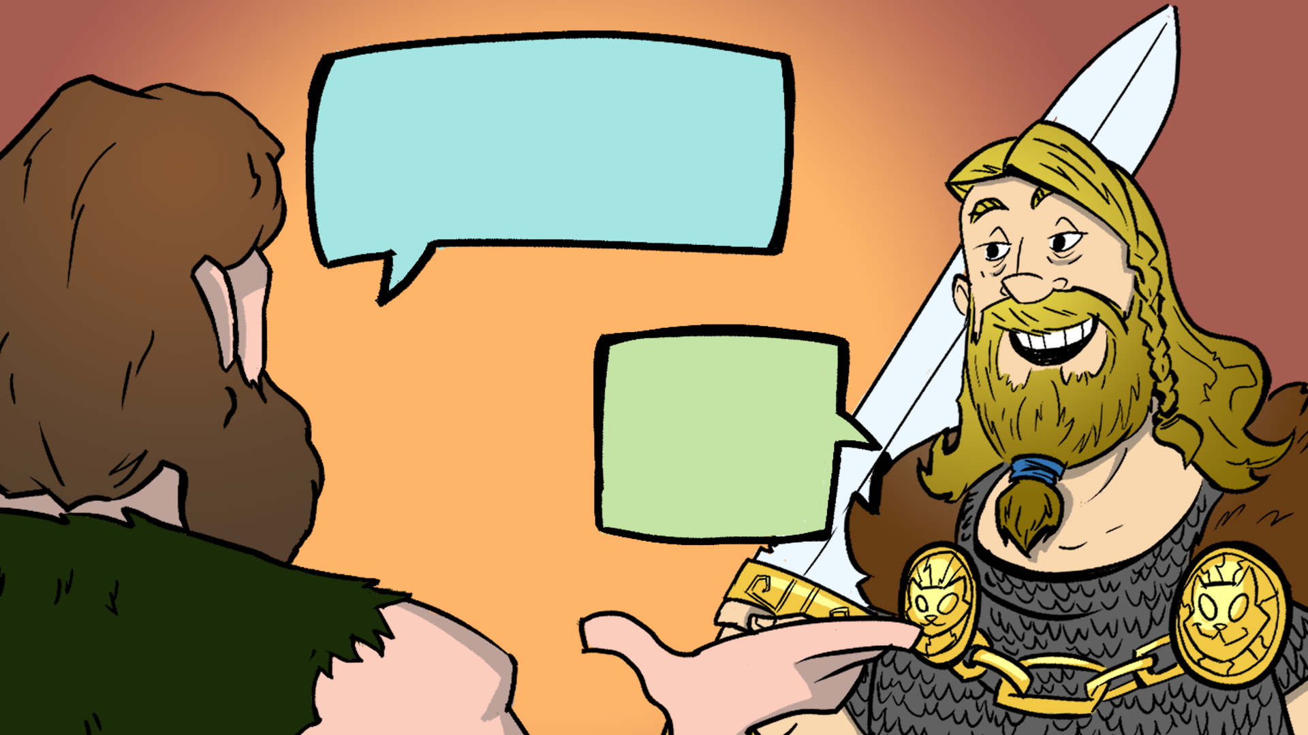
Beowulf Lingo: Decoding the Epic Vibes
Vocabulary from Beowulf

Slide 2
Essential Question
How do context clues, connotation, denotation, and different takes on a text help you clarify the meaning of words?

Slide 3
Learning Objectives
Use context clues, connotation, and denotation to determine the meaning of words within the text.
Analyze the techniques used in classic literature compared to comic book writing to determine how they contribute to the meaning of the vocabulary.

Slide 4
Honeycomb Harvest
Each hexagon has one of the following on it:
Word
Image
Synonyms
With your group, organize these into groups to determine their relationships and how they all connect with each other.

Slide 5
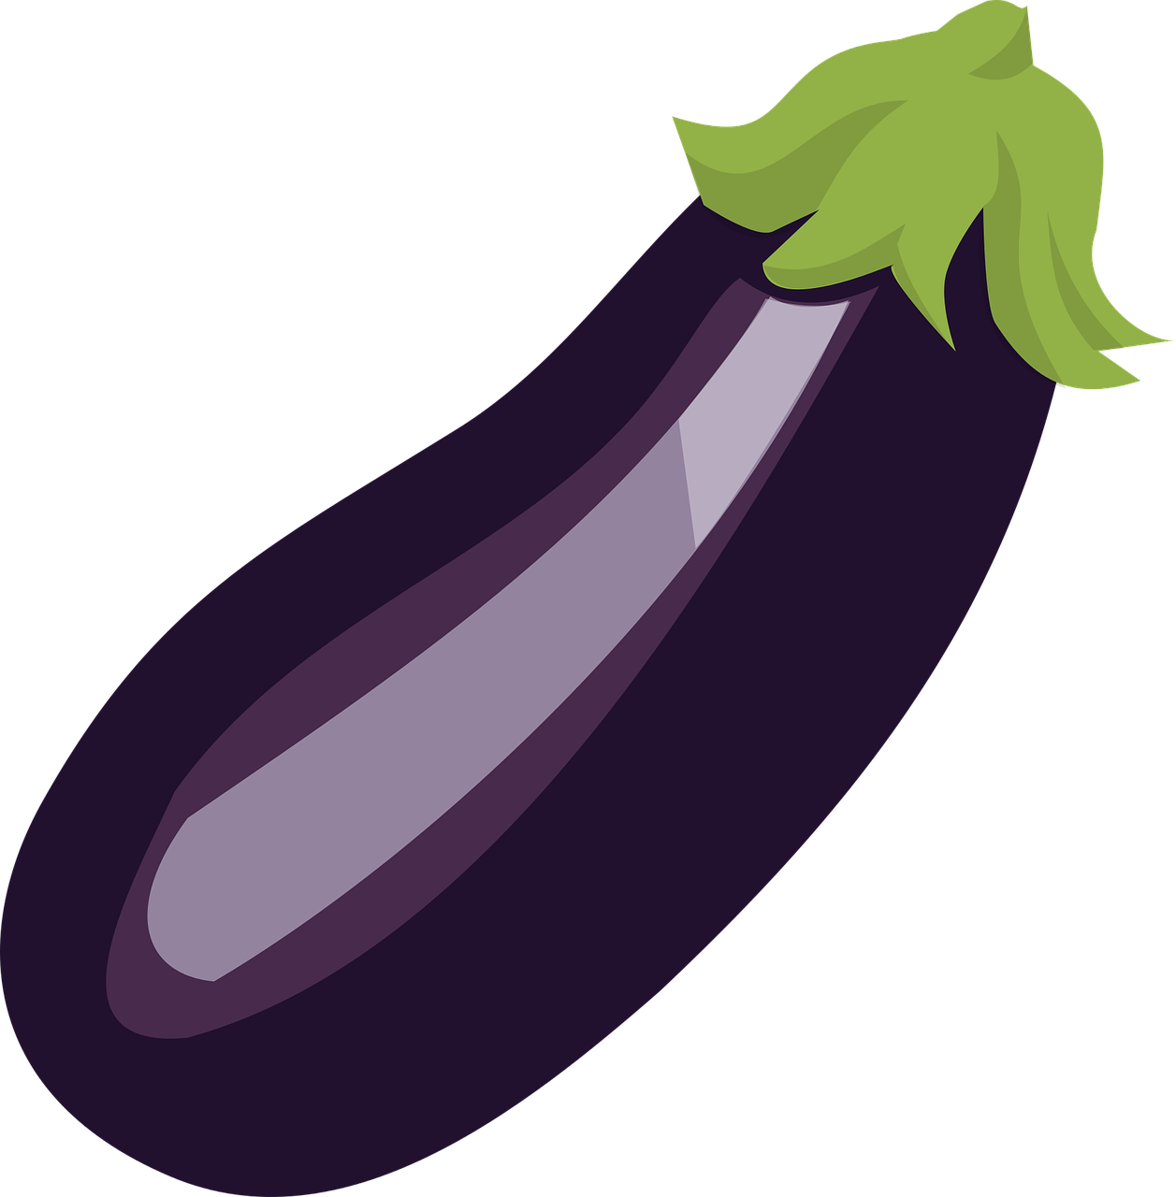
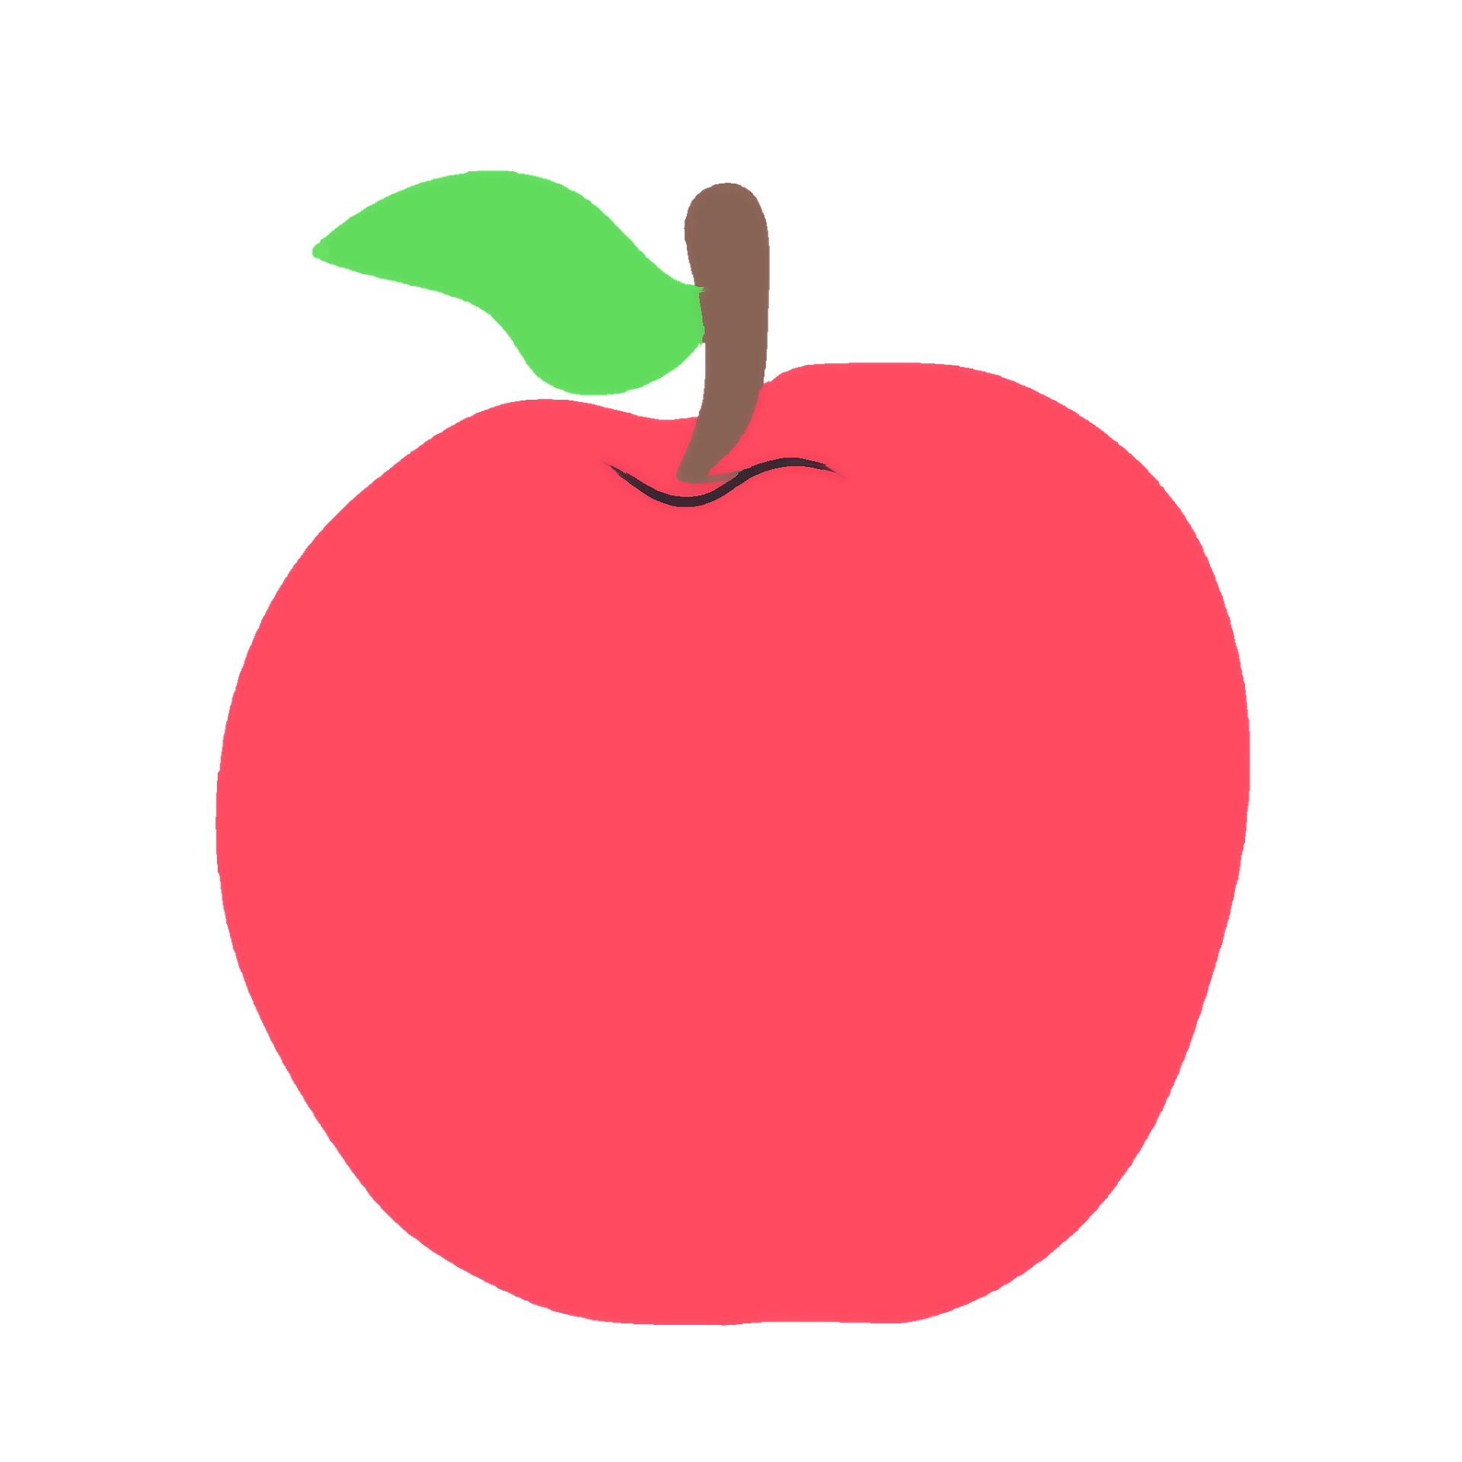
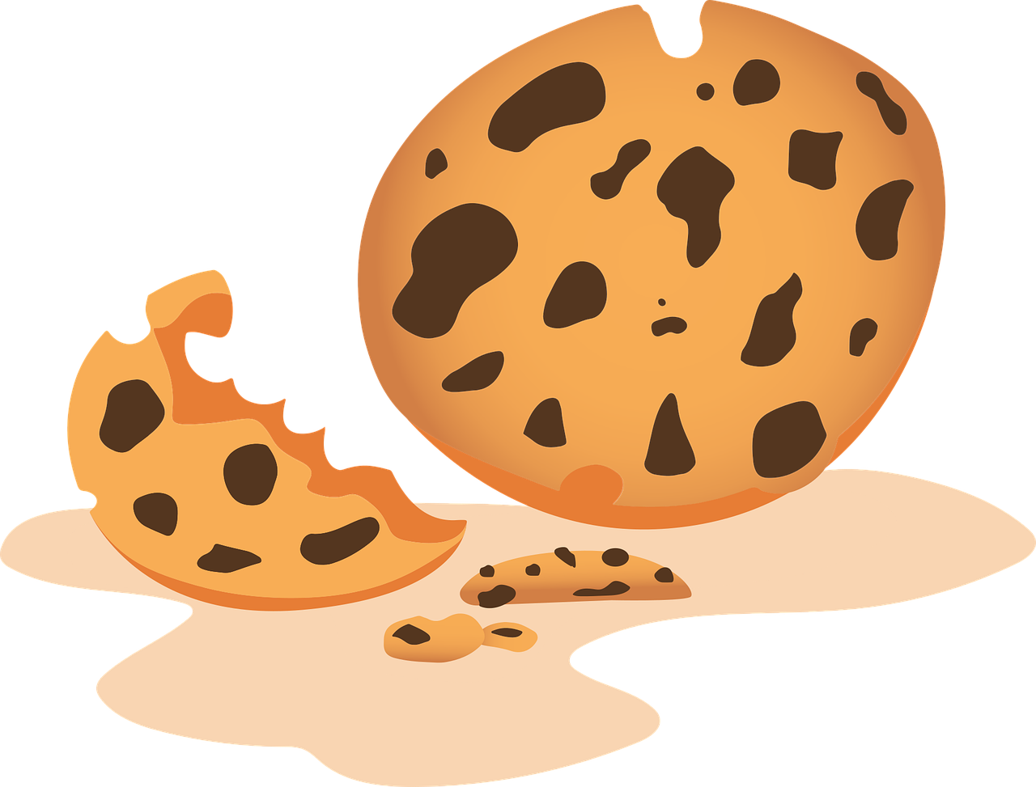
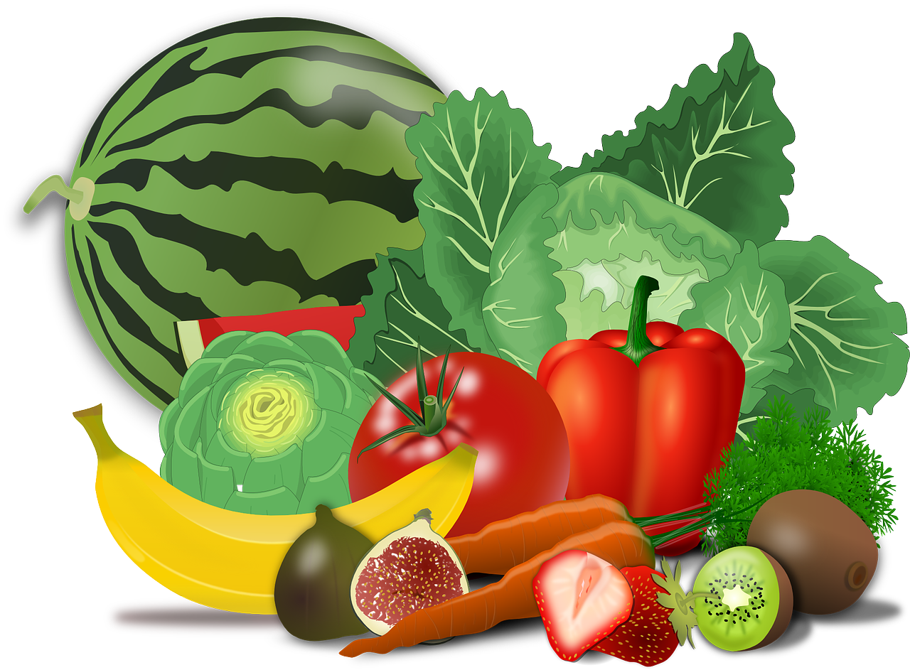
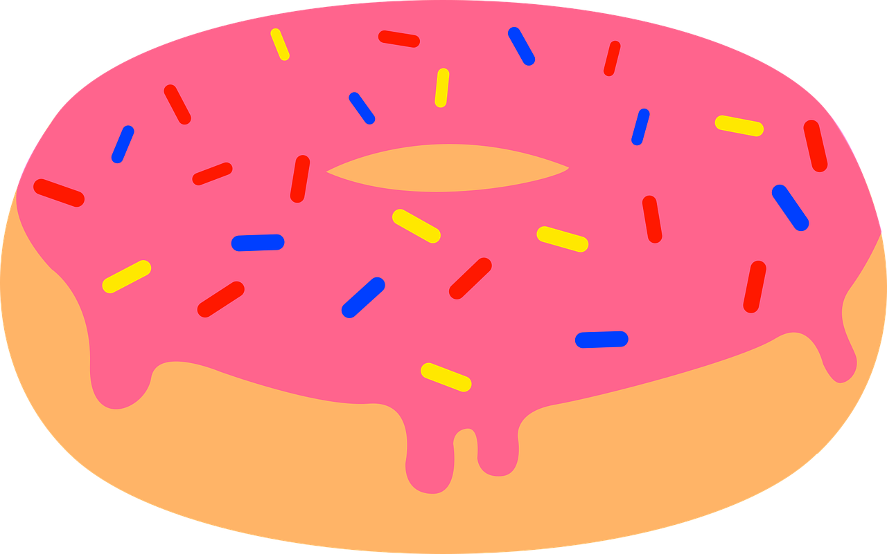
Example Honeycomb Harvest
e
food
d
B
a
b
D
c
apple
f
F
C
Egg-
plant
banana
E
cookie
donut
A
Notes:
https://pixabay.com/illustrations/teacher-apple-school-elementary-1202735/
https://pixabay.com/vectors/banana-bunch-fruit-food-bananas-25339/
https://pixabay.com/vectors/cookie-dessert-snack-biscuits-6035822/
https://pixabay.com/vectors/donut-snack-dessert-sweet-sugary-5985274/
https://pixabay.com/vectors/aubergine-egg-plant-food-greens-1298730/
https://pixabay.com/vectors/vegetables-fruits-food-artichoke-155616/

Slide 6
Egg-
plant
cookie
A
E
c
apple
e
C
a
donut
D
d
banana
f
B
F
b
food

Slide 7
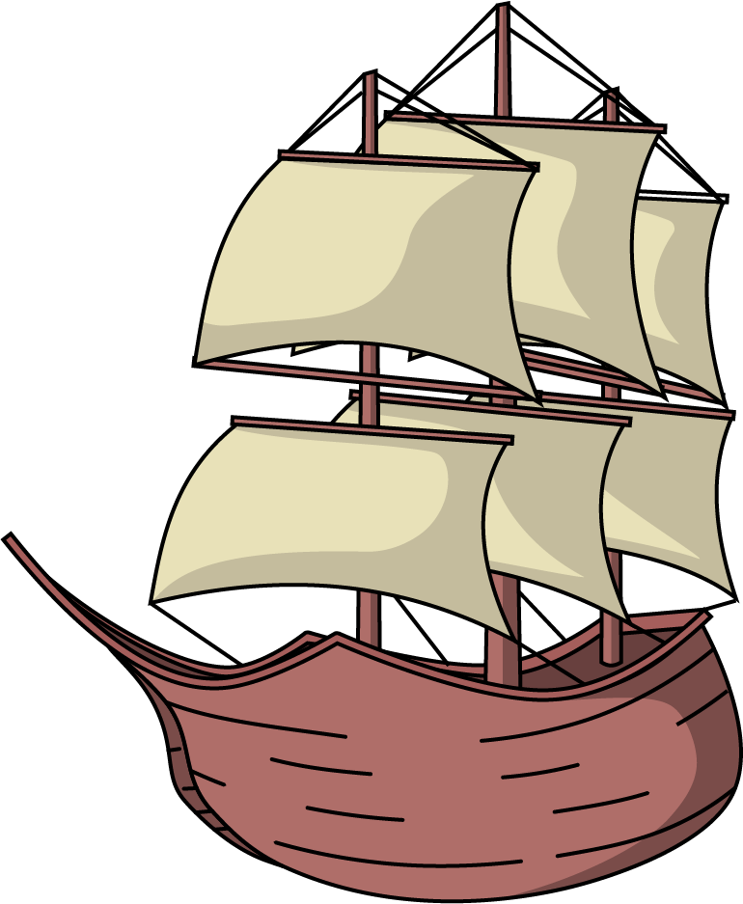
Ship
What does that mean?

Slide 8
Ship
What does that mean?
A large seagoing boat
To cause to be transported
To wishfully regard people or fictional characters to be romantically involved

Slide 9
Cap
What does that mean?

Slide 10
Cap
What does that mean?
A head covering
Set an upper limit on
Lying

Slide 11
Bet
What does that mean?

Slide 12
Bet
What does that mean?
A wager
Ok, I agree
Feeling sure about something

Slide 13
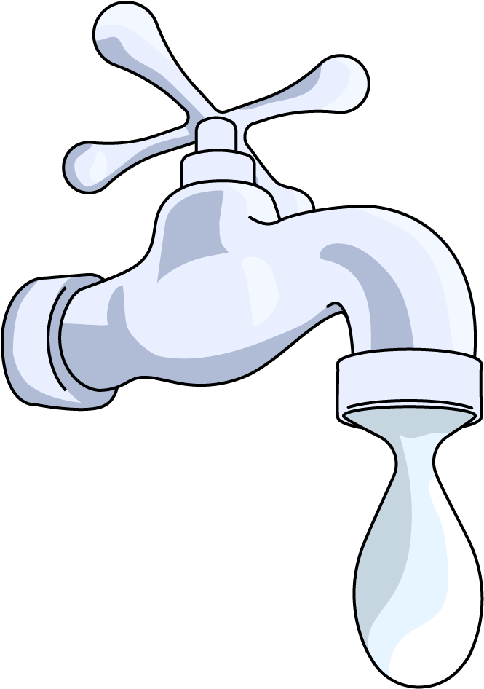
Drip
What does that mean?

Slide 14
Drip
What does that mean?
To let fall in drops
To let out or seem to spill copiously
A fashionable look

Slide 15
Flex
What does that mean?

Slide 16
Flex
What does that mean?
To bend, especially repeatedly
To move a muscle
To talk in a boastful way

Slide 17
Beat
What does that mean?

Slide 18
Beat
What does that mean?
To strike repeatedly
Basic unit of time in music
Apply makeup

Slide 19
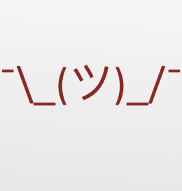
Unknown Vocabulary
What do you think the term on your paper means?
Write down your best guess at a definition in the space provided on your paper.

Slide 20
Unknown Vocabulary
Read the excerpt from Beowulf
Find where the term is used in a sentence:
What do you think the term means now?
What context clues help you understand the meaning of the term?
Update your definition if necessary.

Slide 21
Unknown Vocabulary
Read the pages from the graphic novel
Read the scene where your term is portrayed visually:
What do you think the term means now?
What context clues help you understand the meaning of the term?
Update your definition if necessary.

Slide 22
Context Clues
Context clues are hints found within a sentence, paragraph, or passage that a reader can use to understand the meanings of new or unfamiliar words.

Slide 23
Denotation
The literal or primary meaning of a word, in contrast to the feelings or ideas that the word suggests.

Slide 24
Connotation
An idea or feeling that a word invokes in addition to its literal or primary meaning.

Slide 25
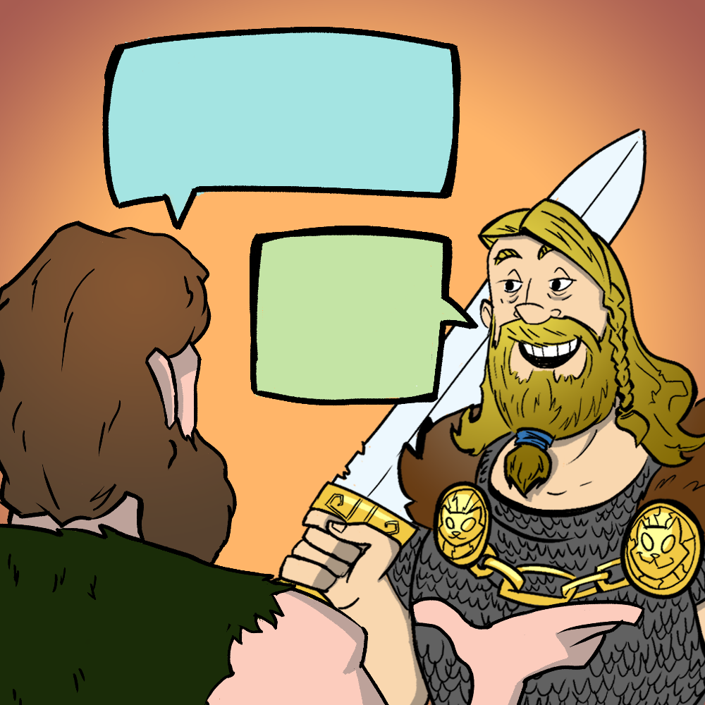
Known Vocabulary
Look up the definition of your term in a dictionary.
How is this definition similar or different from what you thought it would be?

Slide 26
Frayer Model
On your chart paper, include:
Your term
The definition
An new example of your term used in a sentence
Examples
Non-examples

Slide 27
How am I Feeling? What am I Thinking?
Review the following:
The meaning of your vocabulary word
How the word is used in the original text
How the word is visually represented in the graphic novel
What feelings does this word conjure up?
Place those feelings on sticky notes around your chart paper.

Slide 28
Quick Write
Respond to the following question in 2-3 sentences:
How do context clues, connotation, denotation and different takes on a text help you clarify the meaning of words?

