Slide 2
Improving Your Stats
Decoding the Game

Slide 3
Essential Question
How do statisticians use measures of central tendency in sports?

Slide 4
Lesson Objectives
Calculate measures of central tendency for a set of data.
Use knowledge of measures of central tendency to solve real-world, ACT-style problems.

Slide 5
Sports Statistician
Real-Time Stats in Sports

Slide 6
Stats in the Real-World
In sports, how could a statistician use mean, median, or mode?
How do you, or how could you, use mean, median, or mode in your life?

Slide 7
Explore the Score
Work together to complete your problem.
Thoroughly work through your problem while keeping the following in mind:
How many steps are needed to complete the problem?
What prompted you to know how to start?

Slide 8
Explore the Score
Show all the necessary work required for completing the problem.
Create a visually appealing poster that includes:
Your question number
The completed problem
Notes or numbered steps that help explain your work
Be sure to point out what prompted you to know how to start.
5-Minute Timer
Notes:
K20 Center. (2021, September 21). K20 Center 5 minute timer. [Video]. YouTube. https://youtu.be/EVS_yYQoLJg?si=fJvuvFWH3vJ3B0z9

Slide 9
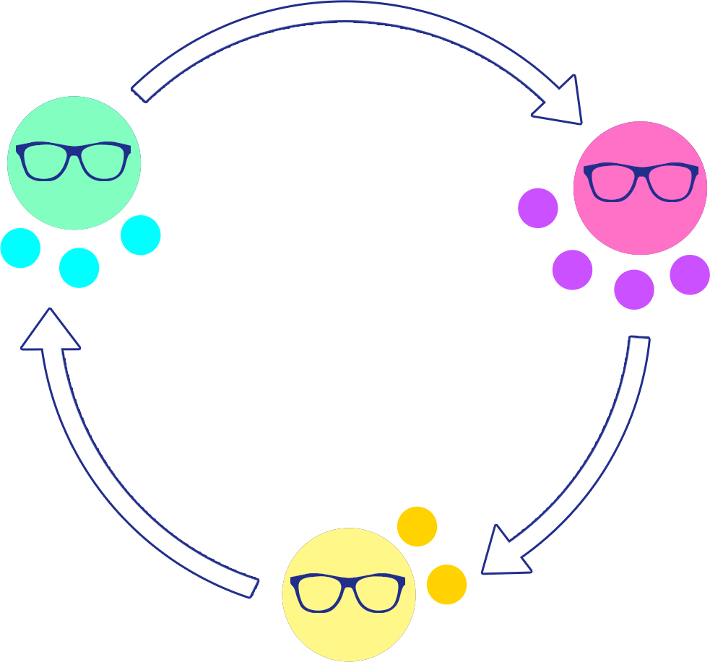
Expert Stay and Stray: Overview
Gather at your poster.
Expert Stay: One person from your group stays to explain your problem to your audience.
Stray: Everyone else rotates to the next poster to listen and learn and be ready to be the next expert.
Notes:
K20 Center. (n.d.). Expert Stay and Stray. Strategies. https://learn.k20center.ou.edu/strategy/2650

Slide 10
Expert Stay and Stray: Round 1
Expert Stay: All students with assigned number 1, stay at your posters. Be ready to present and answer questions.
Stray: Everyone else, move to the next poster to listen and learn and be ready to be the next expert.
Notes:
K20 Center. (n.d.). Expert Stay and Stray. Strategies. https://learn.k20center.ou.edu/strategy/2650

Slide 11
Expert Stay and Stray: Round 1
Experts, present your work and steps to your new audience.
Everyone else, pay attention and ask questions as needed.
3-Minute Timer
Notes:
K20 Center. (n.d.). Expert Stay and Stray. Strategies. https://learn.k20center.ou.edu/strategy/2650
K20 Center. (2021, September 21). K20 Center 3 minute timer. [Video]. YouTube. https://youtu.be/iISP02KPau0?si=2VHRShyG44tA3TV9

Slide 12
Expert Stay and Stray: Round 2
Expert Stay: All students with assigned number 4, stay at the posters you are at. Be ready to present and answer questions.
Stray: Everyone else, move to the next poster to listen and learn and be ready to be the next expert.
Notes:
K20 Center. (n.d.). Expert Stay and Stray. Strategies. https://learn.k20center.ou.edu/strategy/2650

Slide 13
Expert Stay and Stray: Round 2
Experts, present your work and steps to your new audience.
Everyone else, pay attention and ask questions as needed.
3 Minute Timer
Notes:
K20 Center. (n.d.). Expert Stay and Stray. Strategies. https://learn.k20center.ou.edu/strategy/2650
K20 Center. (2021, September 21). K20 Center 3 minute timer. [Video]. YouTube. https://youtu.be/iISP02KPau0?si=2VHRShyG44tA3TV9

Slide 14
Expert Stay and Stray: Round 3
Expert Stay: All students with assigned number 2, stay at the posters you are at. Be ready to present and answer questions.
Stray: Everyone else, move to the next poster to listen and learn and be ready to be the next expert.
Notes:
K20 Center. (n.d.). Expert Stay and Stray. Strategies. https://learn.k20center.ou.edu/strategy/2650

Slide 15
Expert Stay and Stray: Round 3
Experts, present your work and steps to your new audience.
Everyone else, pay attention and ask questions as needed.
3 Minute Timer
Notes:
K20 Center. (n.d.). Expert Stay and Stray. Strategies. https://learn.k20center.ou.edu/strategy/2650
K20 Center. (2021, September 21). K20 Center 3 minute timer. [Video]. YouTube. https://youtu.be/iISP02KPau0?si=2VHRShyG44tA3TV9

Slide 16
Expert Stay and Stray: Round 4
Expert Stay: All students with assigned number 3, stay at the posters you are at. Be ready to present and answer questions.
Stray: Everyone else, move to the next poster to listen and learn and be ready to be the next expert.
Notes:
K20 Center. (n.d.). Expert Stay and Stray. Strategies. https://learn.k20center.ou.edu/strategy/2650

Slide 17
Expert Stay and Stray: Round 4
Experts, present your work and steps to your new audience.
Everyone else, pay attention and ask questions as needed.
3 Minute Timer
Notes:
K20 Center. (n.d.). Expert Stay and Stray. Strategies. https://learn.k20center.ou.edu/strategy/2650
K20 Center. (2021, September 21). K20 Center 3 minute timer. [Video]. YouTube. https://youtu.be/iISP02KPau0?si=2VHRShyG44tA3TV9

Slide 18
How Am I Feeling? What Am I Thinking
Reflect on what you learned today, then take a moment to jot down your answers to the following questions.
How are you feeling?
What are you thinking?
Notes:
K20 Center. (n.d.). How Am I Feeling? What Am I Thinking?. Strategies. https://learn.k20center.ou.edu/strategy/187

Slide 19
Expert Stay and Stray: Round 5
Expert Stay: I will be the expert for the last question.
Stray: Everyone return to your desk.
Notes:
K20 Center. (n.d.). Expert Stay and Stray. Strategies. https://learn.k20center.ou.edu/strategy/2650

Slide 20
Question 3: Weighted Average
During football season, the concession stand sells 30 bags of popcorn at $3 per bag, 50 hot dogs at $5 each, 80 soft drinks at $2 per drink, and 180 candy bars at $1 each. What is the average amount charged per item?
Notes:
K20 Center. (n.d.). Expert stay and Stray. Strategies. https://learn.k20center.ou.edu/strategy/2650

Slide 21
Question 3: Weighted Average
During football season, the concession stand sells 30 bags of popcorn at $3 per bag, 50 hot dogs at $5 each, 80 soft drinks at $2 per drink, and 180 candy bars at $1 each. What is the average amount charged per item?
Notes:
K20 Center. (n.d.). Expert stay and Stray. Strategies. https://learn.k20center.ou.edu/strategy/2650

Slide 22
Time Crunch
Work with your partners to apply what you have learned to answer the 6 ACT-style problems.
Find your 3:00 appointment partner for questions 1-2.
Find your 6:00 appointment partner for questions 3-4.
Find your 9:00 appointment partner for questions 5-6.
Notes:
K20 Center. (n.d.). Appointment Clocks. Strategies.https://learn.k20center.ou.edu/strategy/124
K20 Center. (2021, September 21). K20 Center 5 minute timer. [Video]. YouTube. https://youtu.be/EVS_yYQoLJg?si=fJvuvFWH3vJ3B0z9

Slide 23
Time Crunch
Find a partner for your 3:00 appointment.
5-Minute Timer
Notes:
K20 Center. (n.d.). Appointment Clocks. Strategies.https://learn.k20center.ou.edu/strategy/124
K20 Center. (2021, September 21). K20 Center 5 minute timer. [Video]. YouTube. https://youtu.be/EVS_yYQoLJg?si=fJvuvFWH3vJ3B0z9

Slide 24
Time Crunch
Find a partner for your 6:00 appointment.
5-Minute Timer
Notes:
K20 Center. (n.d.). Appointment Clocks. Strategies.https://learn.k20center.ou.edu/strategy/124
K20 Center. (2021, September 21). K20 Center 5 minute timer. [Video]. YouTube. https://youtu.be/EVS_yYQoLJg?si=fJvuvFWH3vJ3B0z9

Slide 25
Time Crunch
Find a partner for your 9:00 appointment.
5-Minute Timer
Notes:
K20 Center. (n.d.). Appointment Clocks. Strategies.https://learn.k20center.ou.edu/strategy/124
K20 Center. (2021, September 21). K20 Center 5 minute timer. [Video]. YouTube. https://youtu.be/EVS_yYQoLJg?si=fJvuvFWH3vJ3B0z9

Slide 26
Time Crunch (Solution 1: D)
... Aria completed the level in 270 seconds. James, Esme, and Malik completed the level in 300 seconds, 349 seconds, and 289 seconds, respectively. How many of the players completed the level in less time than the average of the 4 speedrun times?

Slide 27
Time Crunch (Solution 2: G)
The table gives some statistics based on the weights Victor lifted on each of his first 3 lifts. If it can be determined, what is the mean number of pounds Victor lifted during his first 3 lifts?
Statistic | Pounds
Range | 25
Median | 342
Maximum | 350

Slide 28
Time Crunch (Solution 3: B)
All 25 baseball players… earned an integer number of points, and no 2 players earned the same number of points. The median points earned was 80. How many players earned more than 80 points?

Slide 29
Time Crunch (Solution 4: H)
The frequency chart below shows the number of bowlers who earned certain scores in the most recent tournament. All 100 bowlers’ scores were recorded. What is the average bowling score?
Score | Number of Bowlers
225 | 6
215 | 25
205 | 42
195 | 27

Slide 30
Time Crunch (Solution 5: D)
Afsana warmed up by walking at a rate of 3 miles per hour for 5 minutes and then walking at a rate of 4 miles per hour for 10 minutes. Which… gives the average rate, in miles per hour, at which she walked over this 15-minute period?

Slide 31
Time Crunch (Solution 5…continued)
Which… gives the average rate, in miles per hour, at which she walked over this 15-minute period?

Slide 32
Time Crunch (Solution 6: C)
A vote revealed that the uneven bars was favored by more gymnasts at Landing High School than any other apparatus. Which…statistical measure was most likely used to determine this result?

Slide 33
Beat the Buzzer
Leave your paper face down until the timer starts.
5-Minute Timer
Notes:
K20 Center. (2021, September 21). K20 Center 5 minute timer. [Video]. YouTube. https://youtu.be/EVS_yYQoLJg?si=fJvuvFWH3vJ3B0z9

Slide 34
Beat the Buzzer (Answers)
D
J
D
G
A
Rember, it is 100% okay to not get 100% of the questions right on the ACT.

Slide 35
Beat the Buzzer (Solution 1)
The mean of 4 golfers’ final scores is –20. Given that 3 of the scores are –9, –15, and –30, what is the remaining score?

Slide 36
Beat the Buzzer (Solution 2)
To increase the mean of 5 numbers by 7, by how much would the sum of the 5 numbers have to increase?

Slide 37
Beat the Buzzer (Solution 3)
The average race times of the Riveredge High School rowing team is a. When the fastest time and slowest time are removed from the 5 race times, the average is b. Which…is an expression for the average of the fastest race time and slowest race time?

Slide 38
Beat the Buzzer (Solution 3…continued)
Which… is an expression for the average of the fastest race time and slowest race time?

Slide 39
Beat the Buzzer (Solution 4)
On the first 7 games of the season, Skyler scored 19, 14, 10, 28, 9, 10, and 22 points. The mean, median, and mode of her points per game were 16, 14, and 10, respectively. During the 8th game, Skyler scored 29 points. How do the mean, median, and mode of all 8 of her points per game compare to the mean, median, and mode of her first 7 points per games?

Slide 40
Beat the Buzzer (Solution 4)
How do the mean, median, and mode of all 8 of her points per game compare to the mean, median, and mode of her first 7 points per games?

Slide 41
Beat the Buzzer (Solution 5)
…For whole numbers x and y, the list (6, 4, 5, 8, x, y) has 5 as its mean, median, and mode. What is the value of xy?

