Slide 2
Who Was Henrietta Lacks?
Ethics in Scientific Research

Slide 3
Essential Question
Should scientists be allowed to use a person's tissues or cells for research without that person's consent?

Slide 4
Inside Out, Part 1
In the innermost circle on your handout, answer the following question:
Should scientists be allowed to use a person's tissues or cells for research without that person's consent?
Notes:
Strategy: K20 Center. (n.d.). Inside Out. Strategies. https://learn.k20center.ou.edu/strategy/93

Slide 5
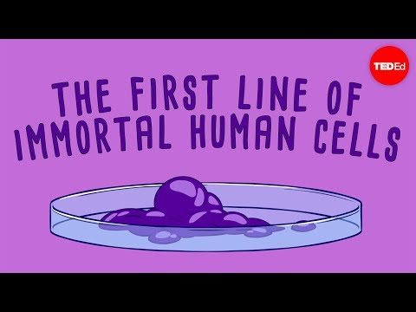
Notes:
Source: TED-Ed. (2016, February 8). The immortal cells of Henrietta Lacks - Robin Bulleri [Video]. YouTube. https://www.youtube.com/watch?v=22lGbAVWhro

Slide 6
Lesson Objective
Use evidence to support and defend your position on the use of a person’s tissues or cells for research without that person’s consent.

Slide 7
Jigsaw: Reading
In your group of four, split up to read the following articles.
There are four articles for you to choose from:
Legal
Familial
Societal
Medical
Notes:
Strategy: K20 Center. (n.d.). Jigsaw. Strategies. https://learn.k20center.ou.edu/strategy/179

Slide 8
Why-lighting
As you read, you should:
Highlight important information from the passage.
Annotate in the margins to explain why you highlighted each piece of information—why is it important?
Notes:
Strategy: K20 Center. (n.d.). Why-lighting. Strategies. https://learn.k20center.ou.edu/strategy/128

Slide 9
Inside Out, Part 2
In the middle circle of your handout, write at least three questions or things you wondered about while reading.

Slide 10
Jigsaw: Discussing
Connect with those who read the same article as you and discuss the following:
Takeaways from the article
Questions you still have
Things you wondered about

Slide 11
Jigsaw: Sharing Out
In your original group of four, each person should share the following:
What you learned from your reading and discussion with peers
What you included in the middle circle of your Inside Out handout

Slide 12
Inside Out, Part 3
In the outermost circle, answer the following question:
What was the most important information you learned from each of your group members?
What you write should come from the articles you DID NOT read.

Slide 13
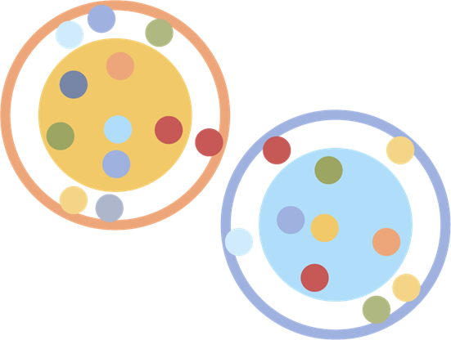
Socratic Seminar: Question
With your small group, choose the most important question that you still want to discuss.
Notes:
Strategy: K20 Center. (n.d.). Socratic Seminar. Strategies. https://learn.k20center.ou.edu/strategy/781

Slide 14
Socratic Seminar: Discussion
Divide into two groups to form an inner circle and an outer circle.
Inner circle: Have a group discussion to answer each question.
Outer circle: Quietly write your observations of the discussion.

Slide 15
Notes:
Source: CrashCourse. (2018, April 18). Henrietta Lacks, the Tuskegee Experiment, and Ethical Data Collection: Crash Course Statistics #12 [Video]. YouTube. https://www.youtube.com/watch?v=CzNANZnoiRs

Slide 16
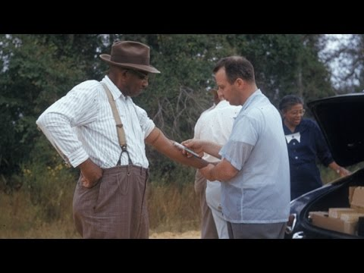
Notes:
This video is optional.
Source: Newsy. (2016, August 25). The unknowns about the Tuskegee syphilis study [Video]. YouTube. https://www.youtube.com/watch?v=J3tQ93fQf8U

Slide 17
Inverted Pyramid in Pairs
With your partner, discuss:
The implications of the Tuskegee study and the harm it has done to Black Americans
Your feelings about scientific research on human subjects
Notes:
Strategy: K20 Center. (n.d.). Inverted Pyramid. Strategies. https://learn.k20center.ou.edu/strategy/173

Slide 18
Inverted Pyramid in Small Groups
With your partner, join another student pair to form a small group and discuss:
The implications of the Tuskegee study and the harm it has done to Black Americans
Your feelings about scientific research on human subjects

Slide 19
Inverted Pyramid as a Class
Did your perspective change after watching the video(s) and discussing with your peers? If so, how and why?

Slide 20
I Used to Think... but Now I Know
Write a personal reflection based on the essential question:
Should scientists be allowed to use a person's tissues or cells for research without that person's consent?
Use your original thoughts from the innermost circle of your Inside Out handout to get you started on your reflection.
Notes:
Strategy: K20 Center. (n.d.). I Used to Think… but Now I Know. Strategies. https://learn.k20center.ou.edu/strategy/137

