Slide 2
We Live in a Society
Human Development

Slide 3
Essential Question
How do humans develop socially?

Slide 4
Lesson Objective
Explain Erik Erikson’s theory of psychosocial development.

Slide 5
Ages and Stages
Think how people develop socially over time.
Add important events or developments that happen to people in each age range.
Add how parents play a role in each age range.
Share what you have written down with another student.

Slide 6
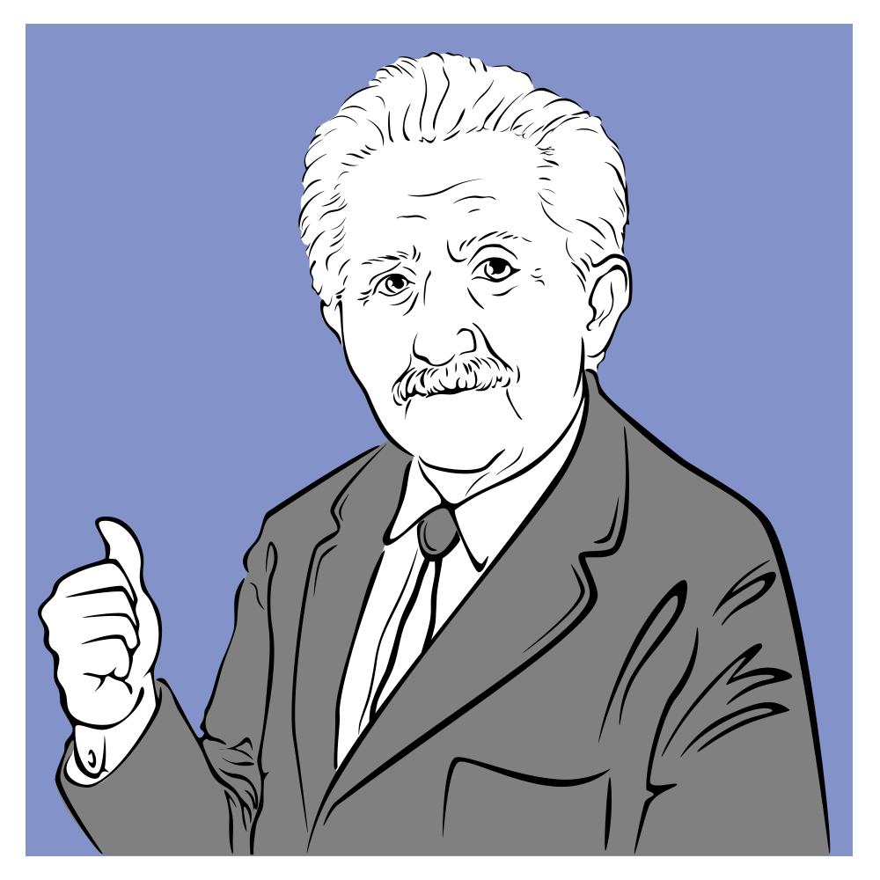
Psychoanalyst Erik Erikson
Born in Denmark in 1902.
Dropped out of art school and then studied psychoanalysis.
Emigrated to the US in 1930 and became a child psychoanalyst and professor.
Changed his last name to Erikson in 1936 because he wanted to develop his identity.
His psychosocial theory suggests that a person’s personality is not fixed in early life but develops over their lifetime.

Slide 7
Erik Erikson’s Stages of Development
Read about the given stage of development.
Create a poster that includes the following:
A title for the poster that summarizes the stage.
Age range of the stage.
A description of the stage.
A real-world example of what occurs during the stage.

Slide 8
Erik Erikson’s Stages of Development
View each of the posters about Erikson’s eight stages of development.
Use the note catcher to write down details from the poster about each stage.

Slide 9
Career Connection: Psychiatrist
As you watch the video about the career of psychiatry, think of one thing that stood out to you.

Slide 10
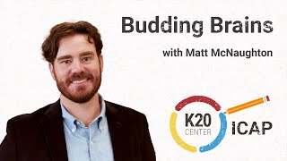
https://youtu.be/YzrRtJXwJv0?si=MPqRDoZrBSP9cZq4
Notes:
K20 ICAP - Psychiatrist - Budding Brains. YouTube. (2023, October 31). https://youtu.be/YzrRtJXwJv0?si=ljXxzfnO8PnJPuKu

Slide 11
Emoji Reflection
Choose an emoji for each of Erikson’s eight stages.
Add a sentence that summarizes each stage.

