Slide 2
Summarizing and Sorting Details from an Informational Text
Identifying the Main Idea

Slide 3
Essential Questions
How can a reader identify the main idea of a text?
How can a reader identify important supporting details?

Slide 4
Learning Objectives
Learn how to use a reading strategy to identify the main idea of a text.
Identify the main idea and supporting details of texts of varying lengths.

Slide 5
Visual Analysis
Examine the following advertisements.
On your handout, infer the main idea of each advertisement.
Record details from each image that support your inference.

Slide 6
Image #1 (Example)
What main idea is conveyed?
Pepsi is a better choice than Coca-Cola.
Which details support that idea?
The cloak covering Pepsi is branded as Coca-Cola, hiding that it is Pepsi.
The word scary is associated with the understanding that Pepsi is “dressing up” as Coca-Cola.
Notes:
Pepsi. (2013). We wish you a scary Halloween! [Advertisement].
D., L. (2014). 33 powerful and creative print ads that’ll make you look twice. Bored Panda. http://www.boredpanda.com/creative-print-ads/

Slide 7
Image #2
What main idea is conveyed?
Which details support
that idea?
Notes:
McDonald’s. (2009). Wi-fries [Advertisement].

Slide 8
Image #3
What main idea is conveyed?
Which details support that idea?
Notes:
Volkswagen. (2012). Hedgehog and Fish [Advertisement].

Slide 9
Image #4
What main idea is conveyed?
Which details support
that idea?
Notes:
Colgate. (2011). Kiwi, Strawberry [Advertisement].

Slide 10
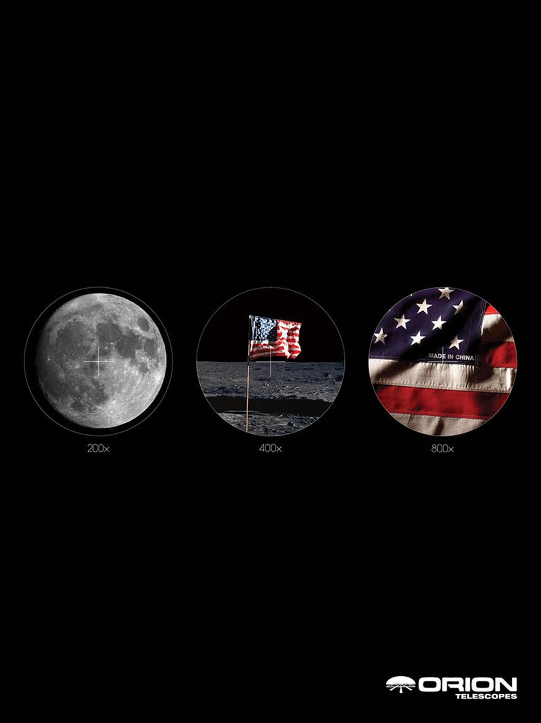
Image #5
What main idea is conveyed?
Which details support
that idea?
Notes:
Orion Telescopes. (2007). Moon [Advertisement].

Slide 11
Reflect
On your Visual Analysis handout, respond to the following:
Explain how you identified the details that support the main idea.
Was every detail necessary?
What helped you recognize the level of importance of each detail?

Slide 12
Textual Analysis: Sentence Sort
Read the series of sentences. All the sentences come from one paragraph.
As a group, sort the sentences into three categories:
Main idea
Important supporting details: sentences that are crucial to understanding the main idea
Non-important details: sentences that are not crucial to understanding the main idea.

Slide 13
Elbow Groups
Form an elbow group and compare your responses for the following:
Main idea
Supporting details
Details that were not important
Discuss with your group any differences in your answers.
Prepare to share with the class.
Notes:
K20 Center. (2021, September 21). K20 Center 5 minute timer [Video]. YouTube. https://youtu.be/EVS_yYQoLJg?si=kTaJ334s_kIiqut4
K20 Center. (n.d.). Elbow partners. Strategies. https://learn.k20center.ou.edu/strategy/116

Slide 14
4-2-1 Summaries
4: Read the article independently and record four key points from the article in your organizer.
2: Find a partner and share your ideas. Narrow your two lists of ideas down to two of the most important ideas. Record those two ideas in your organizer.
1: Join with another pair. Determine the most important idea from the article and record it in your organizer.
Share out the main idea and supporting details identified by your group.
Notes:
K20 Center. (n.d.). 4-2-1. Strategies. https://learn.k20center.ou.edu/strategy/142

Slide 15
Isolating the Main Idea
Choose one of the articles.
Use Why-lighting to annotate the article.
Highlight important details.
Important details include anything that supports or clarifies the overall theme, message, or main idea.
In the margins, write a short note that explains why you highlighted each detail.
Notes:
K20 Center. (n.d.). Why-Lighting. Strategies. https://learn.k20center.ou.edu/strategy/128

Slide 16
GramIt
Partner up with someone who read the same article. Together, create the following images:
One image that represents the main idea
Three images that represent three supporting details
Focus on supporting details that helped you understand the main idea.
Create one image for each detail.
Create a hashtag for each image.
Publish your posts.
Notes:
K20 Center. (n.d.). GramIt. Strategies. https://learn.k20center.ou.edu/strategy/2554

Slide 17
Final Reflection
Reflect on what you learned in the lesson. Write a short response that answers the following questions:
In what ways can you identify the main idea in an informational text?
How do supporting details help a reader identify the main idea?
What reading techniques can you use to approach an informational text?

