Slide 2
Summarizing and Sorting Details from an Informational Text
Identifying the Main Idea

Slide 3
Essential Question
How can a reader identify the main idea of a text?
How can a reader identify which details support the main idea?

Slide 4
Identify the Main Idea: Visual Analysis
On your handout, PREDICT what each of the following advertising images is trying to get across.
Below your prediction, include which details from the image SUPPORT your prediction.

Slide 5
Image #1
What is the main idea
being conveyed?
Which details support
that idea?
Notes:
These images come from http://www.boredpanda.com/creative-print-ads/
There are more images but some are inappropriate so they should be previewed and pulled for students.
You might point out details in the images that don’t help you get to a main point and go over the idea that not all details are crucial in developing an understanding of the main point.

Slide 6
Image #2
What is the main idea
being conveyed?
Which details support
that idea?

Slide 7
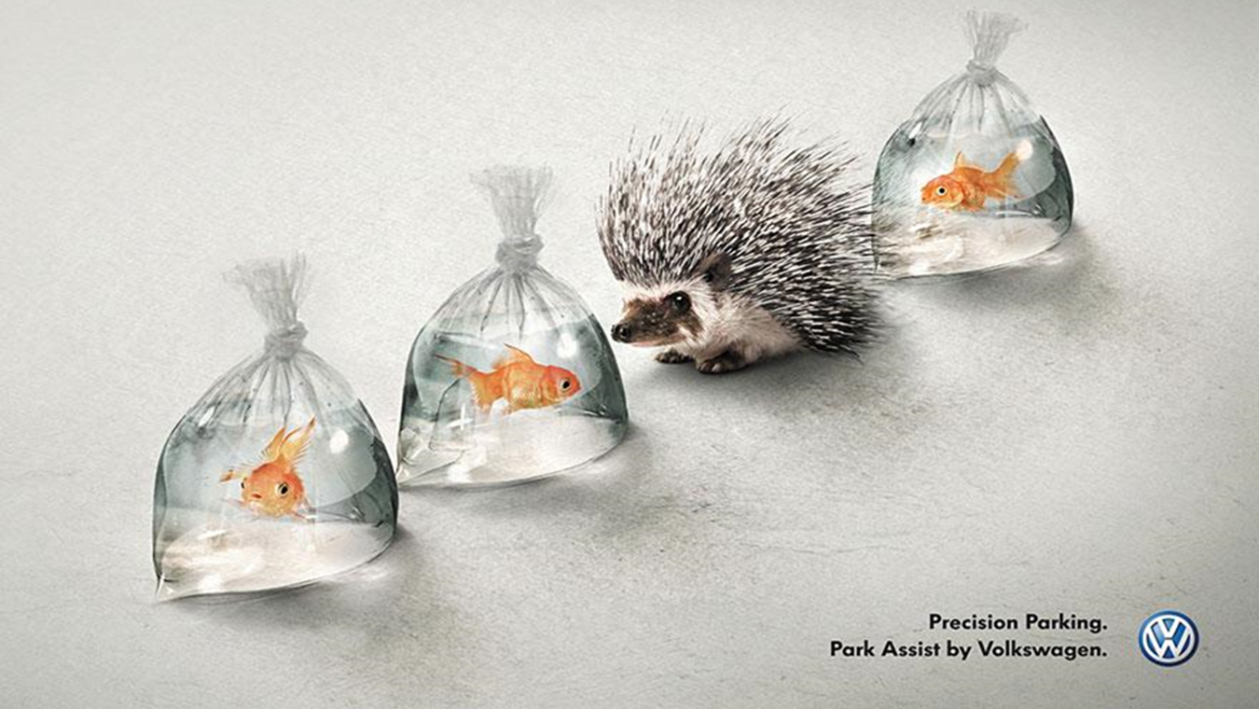
Image #3
What is the main
idea being
conveyed?
Which details
Support that idea?

Slide 8
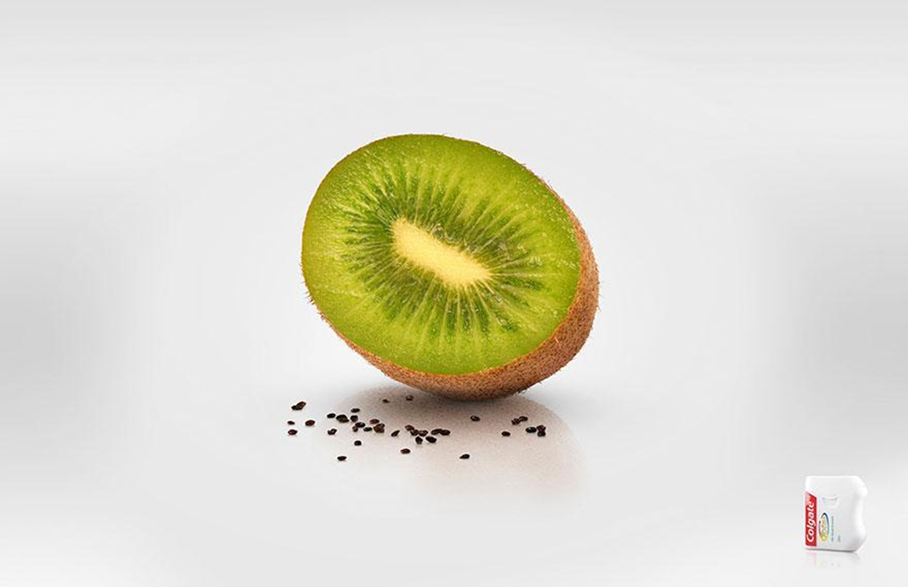
Image #4
What is the main idea
being conveyed?
Which details support
that idea?

Slide 9
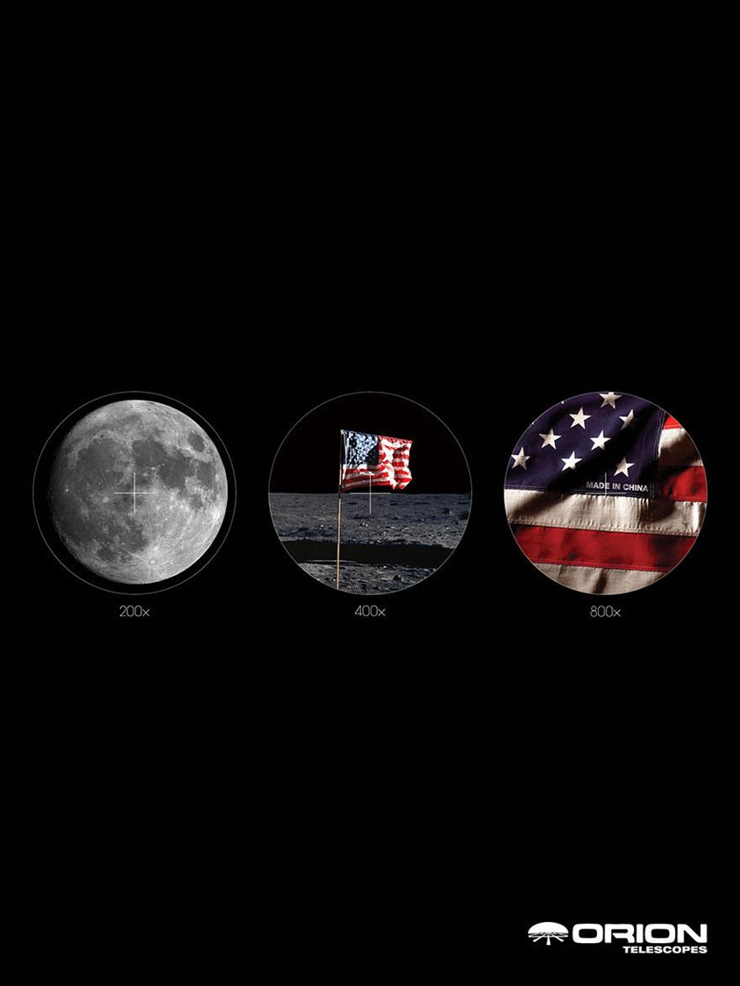
Image #5
What is the main idea
being conveyed?
Which details support
that idea?

Slide 10
At the bottom of the handout
EXPLAIN in a few sentences how you could IDENTIFY the supporting details that helped get you to the main idea each advertisement was trying to convey.
Was every detail important?
How could you tell which ones were important?

Slide 11
Identifying the Main Idea: Textual Analysis
In your small group, you have a series of sentences from a paragraph from an informational text.
As a group, sort sentences into three categories:
Main idea
Important supporting detail—a sentence that is crucial to help you understand the main idea
Details that are not necessary to understand the main idea

Slide 12
Compare and Share
Turn to an elbow group (a group next to you) to compare
Your choice for main idea
Your choices for supporting details
Your choices for details that were not important
Discuss any differences with the other group and justify why you included or didn’t include certain details
Share with the class

Slide 13
Practice: 4-2-1 Summaries
On your own, read the short article; then identify the four key points from the article and write them in your organizer.
Once you are done, pair up to share your ideas. Narrow your four ideas to two of the most important ideas from your lists.
Your pair should combine with another pair and this group should determine the most important overall idea from the article (the main idea).
Discuss with the class your group’s main idea and which details supported that main idea.

Slide 14
Practice: Identifying the Main Idea Solo
Choose one of the articles.
Why-light the article:
highlight/underline details you find important; and
in the margin of the article, record a brief note as to WHY you underlined that detail
Partner up with someone who read the same article.
Create a visual that conveys:
The main idea, and
3-4 supporting details that contributed to your understanding of the main idea

Slide 15
Visual Evaluation
Your visual will be evaluated on the following factors:
How well you’ve identified the main idea
How well you’ve identified the important supporting details
Use of visual/design to support your main idea
Clarity of the visual

Slide 16
Final Reflection
In a brief response reflect on the lesson:
What are the key ways in which you can tell what the main idea is in an informational text?
What roles do supporting details play in identifying the main idea?
What reading techniques can you use when approaching an informational text?

