Slide 2
Unraveling Anxiety
Causes, Symptoms, and Coping Strategies

Slide 3
Always, Sometimes, or Never True
You will be shown statements about anxiety.
Decide whether each statement is always, sometimes, or never true.
Notes:
K20 Center. (n.d.). Always, sometimes, or never true. Strategies. https://learn.k20center.ou.edu/strategy/145

Slide 4
Statement #1
Anxiety is just normal stress.
Sometimes True: Anxiety and stress, while related, are not the same. Anxiety involves excessive and constant worry, which goes beyond the normal stress response.
Notes:
K20 Center. (n.d.). Always, sometimes, or never true. Strategies. https://learn.k20center.ou.edu/strategy/145
Ross, F. (2018, June 8). Stress vs. anxiety - Knowing the difference is critical to your health. National Council for Mental Wellbeing. https://www.mentalhealthfirstaid.org/external/2018/06/stress-vs-anxiety/#:~:text=Anxiety%20is%20a%20person%27s%20specific,after%20a%20concern%20has%20passed

Slide 5
Statement #2
Anxiety is a sign of weakness or lack of willpower.
Never True: Anxiety is not a sign of weakness. When people have anxiety disorders, their anxiety occurs so often that it interferes with their daily lives. People with these disorders often show strength and resilience.
Notes:
Griffiths, K.M., Batterham, P.J., Barney, L. et al. (2011). The generalised anxiety stigma scale (GASS): Psychometric properties in a community sample. BMC Psychiatry 11, 184. doi: 10.1186/1471-244X-11-184
K20 Center. (n.d.). Always, sometimes, or never true. Strategies. https://learn.k20center.ou.edu/strategy/145

Slide 6
Statement #3
Anxiety disorders are not real medical conditions.
Never True: Anxiety disorders are legitimate medical conditions recognized by doctors and mental health professionals. They are not imaginary and require professional diagnosis and treatment.
Notes:
Griffiths, K.M., Batterham, P.J., Barney, L. et al. (2011). The generalised anxiety stigma scale (GASS): Psychometric properties in a community sample. BMC Psychiatry 11, 184. doi: 10.1186/1471-244X-11-184
K20 Center. (n.d.). Always, sometimes, or never true. Strategies. https://learn.k20center.ou.edu/strategy/145

Slide 7
Statement #4
Anxiety is visible.
Sometimes True: Anxiety sometimes has visible effects on a person, such as trembling and fast breathing. It can also have effects that other people can’t see. These internal symptoms of anxiety include racing thoughts and a rapid heartbeat.
Notes:
Hull, M. & Dash, Dr. S. (2023, May 8). 9 common myths about anxiety. The Recovery Village. https://www.therecoveryvillage.com/mental-health/anxiety/anxiety-myths/
K20 Center. (n.d.). Always, sometimes, or never true. Strategies. https://learn.k20center.ou.edu/strategy/145

Slide 8
Statement #5
You can snap out of it or control anxiety easily.
Never True: Telling someone to “snap out of it” oversimplifies anxiety. Anxiety disorders may require the help of a professional and various treatment approaches.
Notes:
Griffiths, K.M., Batterham, P.J., Barney, L. et al. (2011). The generalised anxiety stigma scale (GASS): Psychometric properties in a community sample. BMC Psychiatry 11, 184. doi: 10.1186/1471-244X-11-184
K20 Center. (n.d.). Always, sometimes, or never true. Strategies. https://learn.k20center.ou.edu/strategy/145

Slide 9
Statement #6
Anyone can experience anxiety.
Always True: Anxiety affects individuals of all ages, including children. It is important for people of all ages to recognize when they have too much anxiety so that they can find ways to reduce it.
Notes:
Guarnotta, E. & Gupta, S. (2023, June 9). How is age related to anxiety? GoodRx Health. https://www.goodrx.com/conditions/generalized-anxiety-disorder/how-is-age-related-to-anxiety
K20 Center. (n.d.). Always, sometimes, or never true. Strategies. https://learn.k20center.ou.edu/strategy/145

Slide 10
Statement #7
Medication is the only effective treatment for anxiety.
Sometimes True: While medication can be helpful, it’s not the only option. Therapy, lifestyle changes, and relaxation techniques are also essential in managing anxiety.
Notes:
Hull, M. & Dash, Dr. S. (2023, May 8). 9 common myths about anxiety. The Recovery Village. https://www.therecoveryvillage.com/mental-health/anxiety/anxiety-myths/
K20 Center. (n.d.). Always, sometimes, or never true. Strategies. https://learn.k20center.ou.edu/strategy/145

Slide 11
Essential Questions
What is anxiety and how is it caused? How do we manage our anxiety?

Slide 12
Lesson Objectives
Identify anxiety disorders and their symptoms.
Examine and understand the various causes of anxiety disorders and the factors that contribute to them.
Identify different strategies you can use to manage your own anxiety.

Slide 13
Choice Boards
In small groups, look through the resources in the Choice Board relating to the anxiety disorder you’ve been assigned to research.
Take notes in the appropriate column of your Choice Board Note Catcher.
Select one person from your group to share what you learned with the class.
Write down information about the other disorders in the other columns of your Note Catcher.
Notes:
K20 Center. (n.d.). Choice boards. Strategies. https://learn.k20center.ou.edu/strategy/73

Slide 14
Cognitive Comics
In your template or on a sheet of scrap paper, use the information you learned about the disorder you researched to create a cognitive comic with at least three panels that depict the following:
The cause of the disorder
A specific symptom
A way in which someone with the disorder might be able to ease their anxiety
Notes:
K20 Center. (n.d.). Cognitive comics. Strategies. https://learn.k20center.ou.edu/strategy/198

Slide 15
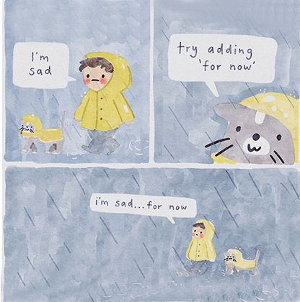
Notes:
van Rensburg, H. J. (2020). For now [watercolor]. https://twitter.com/SWatercolour/status/1257627232387895297/photo/1

Slide 16
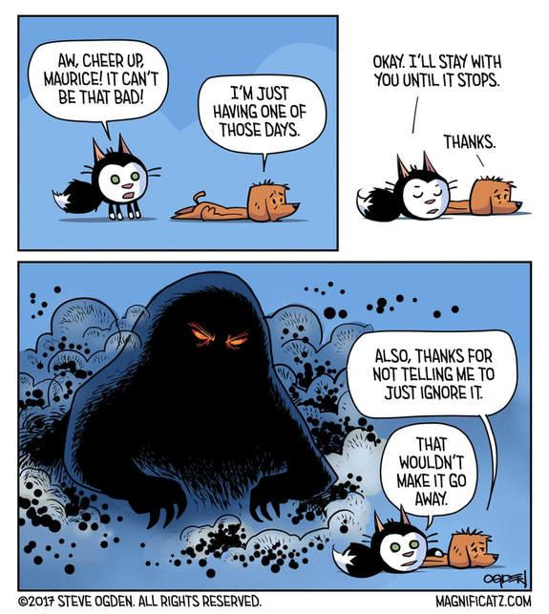
Notes:
Ogden, S. (2017). One of those days [webcomic]. https://www.webtoons.com/en/canvas/magnificatz/list?title_no=878660

Slide 17
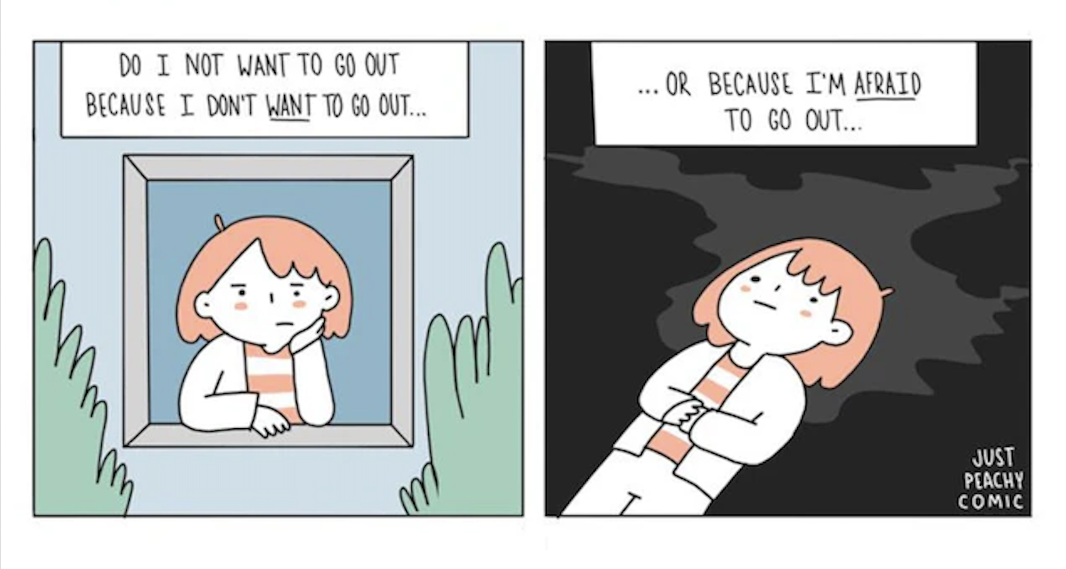
Notes:
Chisholm, H. (2020, December 7). Why I draw comics about my depression. American Foundation for Suicide Prevention. https://afsp.org/story/why-i-draw-comics-about-my-depression/

Slide 18
Notes:
Spang, M. B. (2018, May 7). Mental health, as told by Peanuts. Depression Daily. https://marybethspang.weebly.com/depression-daily/mental-health-as-told-by-peanuts

Slide 19
Stress vs. Anxiety
Stress is a response to an external cause, such as an upcoming exam or an argument with a friend. Stress will reduce when a situation is resolved.
Anxiety can be triggered by stress in some people. Unlike stress, anxiety persists even after a concern has passed. It can develop into a disorder if it occurs so often that it interferes with a person’s life.
Notes:
Ross, F. (2018, June 8). Stress vs. anxiety - Knowing the difference is critical to your health. National Council for Mental Wellbeing. https://www.mentalhealthfirstaid.org/external/2018/06/stress-vs-anxiety/#:~:text=Anxiety%20is%20a%20person%27s%20specific,after%20a%20concern%20has%20passed

Slide 20
Coping Activities for Anxiety
Notes:
National Institute of Mental Health. (2021, September 10). Mental health minute: Stress and anxiety in adolescents [Video]. YouTube. https://www.youtube.com/watch?v=wr4N-SdekqY

Slide 21
Coping Strategies
Grounding
Unwinding
Examples:
Meditation (yoga, tai chi, etc.)
Deep breathing
5-4-3-2-1 (Look around you and find 5 things you see, 4 things you can touch, 3 things you hear, 2 things you smell, and 1 thing you taste)
Progressive Muscle Relaxation (PMR) (contracting different muscles while breathing deeply)
Examples:
Taking a bath
Spending time in nature
Reading a book
Listening to music

Slide 22
Coping Strategies (continued)
Mindfulness
Health
Examples:
Reframe negative thoughts. (Stop yourself when you have a negative thought and think, “Is this thing I’m worrying about really as bad as I think it’s going to be?”)
Journaling (Keep a journal to identify and reframe negative thoughts.)
Positive affirmations (Say encouraging things to yourself like, “I can do this!”)
Examples:
Physical exercise
Limit caffeine consumption. (Cut back on coffee and energy drinks.)
Prioritize healthy eating and sleeping habits. (Eat less junk food and try to get 8 hours of sleep each night.)

Slide 23
Coping Strategies (continued)
Structure
Social Support
Examples:
Establish a daily/weekly routine. (For example, set an alarm each day so that you have plenty of time to get ready.)
Set realistic goals. (For example, let’s say you’ll be getting your driver’s license. Decide what goals you can set in order to overcome obstacles and get your license.)
Put boundaries on social media/news consumption. (Consider spending less time on your phone.)
Examples:
Be part of a community. (For example, join a club.)
Talk to a friend or family member.
Spend quality time with loved ones.
Meet with a doctor or therapist.

Slide 24
Magnetic Statements
You will be given a scenario describing a situation in which anxiety often occurs.
Think about how you or someone you know who might have anxiety would cope with the situation.
Move to the poster that lists your preferred coping strategy.
Discuss with others at the poster why you chose the strategy.
Choose someone from your group to share your reasoning with the class.
Notes:
K20 Center. (n.d.). Magnetic statements. Strategies. https://learn.k20center.ou.edu/strategy/166

Slide 25
Scenario 1
You have a major math exam coming up, and you're feeling overwhelmed with stress. You always feel like no matter how much you study, you end up panicking during a math test and forgetting how to solve the problems.
What coping strategy would you use to help you calm down and ace the exam?

Slide 26
Scenario 2
You have a tight deadline coming for a term paper in your history class, and the pressure is causing you to feel anxious.
What coping strategy would be most effective in this situation?

Slide 27
Scenario 3
You will be acting in a play, and you’re starting to feel nervous as you realize that everyone at your school will be watching you on stage.
What coping strategy would help you manage this anxiety?

Slide 28
Scenario 4
You're invited to a party where you don't know many people and the thought of socializing makes you extremely anxious.
What coping strategy would be most effective in this situation?

Slide 29
Scenario 5
You have arachnophobia (a fear of spiders), and you spot a wolf spider scurrying across your living room floor. You start to shake and breathe heavily and are afraid to approach it.
What coping strategy could you use to stop your panic attack?

Slide 30
Scenario 6
You have trypanophobia (a fear of medical needles), and you need to have your blood drawn at the doctor. You always dread going to the doctor because you know the blood draw will make your heart race and make you feel like you’re going to throw up or faint.
What coping strategy could you use to prevent another panic attack?

Slide 31
Scenario 7
After a conversation with a friend, you replay it in your mind, worrying about whether you said the right things.
What coping strategy would help you manage this anxiety?

Slide 32
Emoji Reflection
On the top of your handout, circle three emojis that best represent a strategy that you or someone you know could use when experiencing anxiety.
On the bottom of your handout, write a response to explain why you chose each image.
Notes:
K20 Center. (n.d.). Emoji reflection. Strategies. https://learn.k20center.ou.edu/strategy/927

