Slide 2
Fiscal Fitness
The Economic Impact of Fiscal Policy

Slide 3
Essential Question
How does government taxing and spending affect the economy?

Slide 4
Lesson Objectives
Explain how the government decides to tax income and spend revenue.
Examine how government taxing and spending affects the economy.

Slide 5
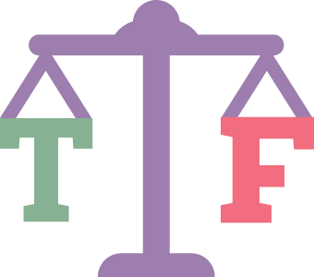
True or False?
Stand up if you think the statement is true.
Stay seated if you think the statement is false.
The government gets over half of its money from personal income taxes (money taken from people’s paychecks).
Notes:
K20 Center. (n.d.). Justified true or false. Strategies. https://learn.k20center.ou.edu/strategy/174

Slide 6
True or False?
True — 55% of tax revenue comes from personal income taxes. The rest comes from corporate income taxes, sales and excise taxes, customs taxes, and the sale of government resources.
Notes:
K20 Center. (n.d.). Justified true or false. Strategies. https://learn.k20center.ou.edu/strategy/174

Slide 7
True or False?
Stand up if you think the statement is true.
Stay seated if you think the statement is false.
The president decides how the government spends its money.
Notes:
K20 Center. (n.d.). Justified true or false. Strategies. https://learn.k20center.ou.edu/strategy/174

Slide 8
True or False?
Partly True — Congress sets the budget and sends it to the president for approval or veto.
Notes:
K20 Center. (n.d.). Justified true or false. Strategies. https://learn.k20center.ou.edu/strategy/174

Slide 9
True or False?
Stand up if you think the statement is true.
Stay seated if you think the statement is false.
Each year, the government spends more money than it brings in.
Notes:
K20 Center. (n.d.). Justified true or false. Strategies. https://learn.k20center.ou.edu/strategy/174

Slide 10
True or False?
True — The government regularly spends more than it brings in. In 2022, the government spent 28% more than it collected.
Notes:
K20 Center. (n.d.). Justified true or false. Strategies. https://learn.k20center.ou.edu/strategy/174

Slide 11
True or False?
Stand up if you think the statement is true.
Stay seated if you think the statement is false.
The government doesn’t have a choice in how tax money is spent.
Notes:
K20 Center. (n.d.). Justified true or false. Strategies. https://learn.k20center.ou.edu/strategy/174

Slide 12
True or False?
Partly True — The government must spend a certain amount on mandatory expenditures. These include Medicaid, Medicare, and Social Security.
Notes:
K20 Center. (n.d.). Justified true or false. Strategies. https://learn.k20center.ou.edu/strategy/174

Slide 13
True or False?
Stand up if you think the statement is true.
Stay seated if you think the statement is false.
The largest amount of spending goes toward the military.
Notes:
K20 Center. (n.d.). Justified true or false. Strategies. https://learn.k20center.ou.edu/strategy/174

Slide 14
True or False?
False — Medicare and Social Security are the largest expenditures of the budget.
Notes:
K20 Center. (n.d.). Justified true or false. Strategies. https://learn.k20center.ou.edu/strategy/174

Slide 15
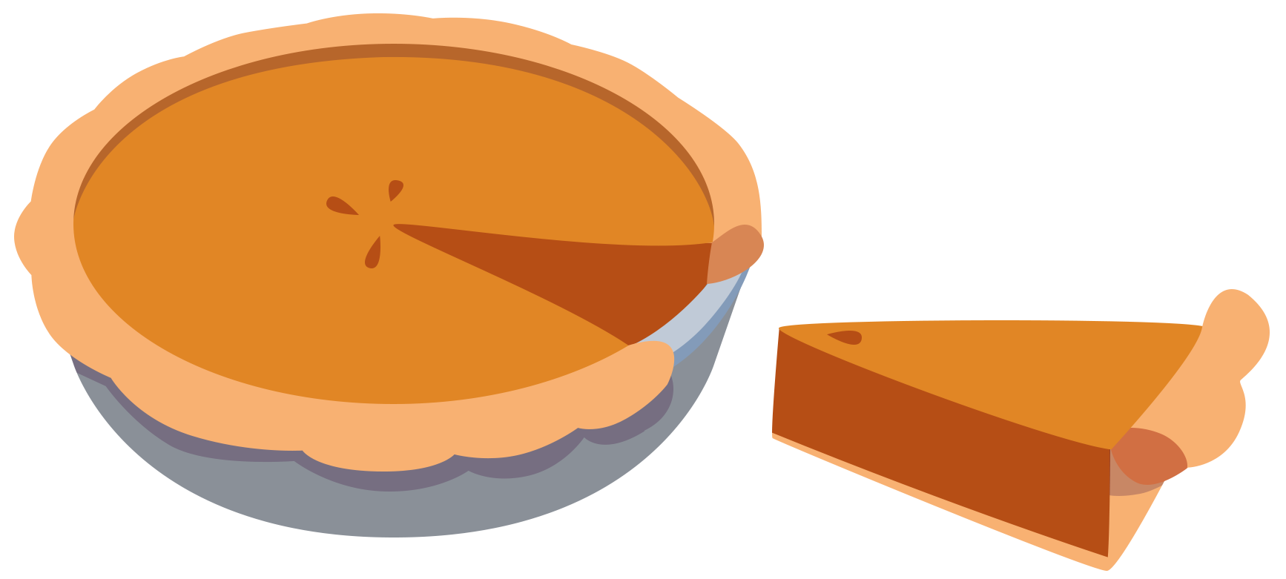
Dividing the (Budget) Pie
Review the provided categories for the budget.
Decide what percentage of the budget is dedicated to each category.
Create a pie chart that depicts each category.
Notes:
K20 Center. (n.d.). Dividing the pie. Strategies. https://learn.k20center.ou.edu/strategy/1867

Slide 16
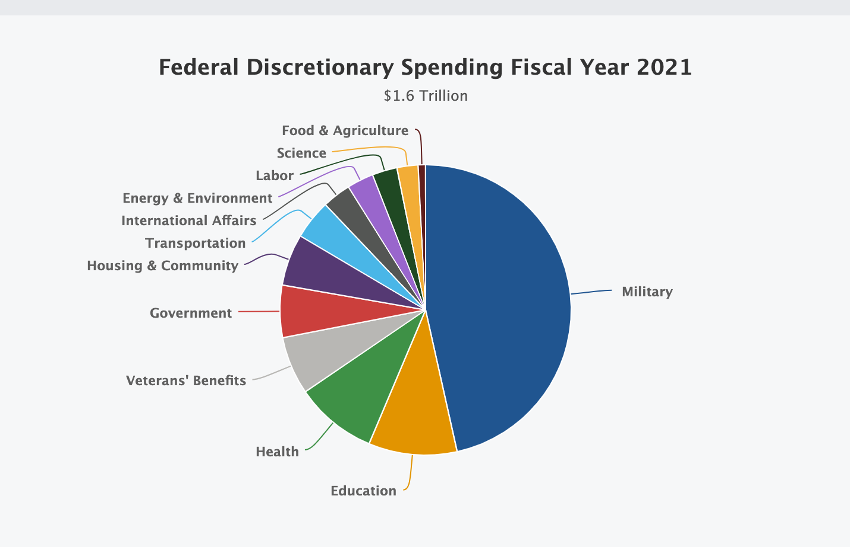
Recent Government Spending
Notes:
National Priorities Project. (n.d.). Federal spending: Where does the money go? Institute for Policy Studies. https://www.nationalpriorities.org/budget-basics/federal-budget-101/spending/

Slide 17
How the Government Spends Its Money
Read the infographic that describes fiscal policy:
English version—http://k20.ou.edu/fiscal
Spanish version—k20.ou.edu/fiscal-esp
As you read, take notes on the Fiscal Policy Note Catcher.

Slide 18

People’s Pie
Play the game at www.icivics.org/peoplespie with a partner.
As you play, decide together what will be funded or cut.
Use the People’s Pie Notes handout to take notes on the decisions you made.
Notes:
iCivics. (n.d.). People’s pie. https://www.icivics.org/peoplespie

Slide 19
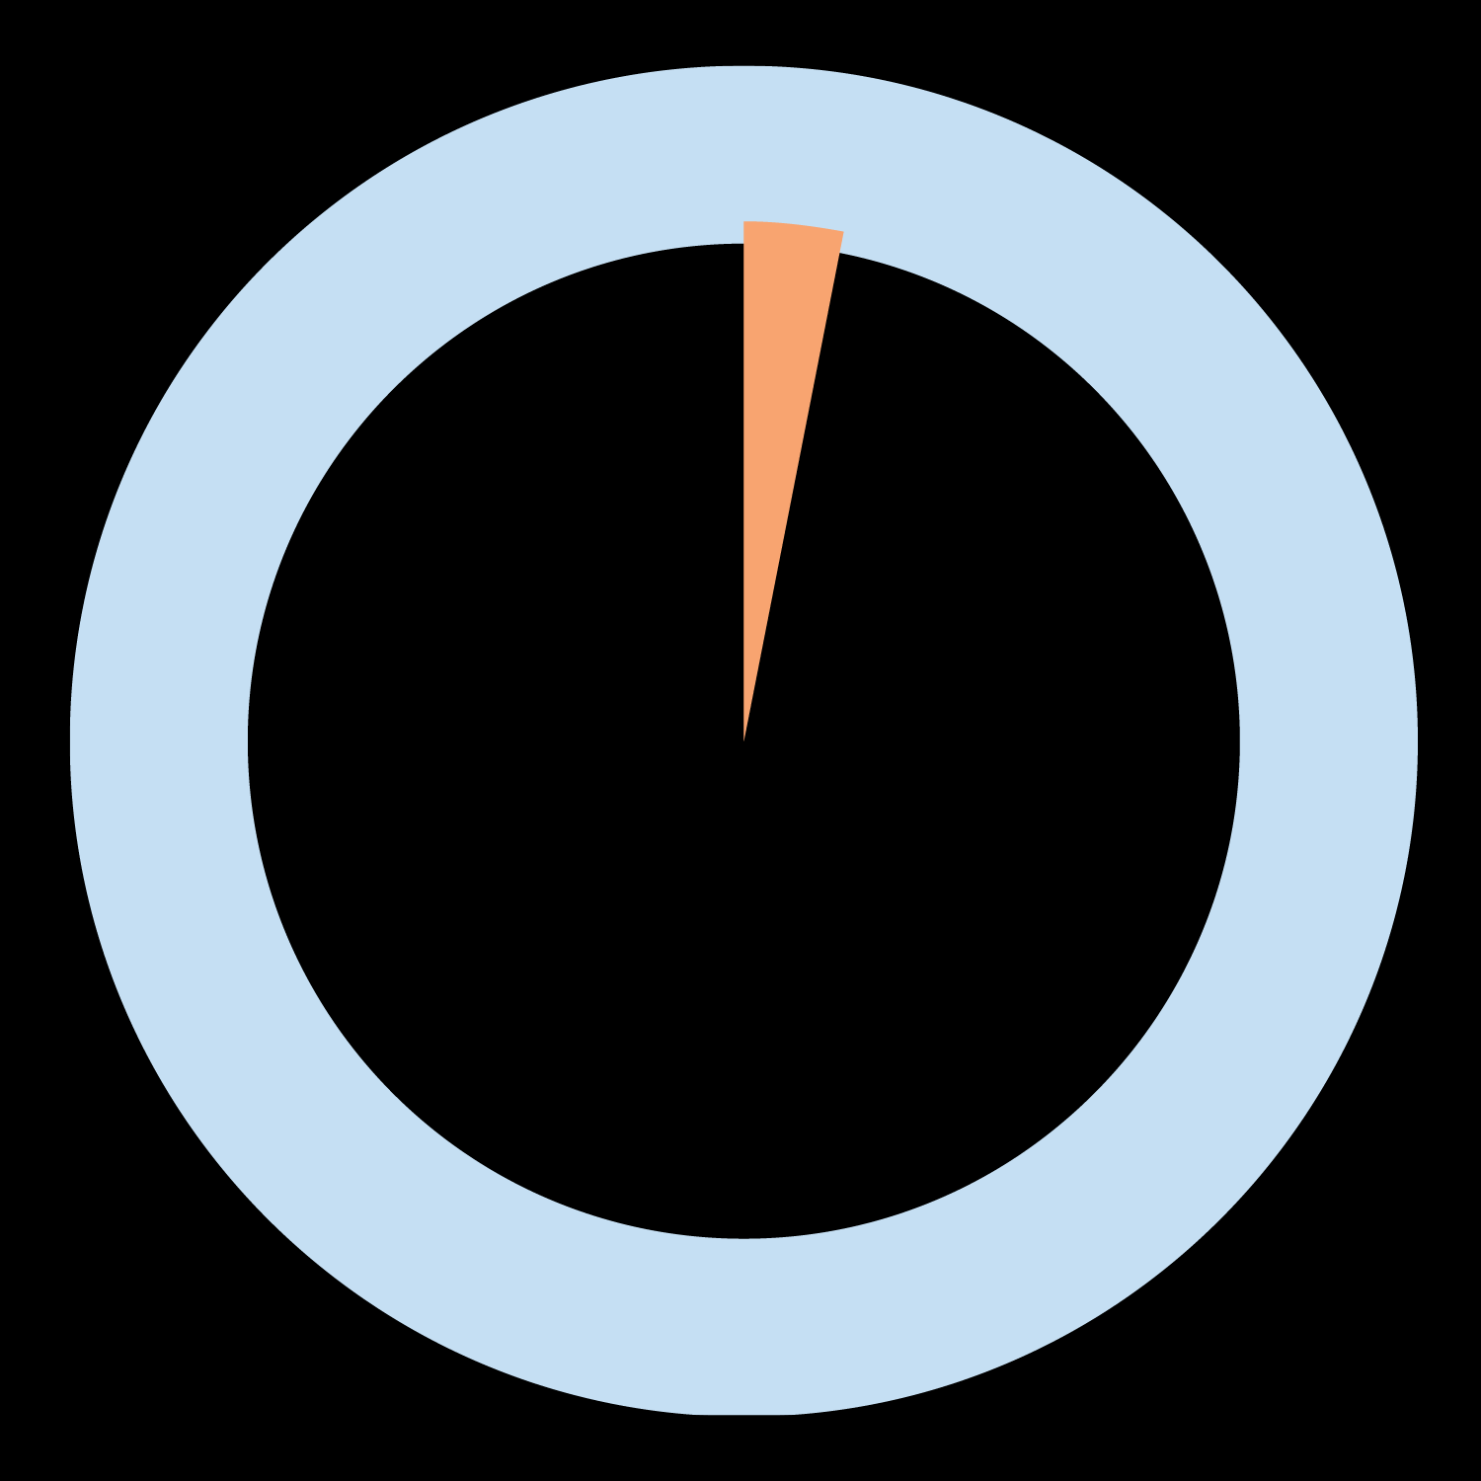
Two-Minute Paper
Think about the following question:
  How does government taxing and spending affect the economy?
On the back of your Fiscal Policy Note Catcher, write for two minutes over the question.
https://timer.k20center.ou.edu/
Notes:
K20 Center. (n.d.). Two-minute paper. Strategies. https://learn.k20center.ou.edu/strategy/152

