Slide 2
Trigger Warnings: Intellectual Rights and Responsibilities
English

Slide 3
Essential Questions
How might trigger warnings affect free speech?
How should schools balance an obligation to facilitate responsible dialogue on tough topics with an obligation to shield students who might feel uncomfortable?

Slide 4
Bell Work
This is a note found on CUNY Graduate Center graduate student teacher Kyla Bender-Baird’s course syllabus:
“It is my goal in this class to create a safe environment in which we examine our assumptions . . . Discomfort can be part of the learning process as we are challenged to shift our paradigms*. I invite you to sit with this discomfort. However, if the discomfort starts to turn to distress, I want you to take care of yourself. You can withdraw from an activity or even leave the classroom.”
You will need ONE sticky note.
On the front of your sticky note, write your name and whether you AGREE or DISAGREE with the quote.
On the back, list AT LEAST THREE reasons why you agree or disagree.
When you are finished, place your sticky note as neatly as possible in the correct parking lot, either under the word Agree or the word Disagree.
*paradigm: A typical example or pattern of something; a model
Notes:
Quote source: http://flavorwire.com/520346/teaching-trigger-warnings-what-pundits-dont-understand-about-the-years-most-controversial-higher-ed-debate
*Note: Do not share this link with students. Flavorwire occasionally features posts that are NSFS.

Slide 5
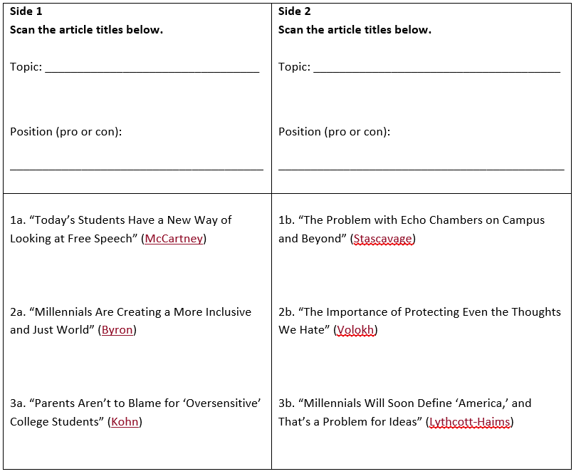
Opinion Analysis
Examine the article titles for Side 1 and Side 2 on your handout. All six articles are part of a series from The New York Times called “When Free Speech Disappears from Campus.”
What is the topic of all six articles?
What positions do the Side 1 articles take? The Side 2?
Choose one article from Side 1 and one from Side 2 to read and CUS.
Notes:
CUS and Discuss strategy information: https://learn.k20center.ou.edu/strategy/b30762a7557ba0b391f207f4c6010158

Slide 6
T-Chart
Claim: This is the main idea/argument in the article. What is the author’s position on the topic?
Evidence: How does the author support his/her claim? Give at least three direct quotations from the article. Remember to cite using the author’s last name in parentheses.
Counter-arguments: Create at least two counter-arguments someone could make against the author’s claim. In other words, imagine what the other side might argue in a debate.

Slide 7
Term - Trigger Warning
“‘Trigger Warning’ – arising from PTSD psychology and popularized in feminist spaces on the Internet – refers to an advance notice for any content, usually violent, that might prompt a flashback, panic attack, or episode for survivors of trauma.” (Seltzer)
Notes:
Seltzer, S. (2015, May 27) Teaching trigger warnings: What pundits don’t understand about the year’s most controversial higher-ed debate. Flavorwire. Retrieved from http://flavorwire.com/520346/teaching-trigger-warnings-what-pundits-dont-understand-about-the-years-most-controversial-higher-ed-debate

Slide 8
Roving Paragraphs – Step 1
What is your opinion on the use of trigger warnings in schools, specifically high schools? Do you AGREE or DISAGREE that trigger warnings are beneficial for students and/or learning? Write a CLAIM STATEMENT that expresses your opinion on the use of trigger warnings in schools. Remember that a claim statement MUST be arguable.
Sentence Starter: I [agree/disagree] that trigger warnings are beneficial to students and learning.
Notes:
Transitional words and phrases list at https://depts.washington.edu/owrc/Handouts/Using%20Transitions%20Effectively.pdf

Slide 9
Roving Paragraphs – Step 2
Find a partner. Read your claim sentence to your partner, and then trade papers. Use one of the transitional words or phrases on the handout provided to write the EVIDENCE sentence for your partner’s argument. Use the articles you read earlier to find DIRECT evidence. Make sure you cite in MLA (LastName PageNumber).
Example: For instance, a veteran and college student argues against trigger warnings, saying, “The end result will be even more polarization in America, with societal fault lines growing increasingly contentious and unproductive” (Stascavage).
Notes:
Transitional words and phrases list at https://depts.washington.edu/owrc/Handouts/Using%20Transitions%20Effectively.pdf

Slide 10
Roving Paragraphs – Step 3
Make sure you have your original paper with your original claim. Find a new partner. Share your claim and evidence sentences. Trade papers. Write a commentary sentence for your partner. It should connect the claim and evidence together. How does the evidence prove the claim? Use a new transitional word or phrase.
Example: As such, the primary concern among those opposed to trigger warnings lies with the echo chambers and “stovepipes of thought” they could create.
Notes:
Transitional words and phrases list at https://depts.washington.edu/owrc/Handouts/Using%20Transitions%20Effectively.pdf

Slide 11
Roving Paragraphs – Step 4
Make sure you have your original paper with your original claim. Find a new partner. Share your claim, evidence, and commentary sentences. Trade papers. Write a second commentary sentence for your new partner. It should connect with the previous sentence (i.e., it needs to make sense). Use a new transitional word or phrase.
Example: Furthermore, some critics of trigger warnings worry their use in classrooms might stifle intellectual freedoms, which goes against the function of academia.
Notes:
Transitional words and phrases list at https://depts.washington.edu/owrc/Handouts/Using%20Transitions%20Effectively.pdf

Slide 12
Roving Paragraphs – Step 5
Make sure you have your original paper with your original claim. Find a new partner. Share your claim, evidence, and two commentary sentences. Trade papers. Write a counter-argument. What might someone on the other side say? Use a new transitional word or phrase.
Example: However, some students might argue that trigger warnings allow those who’ve experienced trauma to prepare and engage appropriately with sensitive material.
Notes:
Transitional words and phrases list at https://depts.washington.edu/owrc/Handouts/Using%20Transitions%20Effectively.pdf

Slide 13
Roving Paragraphs – Step 6
Make sure you have your original paper with your original claim. Find a new partner. Share your claim, evidence, two commentary sentences, and counter-argument. Trade papers. Write a rebuttal. How should the person making the claim respond to the counter-argument? Use a new transitional word or phrase.
Example: Ultimately, trigger warnings do more harm than good because they make it easier for students to get out of engaging with material that might simply make them uncomfortable.
Notes:
Transitional words and phrases list at https://depts.washington.edu/owrc/Handouts/Using%20Transitions%20Effectively.pdf

Slide 14
Roving Paragraphs – Step 7
Make sure you have your original paper with your original claim. Return to your seat. Read over your trigger warning paragraph. Write a concluding sentence. This sentence should restate your claim and sum up your argument. Use a new transitional word or phrase.
Example: I am against the use of trigger warnings, in summary, because they do more harm than good when it comes to promoting intellectual freedom and responsibilities in the classroom.
Notes:
Transitional words and phrases list at https://depts.washington.edu/owrc/Handouts/Using%20Transitions%20Effectively.pdf

Slide 15
Peer Response
Trade papers with a partner. This should be someone you haven’t worked with yet.
With a marker, write either PRO or CON depending on the author’s claim. Write your name, too. Then circle at least two words or phrases in the claim that tell you the author’s position on the topic.
For each sentence in the paragraph, determine a rating using a 0-4 scale (0 is weakest and 4 is strongest). For each label, explain your rating. You should have seven labels and seven ratings.
Lastly, share each sentence rating and explanation with your partner.

Slide 16
Peer Response - Rubric
RATING | EXPLANATION
4 | Sentence is sophisticated, clear, completely achieves its purpose in the paragraph, and is impressive in its control of language. The author successfully integrates the sentence in the paragraph. The sentence is complete and does not contain lapses that hinder understanding.
3 | Sentence is clear and mostly achieves its purpose in the paragraph. The author is mostly successful at integrating the sentence in the paragraph. The sentence is complete but may contain lapses that hinder understanding.
2 | Sentence is somewhat clear but does not entirely achieve its purpose in the paragraph. The author attempts to integrate the sentence in the paragraph but falls short. The sentence does contain lapses that hinder understanding.
1 | Sentence is unclear and, as a result, does not achieve its purpose in the paragraph. The author does not attempt to integrate the sentence in the paragraph. The sentence contains significant lapses that hinder understanding.
0 | Sentence is missing entirely from paragraph.
Notes:
SOURCE (adapted from): The College Board. (2006). AP language and composition sample scoring guidelines for the synthesis essay. Retrieved from https://secure-media.collegeboard.org/apc/samplescoringguidelin_51461.pdf

Slide 17
Essential Questions
How might trigger warnings affect free speech?
How should schools balance an obligation to facilitate responsible dialogue on tough topics with an obligation to shield students who might feel uncomfortable?

