Slide 2
Packet Up
Data Delivery and Networks

Slide 3
Essential Question
How does the internet work to share information?

Slide 4
Lesson Objectives
Understand what a packet is and its importance in moving information.
Assess the benefits of two transfer protocols used on the internet and the best one to use for different types of information.

Slide 5

Puzzle Sort
Use the pieces in your envelope to put together the puzzle.

Slide 6

I Used to Think…
What do you know about the internet and how it works?
Fill in only the “I Used to Think” portion of the handout.

Slide 7
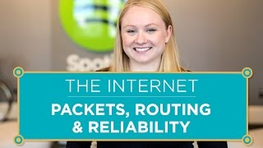
Protocols and Packets
Notes:
https://www.youtube.com/watch?v=AYdF7b3nMto&list=PLzdnOPI1iJNfMRZm5DDxco3UdsFegvuB7&index=5

Slide 8
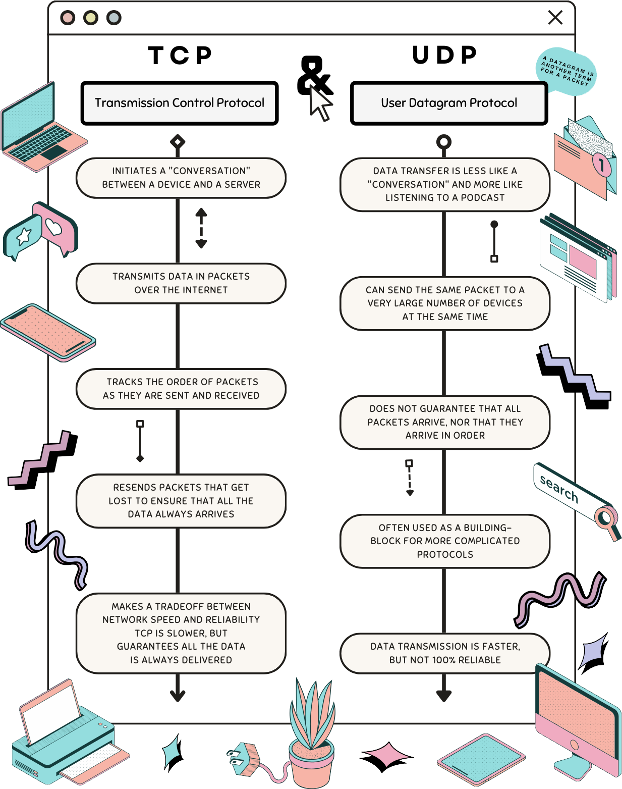
TCP & UDP Infographic

Slide 9
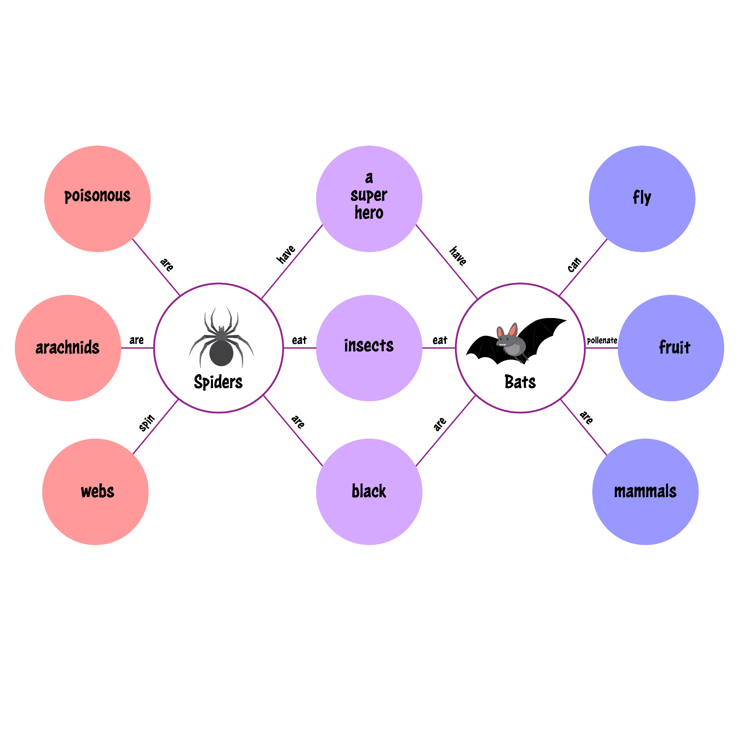
Double Bubble

Slide 10

Card Sort
TCP
UDP

Slide 11
…But Now I Know
What have you learned about how the internet works?

