Slide 2
Tales from the Encrypt
Data Security and Encryption

Slide 3
Essential Questions
Why does electronic information need to be protected when being transmitted on the internet?
How do we encrypt data?

Slide 4
Lesson Objectives
Define data encryption.
Evaluate methods of encryption and determine applications for their use.

Slide 5
Birthday Surprise!
Groups of 3: Friend A, Friend B, and Friend C.
Friend A: Try to let Friend B know your idea for a birthday present for Friend C without Friend C finding out.
Friend C is allowed to hear and see everything you do.
Can you find a way to share your message?

Slide 6
Cyber Security Tales
Establish five groups.
Read your passage as a group.
Be ready to share what you have learned.
What did these “cyber fails” have in common?
How were their solutions similar?

Slide 7
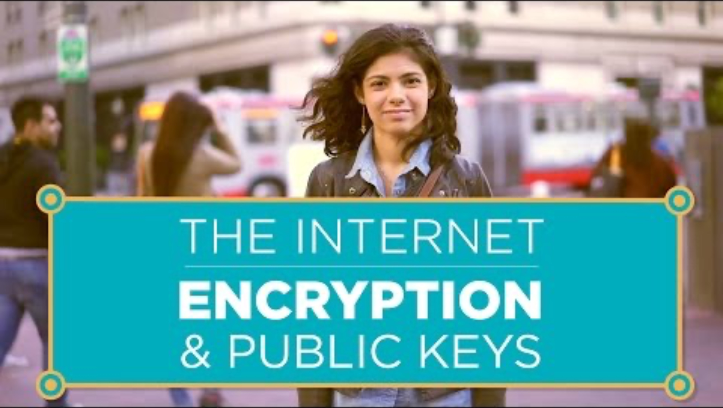
Encryption and Public Keys
Notes:
https://www.youtube.com/watch?v=ZghMPWGXexs

Slide 8
Chat Stations
At each station:
Read the information.
Record your thoughts.
Talk about it as a group.
Move to the next station when told to do so.
Be ready to discuss.

Slide 9
Encrypt Your Own Message
As a group, decide the following:
What kind of encryption you want to use?
How will it work?
Next:
Try out your encryption method to encode a message.
Practice sending and decoding messages.
Make changes to your encryption strategy as needed.

Slide 10
Exit Ticket
What have I learned about encryption?
What are my thoughts on encryption methods?
What makes encryption successful?

