Slide 2

5W Cubes
In your groups, take turns rolling the cube to generate a question. Once you have your question, share your answer with the group and then pass the cube in a clockwise manner.
Notes:
K20 Center. (n.d.). 5W cube. Strategies. https://learn.k20center.ou.edu/strategy/81

Slide 3
WHO | 2. WHAT | 3. WHEN
WHO is a loved one who has passed that you honor? | WHAT do you do to honor loved ones who have passed? | WHEN do you honor loved ones who have passed?
4. WHERE | 5. WHY | 6. HOW
WHERE do you honor loved ones who have passed? | WHY do you honor loved ones who have passed? | HOW do you honor loved ones who have passed?

Slide 4
Rituals of Remembrance
Día de los Muertos and Other Occasions Honoring the Dead

Slide 5
Essential Questions
How do different cultures celebrate and mourn the dead?
Why are these customs important to learn about and share?

Slide 6
Lesson Objectives
Have informed discussions comparing cultural remembrance rituals and celebrations.
Be able to discuss Día de los Muertos, its historical significance, and the customs of the event today.

Slide 7



Ritual of Remembrance Anchor Chart
With your group, you will create an Anchor Chart to represent your assigned ritual of remembrance.
Incorporate pictures/symbols connected with this day.
Your chart should answer the following questions:
  What is the name of this ritual?
  How is this observed?
  What are traditions associated with it?
  What is its overall significance?
Use the following link to the Wakelet to research your topic:
  http://k20.ou.edu/rituals
Or scan the QR code
Notes:
K20 Center. (n.d.). Anchor charts. Strategies. https://learn.k20center.ou.edu/strategy/58

Slide 8
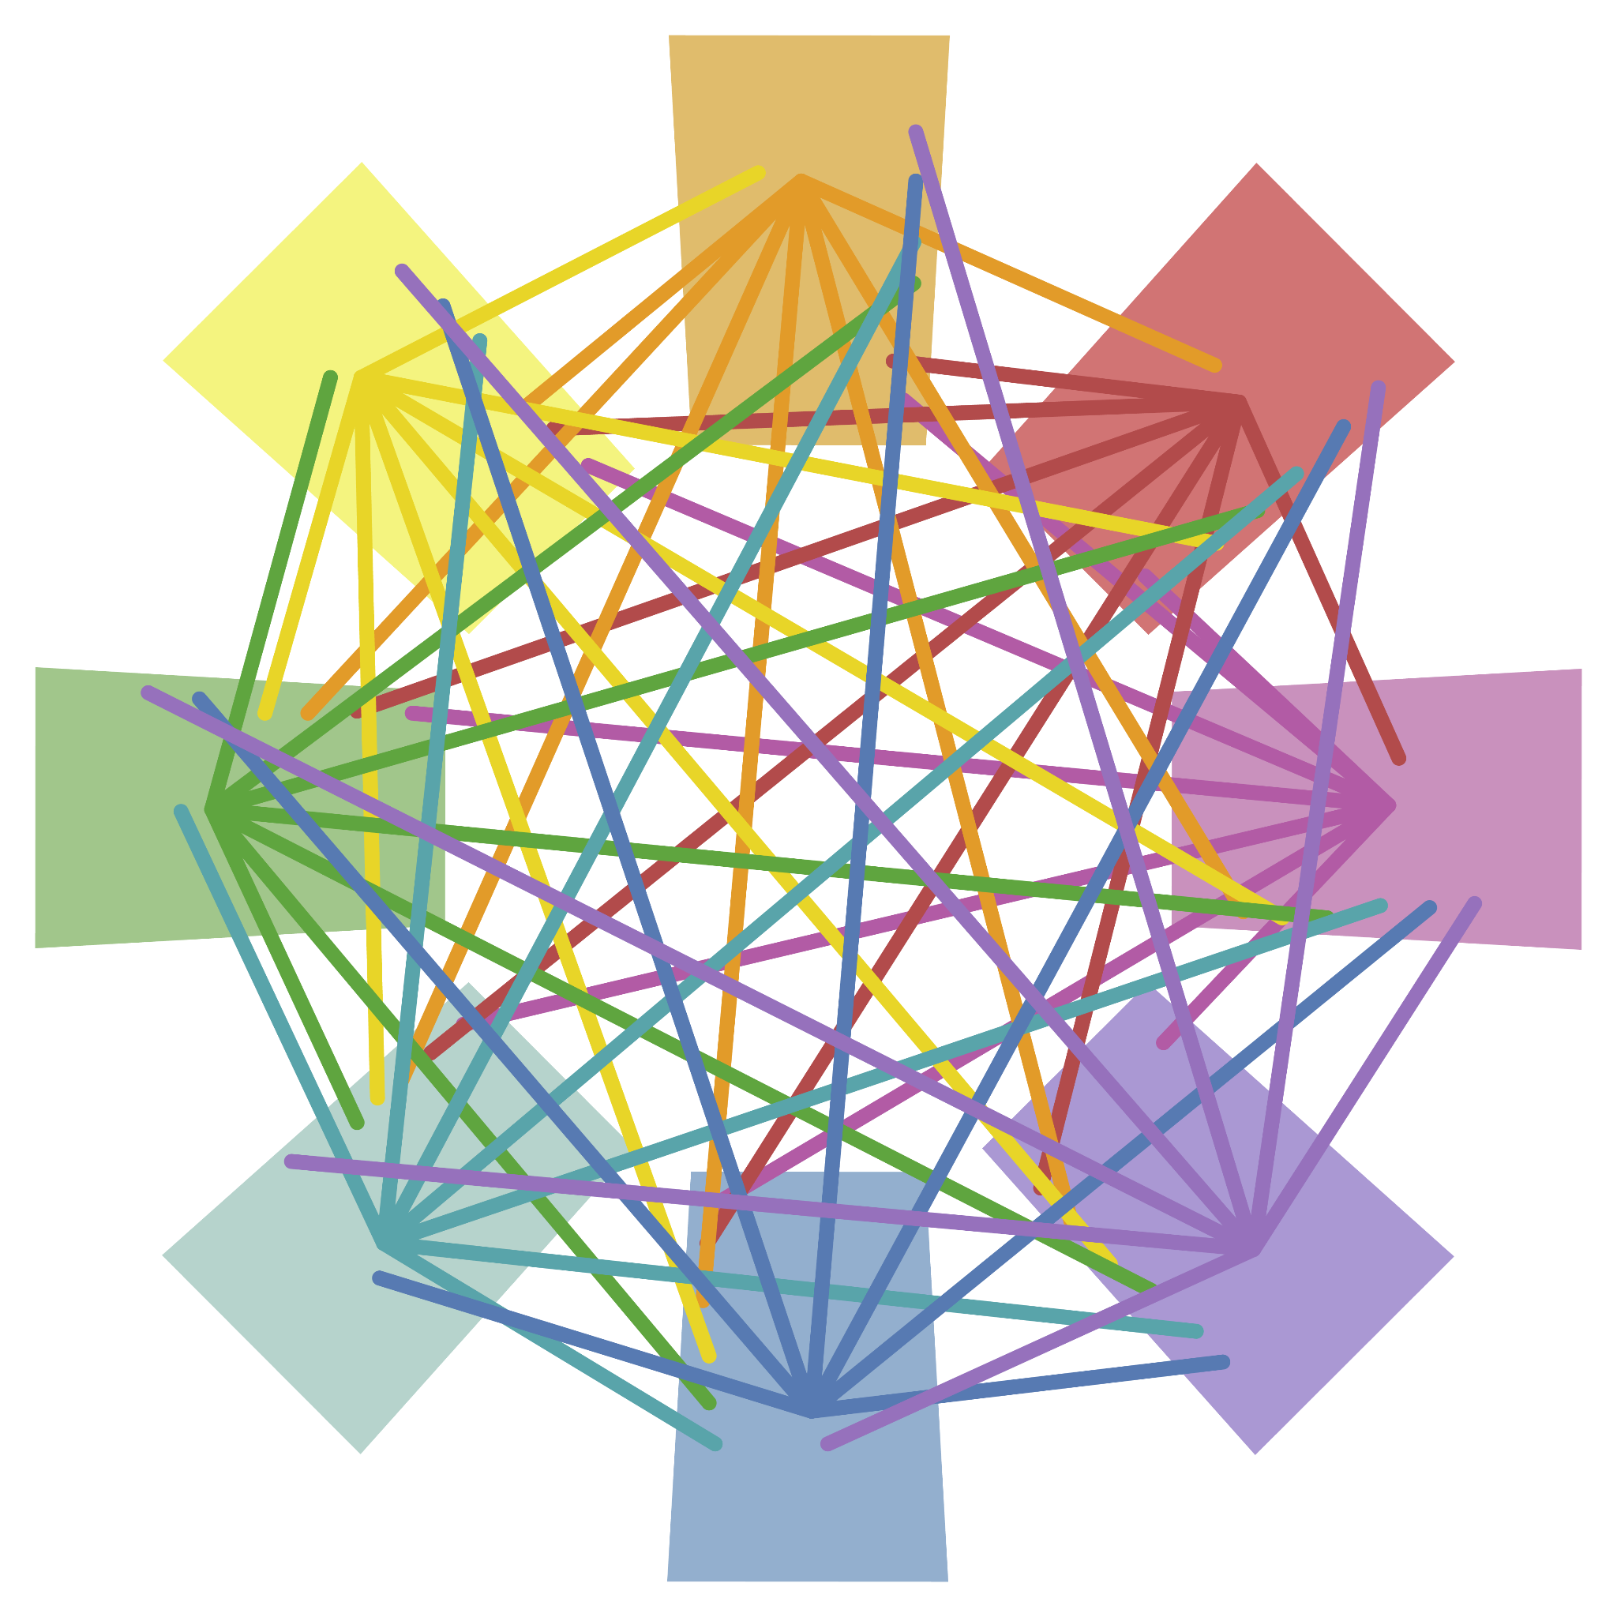
Detective Board
Hang your completed posters around the room.
Visit all the posters the other groups designed.
Take notes on each and be sure in your notes to write about any important similarities you notice between the rituals described in the posters.
Take the skein of yarn, scissors, and tape your group has been handed, and connect two similar ideas in different posters with a string of yarn.
Make sure that you don’t make the same connection as another group.
Notes:
K20 Center. (n.d.). Detective board. Strategies. https://learn.k20center.ou.edu/strategy/3530
K20 Center. (n.d.) Gallery walk / carousel. Strategies. https://learn.k20center.ou.edu/strategy/118

Slide 9

Point of Most Significance (POMS)
You will have a few minutes to read the handout ¿Qué es el Día de los Muertos?
As you read, consider what stood out to you to most, or what was your point of most significance.
Be prepared to share out.
Notes:
K20 Center. (n.d.). POMS: Point of most significance. Strategies. https://learn.k20center.ou.edu/strategy/101

Slide 10

Painting a Picture
Review images and text in the Painting a Picture Set provided.
As you go through each image, you will record any observations/inferences and the purpose of each item in the Painting a Picture Chart provided.
  Observation: What do you see?
  Inferences: Based on what you see, what can you conclude about this item?
  Purpose: Based on your observations and inferences, what is the purpose of this item?
Notes:
K20 Center. (n.d.). Painting a picture. Strategies. https://learn.k20center.ou.edu/strategy/1331

Slide 11

Notes:
K20 Center. (2021, September 21). K20 Center 15 minute timer [video]. YouTube. https://www.youtube.com/watch?v=m3zT2IxZQaw

Slide 12

Día de los Muertos Ofrenda-Canva
Go to http://k20.ou.edu/dod.
Select “Use template for new design.” It will ask you to sign in. You can use your school email address to sign in and create a new account.
  If you previously created a Canva account, sign into your existing account.
Once you have completed these steps, it will allow you to create your own ofrenda.
Notes:
K20 Center. (n.d.). Canva. Tech Tools. https://learn.k20center.ou.edu/tech-tool/612

Slide 13
Ofrenda Requirements
For your ofrenda, include the following:
Minimum of one photo of a loved one or person being honored.
A background photo of a place where your loved one liked to visit.
At least two items that they enjoyed.
  For example, if they enjoyed reading, a book can be added, or if their favorite drink was Dr. Pepper, add a Dr. Pepper image.
Add a text box and write an explanation of who your ofrenda is honoring and what the items you chose represent.
Once you have completed your ofrenda, click the share button and copy
the link provided.

Slide 14

Mirror, Microscope, Binoculars
Reflect individually on what you have learned in this lesson.
Mirror (internal reflection): How has this experience changed my thinking?
Microscope (close inspection): How can this knowledge be applied?
Binoculars (global reflection): What could be done to be more inclusive of others’ cultural celebrations?
Notes:
K20 Center. (n.d.). Mirror, microscope, binoculars. Strategies. https://learn.k20center.ou.edu/strategy/3020

