Slide 2
Countdown to Congruence
Investigating Triangle Congruence Theorems

Slide 3
Who Wants to Be a Math Master?
What can we conclude if two triangles are congruent?
A: All corresponding angles are equal in measure.
B: All corresponding sides are equal in measure.
C: Areas are equal.
D: All of the above.
Notes:
K20 Center. (n.d.). Bell ringers and exit tickets. Strategies. https://learn.k20center.ou.edu/strategy/125

Slide 4
Who Wants to Be a Math Master?
What is the minimum number of parts (sides and angles) you would need to measure to prove congruence?
A: 1 part per triangle
B: 2 parts per triangle
C: 3 parts per triangle
D: 4 parts per triangle
E: 5 parts per triangle
F: 6 parts per triangle
Notes:
K20 Center. (n.d.). Bell ringers and exit tickets. Strategies. https://learn.k20center.ou.edu/strategy/125

Slide 5
Essential Question
How can we justify that two triangles are congruent?

Slide 6
Lesson Objectives
Determine the minimum information needed to prove triangles are congruent.
Prove that given triangles are congruent using different congruence theorems.

Slide 7
Who Wants to Be a Math Master?
If only 1 or 2 parts of a pair of triangles are congruent, this does not guarantee that the pair of triangles are congruent. It is very possible that they are not congruent.

Slide 8
Triangle Congruence Possibilities
Create a list of all the combinations of 3 parts that we could measure.
Use “S” to represent a side.
Use “A” to represent an angle.
For example, if we needed all 6 parts, we could write that as SASASA.
We read or label a triangle either clockwise or counterclockwise.
S
A
S
A
A
S

Slide 9
Triangle Congruence Possibilities
There are only 6 options to test:
Side–Side–Side (SSS)
Side–Side–Angle (SSA)
Side–Angle–Side (SAS)
Angle–Angle–Angle (AAA)
Angle–Angle–Side (AAS)
Angle–Side–Angle (ASA)

Slide 10
Exploring the Possibilities
Side–Side–Side (SSS)
Three pairs of congruent sides
Side–Side–Angle (SSA)
Two pairs of congruent sides and one pair of congruent angles (angles not between the pairs of sides)
Side–Angle–Side (SAS)
Two pairs of congruent sides and one pair of congruent angles (angles between the pairs of sides)

Slide 11
Can You Match My Triangle?
We are going to play another game!
In this game, I am going to give you 3 measurements of my triangle.
Your challenge is to see if you can create my triangle.

Slide 12
Can You Match My Triangle?
Round 1
My triangle, ΔABC, has…
3-Minute Timer
Notes:
K20 Center. (n.d.). Inverted pyramid. Strategies. https://learn.k20center.ou.edu/strategy/173
K20 Center. (2021, September 21). K20 Center 3 minute timer [Video]. YouTube. https://youtu.be/iISP02KPau0?si=oew-VIocHqA5Tn8z

Slide 13
Can You Match My Triangle?
Round 1
Find another pair and compare your triangles.
Are they congruent?
Notes:
K20 Center. (n.d.). Inverted pyramid. Strategies. https://learn.k20center.ou.edu/strategy/173

Slide 14
Can You Match My Triangle?
Round 1
Are they all congruent?
Did anyone find a counterexample?
Which triangle congruence possibility did we just test?
Notes:
K20 Center. (n.d.). Inverted pyramid. Strategies. https://learn.k20center.ou.edu/strategy/173

Slide 15
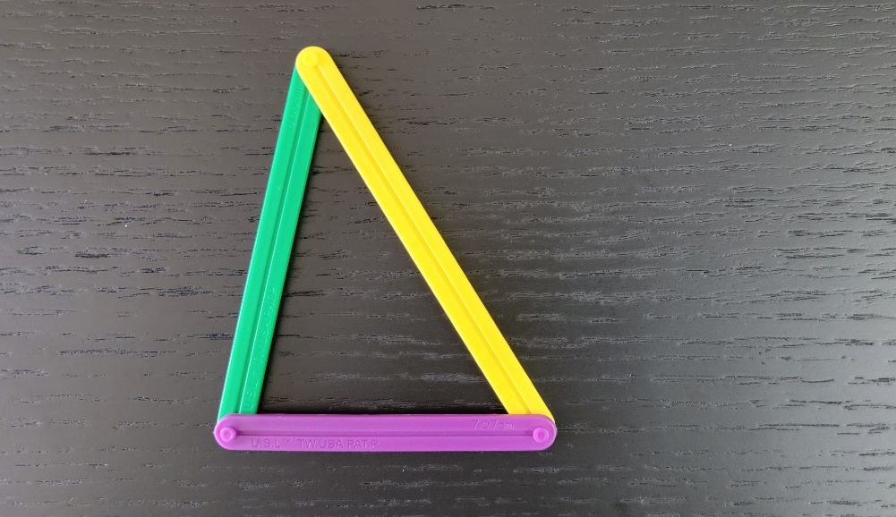
Did You Match My Triangle?
Round 1
My Triangle:
Notes:
K20 Center. (n.d.). Inverted pyramid. Strategies. https://learn.k20center.ou.edu/strategy/173

Slide 16
Can You Match My Triangle?
Round 2
My triangle, ΔABC, has…
3-Minute Timer
Notes:
K20 Center. (n.d.). Inverted pyramid. Strategies. https://learn.k20center.ou.edu/strategy/173
K20 Center. (2021, September 21). K20 Center 3 minute timer [Video]. YouTube. https://youtu.be/iISP02KPau0?si=oew-VIocHqA5Tn8z

Slide 17
Can You Match My Triangle?
Round 2
Find another pair and compare your triangles.
Are they congruent?
Notes:
K20 Center. (n.d.). Inverted pyramid. Strategies. https://learn.k20center.ou.edu/strategy/173

Slide 18
Can You Match My Triangle?
Round 2
Are they all congruent?
Did anyone find a counterexample?
Which triangle congruence possibility did we just test?
Notes:
K20 Center. (n.d.). Inverted pyramid. Strategies. https://learn.k20center.ou.edu/strategy/173

Slide 19
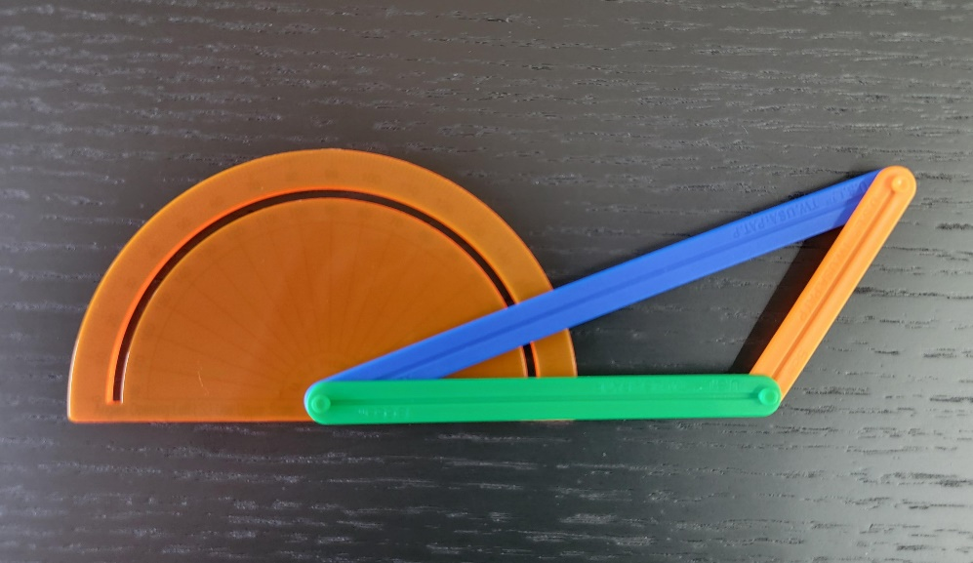
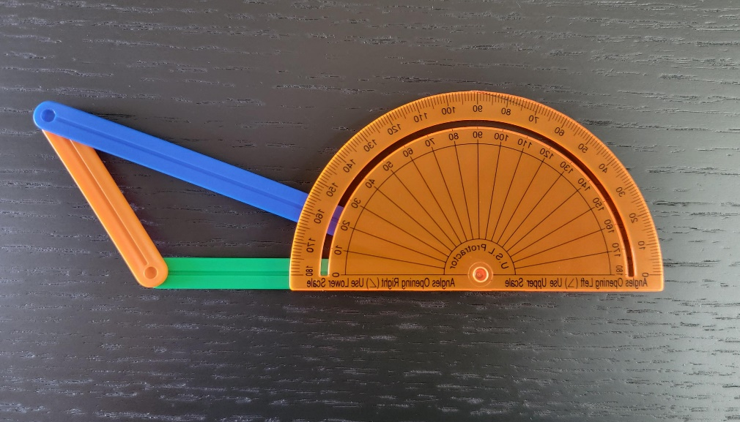
Did You Match My Triangle?
Round 2
My Triangle:
Notes:
K20 Center. (n.d.). Inverted pyramid. Strategies. https://learn.k20center.ou.edu/strategy/173

Slide 20
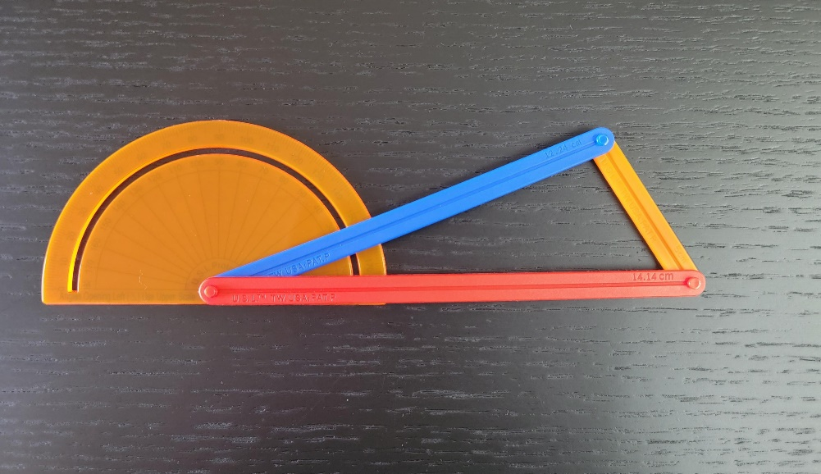
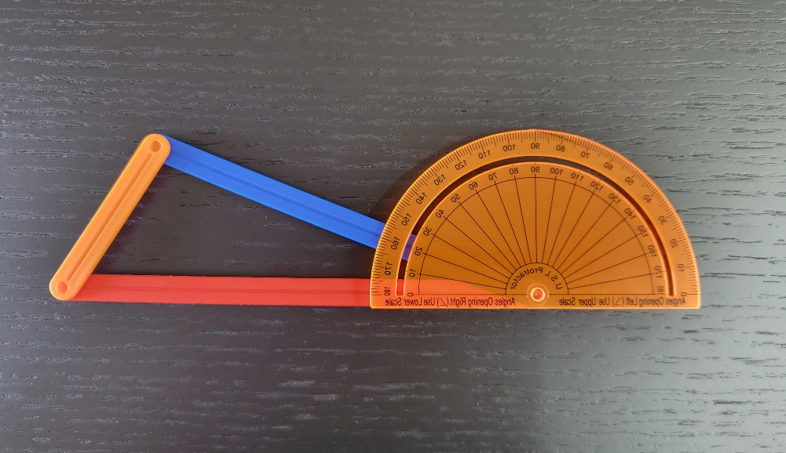
Did You Match My Triangle?
Round 2
My Triangle:

Slide 21
Can You Match My Triangle?
Round 3
My triangle, ΔABC, has…
3-Minute Timer
Notes:
K20 Center. (n.d.). Inverted pyramid. Strategies. https://learn.k20center.ou.edu/strategy/173
K20 Center. (2021, September 21). K20 Center 3 minute timer [Video]. YouTube. https://youtu.be/iISP02KPau0?si=oew-VIocHqA5Tn8z

Slide 22
Can You Match My Triangle?
Round 3
Find another pair and compare your triangles.
Are they congruent?
Notes:
K20 Center. (n.d.). Inverted pyramid. Strategies. https://learn.k20center.ou.edu/strategy/173

Slide 23
Can You Match My Triangle?
Round 3
Are they all congruent?
Did anyone find a counterexample?
Which triangle congruence possibility did we just test?
Notes:
K20 Center. (n.d.). Inverted pyramid. Strategies. https://learn.k20center.ou.edu/strategy/173

Slide 24
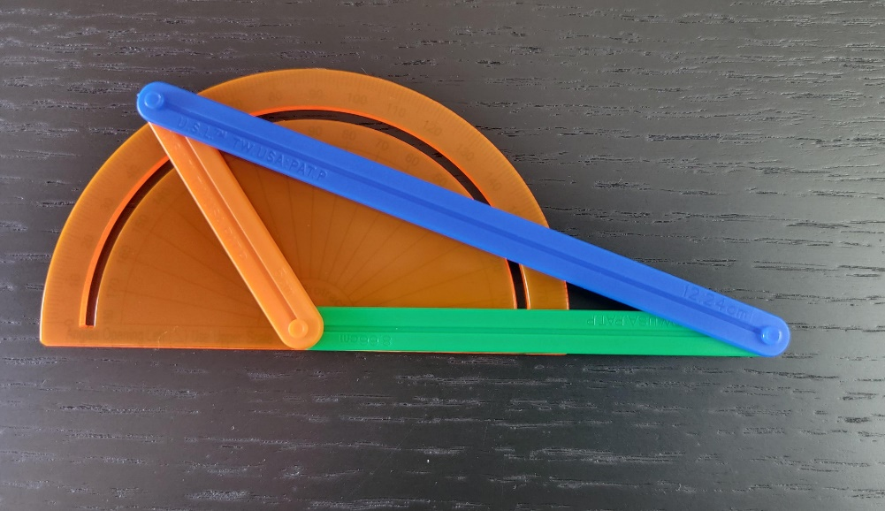
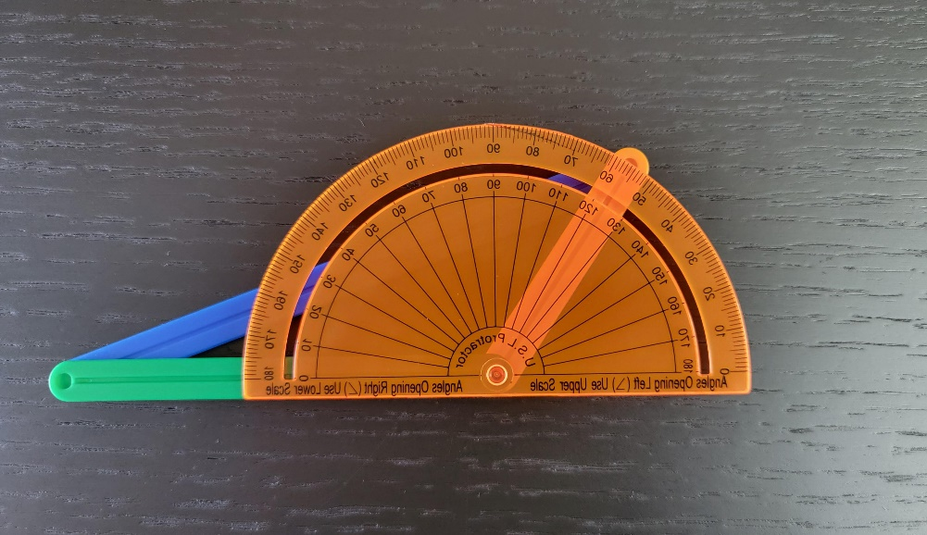
Did You Match My Triangle?
Round 3
My Triangle:
Notes:
K20 Center. (n.d.). Inverted pyramid. Strategies. https://learn.k20center.ou.edu/strategy/173

Slide 25
What Can We Conclude?
We have not completed any official proofs. We only made observations, so we are only able to write conjectures.
A conjecture is a statement that has not yet been formally proven. It a statement made based on observation.
A lack of a counterexample is not proof of something being always true—maybe we have not found it yet.
Complete the conjectures on the following slide.

Slide 26
Writing a Mathematical Conjecture
If the three sides of one triangle are congruent to the three sides of another triangle, then _____.
If two sides and a non-included angle of one triangle are congruent to two sides and a non-included angle of another triangle, then _____.
If two sides and the included angle of one triangle are congruent to two sides and the included angle of another triangle, then _____.

Slide 27
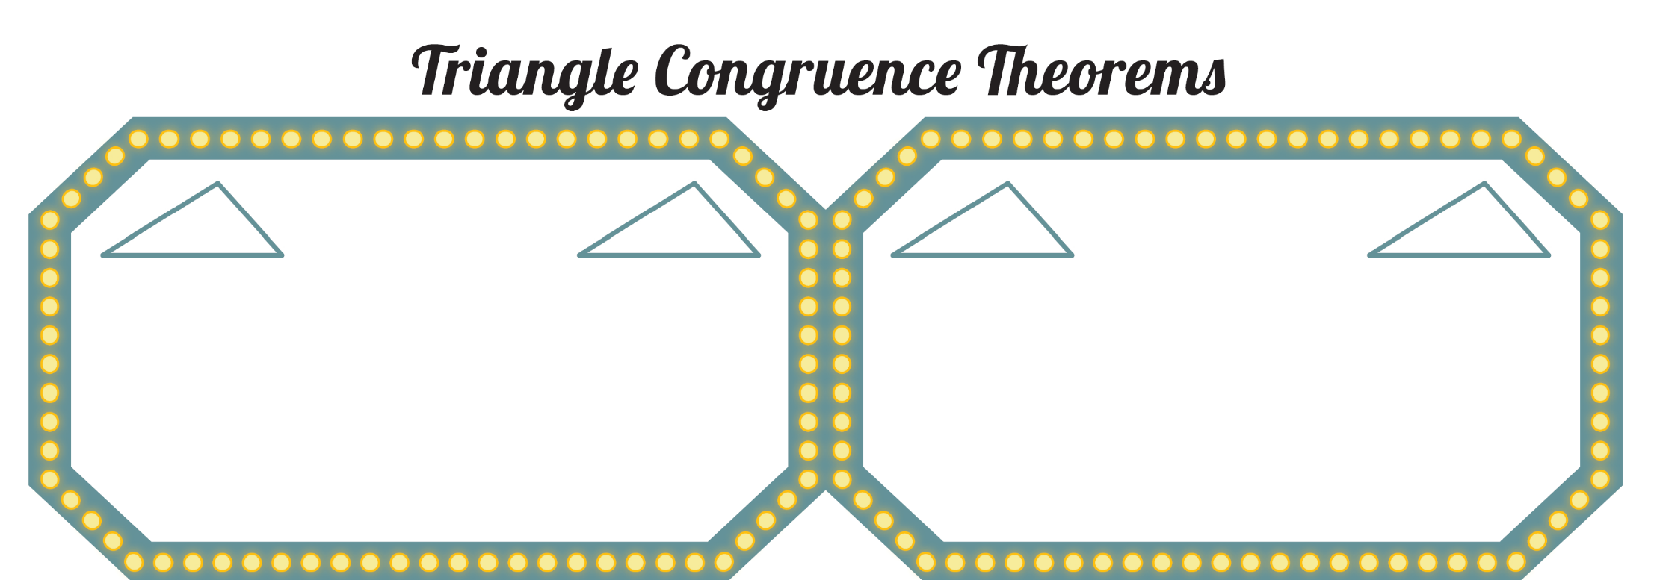
Triangle Congruence Theorems
Luckily, mathematicians have proven that SSS and SAS are more than conjectures, they are congruence theorems.
Write the SSS and SAS congruence theorems and label the triangles:
How should you label these triangles?
SSS
SAS
Write this theorem in your own words.
Write this theorem in your own words.

Slide 28
Exploring the Possibilities
Angle–Angle–Angle (AAA)
Three pairs of congruent angles
Angle–Angle–Side (AAS)
Two pairs of congruent angles and one pair of congruent sides (sides not between the pairs of angles)
Angle–Side–Angle (ASA)
Two pairs of congruent angles and one pair of congruent sides (sides between the pairs of angles)

Slide 29
Can You Match My Triangle?
Challenge
Rounds
We are going to play the Challenge Rounds!
Again, I am going to give you 3 measurements of my triangle.
Your challenge is to see if you can create my triangle.
Notes:
K20 Center. (n.d.). Inverted pyramid. Strategies. https://learn.k20center.ou.edu/strategy/173

Slide 30
Can You Match My Triangle?
Challenge
Round 1
My triangle, ΔABC, has…
5-Minute Timer
Notes:
K20 Center. (n.d.). Inverted pyramid. Strategies. https://learn.k20center.ou.edu/strategy/173
K20 Center. (2021, September 21). K20 Center 5 minute timer. [Video]. YouTube. https://youtu.be/EVS_yYQoLJg?si=fJvuvFWH3vJ3B0z9

Slide 31
Can You Match My Triangle?
Challenge
Round 1
Are they all congruent?
Did anyone find a counterexample?
Which triangle congruence possibility did we just test?
Notes:
K20 Center. (n.d.). Inverted pyramid. Strategies. https://learn.k20center.ou.edu/strategy/173

Slide 32
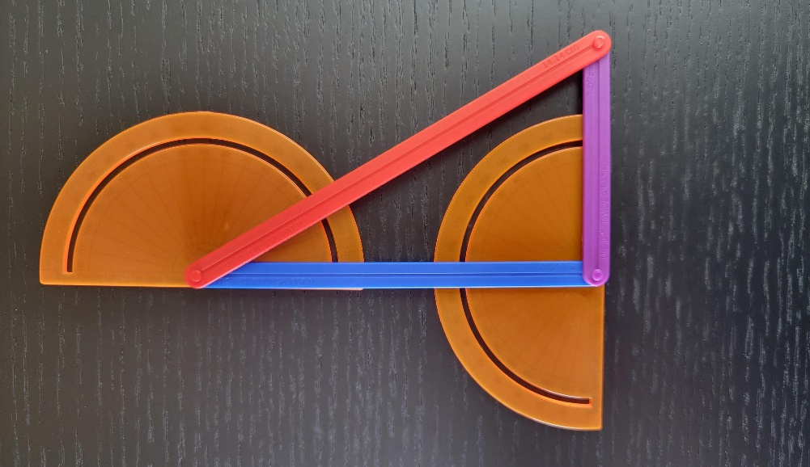
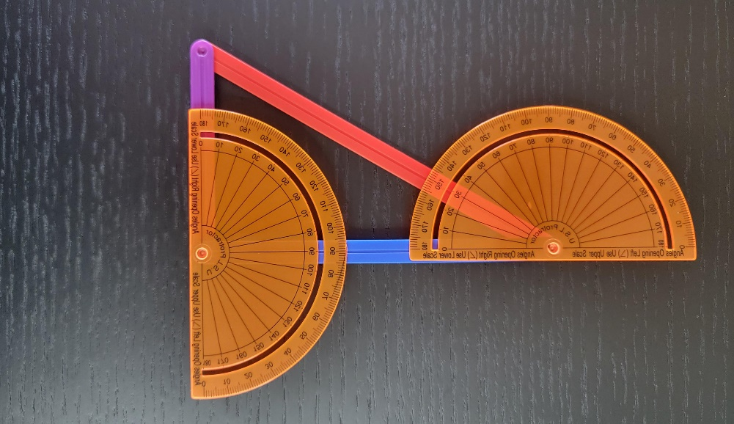
Did You Match My Triangle?
Challenge
Round 1
My Triangle:
Notes:
K20 Center. (n.d.). Inverted pyramid. Strategies. https://learn.k20center.ou.edu/strategy/173

Slide 33
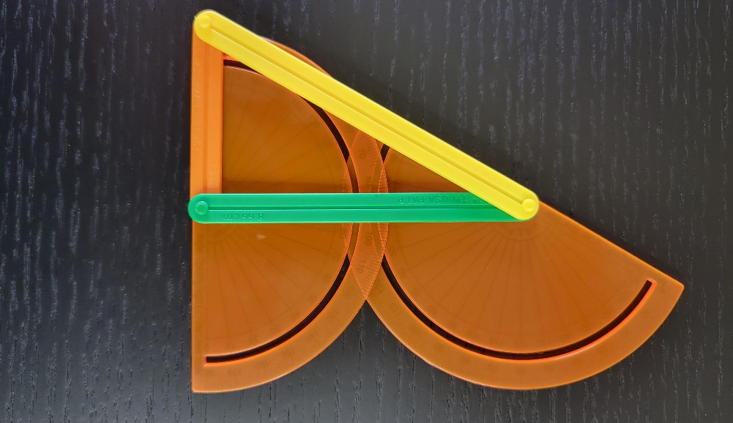
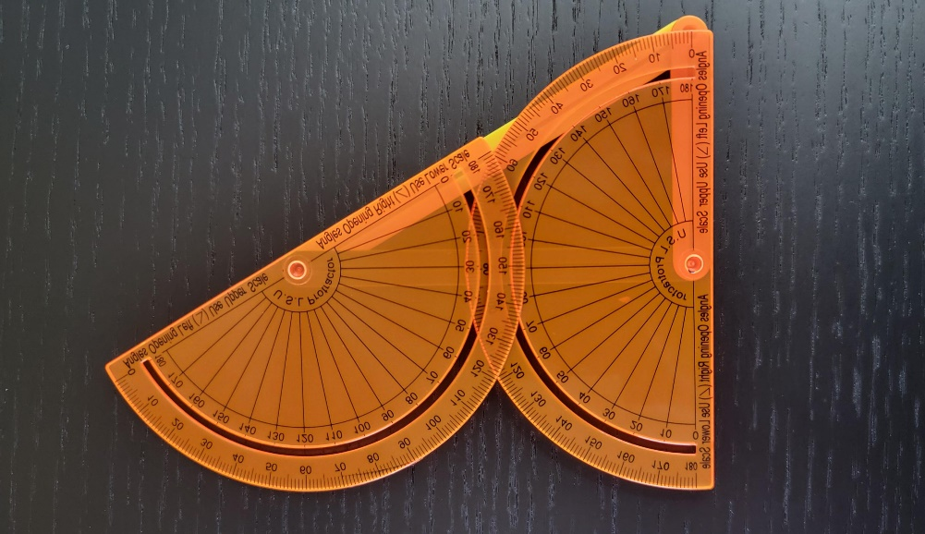
Did You Match My Triangle?
Challenge
Round 1
My Triangle:
Notes:
K20 Center. (n.d.). Inverted pyramid. Strategies. https://learn.k20center.ou.edu/strategy/173

Slide 34
Can You Match My Triangle?
Challenge
Round 2
My triangle, ΔABC, has…
5-Minute Timer
Notes:
K20 Center. (n.d.). Inverted pyramid. Strategies. https://learn.k20center.ou.edu/strategy/173
K20 Center. (2021, September 21). K20 Center 5 minute timer. [Video]. YouTube. https://youtu.be/EVS_yYQoLJg?si=fJvuvFWH3vJ3B0z9

Slide 35
Can You Match My Triangle?
Challenge
Round 2
Are they all congruent?
Did anyone find a counterexample?
Which triangle congruence possibility did we just test?

Slide 36
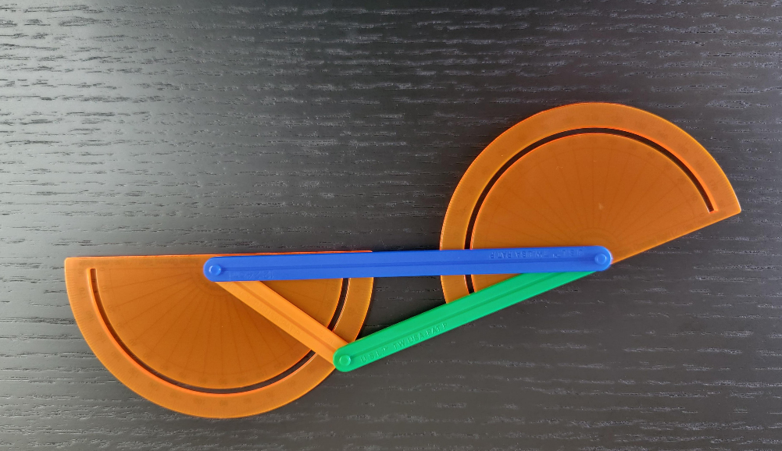
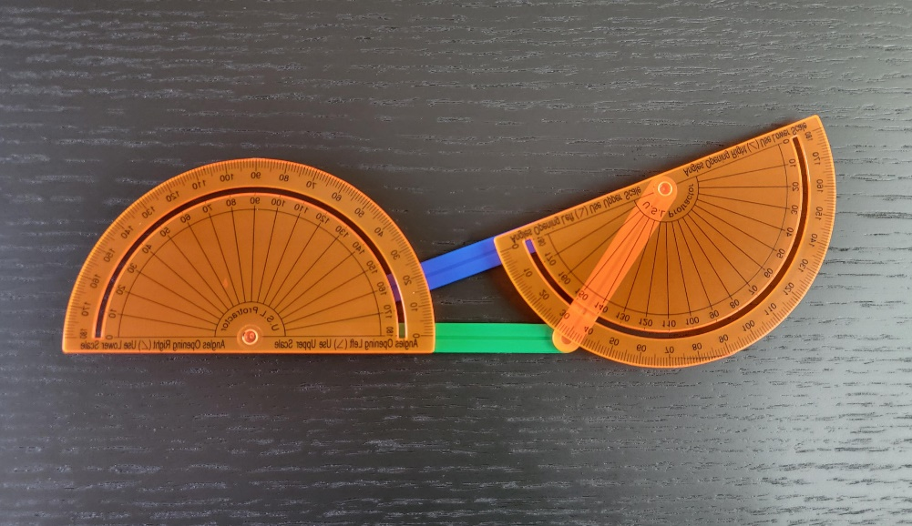
Did You Match My Triangle?
Challenge
Round 2
My Triangle:
Notes:
K20 Center. (n.d.). Inverted pyramid. Strategies. https://learn.k20center.ou.edu/strategy/173

Slide 37
Can You Match My Triangle?
Challenge
Round 3
My triangle, ΔABC, has…
5-Minute Timer
Notes:
K20 Center. (n.d.). Inverted pyramid. Strategies. https://learn.k20center.ou.edu/strategy/173
K20 Center. (2021, September 21). K20 Center 5 minute timer [Video]. YouTube. https://youtu.be/EVS_yYQoLJg?si=fJvuvFWH3vJ3B0z9

Slide 38
Can You Match My Triangle?
Challenge
Round 3
Are they all congruent?
Did anyone find a counterexample?
Which triangle congruence possibility did we just test?
Notes:
K20 Center. (n.d.). Inverted pyramid. Strategies. https://learn.k20center.ou.edu/strategy/173

Slide 39
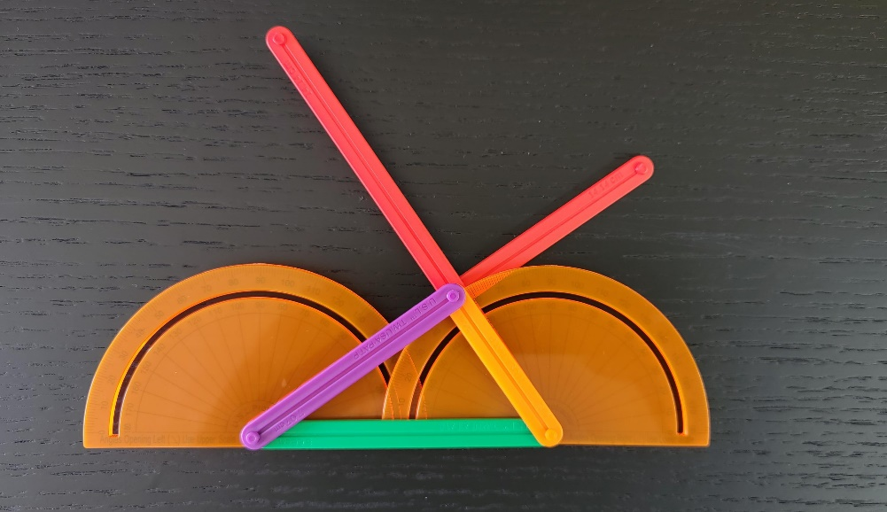
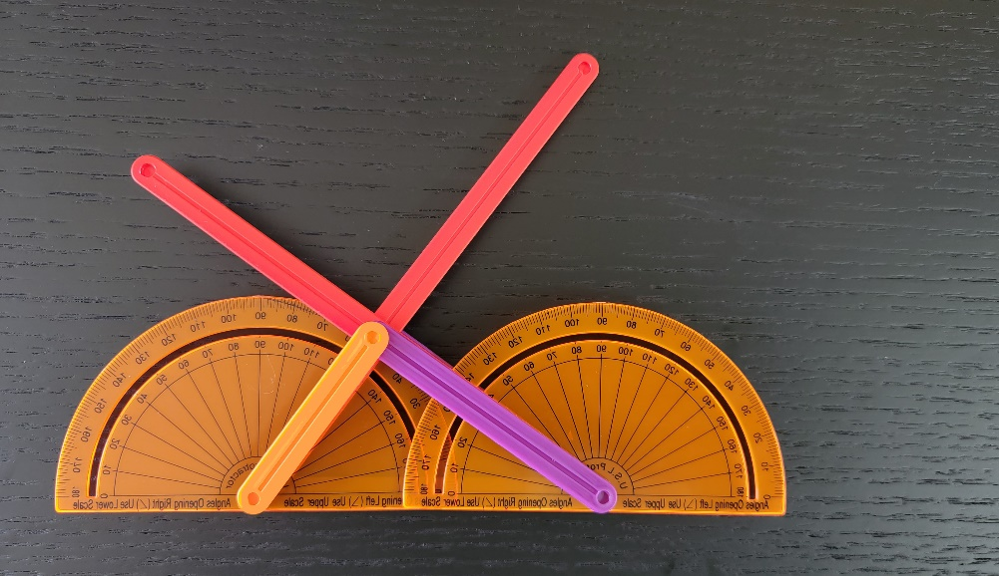
Did You Match My Triangle?
Challenge
Round 3
My Triangle:
Notes:
K20 Center. (n.d.). Inverted pyramid. Strategies. https://learn.k20center.ou.edu/strategy/173

Slide 40
Complete Each Conjecture
If the three angles of one triangle are congruent to the corresponding angles of another triangle, then _____.
If two angles and a non-included side of one triangle are congruent to the corresponding angles and side of another triangle, then _____.
If two angles and the included side of one triangle are congruent to two angles and the included side of another triangle, then _____.

Slide 41
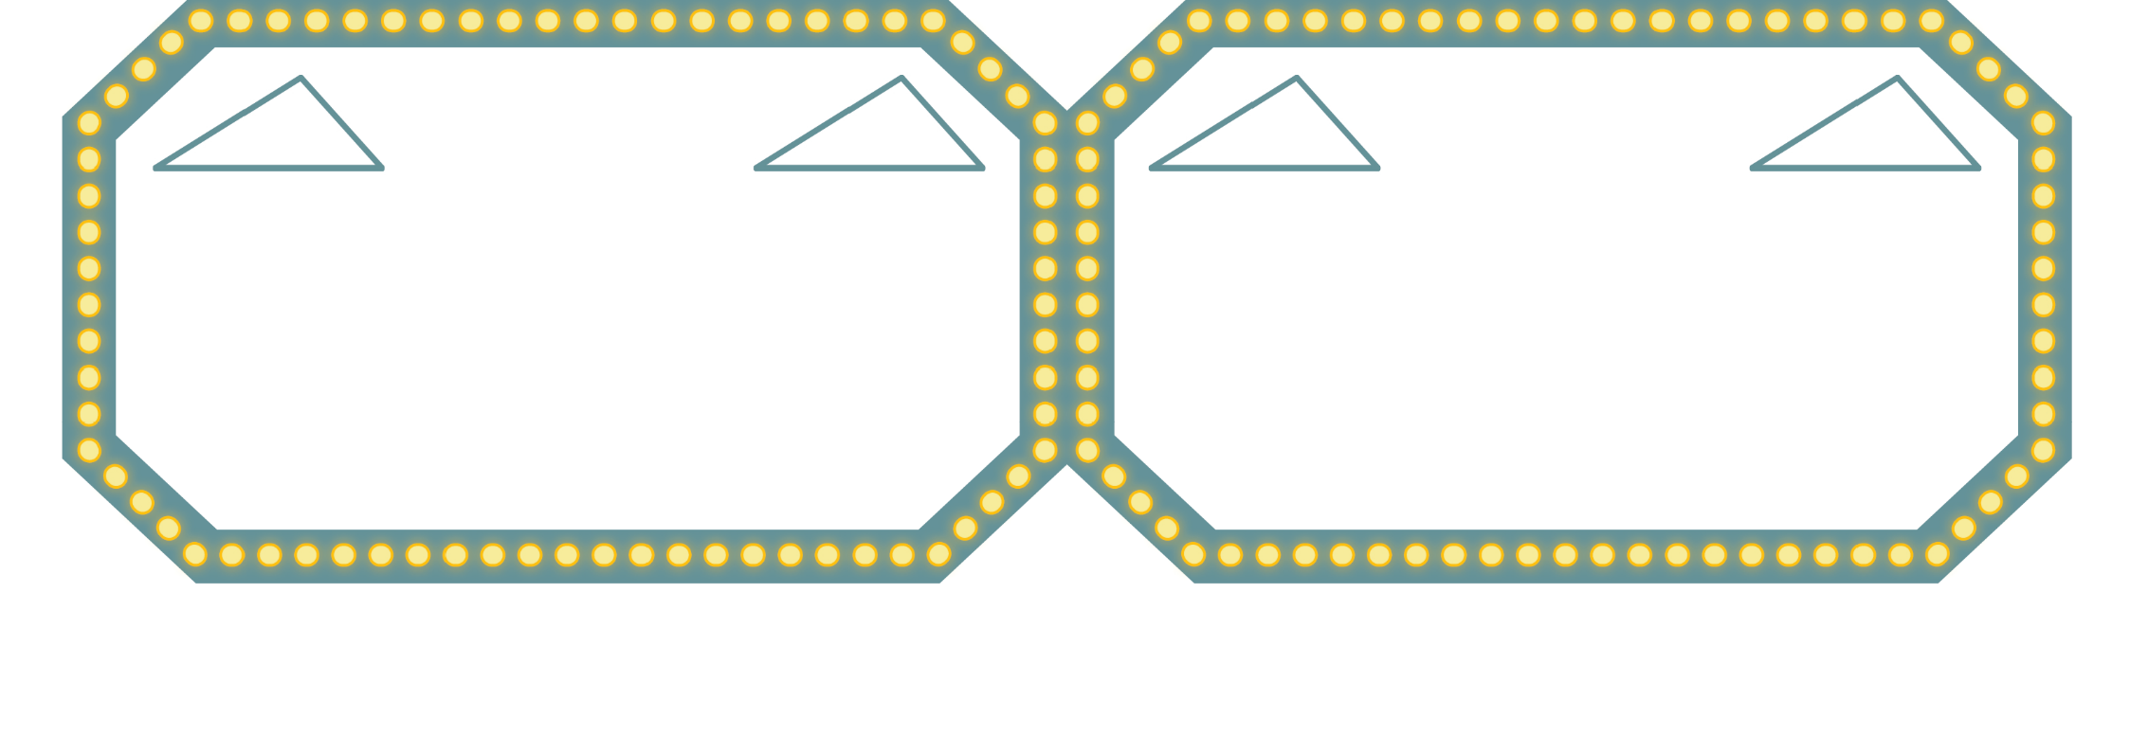
Triangle Congruence Theorems
Again, mathematicians have proven that AAS and ASA are more than conjectures, they are congruence theorems.
Write the AAS and ASA congruence theorems and label the triangles:
AAS
ASA
Don’t forget to label your triangles.
Write this theorem in your own words.
Write this theorem in your own words.

Slide 42
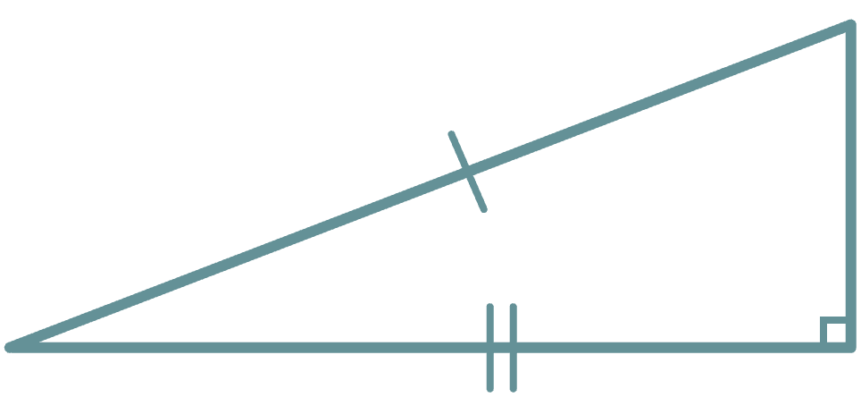
Triangle Congruence Theorem: HL
There is one more congruence theorem that could be helpful to know for timed exams like the ACT.
Hypotenuse–Leg (HL) Theorem: if the hypotenuse and leg of one right triangle are congruent to those corresponding parts of another right triangle, then the two triangles are congruent.

Slide 43
Triangle Congruence Theorem: HL
The Hypotenuse–Leg (HL) Theorem only works for right triangles and is basically a shortcut for the Side–Side–Side (SSS) Theorem (thus a time-saver).
Using the Pythagorean Theorem, if we know the lengths of 2 sides of a right triangle, we can find the length of the third. We know that if 3 sides of a triangle are congruent to the 3 sides of another triangle, then by the SSS theorem, we know the triangles are congruent.

Slide 44
Let’s Make a Proof
You’re the lucky contestants! Let’s make some proofs!
Apply your knowledge of the SSS, SAS, ASA, and AAS congruence theorems to complete the given handout.

Slide 45
Phone a Friend
Your friend is on Who Wants to be a Math Master? and is unsure about one of the questions. Luckily for them, they have the option to call a friend: you!
Individually answer the question on your handout.
Notes:
K20 Center. (n.d.). Bell ringers and exit tickets. Strategies. https://learn.k20center.ou.edu/strategy/125

Slide 46
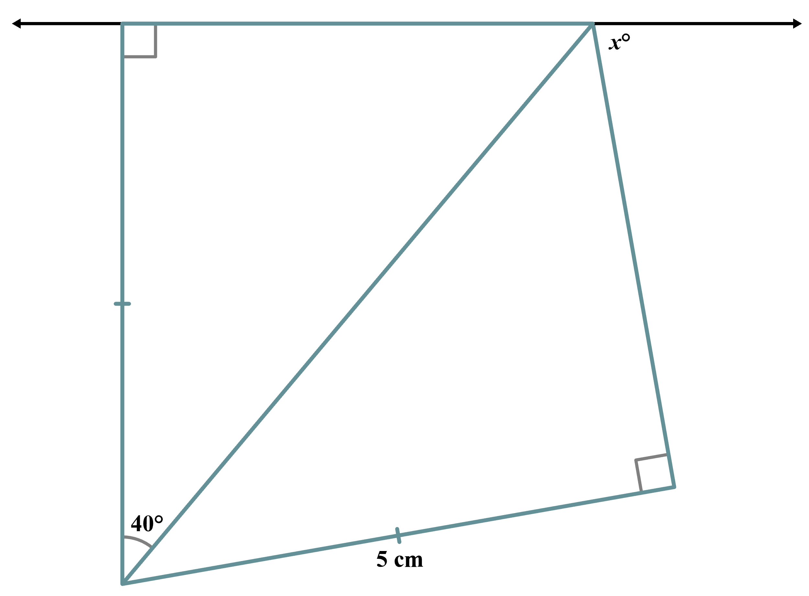
ACT Prep
Use the congruence markers in the given figure to determine the value of x.

Slide 47
ACT Prep (Solution)
By the HL theorem, the two triangles are congruent, which means their corresponding parts are congruent. The three angles in the top-right create a straight line (180°). So, 50° + 50° + x° = 180°, therefore x = 80.
50°
50°

