Slide 1
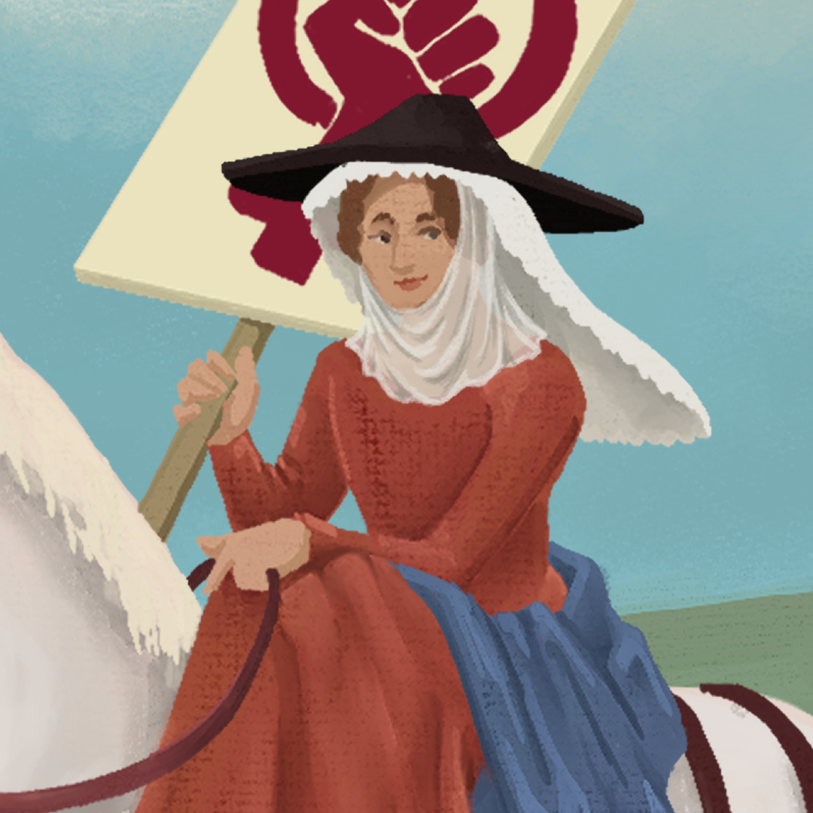
Bubbling Personalities: Unraveling the Wife of Bath’s Tale
Chaucer

Slide 2
Essential Question
How does literature serve as a mirror to society, offering insights into different eras, cultures, and human experiences?
How can literature encourage empathy and understanding?

Slide 3
Learning Objective
Explore perspectives of people and characters based on their circumstances.

Slide 4
Marriage Laws
With your partner, read over the marriage laws.
Sort the cards into two groups:
Real
Fake
Notes:
K20 Center. (n.d.). Card sort. Strategies. https://learn.k20center.ou.edu/strategy/147

Slide 5
The Wife of Bath’s Tale
As you listen, follow along with the text.
Highlight things that you find surprising, interesting, and troubling
Surprising - yellow
Interesting - orange
Troubling - pink
Notes:
K20 Center. (n.d.). Categorical highlighting. Strategies. https://learn.k20center.ou.edu/strategy/192
K20 Center. (n.d.). Surprising, interesting, troubling. Strategies. Retrieved from https://learn.k20center.ou.edu/strategy/926

Slide 6
The Wife of Bath’s Tale
The Wife of Bath’s Prologue
The Wife of Bath’s Tale
Notes:
The Wife of Bath’s Tale-Prologue: https://youtu.be/xPhnGmvkBAU
The Wife of Bath’s Tale: https://youtu.be/qZ2yCaD4jTo

Slide 7
Step In, Step Out, Step Back
Think back to the characters in The Wife of Bath’s Tale.
Choose one character from the tale.
Put yourself in their shoes and answer the questions as if you were that character.
Notes:
K20 Center. (n.d.). Step In, Step Out, Step Back. Strategies. Retrieved from https://learn.k20center.ou.edu/strategy/1585

Slide 8
Step In
Given what you see and know at this time, what do you think this person might feel, believe, know, or experience?
Notes:
K20 Center. (n.d.). Step In, Step Out, Step Back. Strategies. Retrieved from https://learn.k20center.ou.edu/strategy/1585

Slide 9
Step Out
What else would you like or need to learn to understand this person’s perspective better?
Notes:
K20 Center. (n.d.). Step In, Step Out, Step Back. Strategies. Retrieved from https://learn.k20center.ou.edu/strategy/1585

Slide 10
Step Back
Given your exploration of this perspective so far, what do you notice about your own perspective and what it takes to take on somebody else’s?
Notes:
K20 Center. (n.d.). Step In, Step Out, Step Back. Strategies. Retrieved from https://learn.k20center.ou.edu/strategy/1585

Slide 11
What Women Want
As you read the article, focus on issues or feelings that surprise, interest, or trouble you.
Highlight the following:
Surprising - yellow
Interesting - orange
Troubling - pink
Notes:
K20 Center. (n.d.). Categorical highlighting. Strategies. https://learn.k20center.ou.edu/strategy/192
K20 Center. (n.d.). Surprising, interesting, troubling. Strategies. Retrieved from https://learn.k20center.ou.edu/strategy/926

Slide 12
Women’s Liberty Poster
Create a poster similar to a Women’s Liberty poster
Include the following in your poster:
Surprising: an issue that women faced historically but still face today
Interesting: fact or information you learned from this lesson
Troubling: include data or information that stands out and is concerning.
Connect it to The Wife of Bath’s Tale and the What Women Want article.
Include images, words, phrases, titles, headings, color, etc.
Notes:
K20 Center. (n.d.). Surprising, interesting, troubling. Strategies. Retrieved from https://learn.k20center.ou.edu/strategy/926

