Slide 2
The Great Divide
Polynomial Division

Slide 3
Essential Question
What is your preferred way to solve polynomial equations?

Slide 4
Lesson Objectives
Students will be able to solve polynomial equations through graphing, factoring, and dividing.
Students will be able to divide polynomials with and without remainders.
Students will be able to choose the most efficient method of solving polynomial equations.

Slide 5

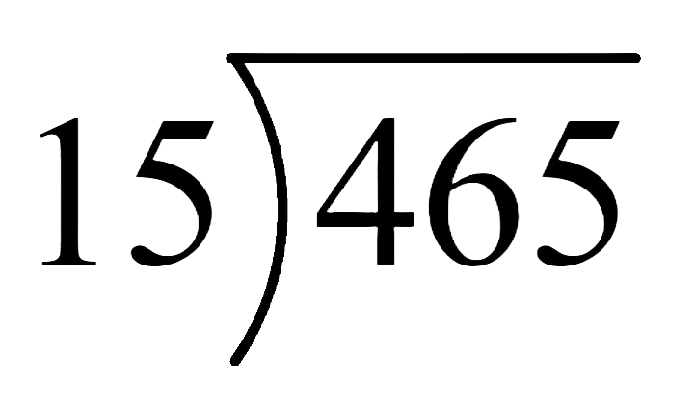
Tell Me Everything
Write down everything you know about the following problem.
  Ex.
  What is the answer?
  How do you know?
  What method did you use to solve?
Notes:
K20 Center. (n.d.). Tell Me Everything. Strategies. https://learn.k20center.ou.edu/strategy/107

Slide 6

Skill review - On your paper solve the following math problems.
2. 3.

Slide 7

Always, Sometimes, Never
Read the following statement and determine if it is Always true, Sometimes true, or Never true.
A polynomial written in standard form has the highest degree listed first.
Notes:
K20 Center. (n.d.). Always, Sometimes, Never True. Strategies. https://learn.k20center.ou.edu/strategy/60

Slide 8
Always, Sometimes, Never
Read the following statement and determine if it is Always true, Sometimes true, or Never true.
The degree of a linear binomial is three.

Slide 9
Always, Sometimes, Never
Read the following statement and determine if it is Always true, Sometimes true, or Never true.
The product of two binomials is a polynomial.

Slide 10
Always, Sometimes, Never
Read the following statement and determine if it is Always true, Sometimes true, or Never true.
A polynomial has a leading coefficient of one.

Slide 11
Always, Sometimes, Never
Read the following statement and determine if it is Always true, Sometimes true, or Never true.
The quotient of two polynomials is a polynomial.

Slide 12

Dividing Polynomials
In your groups, solve the problems on your handout.
  Simply the first question
  Solve the second question through graphing or factoring.
Write your method and show all necessary work on your paper.
https://timer.k20center.ou.edu/

Slide 13
Showing Your Work
Refer to the top of your handout to determine which group number you are.
Each group will choose to work out either question 1 or question 2 for the class.
Explain to the class what methods you used to solve the problem, and what your answer is.

Slide 14
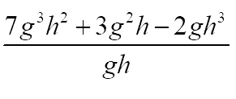
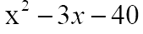
Group 1

Slide 15
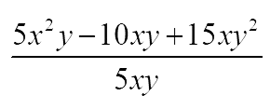
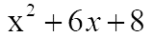
Group 2

Slide 16
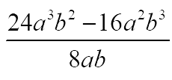
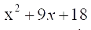
Group 3

Slide 17
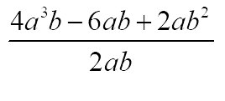
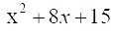
Group 4

Slide 18
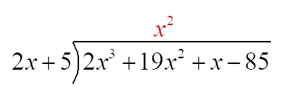
Example 1:

Slide 19
Example 1:

Slide 20
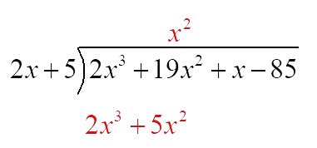
Example 1:

Slide 21
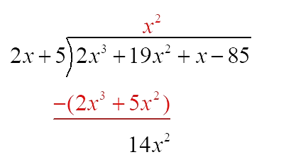
Example 1:

Slide 22
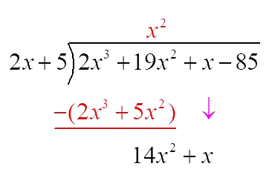
Example 1:

Slide 23
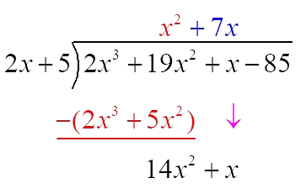
Example 1:

Slide 24
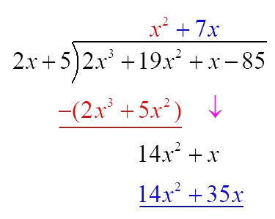
Example 1:

Slide 25
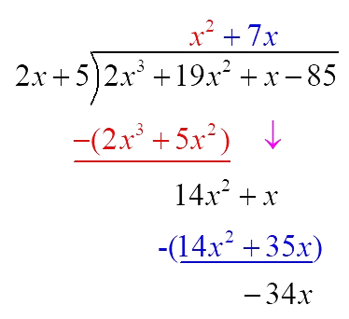
Example 1:

Slide 26
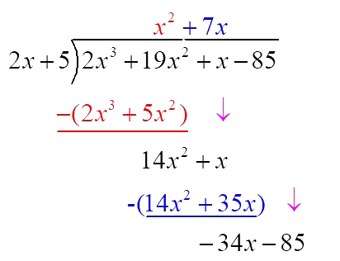
Example 1:

Slide 27
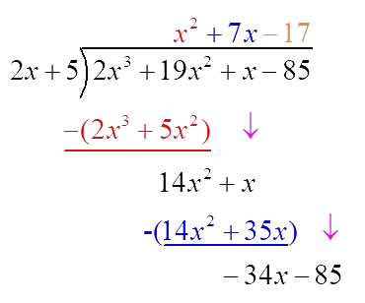
Example 1:

Slide 28
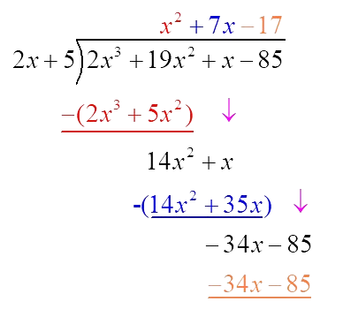
Example 1:

Slide 29
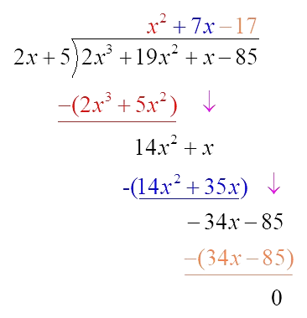
Example 1:

Slide 30
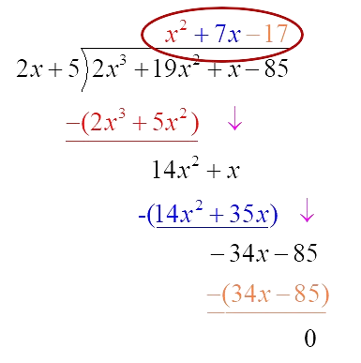
Example 1:

Slide 31

Example 2:

Slide 32
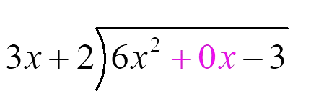
Example 2:

Slide 33
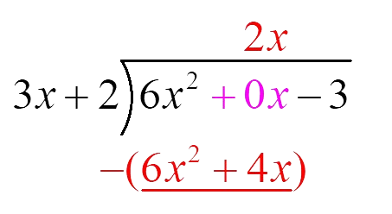
Example 2:

Slide 34
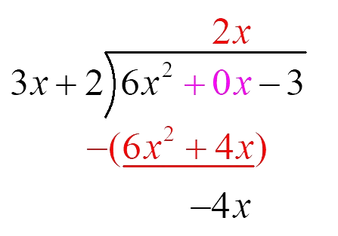
Example 2:

Slide 35
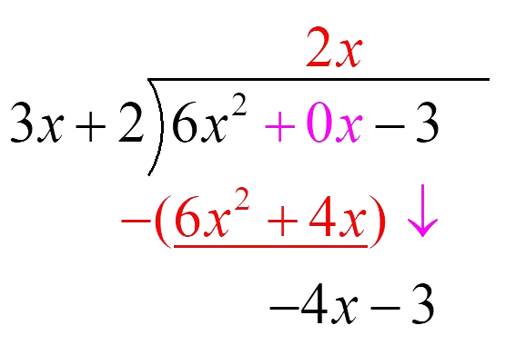
Example 2:

Slide 36
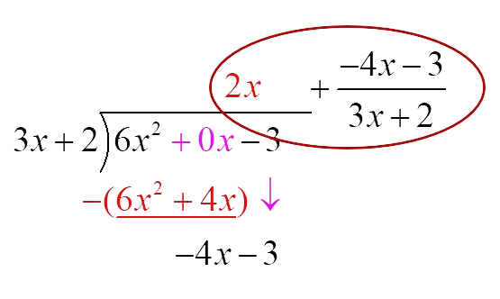
Example 2:

Slide 37
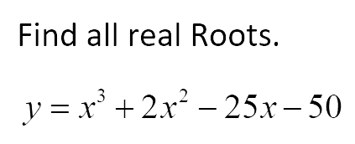
Example 3:
If one factor is x+5, identify all other factors of this function through Graphing, Factoring, and Division.

Slide 38
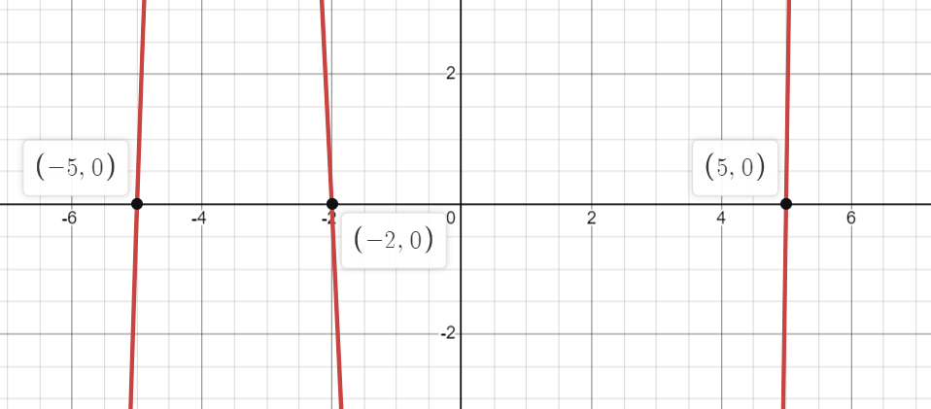
Example 3:
Graphing
Zeros:

Slide 39

Example 3:
Graphing
Zeros:

Slide 40
Example 3:
Graphing
Zeros:
Factors:

Slide 41

Example 3:
Graphing
Zeros:
Factors:

Slide 42

Example 3:
Graphing
Zeros:
Factors:

Slide 43
Example 3:
Graphing
Zeros:
Factors:

Slide 44

Example 3:
Factoring

Slide 45

Example 3:
Factoring

Slide 46
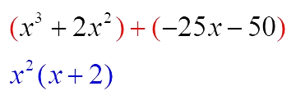
Example 3:
Factoring

Slide 47
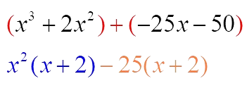
Example 3:
Factoring

Slide 48

Example 3:
Factoring

Slide 49
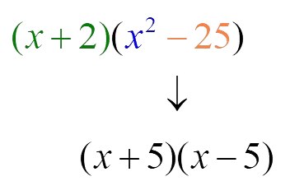
Example 3:
Factoring

Slide 50

Example 3:
Factoring

Slide 51
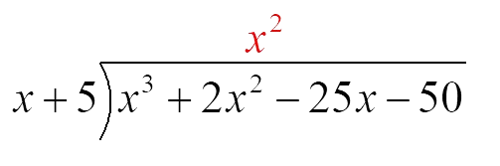
Example 3:
Dividing

Slide 52
Example 3:
Dividing

Slide 53
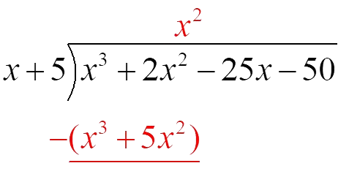
Example 3:
Dividing

Slide 54
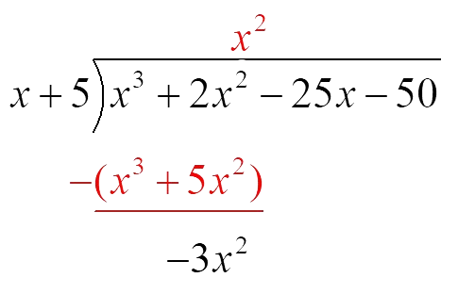
Example 3:
Dividing

Slide 55
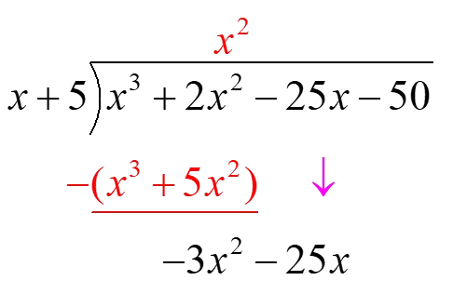
Example 3:
Dividing

Slide 56
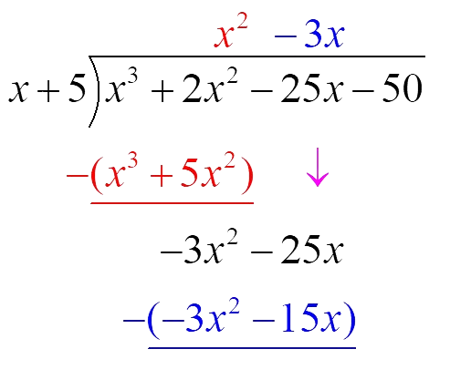
Example 3:
Dividing

Slide 57
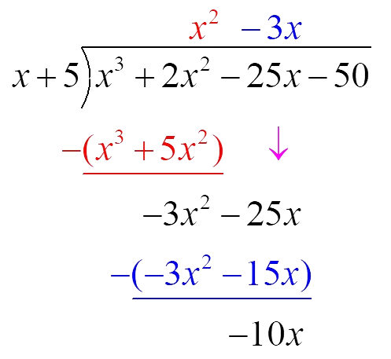
Example 3:
Dividing

Slide 58
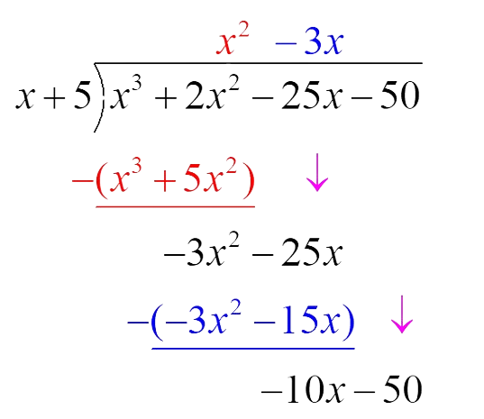
Example 3:
Dividing

Slide 59
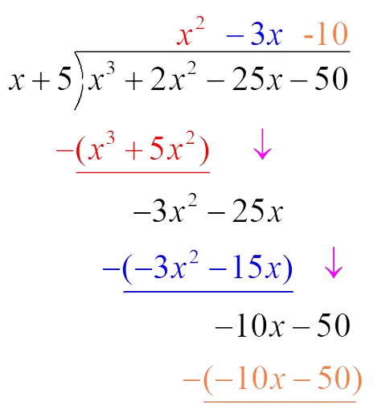
Example 3:
Dividing

Slide 60
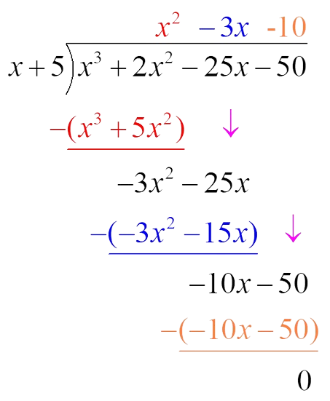
Example 3:
Dividing

Slide 61


Example 3:
Dividing

Slide 62
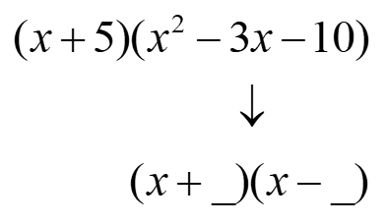
Example 3:
Dividing

Slide 63
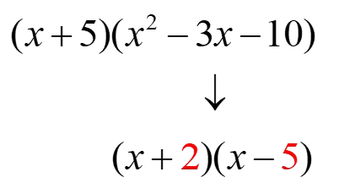
Example 3:
Dividing

Slide 64
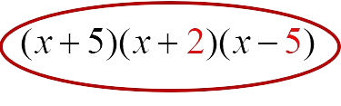
Example 3:
Dividing

Slide 65
Example 4:

Slide 66
Example 4:
Can we factor?

Slide 67
Example 4:
Can we factor?
No, there are too many terms.

Slide 68
Example 4:
Let’s Graph

Slide 69
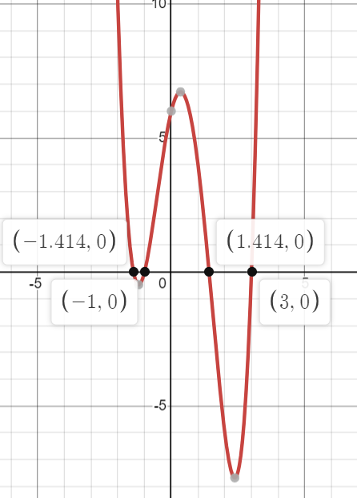
Example 4:
Let’s Graph

Slide 70
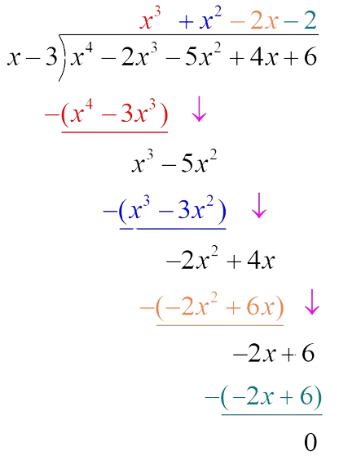
Example 4: Division

Slide 71
Example 4: Division

Slide 72
Example 4: Division

Slide 73
Example 4: Division

Slide 74
Example 4: Division

Slide 75

Example 4:

Slide 76
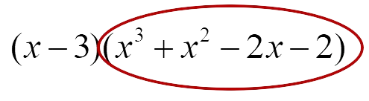
Example 4:

Slide 77
Example 4:

Slide 78
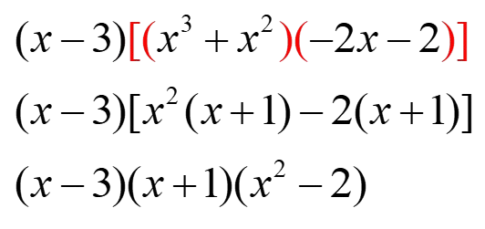
Example 4:

Slide 79
Example 4:

Slide 80
Example 4:

Slide 81
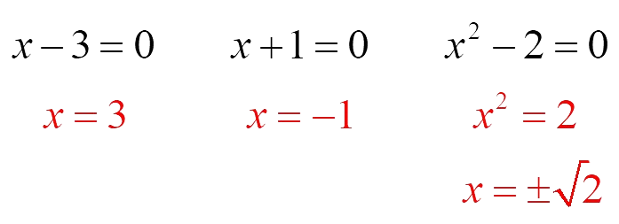
Example 4:

Slide 82
Example 4:

Slide 83
Example 4:

Slide 84
Practice
Complete the practice problems independently.
https://timer.k20center.ou.edu/
Notes:
K20 Center. (n.d.). Elbow Partners. Strategies. https://learn.k20center.ou.edu/strategy/116

Slide 85
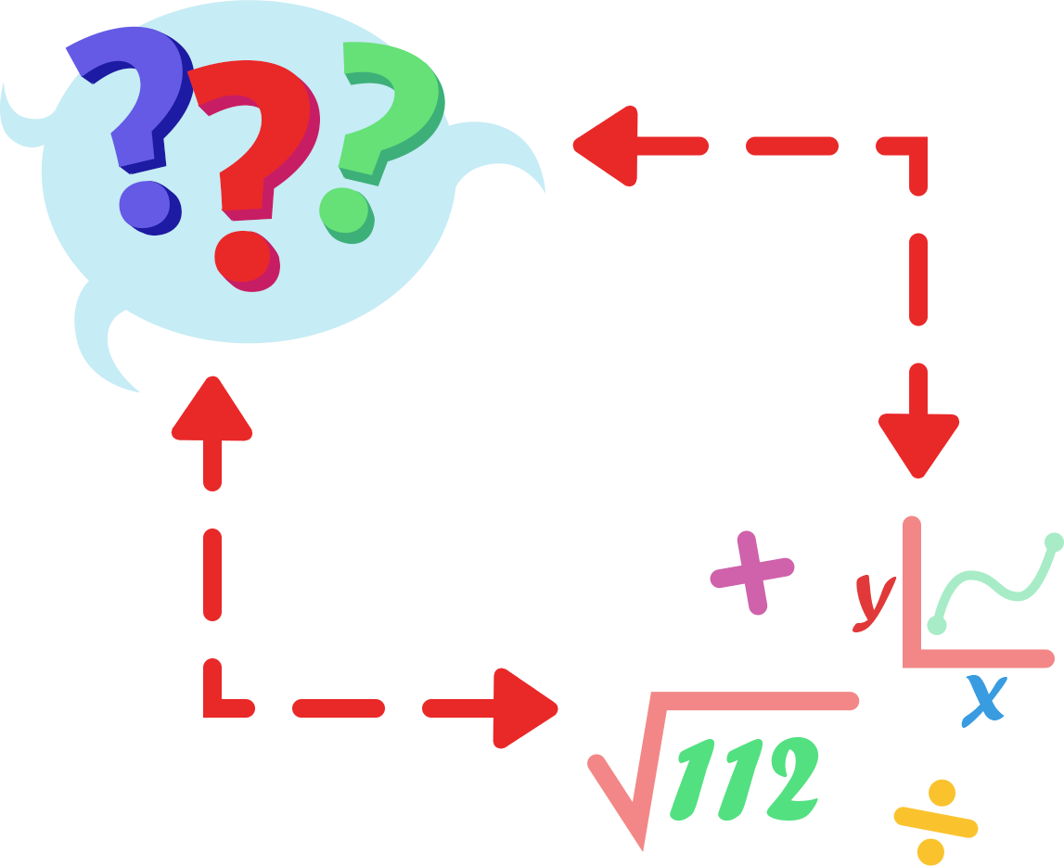
Math Interview
Partner A will interview Partner B over the Equation Expedition handout.
Ask the questions on the math interview handout and take notes based on your partner’s responses.
When one partner A has been interviewed, switch rolls and Partner A interview Partner B.
Notes:
K20 Center. (n.d.). Math Interview. Strategies. https://learn.k20center.ou.edu/strategy/3296

