Slide 2
We Like to Move It, Move It
World Geography
Push and Pull Factors

Slide 3
Essential Questions
What motivates people to move from place to place?
How do push and pull factors influence human movement and settlement?

Slide 4
Learning Objectives
Recognize and identify the difference between push and pull factors.
Determine how push and pull factors impact the choices that humans make in their lives.
Consider the challenges that rapid urbanization can create within an area by examining the nation of India.

Slide 5


Think-Pair-Share
Write down your response to the following question:
  What motivates people to move from place to place?
Working with your partner, spend five minutes thinking of as many responses to this question as you can.
  Be prepared to share out your responses!
Notes:
K20 Center. (2021, September 21). K20 Center 5-minute timer. [Video]. YouTube. https://www.youtube.com/watch?v=EVS_yYQoLJg
K20 Center. (n.d.). Think, pair, share. Strategy. https://learn.k20center.ou.edu/strategy/139

Slide 6
Factors That Affect Migration
PUSH FACTORS
PULL FACTORS
Push factors force people to leave their home. People have no choice but to leave.
Examples:
  Natural disasters (e.g., hurricanes, earthquakes)
  Lack of jobs or economic opportunity
  War or conflict
Pull factors draw people to move to a different place to participate in a better life situation. People choose to leave.
Examples:
  Warm Weather
  Better educational opportunities
  Access to quality healthcare
Notes:
Stress the difference in choice in the Push/Pull factors

Slide 7
Push or Pull?
Would starting a new job be a push or a pull factor?

Slide 8
Starting a New Job
Push Factor:
If a factory or business closes and it means that the person loses their job, then that person might be forced to relocate to find a new job or face poverty.
Pull Factor:
If a person chooses to find a new job because it is better for them.

Slide 9

It’s a Zombie Apocalypse!
Notes:
TED-Ed. (2013, June 3). How do you decide where to go in a zombie apocalypse? - David Hunter [Video]. YouTube. https://www.youtube.com/watch?v=vdtQgwOOiBg

Slide 10
Class Discussion
If zombies are attacking your town and you are forced to leave or be eaten, which factor would this be in human migration?
What type of town would be best to move to where you would have the best chance of survival against a zombie attack?
Finding or choosing the perfect town to survive a zombie attack
would be an example of which factor?

Slide 11

Is it a PUSH Factor or a PULL factor?
Using the class list of reasons why people move, decide with your partner whether each reason is a PUSH factor or a PULL factor. If it could be both, explain your reasoning.
PUSH FACTOR
PULL FACTOR
1. Poverty
1. Education
(located in
another town)
This Photo by Unknown Author is licensed under CC BY-NC

Slide 12
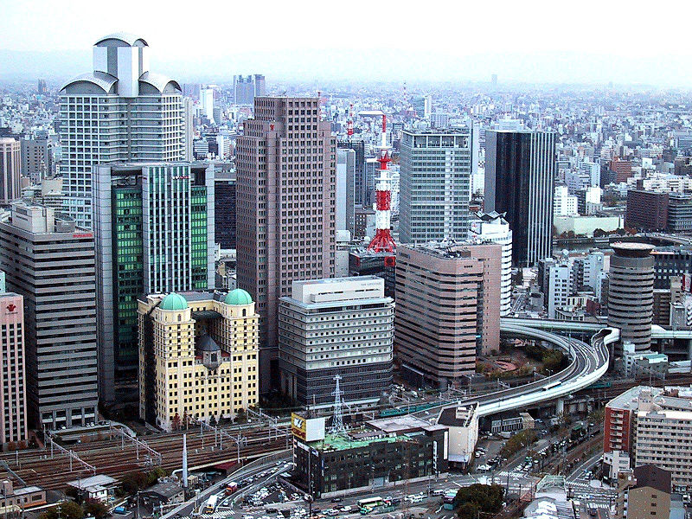
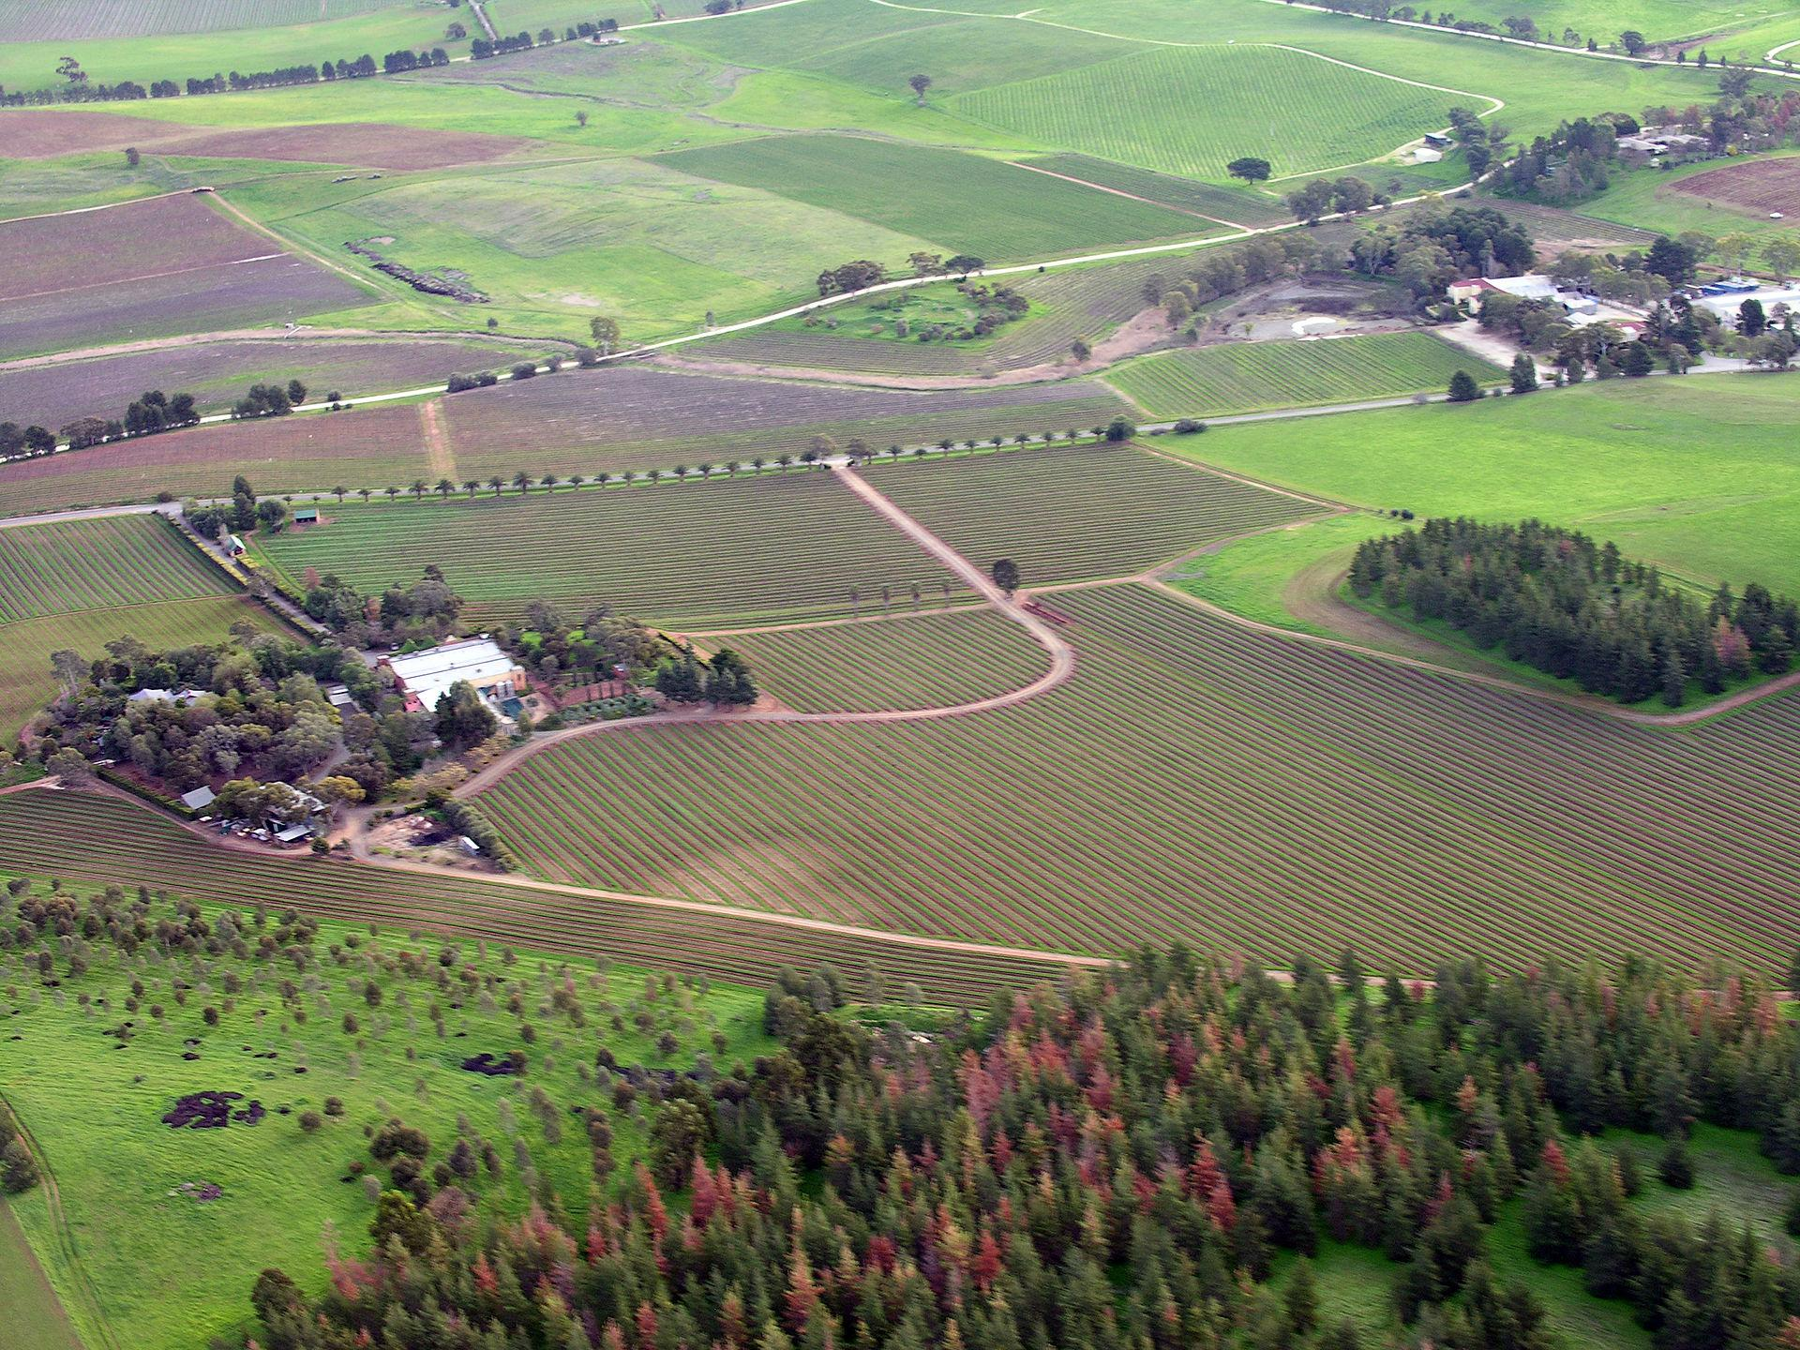
What is Urbanization?
When people move to a location because it has more resources such as jobs, housing, goods, culture, education, and ideas, this location may grow in population.
Rural to Urban
Notes:
This Photo by Unknown Author is licensed under CC BY-SA.
This Photo by Unknown Author is licensed under CC BY-SA.

Slide 13
Analyzing Articles
Spend the next 15-20 minutes to individually read your section of the article.
Once you have completed reading, share the main idea of your section with your group.

Slide 14
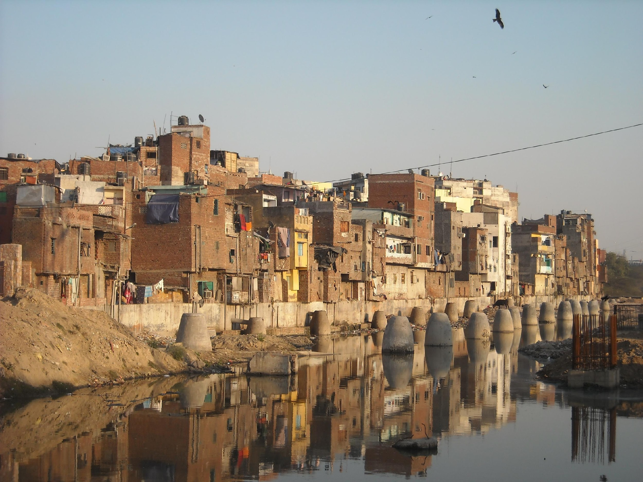
What are the effects of rapid urbanization?
Jigsaw Reading
With your group, write one statement about the effects of urbanization on major cities in India.
Rural to Urban
Notes:
This Photo by Unknown Author is licensed under CC BY-SA
This Photo by Unknown Author is licensed under CC BY-SA

Slide 15

Claim, Evidence, Reasoning
Take out and review your CER Organizer handout.
You will be finding evidence to support the following claim: India has to navigate complex social and economic challenges that can be connected back to rapid urbanization.
Divide the Urbanization Stories from India and Maps of India handouts among your group. Use information from these handouts to complete your CER Organizer.
Notes:
K20 Center. (n.d.). Claim, Evidence, Reasoning (CER). Strategy. https://learn.k20center.ou.edu/strategy/156

Slide 16

Commit and Toss
On one piece of paper, respond to the following prompt: What is one factor that would make you want to stay in your local community?
Crumple up your paper and toss it.
Grab a crumpled-up piece of paper other than your own. Read the response and be prepared to share!
Repeat this process one more time responding to the next prompt: What is a pull factor that would make you choose to move from your local community?
Notes:
K20 Center. (n.d.). Commit and Toss. Strategy. https://learn.k20center.ou.edu/strategy/119

Slide 17

Two-Minute Paper
On a piece of notebook paper, write a two-minute paper in response to one of these questions:
What motivates people to move from place to place?
How do push and pull factors influence human movement and settlement?
Notes:
K20 Center. (n.d.). Two-minute paper. Strategy. https://learn.k20center.ou.edu/strategy/152

