Slide 2
We Like to Move It, Move It
World Human Geography
World Geography

Slide 3
Essential Questions
What motivates people to move from place to place?
What problems does India face with urbanization?

Slide 4
Factors that Affect Migration
PUSH FACTORS
PULL FACTORS
Push factors force people to leave their home. People have no choice but to leave.
Pull factors draw people to move to a different place to participate in a better life situation. People choose to leave.
Notes:
Stress the difference in choice in the Push/Pull factors

Slide 5
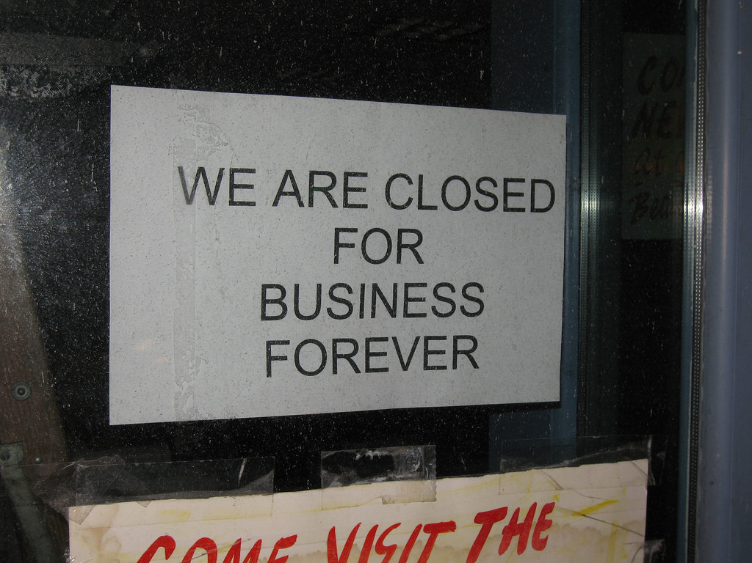
A NEW JOB would be which factor?
PUSH FACTORS
PULL FACTORS
Push factors force people to leave their homes. People have no choice but to leave.
Pull factors draw people to move to a different place to participate in a better life situation. People choose to leave.
This Photo by Unknown Author is licensed under CC BY-ND
This Photo by Unknown Author is licensed under CC BY
Notes:
If a factory is closed and a person is forced out of a job, they may be forced to move to a new location to be employed in a new job. In this case, this is a PUSH factor. If they choose to move because they simply want a better job, then this is a PULL factor.

Slide 6
Class Discussion
When people move or migrate, what do they bring with them?
If zombies are attacking your town and you are forced to leave or be eaten, which factor would this be in human migration?
What type of town would be best to move to where you would have the best chance of survival against a zombie attack?
Finding or choosing the perfect town to survive a zombie attack would be an example of which factor?

Slide 7
Is it a PUSH Factor or a PULL factor?
Using the class list of reasons why people move, decide with your partner whether each reason is a PUSH factor or a PULL factor. If it could be both, explain your reasoning.
PUSH FACTOR
PULL FACTOR
1. Poverty
1. Education (located in another town)
This Photo by Unknown Author is licensed under CC BY-NC

Slide 8
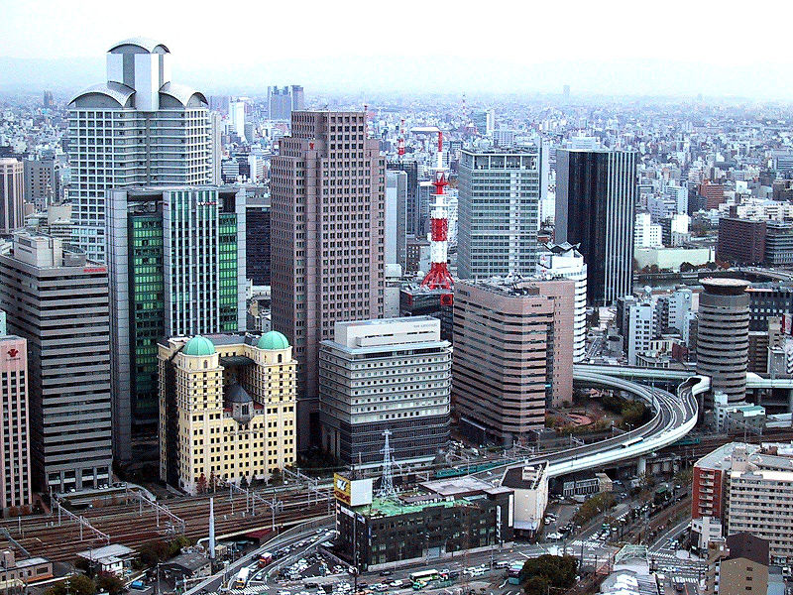
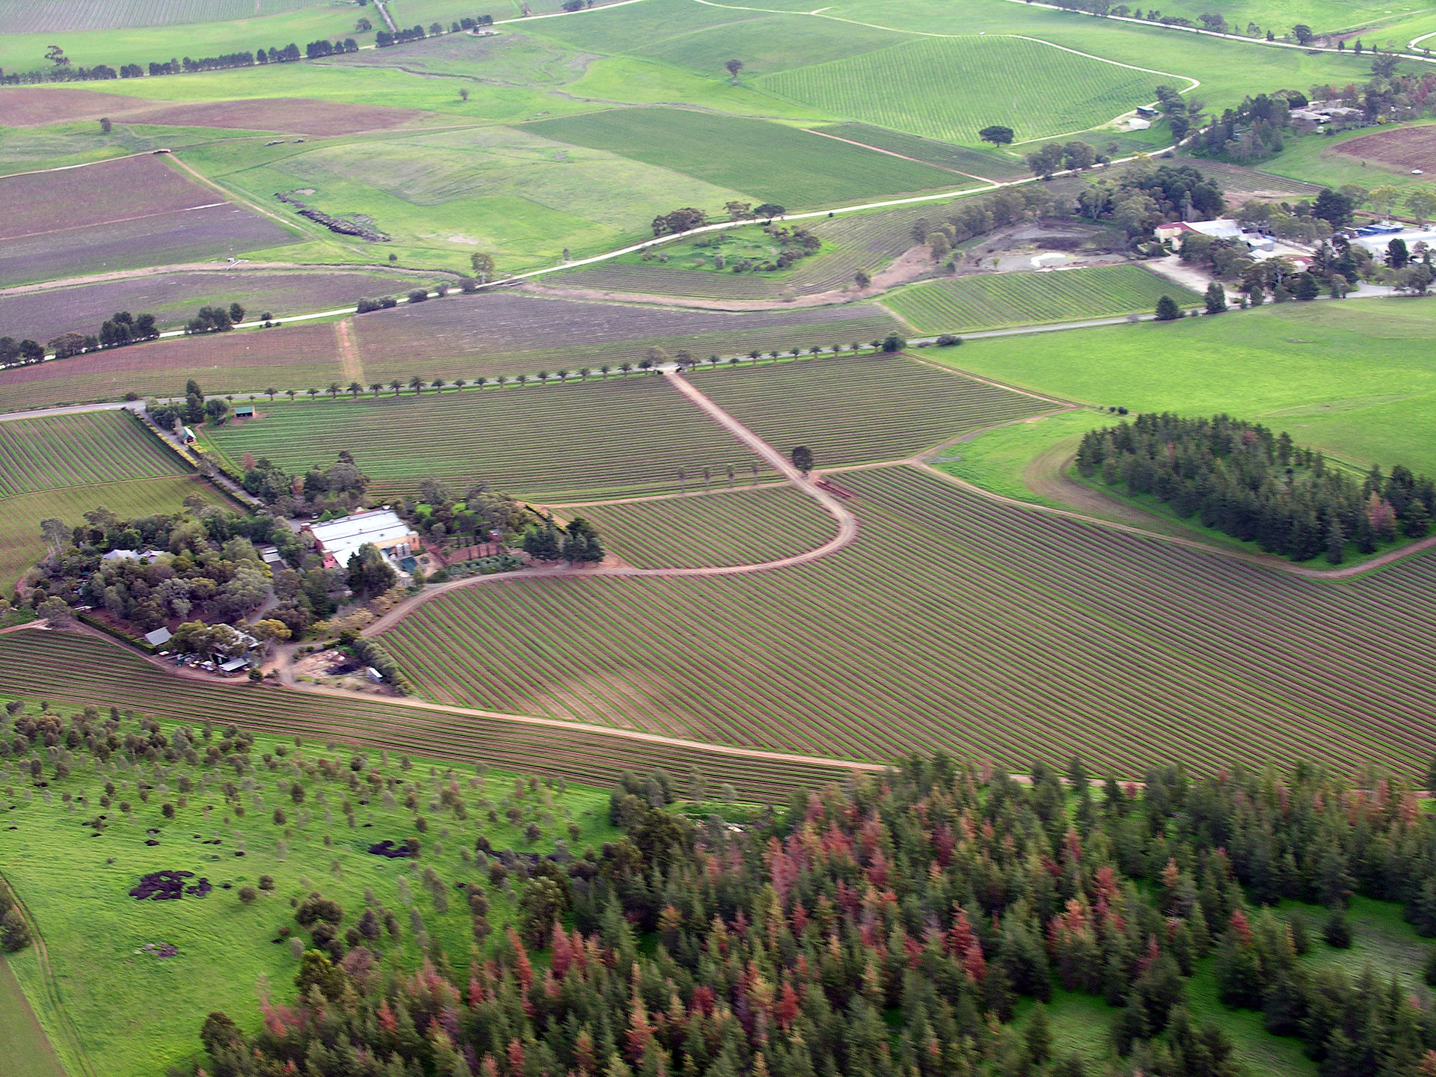
What is Urbanization?
When people move to a location because it has more resources such as jobs, housing, goods, culture, education,and ideas, this location may grow in population.
Rural to Urban
This Photo by Unknown Author is licensed under CC BY-SA.
This Photo by Unknown Author is licensed under CC BY-SA.

Slide 9
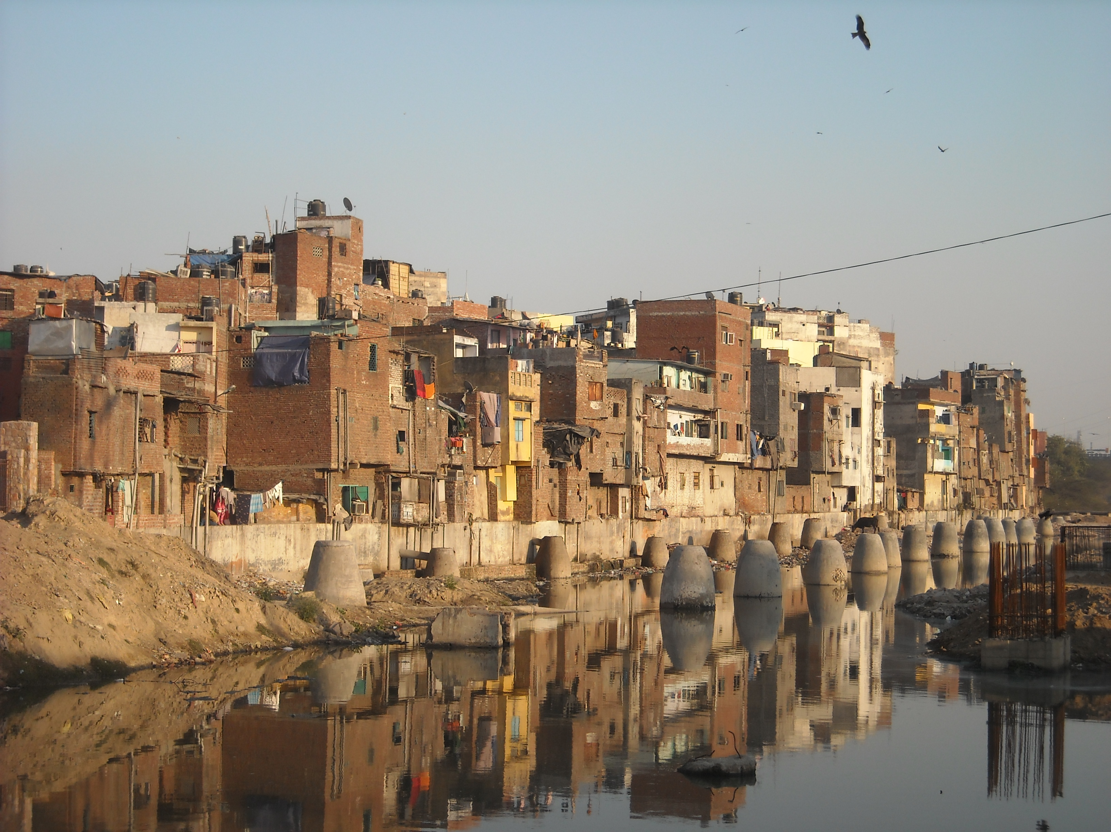
What are the effects of rapid urbanization?
Jigsaw Reading
With your group, write one statement about the effects of urbanization on major cities in India.
Rural to Urban
This Photo by Unknown Author is licensed under CC BY-SA
This Photo by Unknown Author is licensed under CC BY-SA

Slide 10
Evaluation
Write a short, two-minute paper in response to one of these questions:
What motivates people to move from place to place?
How do push and pull factors influence human settlements?
Notes:
Explain that the human settlements can be the urban areas of India

