Slide 2
Why Are Books Written?
Exploring Creativity

Slide 3
Essential Questions
Why do authors write books?
How are books written?

Slide 4
Lesson Objectives
To explore some of the reasons books are written
To consider the many shapes, sizes, and kinds of books
To make a book

Slide 5
Why are books written?
To entertain
To record events
To share feelings or inspire

Slide 6
Meet Joshua T. Jones
https://youtu.be/SaOzDmUb-EI

Slide 7
Elbow Partners
Ask the person next to you:
“Why did Joshua T. Jones write
his book?”

Slide 8
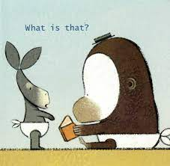
How are books special?
https://www.youtube.com/watch?v=x4BK_2VULCU

Slide 9
How many shapes do books come in?

Slide 10
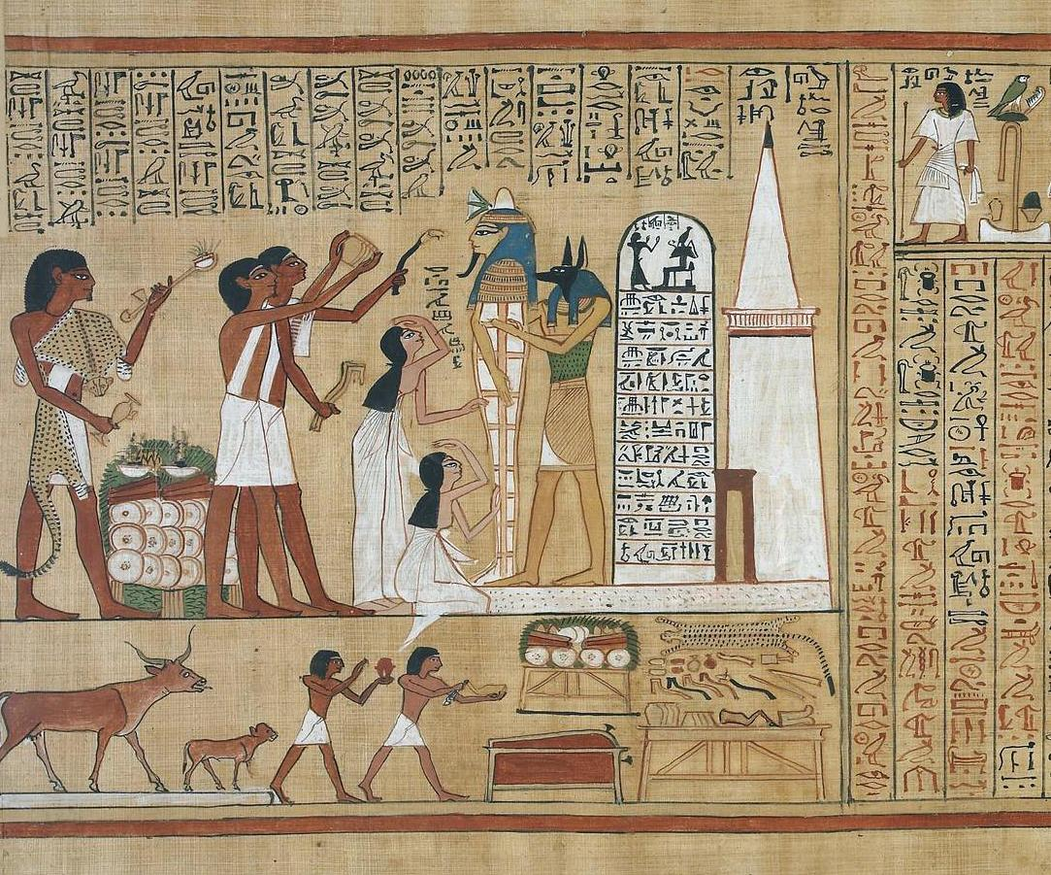
© The Trustees of the British Museum, London

Slide 11
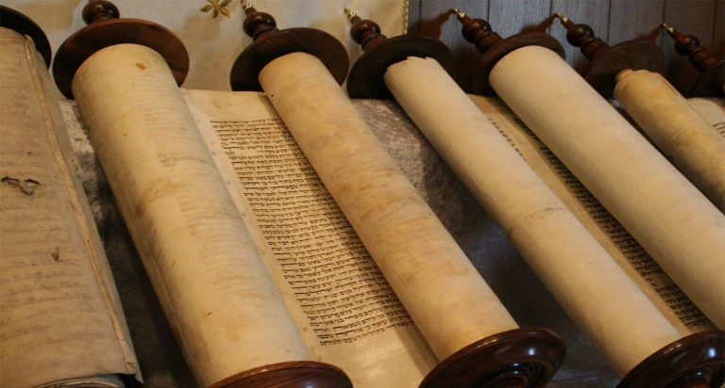
Image courtesy of the Christian Heritage Foundation

Slide 12
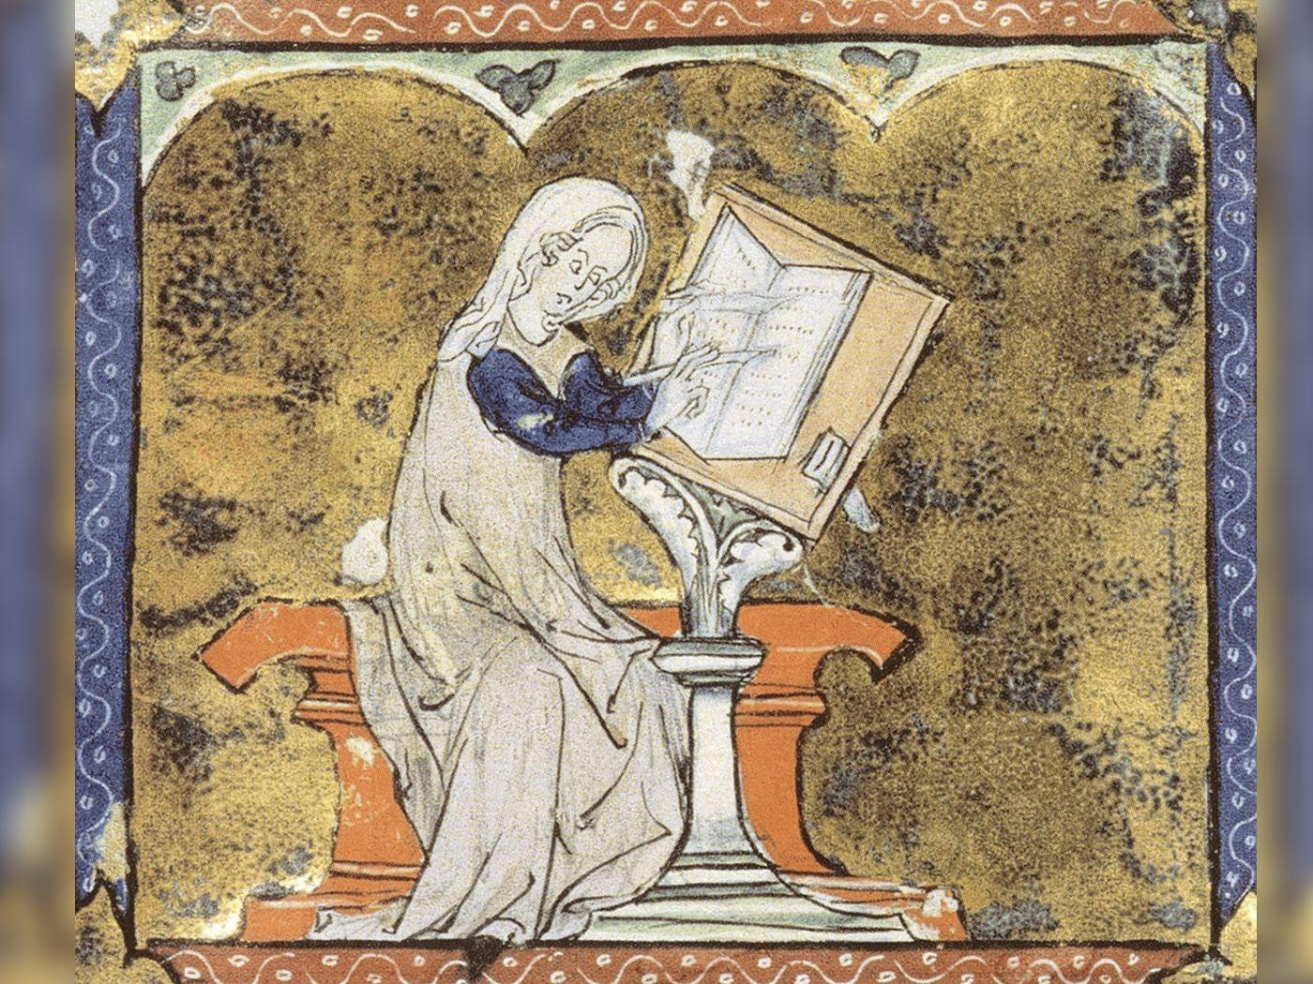
Public domain via Wikimedia Commons

Slide 13
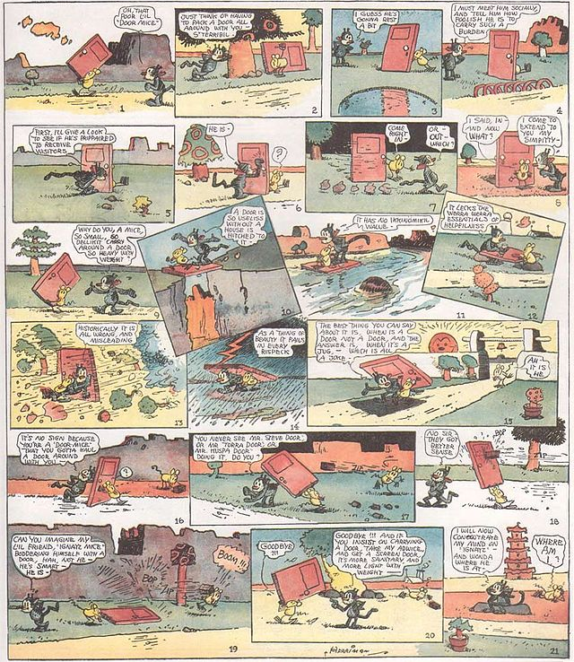
Public domain via Wikimedia Commons

Slide 14
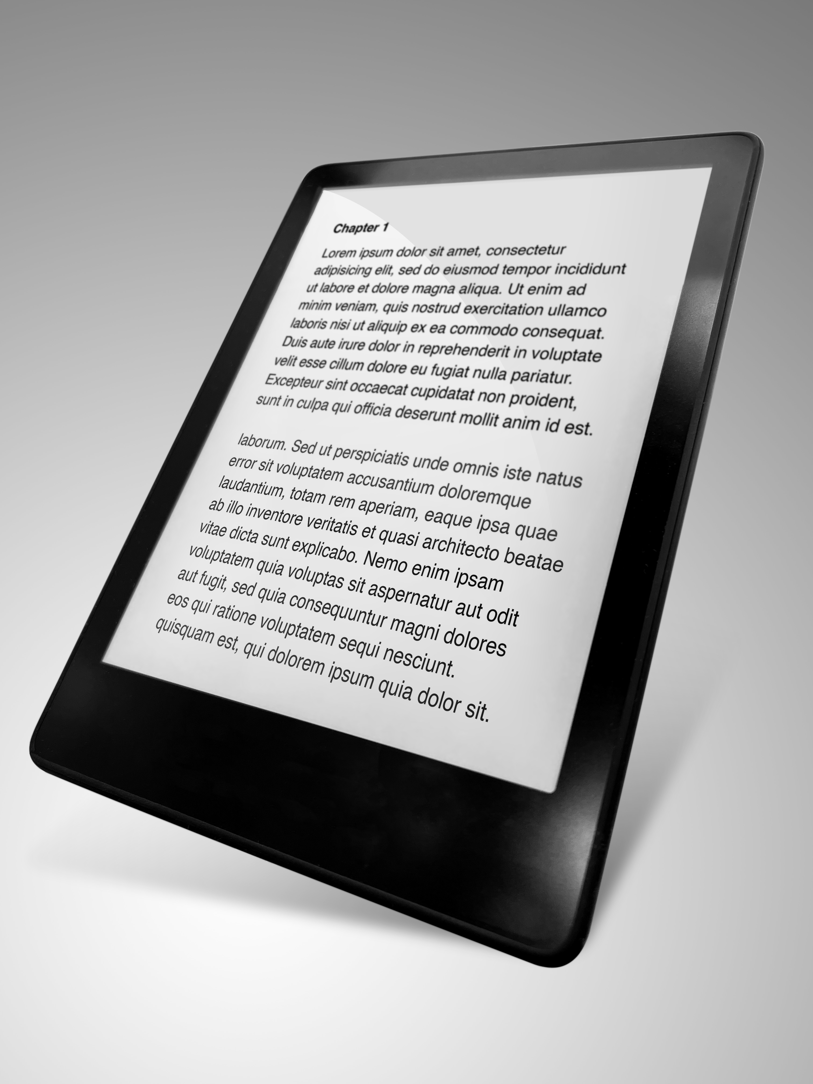
Public domain via Wikimedia Commons

Slide 15
Write Your Own Story
Fill out your Brainstorming Sheet.
Think of words you might use and write them down.
Come up with your story: beginning, middle, and end and write them down.

Slide 16
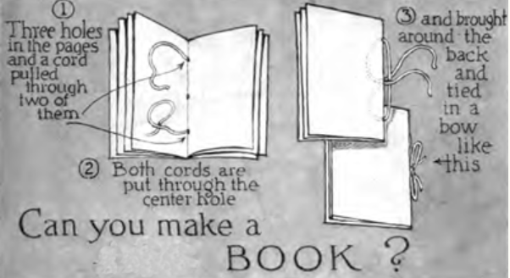
Make Your Own Book
Stack up your pieces of paper.
Make 3 holes in the pages.
Pull cords through 2 of the holes.
Push both of the cords through the center hole.
Tie both ends in the back of the book to make a seam.
OR make a scroll or comic book.*
*Ask your teacher for a 4- or 6-panel
Comics Template.
AHC Arts and Crafts. (2018). Book-making Crafts for Kids. https://www.artistshelpingchildren.org/bookmaking-crafts-make-books.html

Slide 17
Exit Tickets
Answer these questions:
“What are some reasons books are written?”
“Why did you write your book?”

