Slide 2
Keep It Simple
Simplifying Algebraic Expressions

Slide 3
Essential Question
How can we simplify algebraic expressions?

Slide 4
Lesson Objectives
Write equivalent expressions.
Use the associative, commutative, and/or distributive properties to simplify expressions.

Slide 5
Model the Expression
3x + 2y

Slide 6
Model the Expression
–2x + y

Slide 7
Model the Expression
x + 3y

Slide 8
Combining Expressions
(–2x + y) + (x + 3y)

Slide 9
Combining Expressions
(4x + 2y) – (3x + y)

Slide 10
Combining Expressions
(2x – 3y) – (x – 2y)

Slide 11
Combining Expressions
(–3x + 3y) – (–2x + 4y)

Slide 12
Combining Expressions (Algebra Tiles)
(–3x + 3y) – (–2x + 4y)
–x
–x
–x
–x
–x
–x
y
y
y
y
y
y
y
y

Slide 13
Combining Expressions (Algebra Tiles)
–x
–x
zero pair
y
–y
y
y

Slide 14
Combining Expressions (Algebra Tiles)
(–3x + 3y) – (–2x + 4y) = –x + (–y) = –x – y
–x
–x
–y
y
y
–y

Slide 15
Combining Expressions
(–3x + 3y) – (–2x + 4y)
–x + (–y)
–x – y

Slide 16
Equivalent Expressions
(–3x + 3y) – (–2x + 4y)

Slide 17
Equivalent Expressions
(–3x + 3y) – (–2x + 4y)
(–3x + 3y) + (–1)(–2x + 4y)

Slide 18
Simplifying Algebraic Expressions
Use what you have learned to simplify each given expressions.
Be sure to check your work with your partner.

Slide 19
Simplifying Algebraic Expressions (Sample)
Given Expression | Equivalent Expression | Simplified Expression
1) (4x + 5y) + (3x + 8y) | (4x + 3x) + (5y + 8y) | 7x + 13y
2) (5x – 3y) + (2x + 6y) | 5x + 2x – 3y + 6y | 7x + 3y
3) (x + 7y) – (3x + 2y) | x –3x + 7y – 2y | –2x + 5y
4) (4x – 5y) + (–8x + 5y) | 4x –8x – 5y + 5y | –4x
5) 4x + (3x – 7y) | (4x + 3x) – 7y | 7x – 7y
6) (12x – 3y) + (–8x + 7y) | (12x – 8x) + (–3y + 7y) | 4x + 4y
7) –(4x – 5y) – (3x + 2y) | –4x + 5y – 3x – 2y | –7x + 3y

Slide 20
Simplifying Algebraic Expressions (#3)
(x + 7y) – (3x + 2y)
x + 7y – 3x – 2y
–2x + 5y

Slide 21
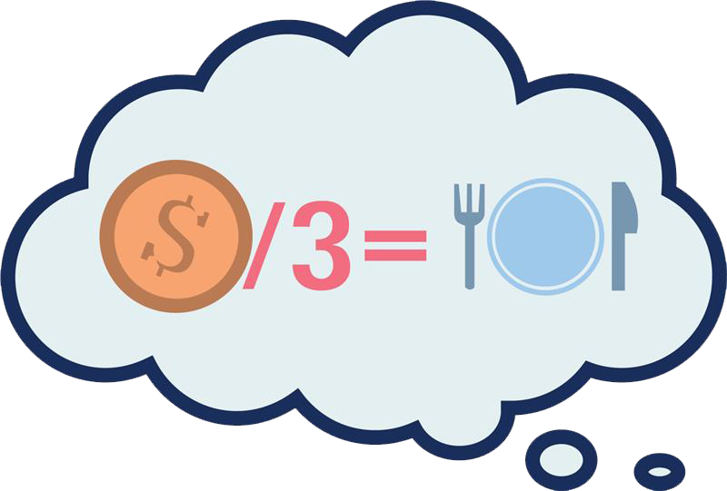
Create the Problem
You’ve been given 5 answers but
were not given the questions.
The directions asked you to
“simplify each expression.” Pick three of the
five answers and then write a question for each one.
You must select at least one that uses the distributive property (questions #4 and #5).
Notes:
K20 Center. (n.d.). Create the problem. Strategies. https://learn.k20center.ou.edu/strategy/149

Slide 22
Create the Problem
Trade papers.
Check your friend’s work.
Notes:
K20 Center. (n.d.). Create the problem. Strategies. https://learn.k20center.ou.edu/strategy/149

