Slide 2
Graphing: The Ups and Downs
Graphing Sine and Cosine

Slide 3
Essential Question
Why are the trigonometric functions not considered algebraic functions?

Slide 4
Lesson Objective
Students will discover how to write the equations of transformed sine and cosine graphs.

Slide 5
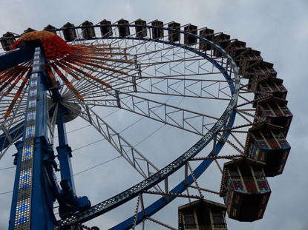
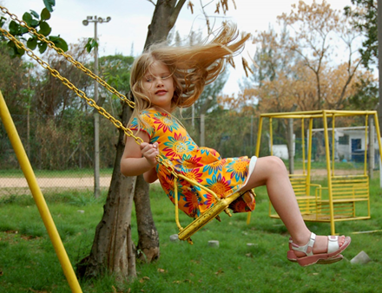
What Do These Pictures Have in Common?
Notes:
Sandstein. (2006). Little girl on swing [Image]. In Wikimedia Commons. https://commons.wikimedia.org/wiki/File:Little_girl_on_swing.jpg
U.S. Climate Data. (2017). Climate Oklahoma - Oklahoma City [Image]. https://www.usclimatedata.com/climate/oklahoma/united-states/3206
Webneel. (n.d.). Starfish shells beach sand wallpaper [Image]. http://webneel.com/wallpaper/i/6-starfish-seashells-beach-sand-wallpaper/1846/o/9109
Ferris wheel and boy on swing available on Pixabay.com

Slide 6
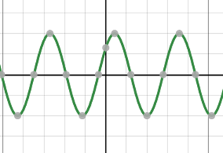
Card Sort
Sort the cards into two different categories.
Justify why you split the cards the way that you did.

Slide 7
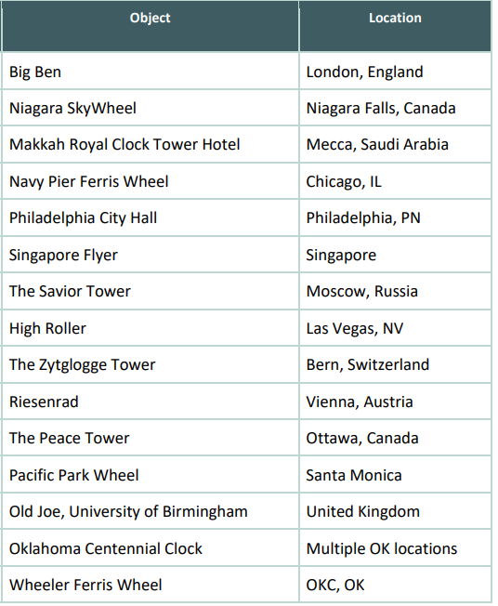
Pick a Landmark
Pick a landmark
Complete the data gathering sheet
Graph height vs. time scatter plot of your data
use graphing checklist on group activity sheet as a guideline
On the graph paper, write three cool facts about their object

Slide 8
Definitions
Amplitude | Period | Midline

Slide 9
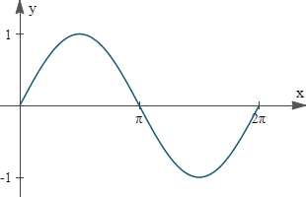
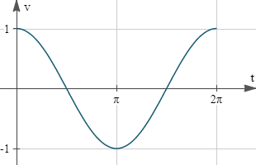
Sine and Cosine Graph
Sine Graph
Cosine Graph
Do you see any similarities to the graph you created?
Try to make an equation of your graph knowing this new knowledge.

Slide 10
Gallery Walk
Place the graph your group created on the wall with a sticky note of the equation next to it
As a group go to your peer’s graph and determine if the equation matches the graph
Place a check mark on sticky note if you feel it is correct
If you feel it is not correct, on a different sticky note write what you believe is the correct equation

Slide 11
Reflection
Go back to your original graph.
Discuss the additions, changes, or corrections to the equation and determine which one best fits their graph.
On a piece of paper, write why their group chose the equation they did.

