Slide 1
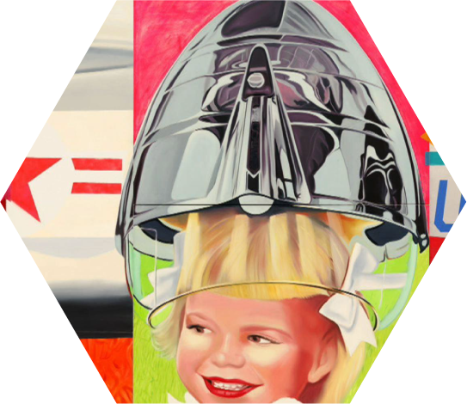
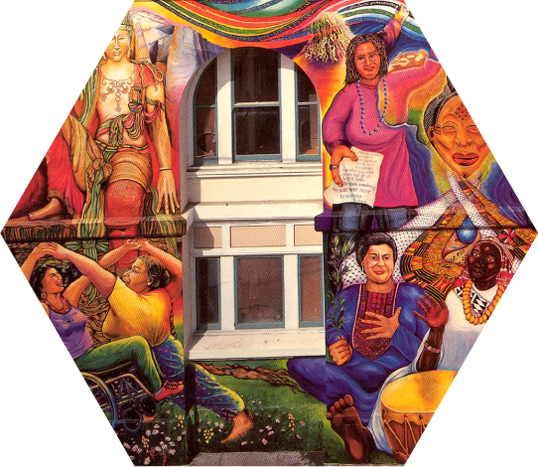
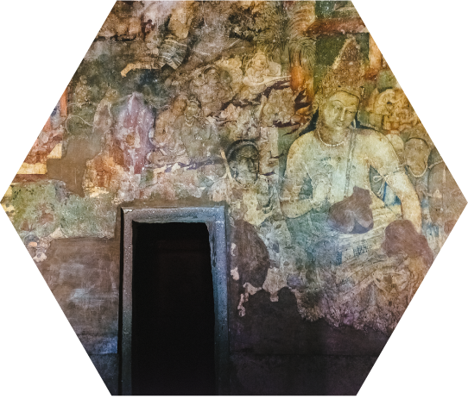
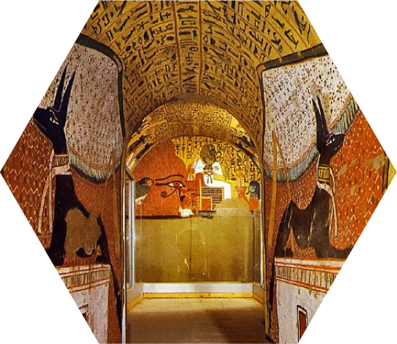
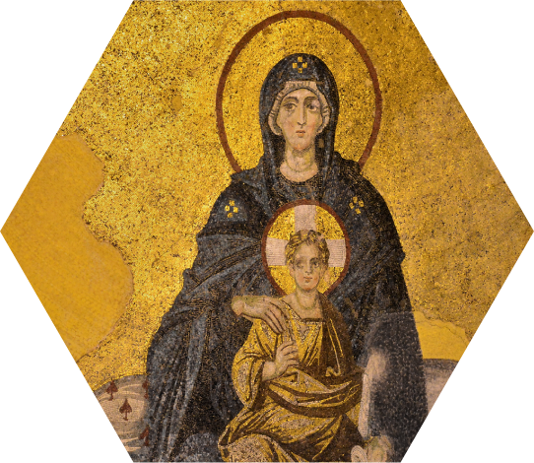
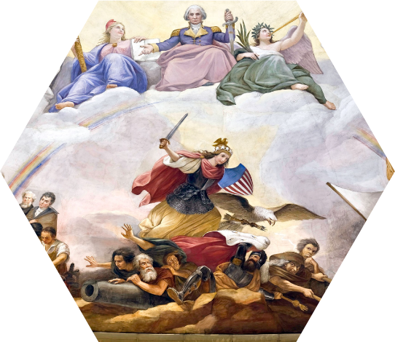
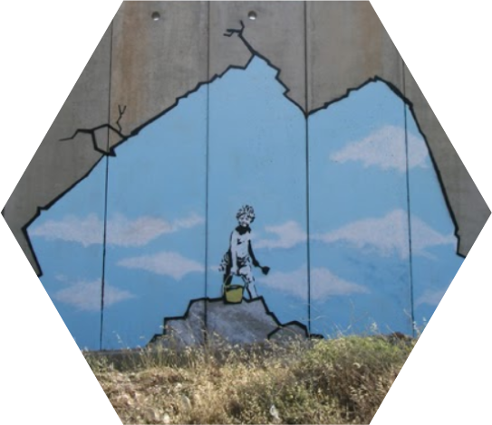
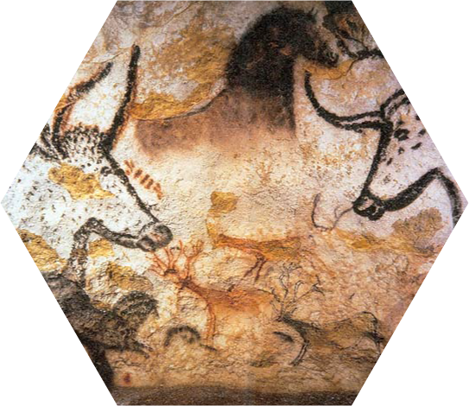
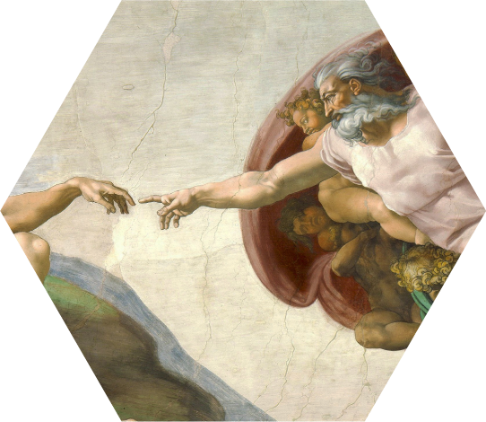
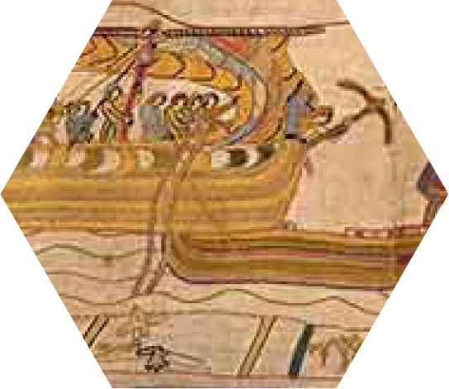
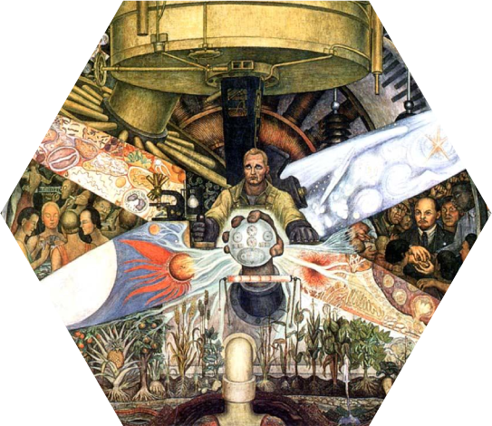
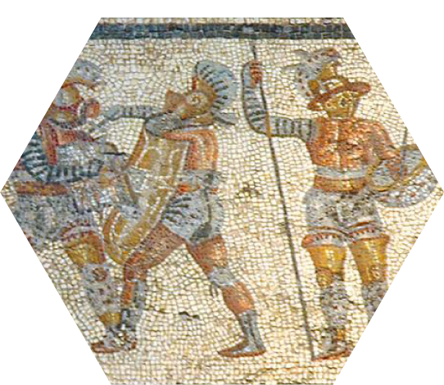
Notes:
Put artworks in chronological order

Slide 2
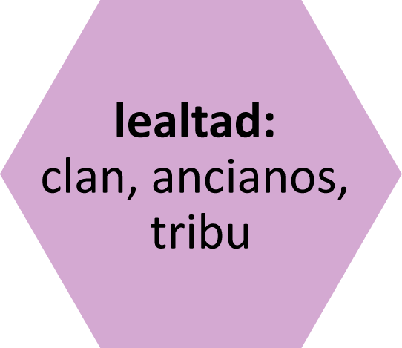
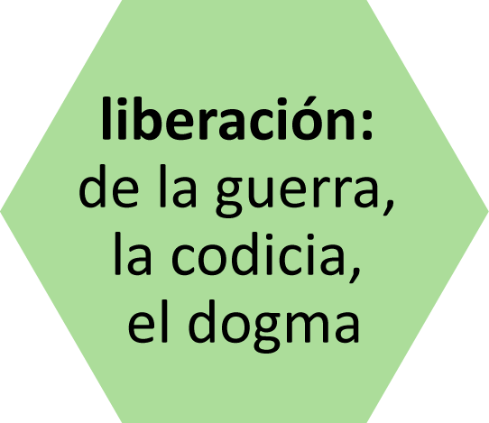
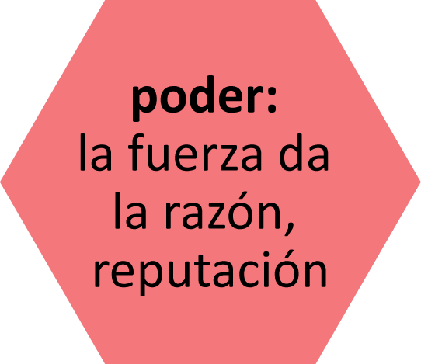
Notes:
Arrange art by shared themes. Click on an artwork to go to a slide with more details about the art.

Slide 3
cuadrícula
mosaico
fresco
plantilla
tapiz
a mano alzada
Notes:
Arrange art by what technique/s you think might have been used

Slide 4
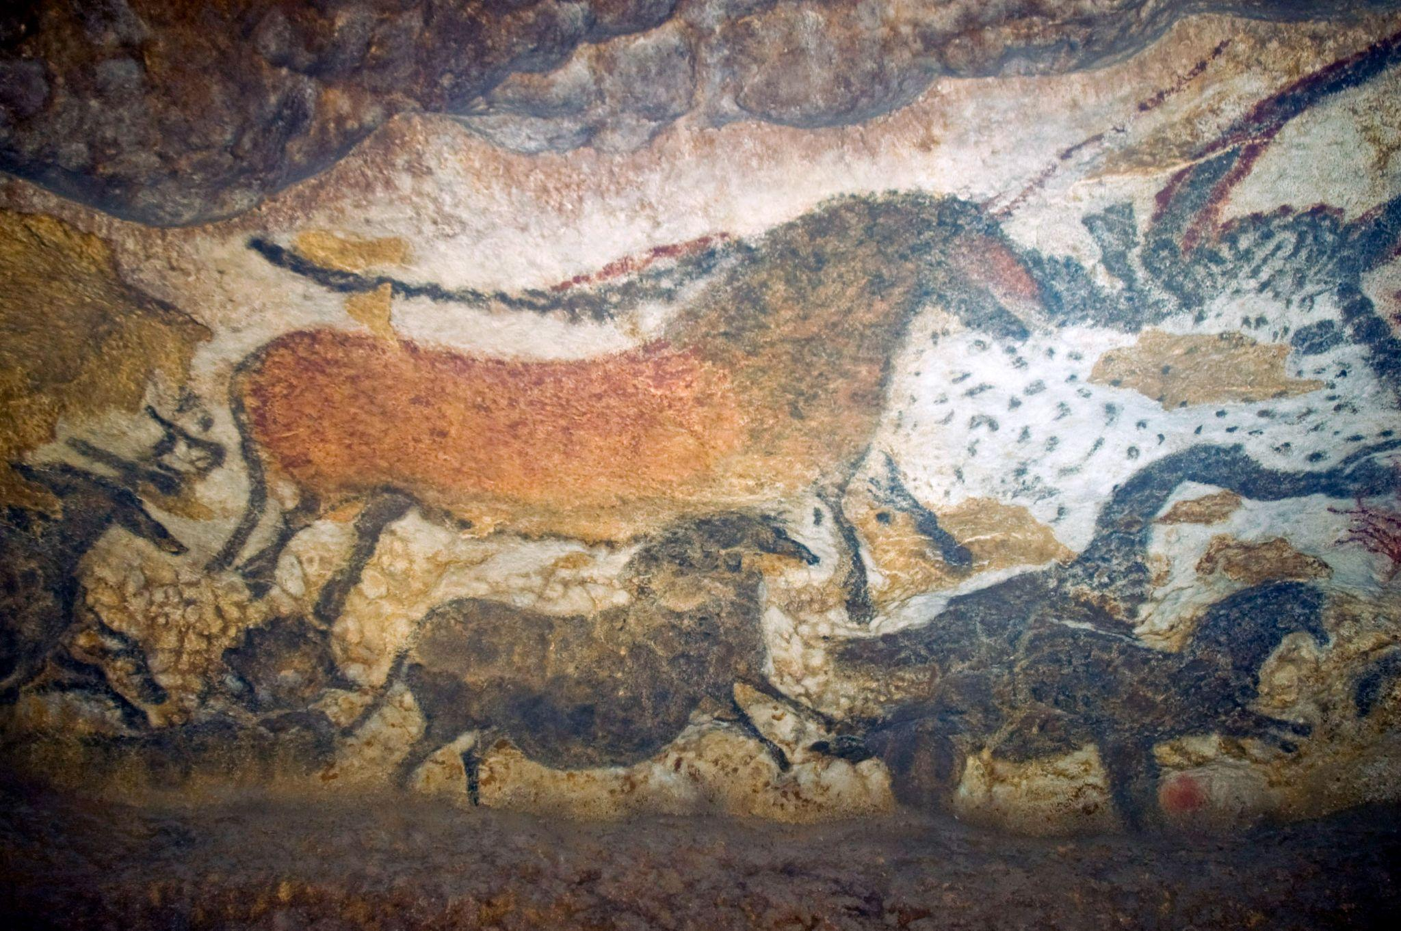
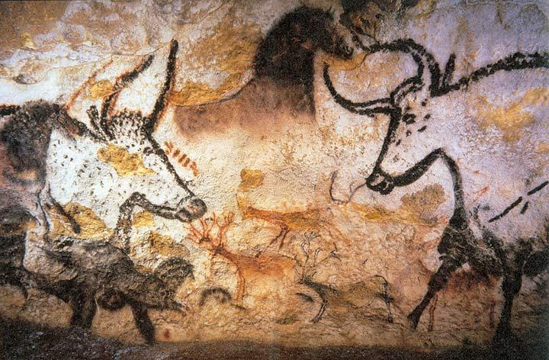
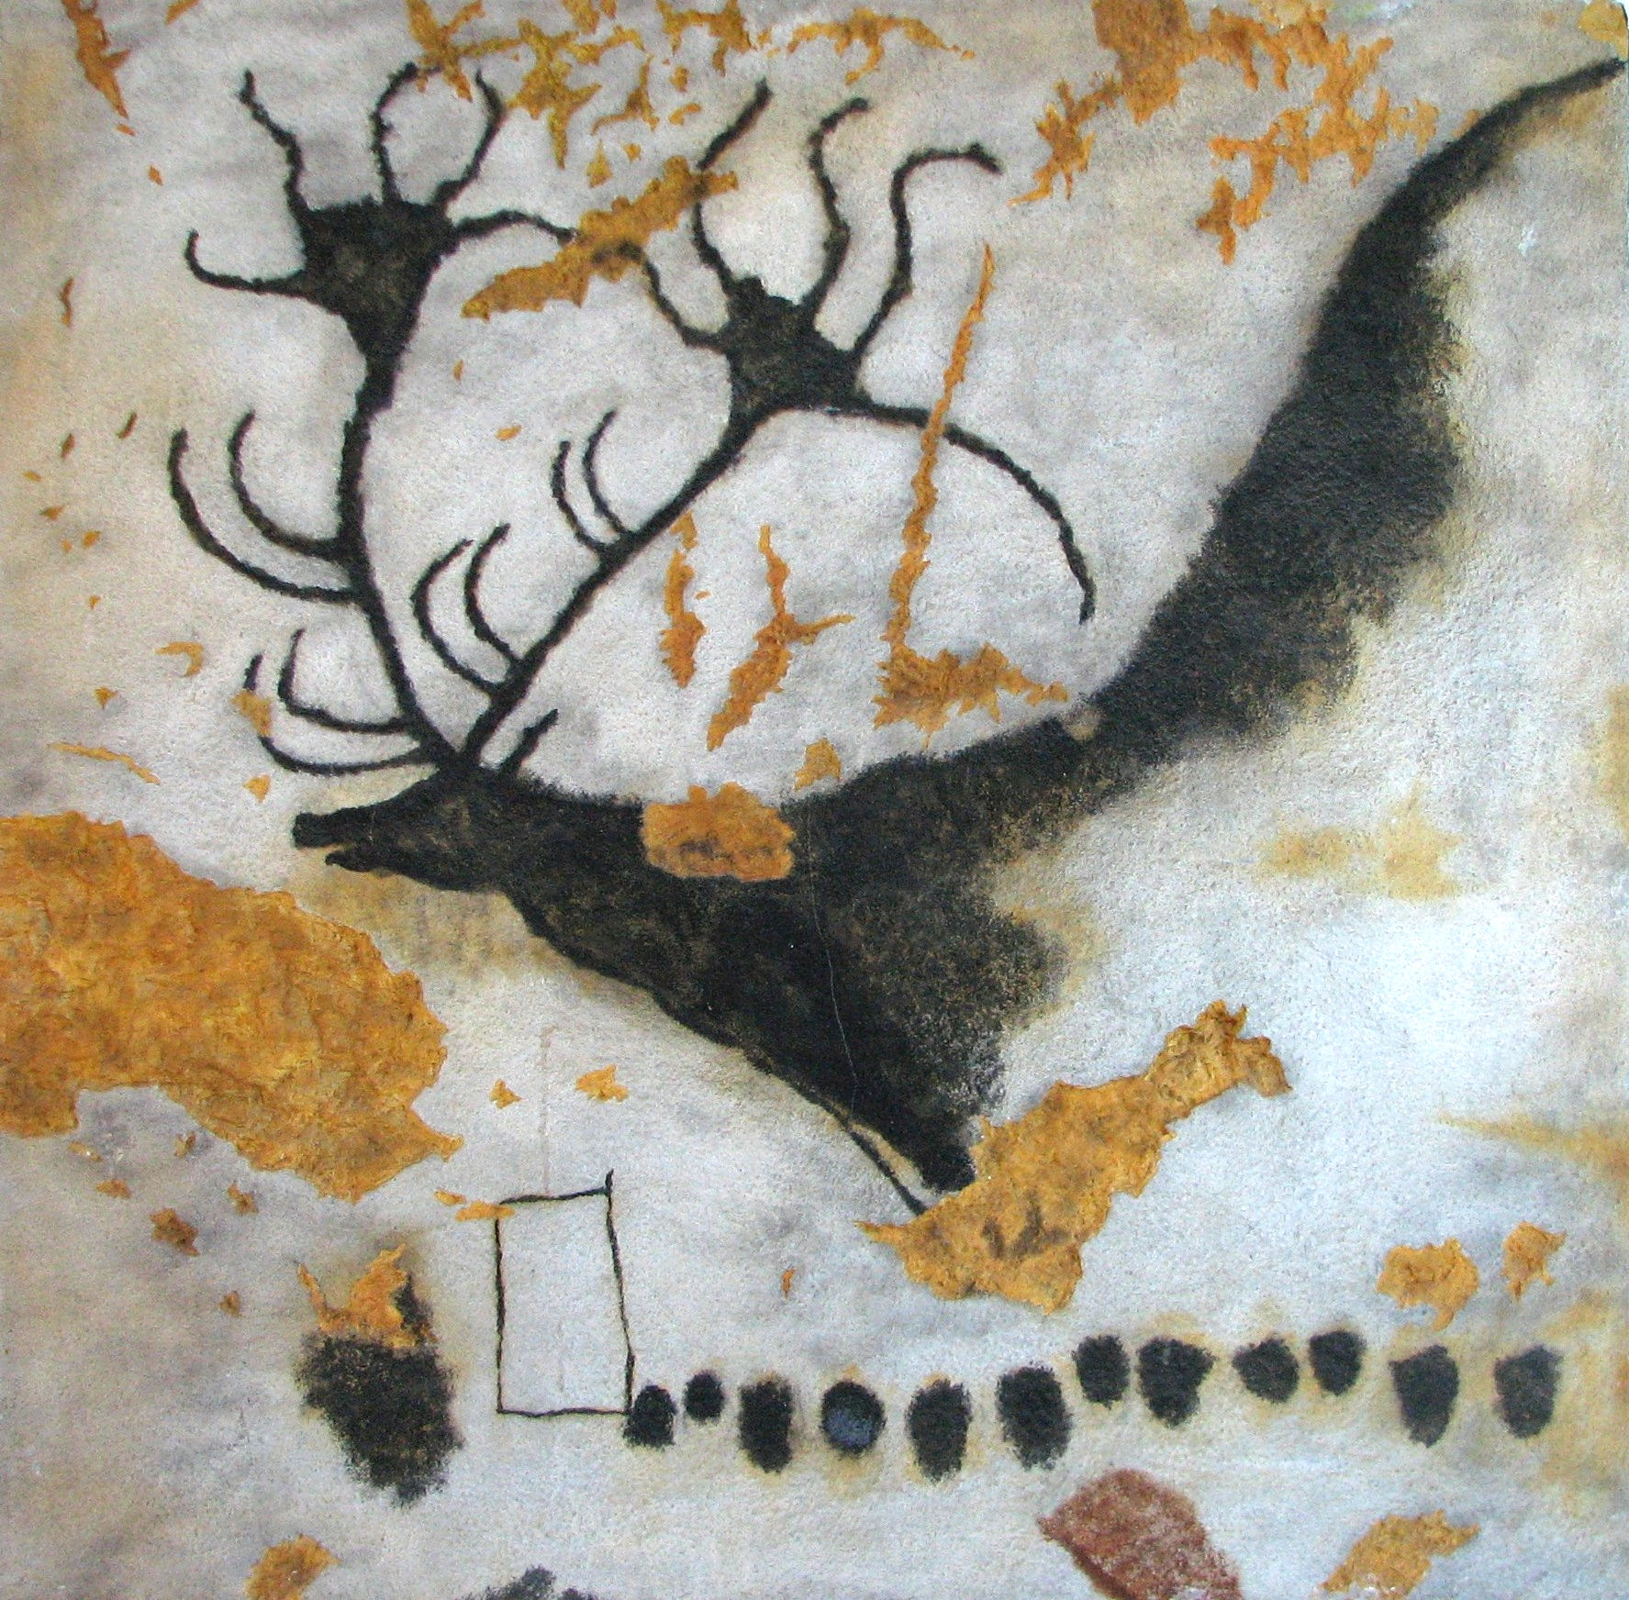
Pinturas rupestres de Lascaux, Francia
c. 17,000 - c. 12,000 antes del presente
Notes:
https://en.wikipedia.org/wiki/Lascaux#/media/File:Lascaux_painting.jpg

Slide 5
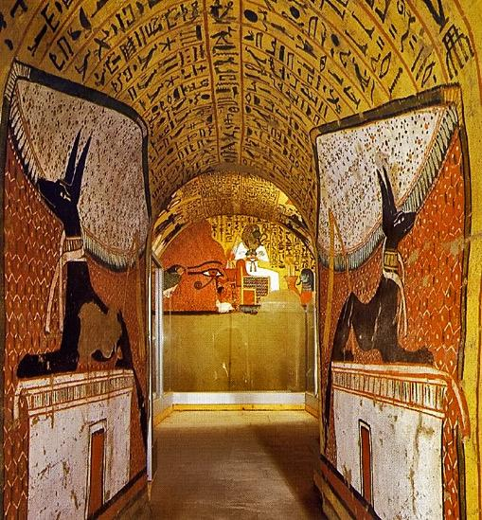
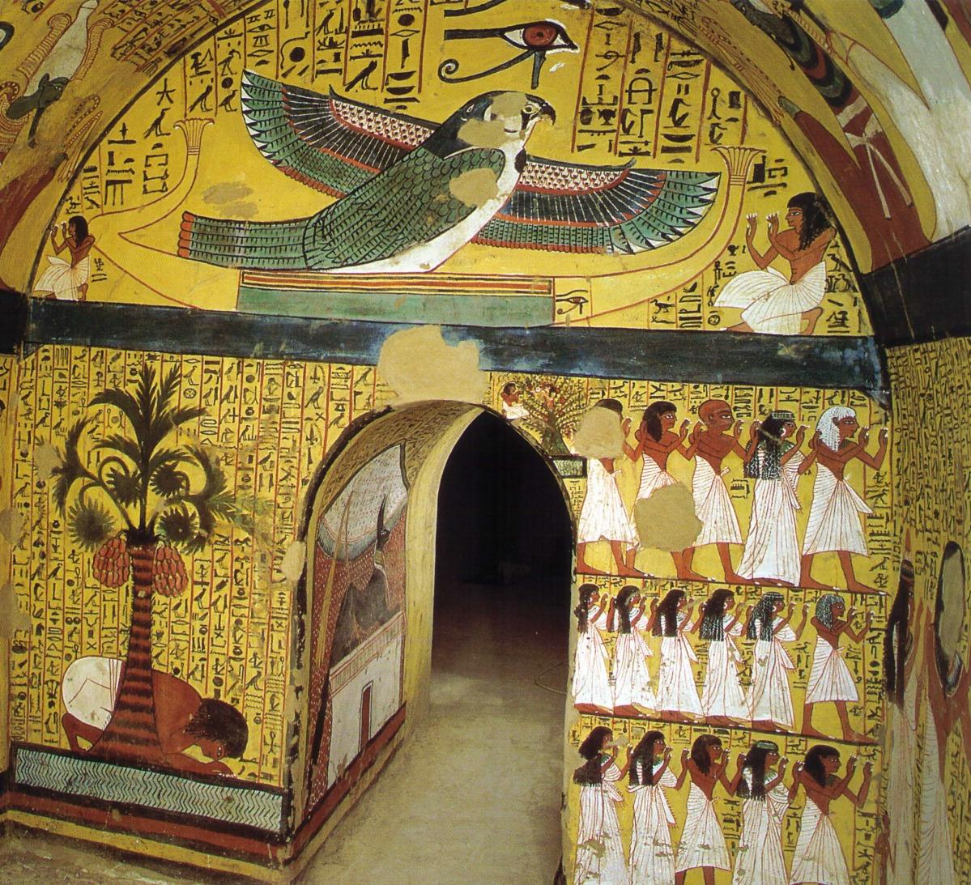
Tumba de Pashedu, Egipto
3150 a. e. c.
Notes:
About: https://www.ask-aladdin.com/all-destinations/egypt/category/egypt-site-guide/page/pashedu
Image credit: https://www.veniceclayartists.com/relief-art-egypt/
Image credit: https://www.reddit.com/r/OutoftheTombs/comments/tw4obf/the_eastern_wall_of_the_burial_chamber_of_the/

Slide 6
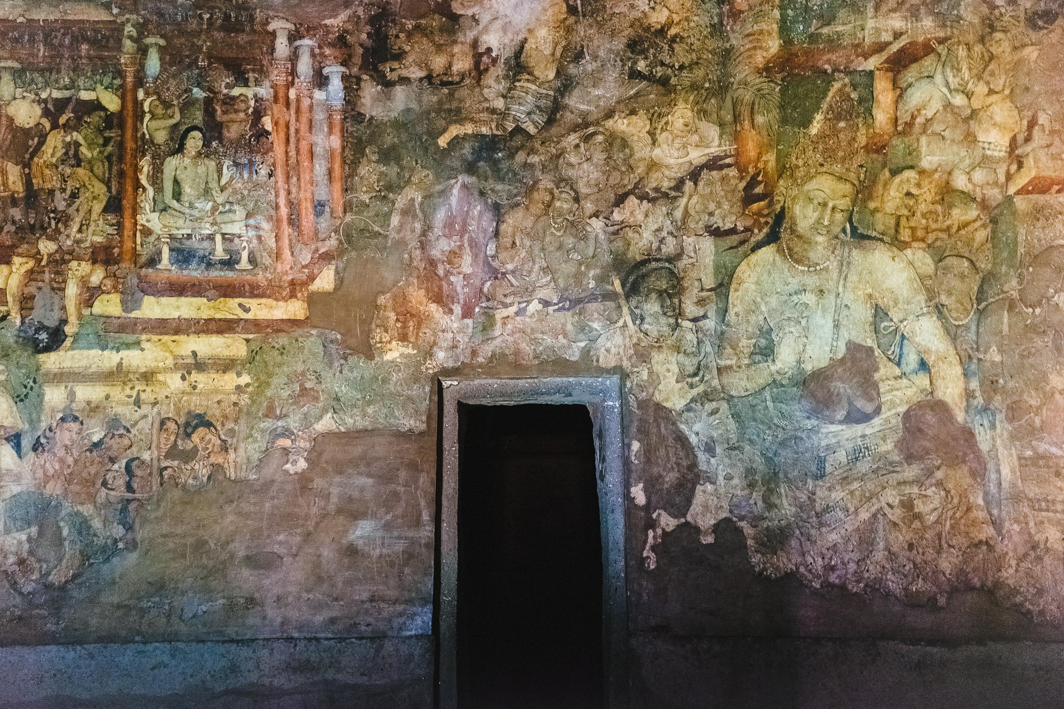
Pinturas de la Cueva de Ellora, India
Siglo II a. e. c.
Notes:
https://en.wikipedia.org/wiki/Ellora_Caves
Image credit: https://www.flickr.com/photos/turndeaux/19612144255

Slide 7
Tapiz de Bayeux
Normandía
Decada de 1070
Notes:
https://historylearning.com/medieval-england/bayeux-tapestry/bayeux-tapestry-scene-by-scene/

Slide 8
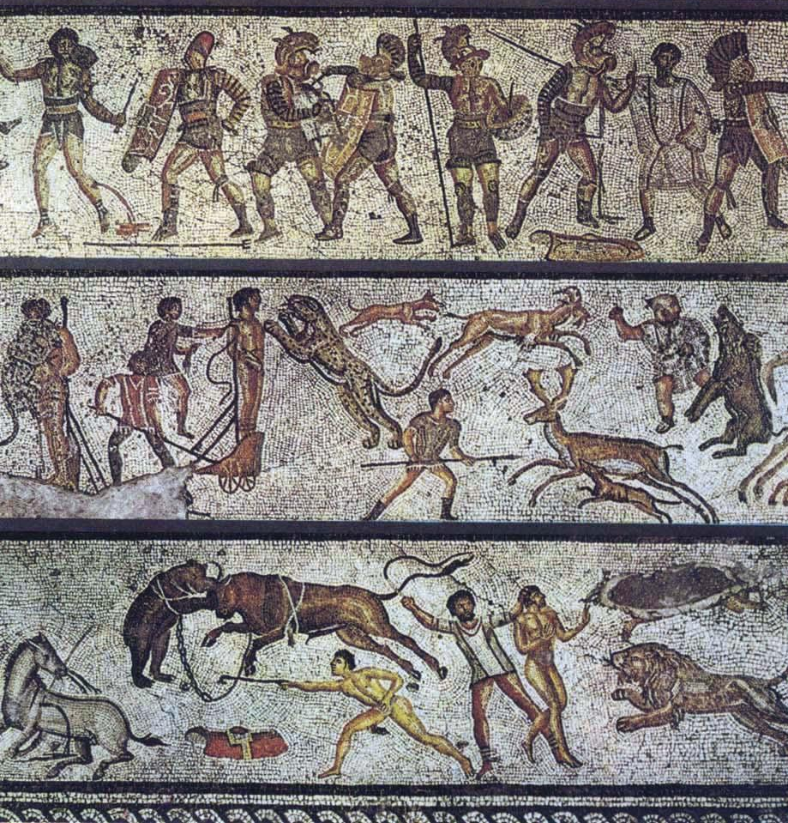
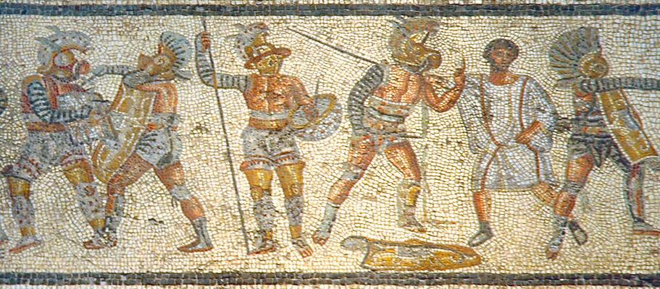
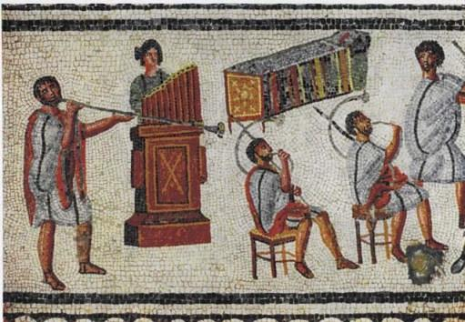
Mosaico de Zilten, Libia
Siglo II a. e. c.
Notes:
https://en.wikipedia.org/wiki/Zliten_mosaic

Slide 9
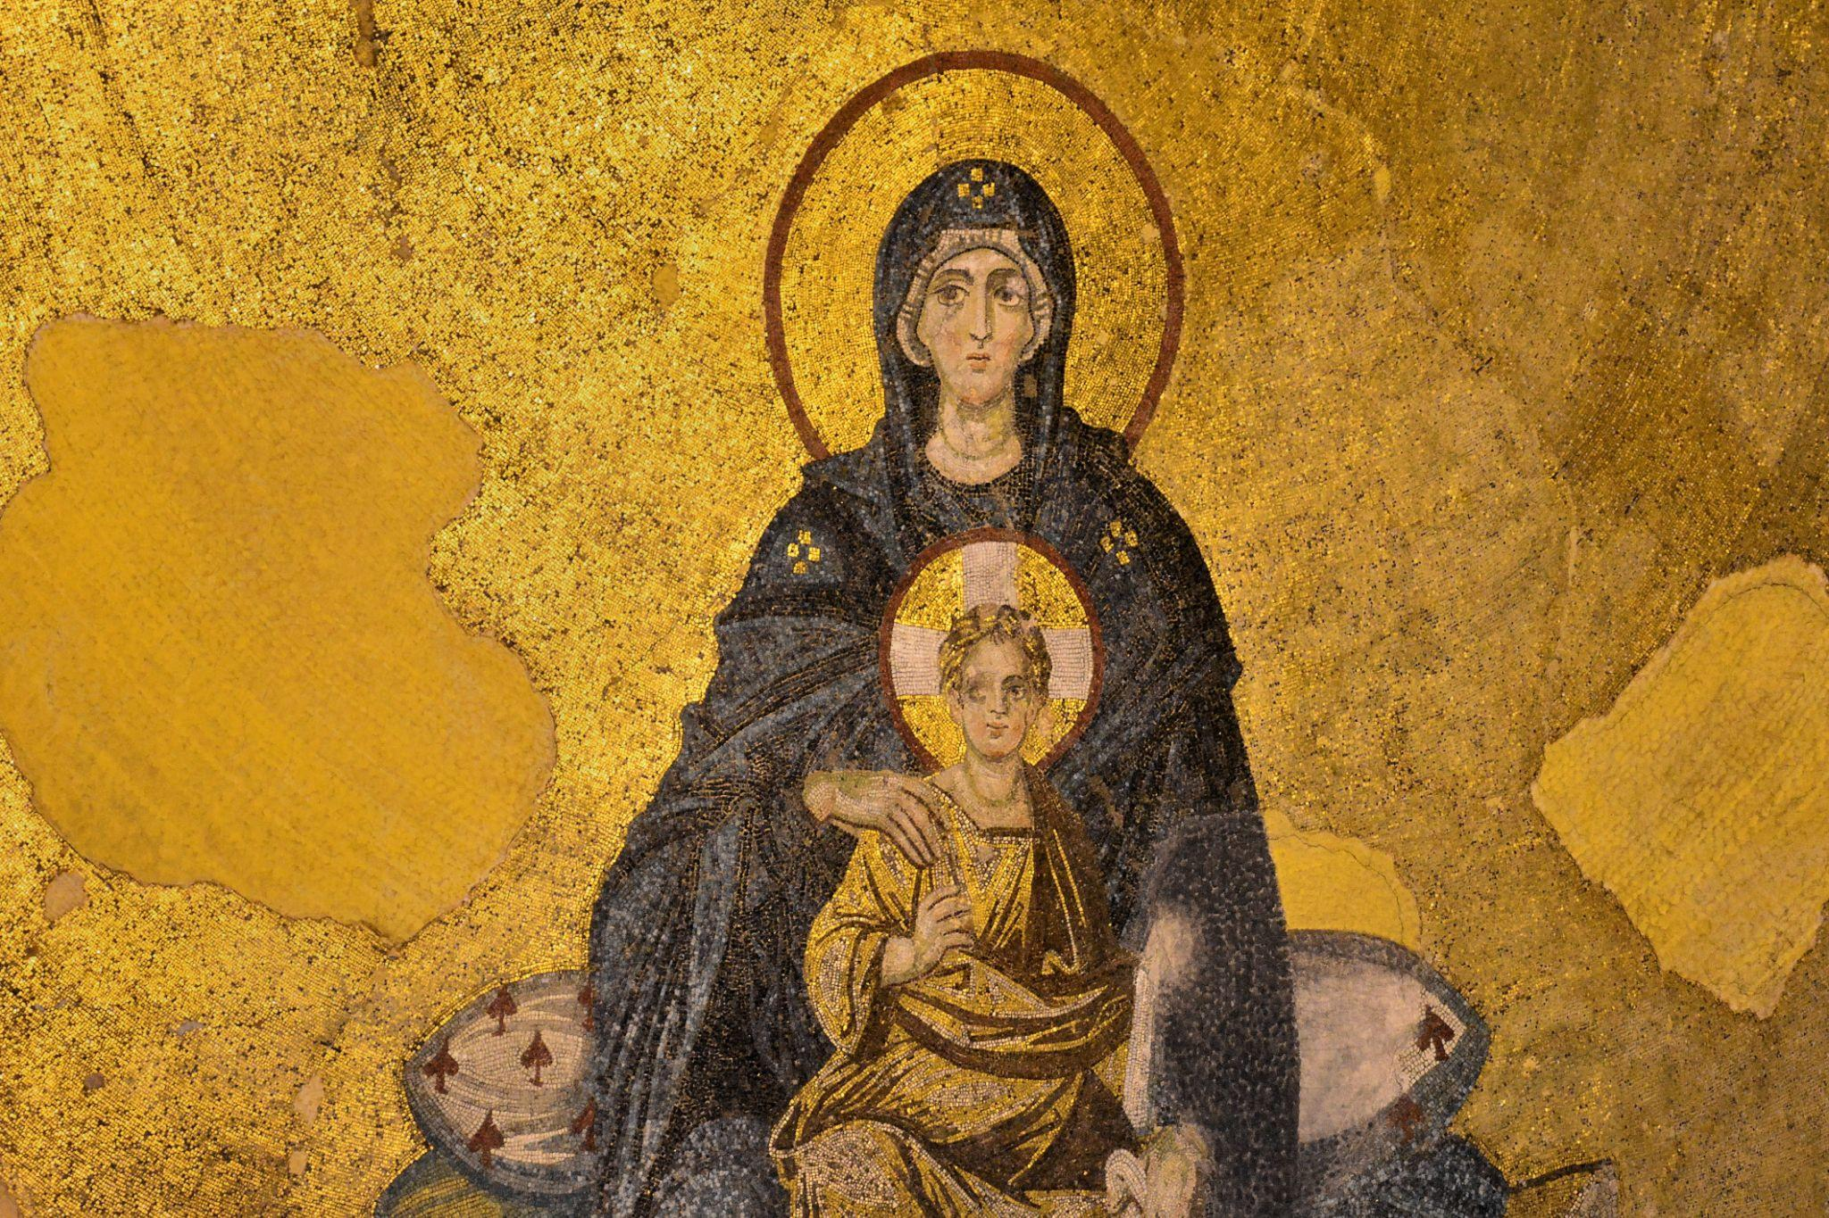
La Virgen con el Niño, Turquía
Siglo IX e. c
Notes:
https://www.pallasweb.com/deesis/virgin-and-child-hagia-sophia.html
Team, H. S. R. (2018, January 24). The Virgin and Child Mosaic, Hagia Sophia. World History Encyclopedia. Retrieved from https://www.worldhistory.org/image/7973/the-virgin-and-child-mosaic-hagia-sophia/

Slide 10
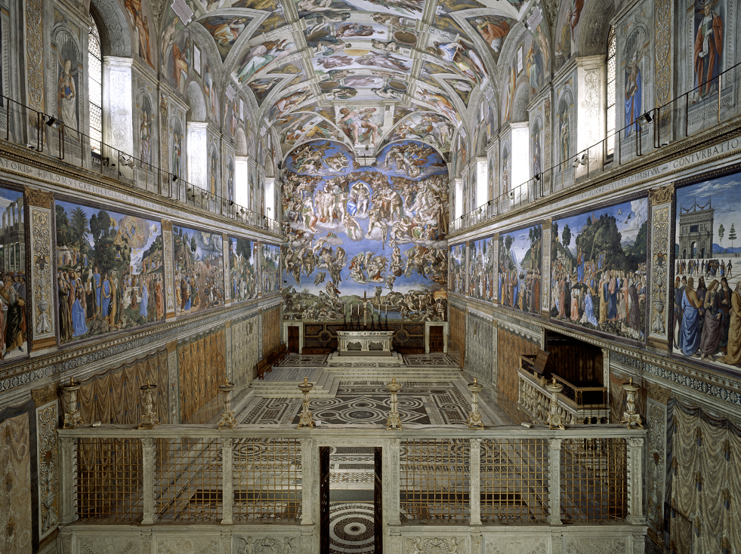
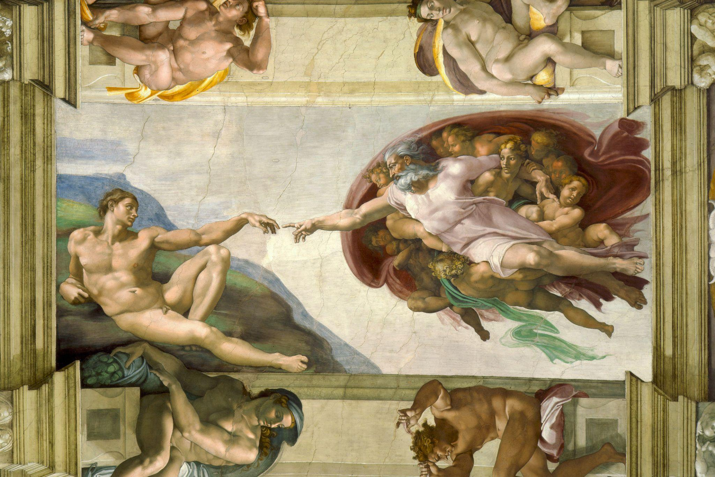
Capilla Sixtina, Vaticano
Miguel Ángel
1508-1512
Notes:
https://m.museivaticani.va/content/museivaticani-mobile/en/collezioni/musei/cappella-sistina/storia-cappella-sistina.html
https://en.wikipedia.org/wiki/Sistine_Chapel_ceiling

Slide 11
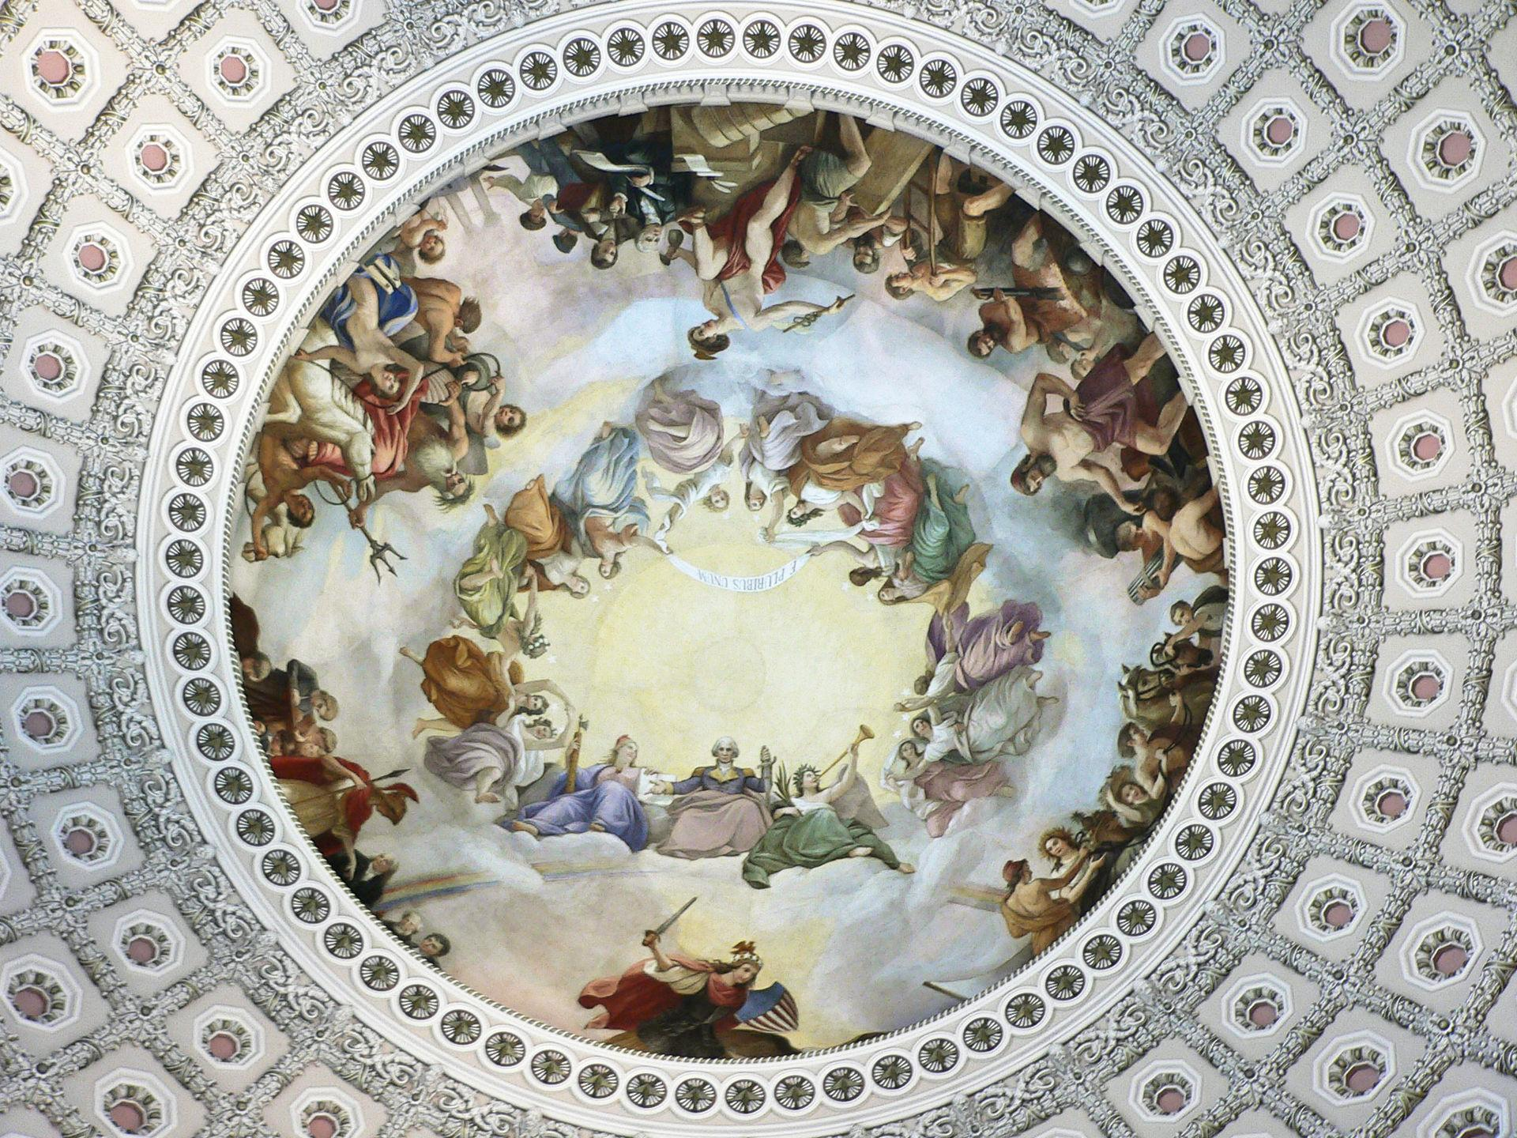
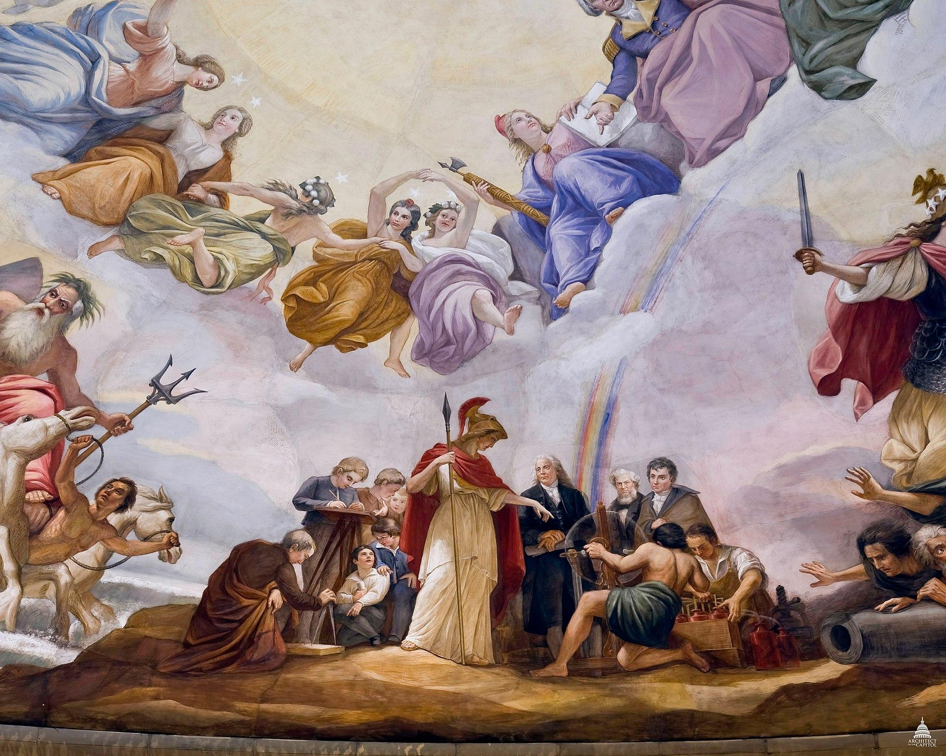
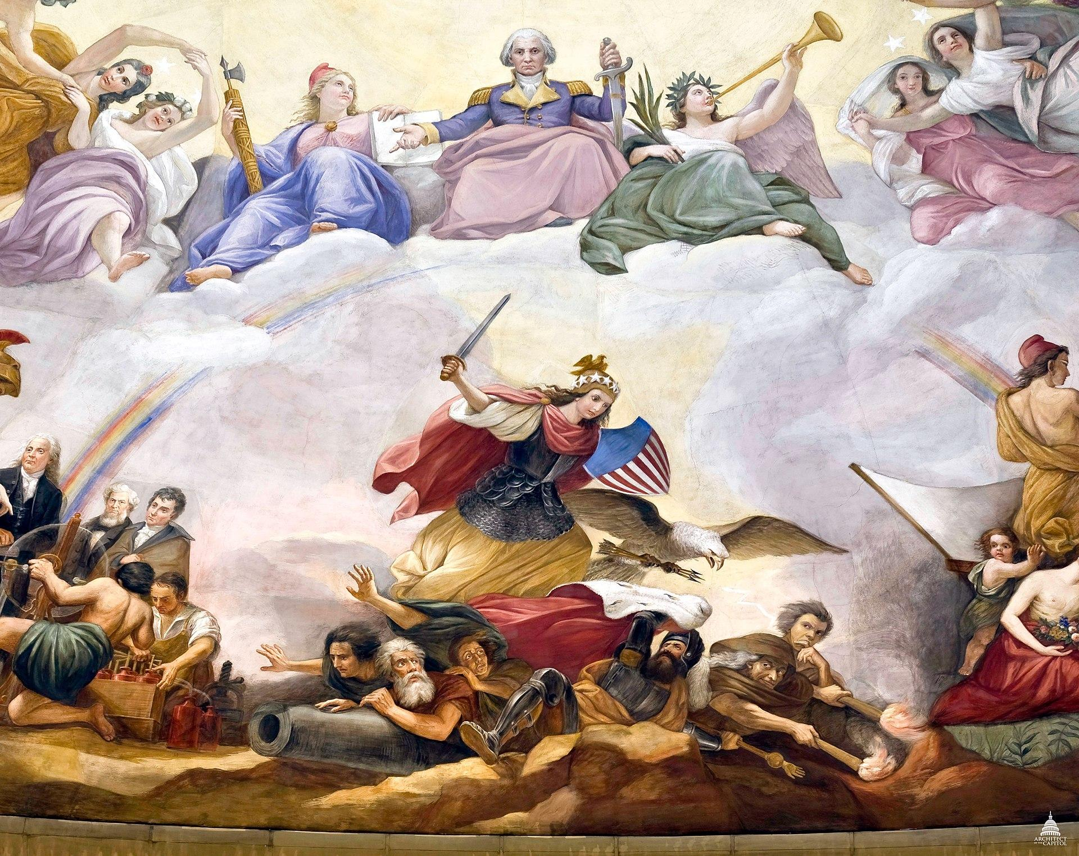
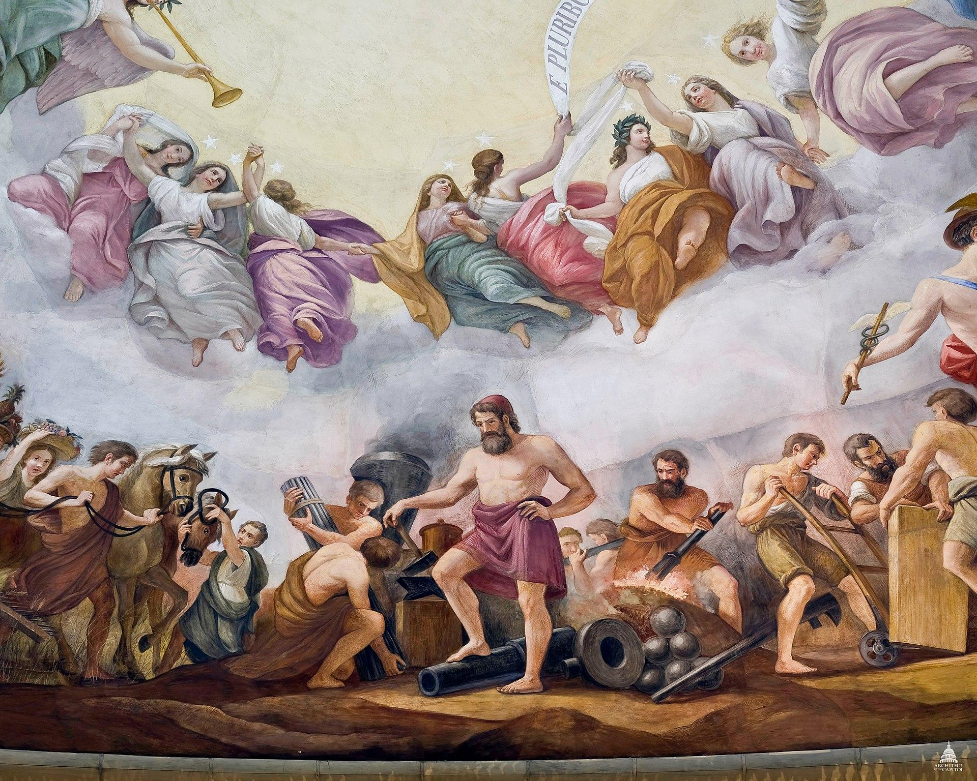
La Apoteosis de Washington, Capitolio de EE. UU
Constantino Brumidi
1865
Notes:
https://en.wikipedia.org/wiki/The_Apotheosis_of_Washington

Slide 12
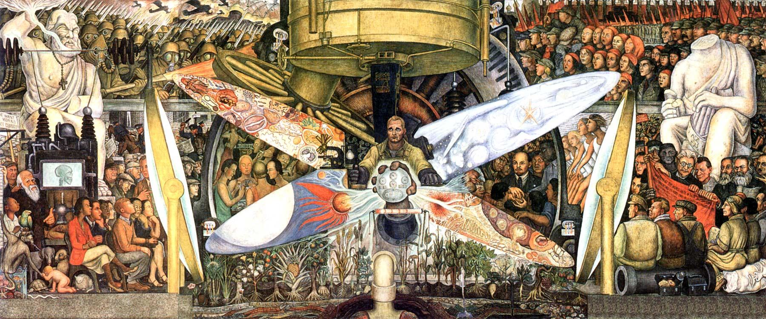
Hombre en la encrucijada, Nueva York
Diego Rivera
1933
Notes:
https://en.wikipedia.org/wiki/Man_at_the_Crossroads

Slide 13
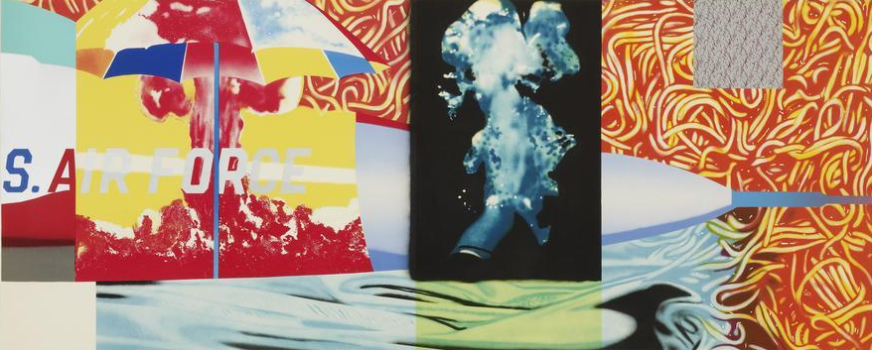
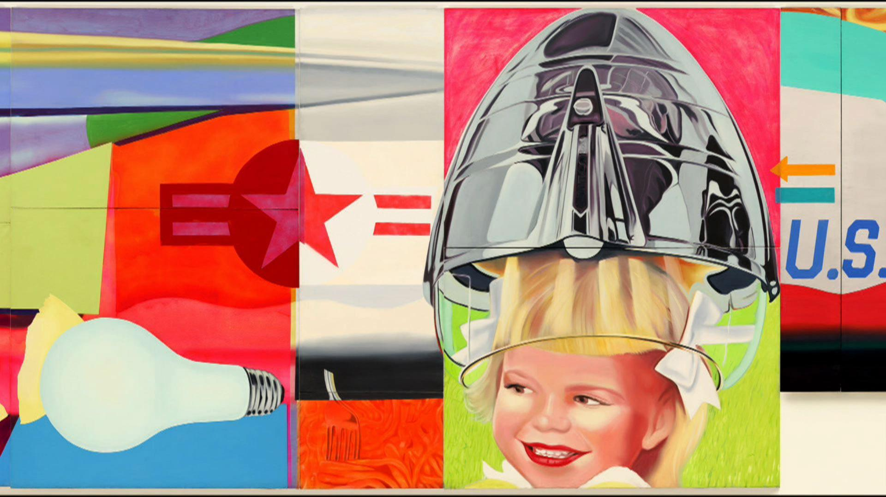
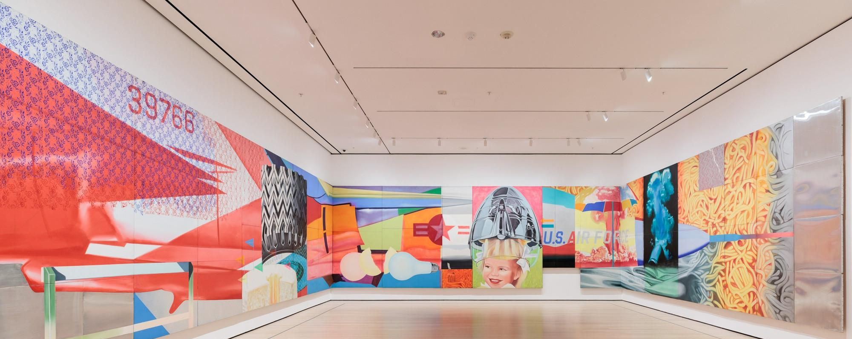
F-111, MoMA
James Rosenquist
1974
Notes:
https://www.moma.org/calendar/galleries/5512

Slide 14
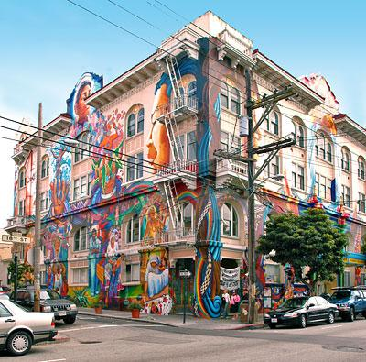
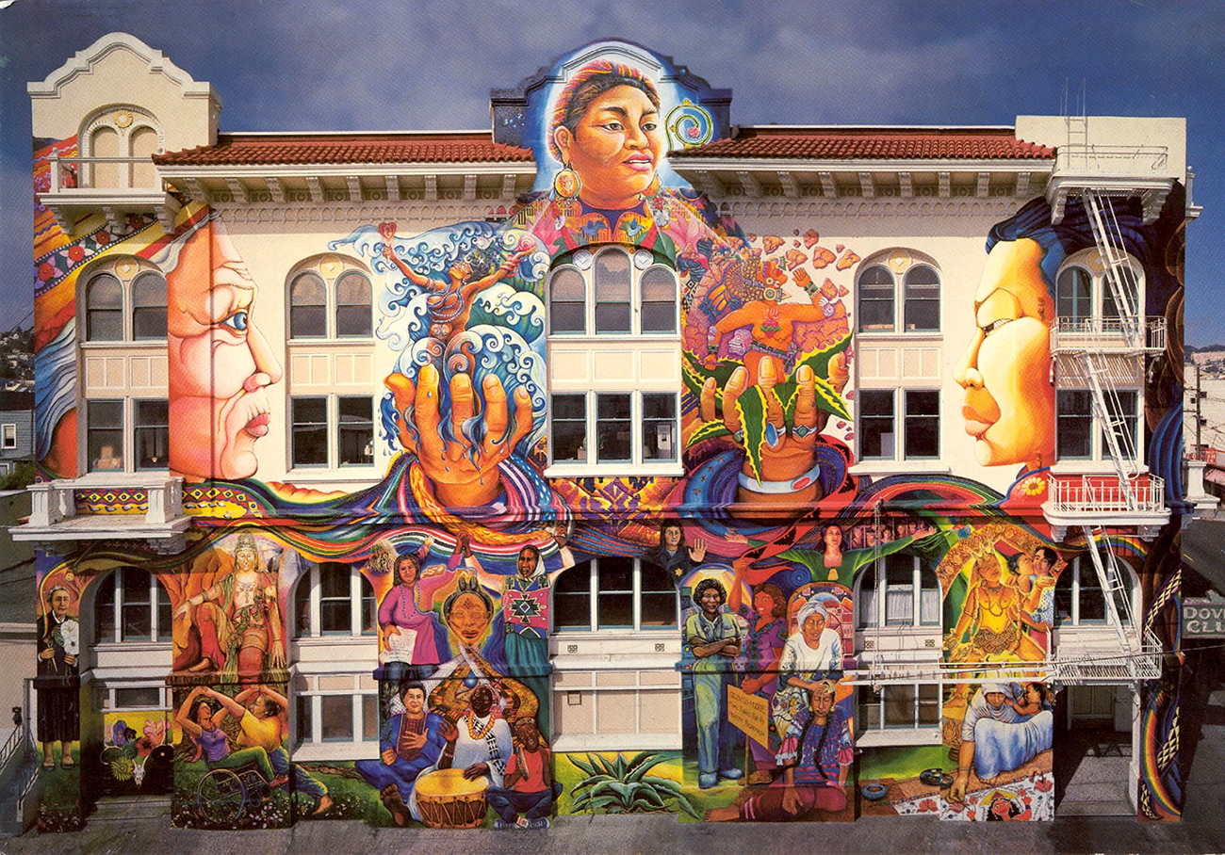
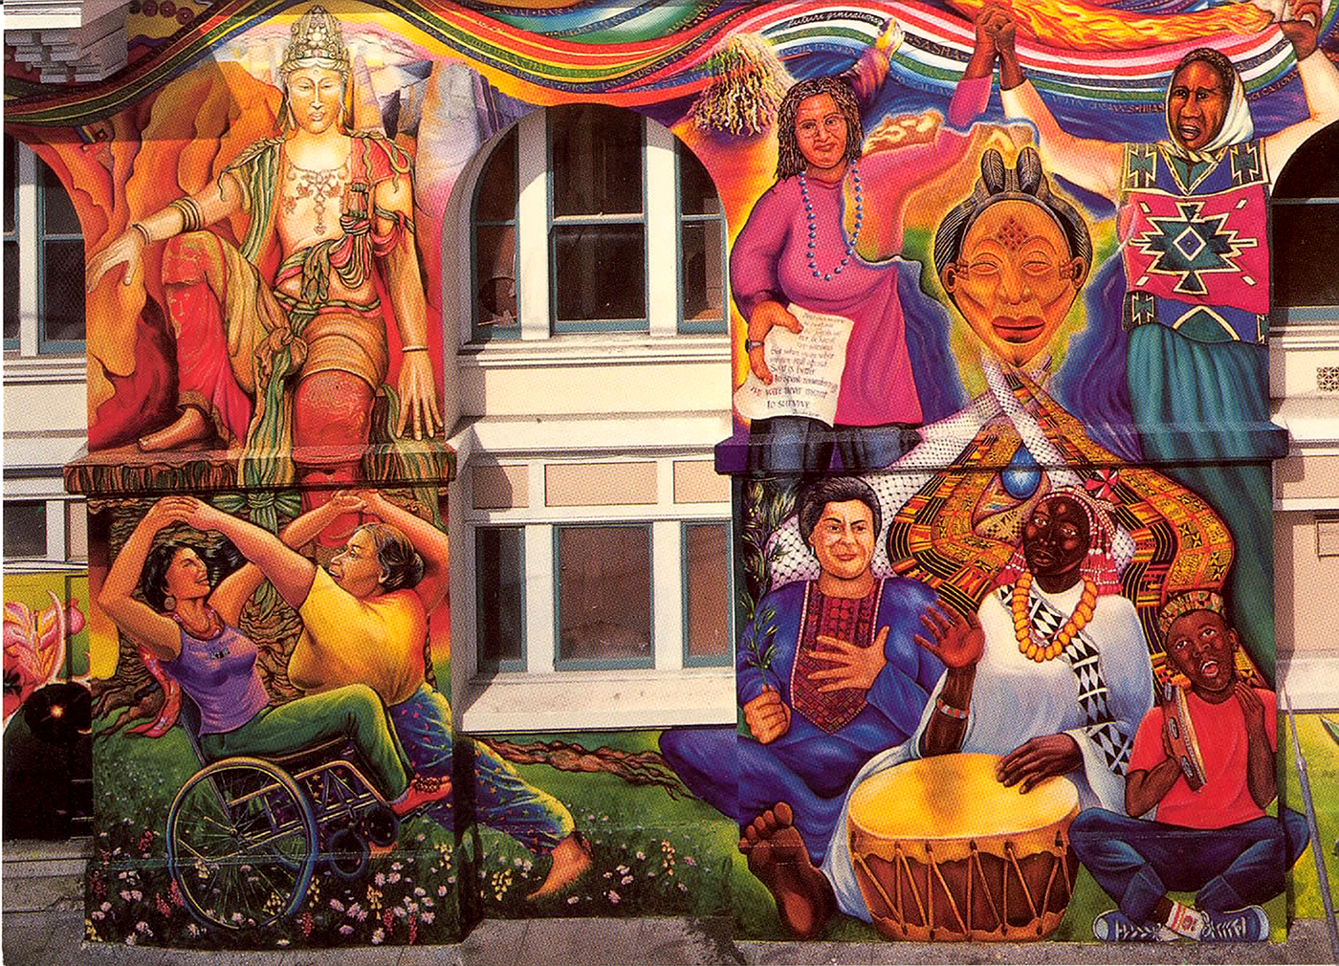
MAESTRAPEACE, San Francisco
Susan Cervantes, Meera Desai, Yvonne Littleton y Irene Perez, © 1994, 2000, 2010
Notes:
https://noehill.com/sf/landmarks/sf178.asp
https://womensbuilding.org/the-mural/

Slide 15
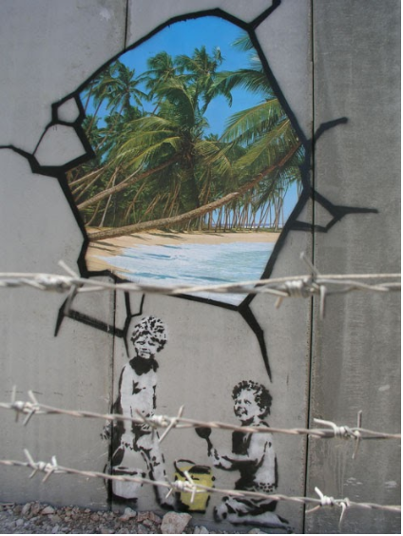
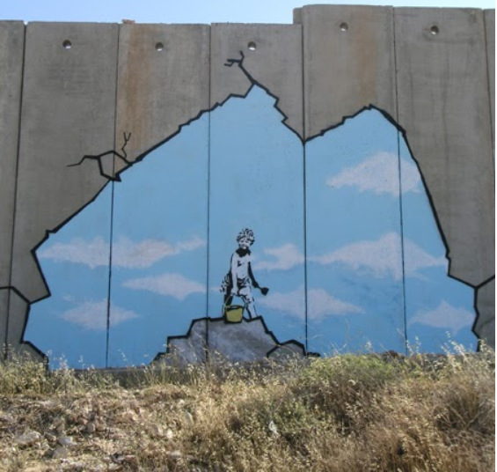
El Muro de segregación,
Palestina
Banksy
2005
Notes:
https://banksyexplained.com/the-segregation-wall-palestine-2005/

