Slide 1
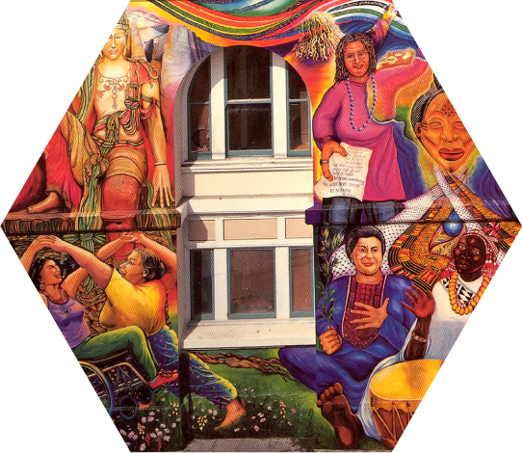
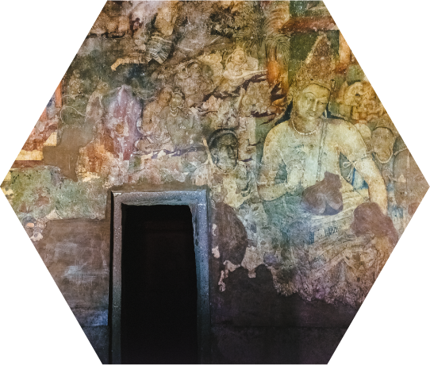
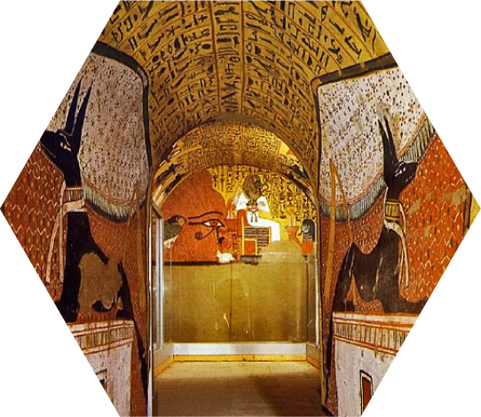
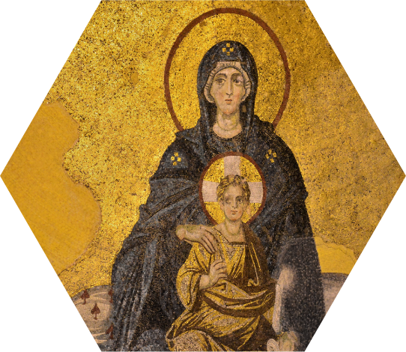
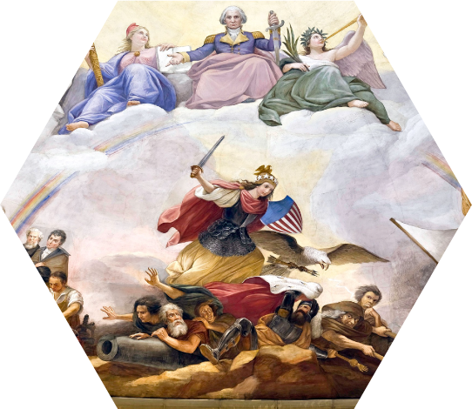
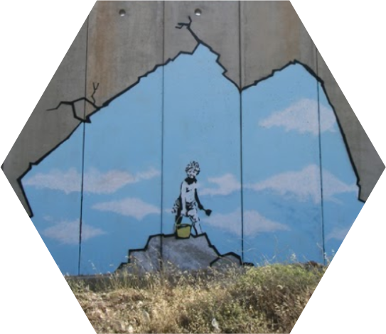
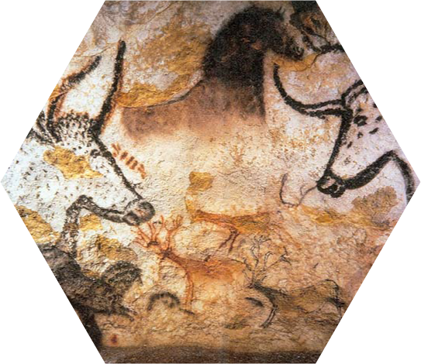
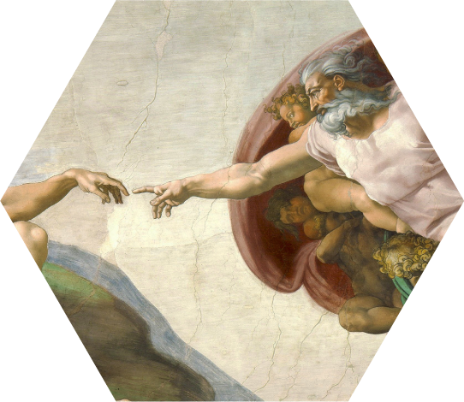
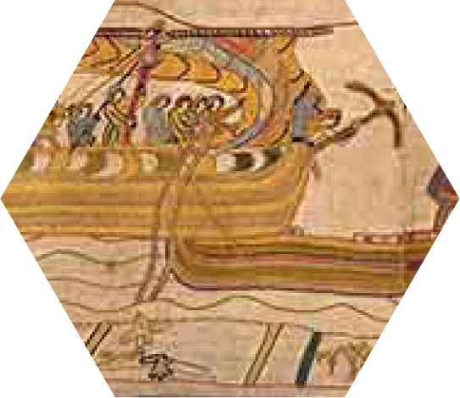
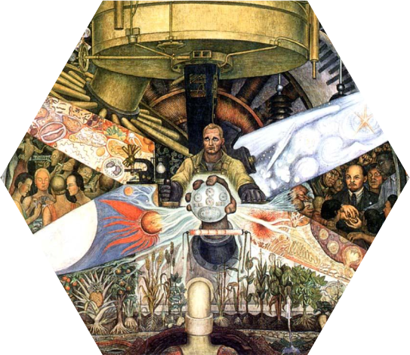
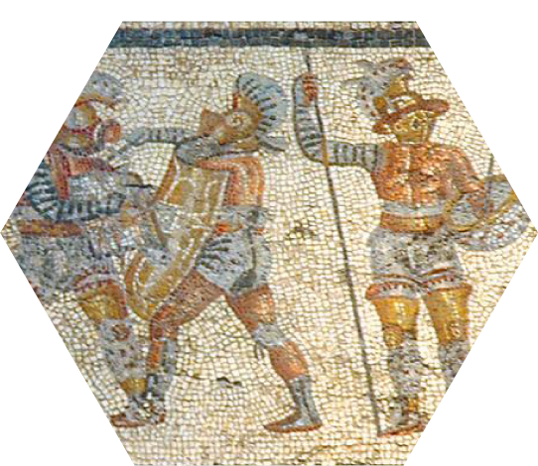
Notes:
Put artworks in chronological order

Slide 2
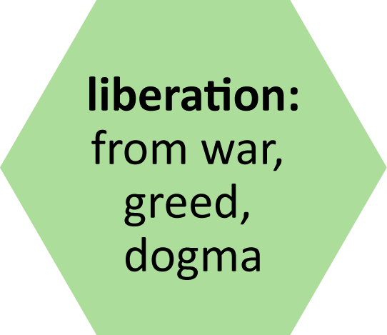
Notes:
Arrange art by shared themes. Click on an artwork to go to a slide with more details about the art.

Slide 3
grid
mosaic
fresco
stencil
tapestry
freehand
Notes:
Arrange art by what technique/s you think might have been used

Slide 4
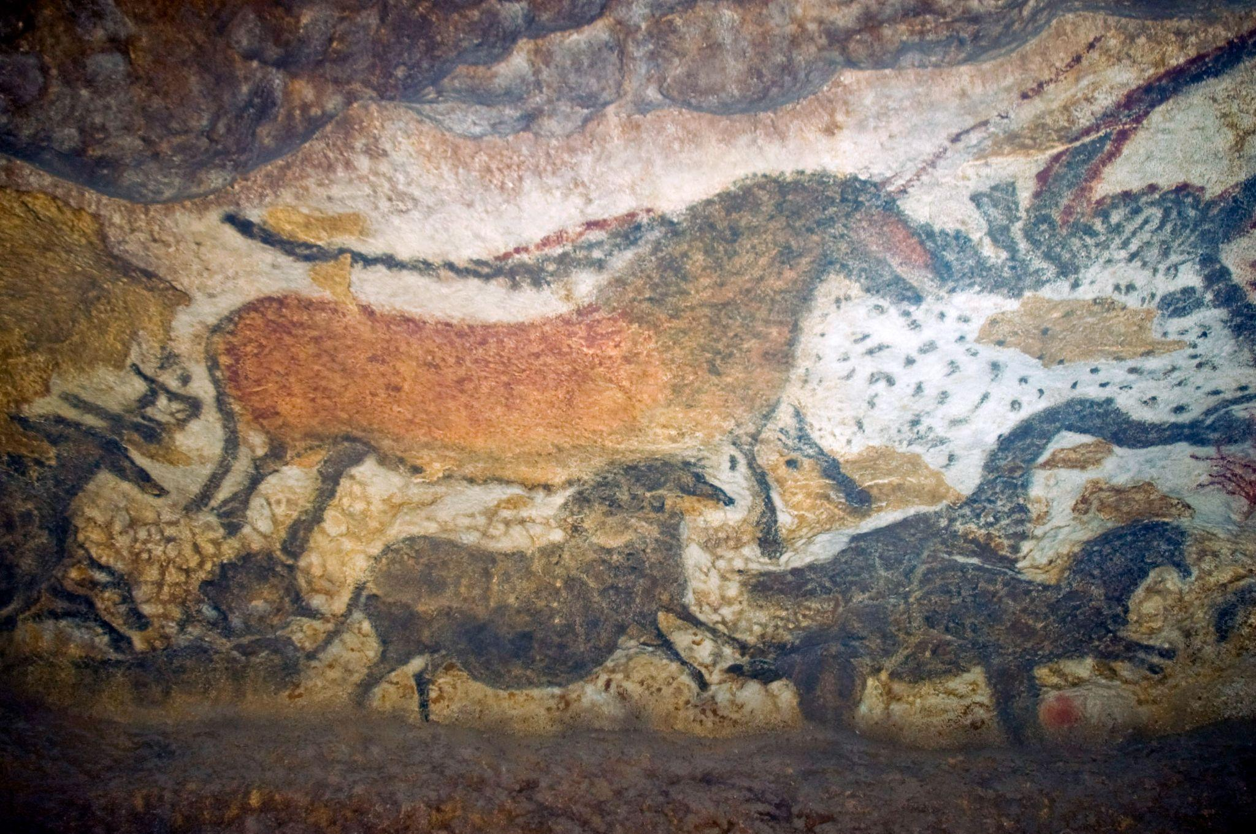
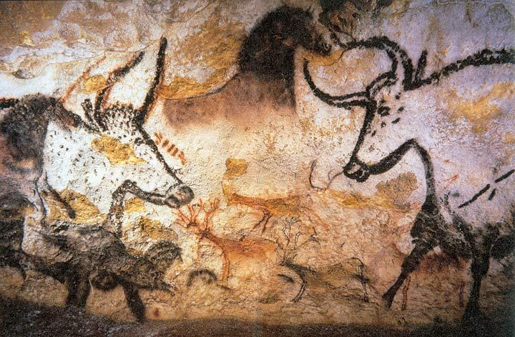
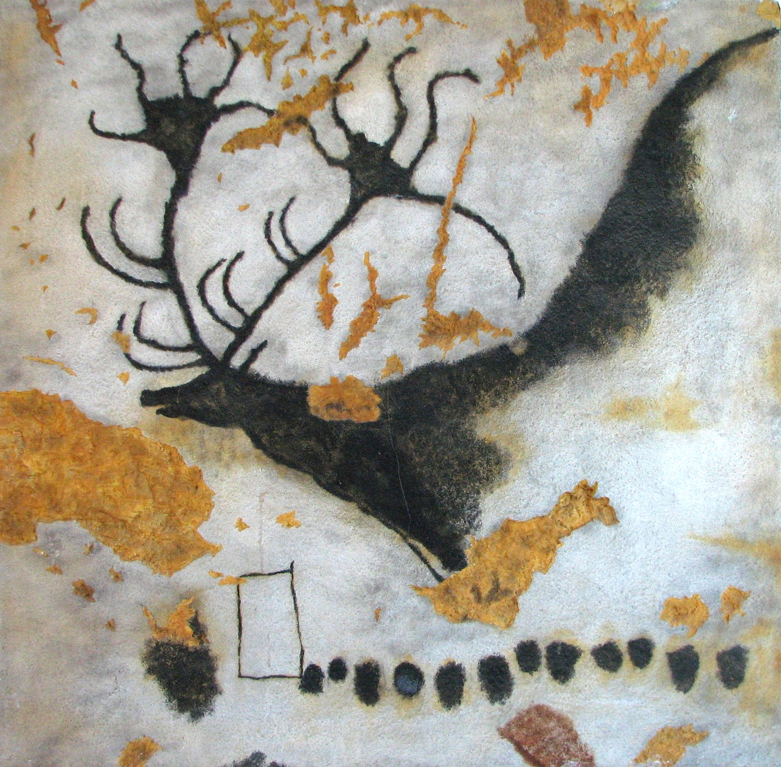
Lascaux Cave Paintings, France
c. 17,000-c. 12,000 BP
Notes:
https://en.wikipedia.org/wiki/Lascaux#/media/File:Lascaux_painting.jpg

Slide 5
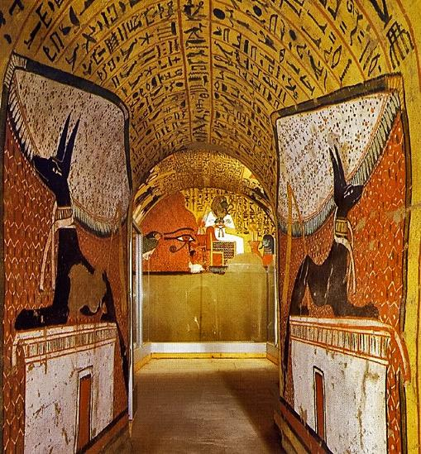
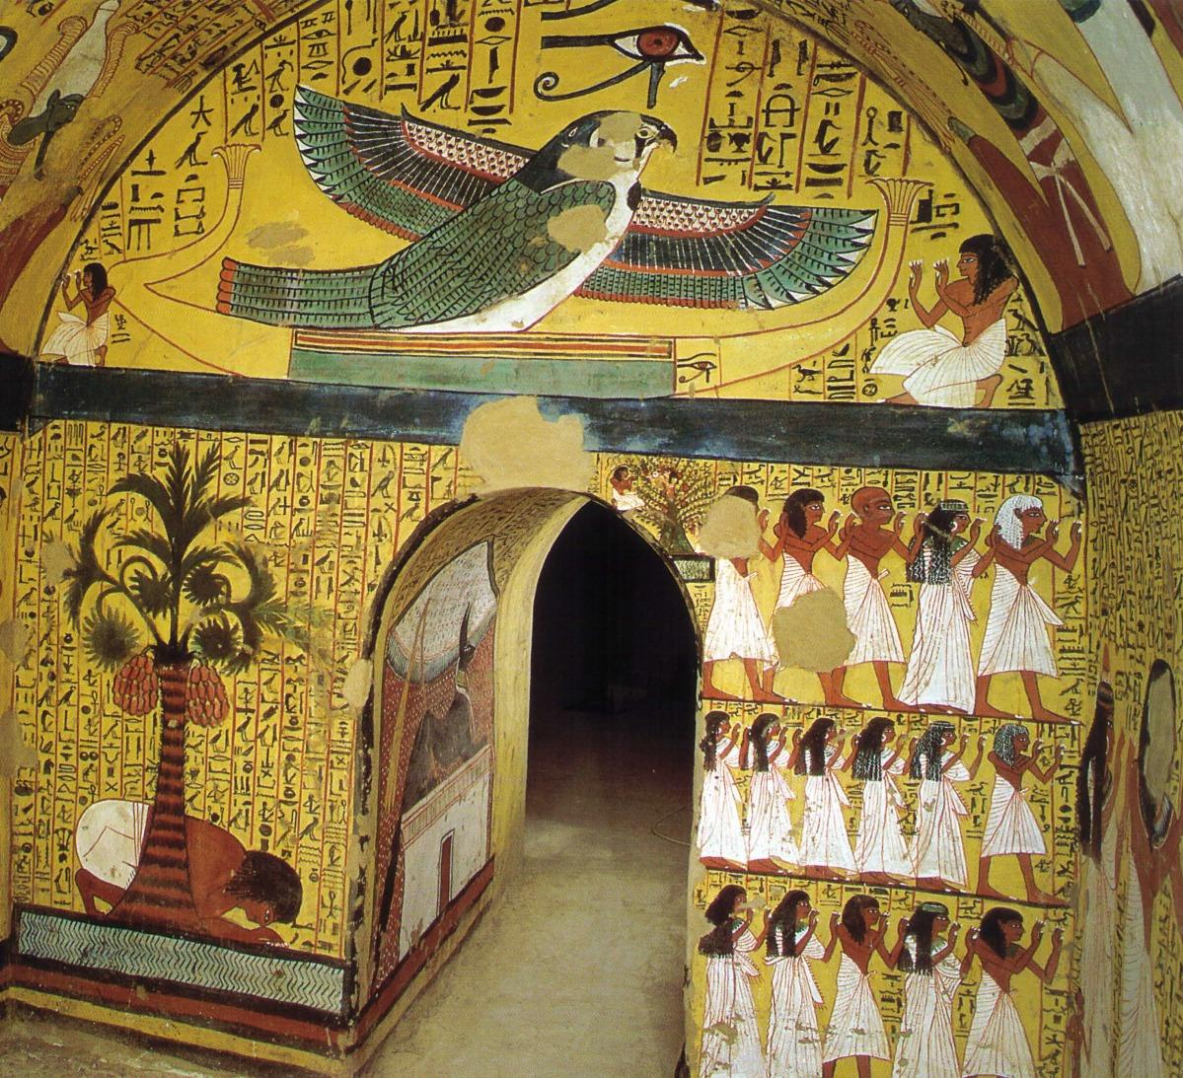
Tomb of Pashedu, Egypt
3150 BCE
Notes:
About: https://www.ask-aladdin.com/all-destinations/egypt/category/egypt-site-guide/page/pashedu
Image credit: https://www.veniceclayartists.com/relief-art-egypt/
Image credit: https://www.reddit.com/r/OutoftheTombs/comments/tw4obf/the_eastern_wall_of_the_burial_chamber_of_the/

Slide 6
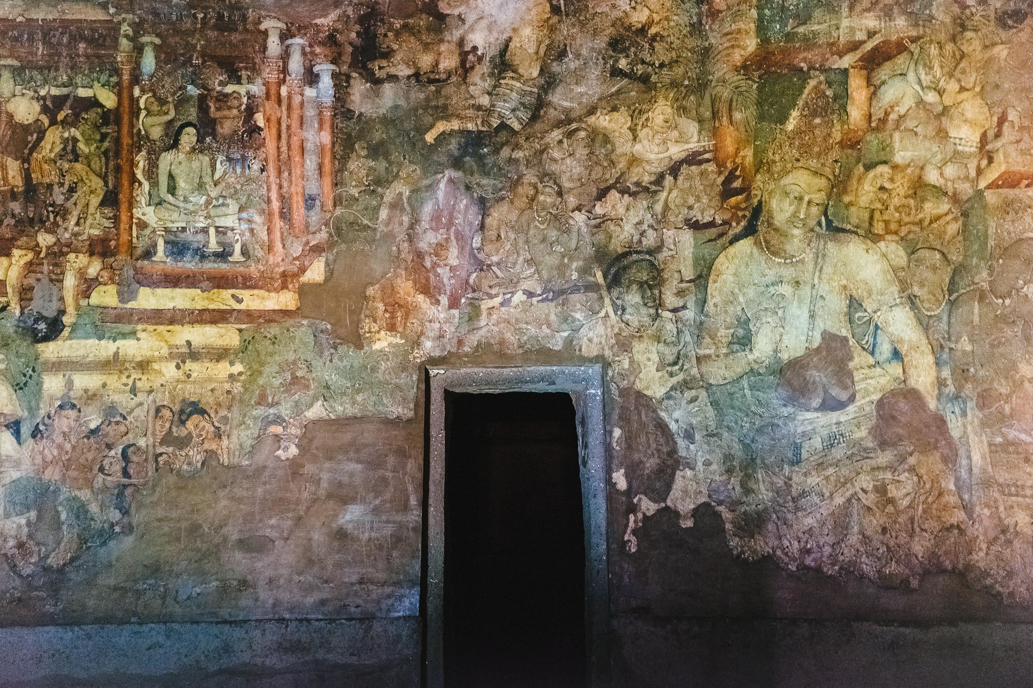
Ellora Cave Paintings, India
2nd Century BCE
Notes:
https://en.wikipedia.org/wiki/Ellora_Caves
Image credit: https://www.flickr.com/photos/turndeaux/19612144255

Slide 7
Bayeux Tapestry
Normandy
1070s
Notes:
https://historylearning.com/medieval-england/bayeux-tapestry/bayeux-tapestry-scene-by-scene/

Slide 8
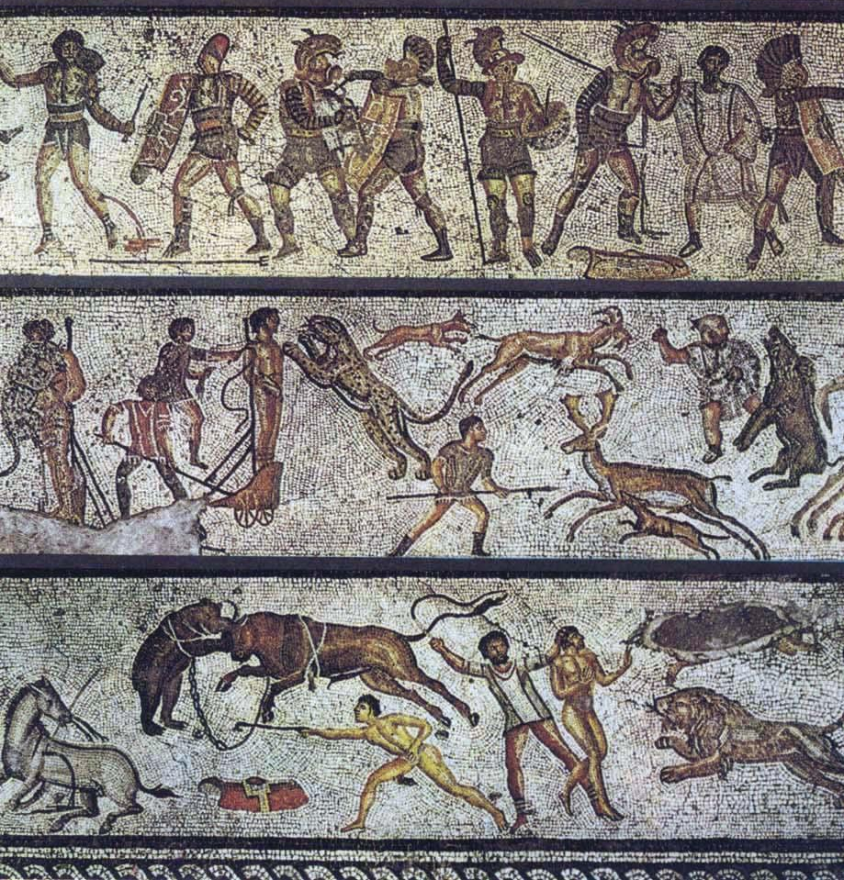
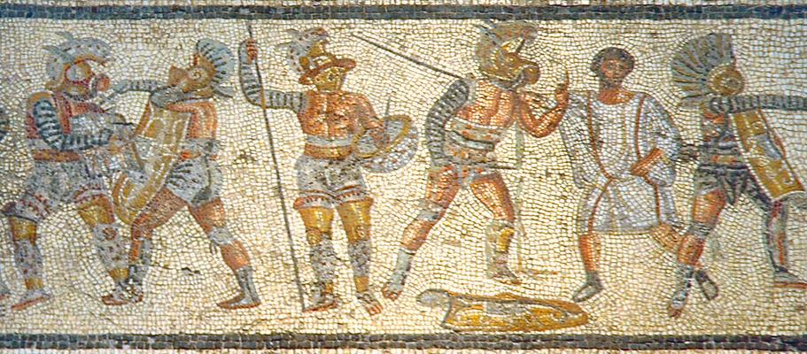
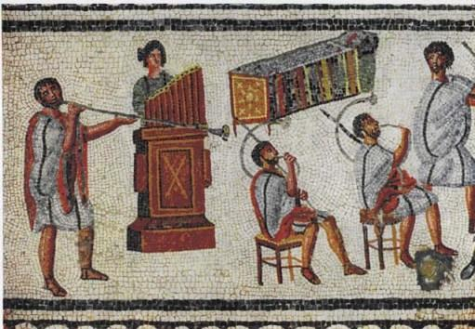
Zilten Mosaic, Libya
2nd Century AD
Notes:
https://en.wikipedia.org/wiki/Zliten_mosaic

Slide 9
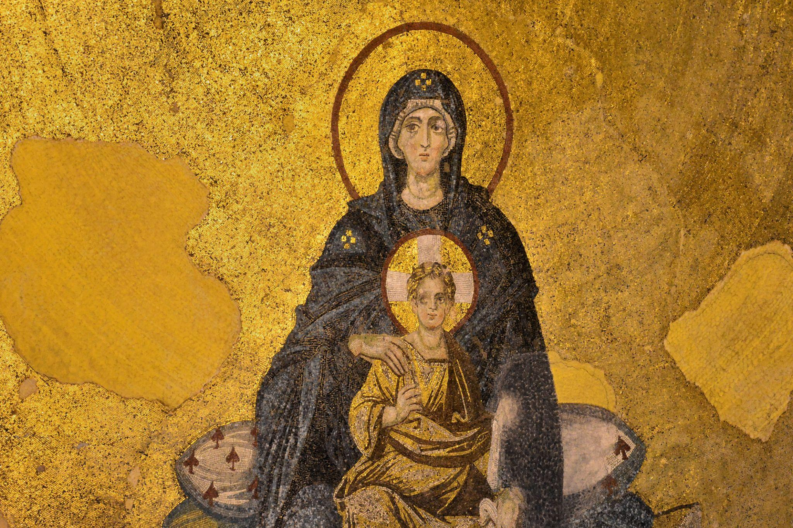
The Virgin and Child, Turkey
9th century CE
Notes:
https://www.pallasweb.com/deesis/virgin-and-child-hagia-sophia.html
Team, H. S. R. (2018, January 24). The Virgin and Child Mosaic, Hagia Sophia. World History Encyclopedia. Retrieved from https://www.worldhistory.org/image/7973/the-virgin-and-child-mosaic-hagia-sophia/

Slide 10
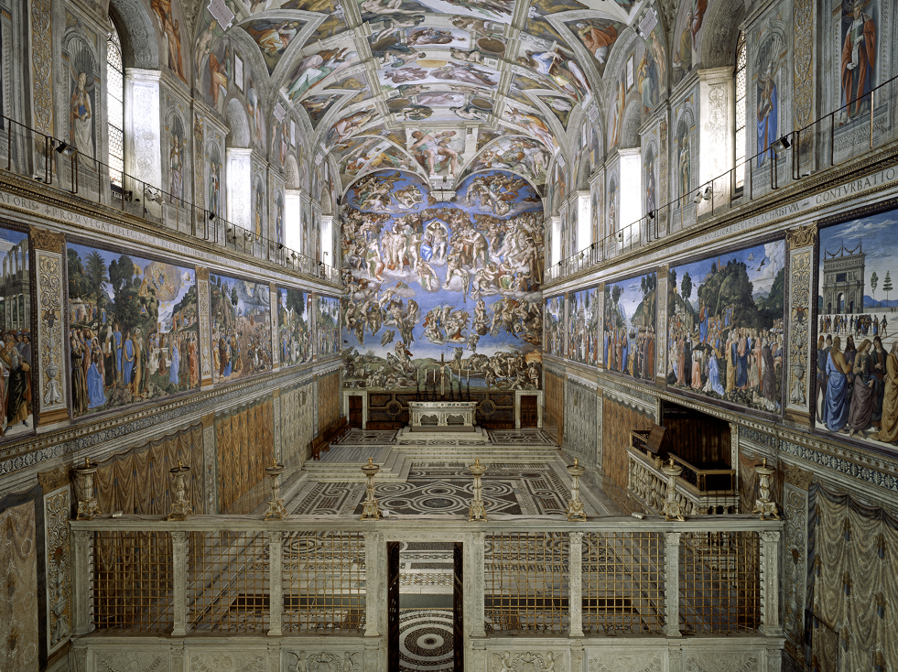
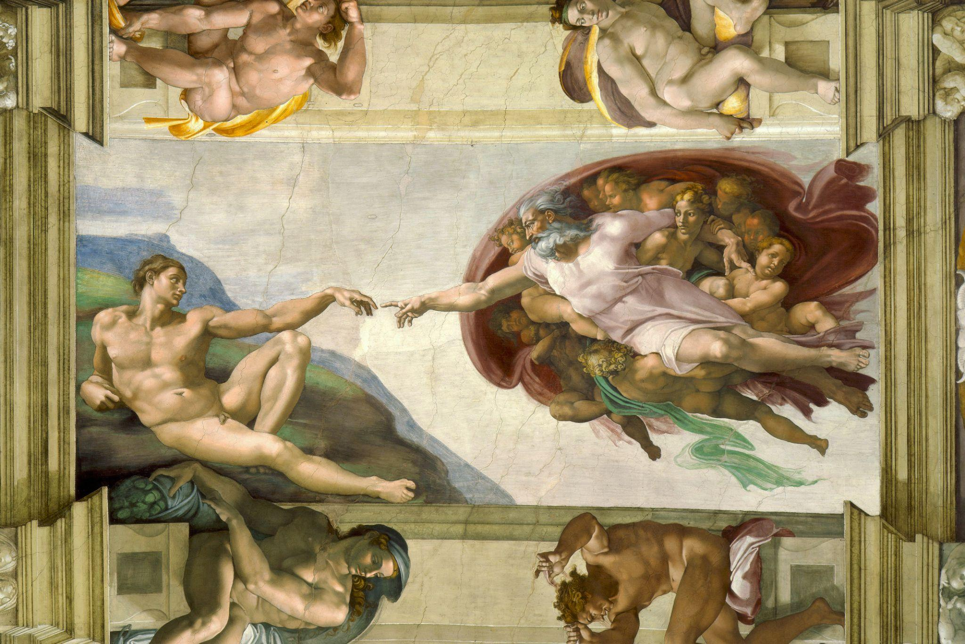
The Sistine Chapel, Vatican
Michelangelo
1508-1512
Notes:
https://m.museivaticani.va/content/museivaticani-mobile/en/collezioni/musei/cappella-sistina/storia-cappella-sistina.html
https://en.wikipedia.org/wiki/Sistine_Chapel_ceiling

Slide 11
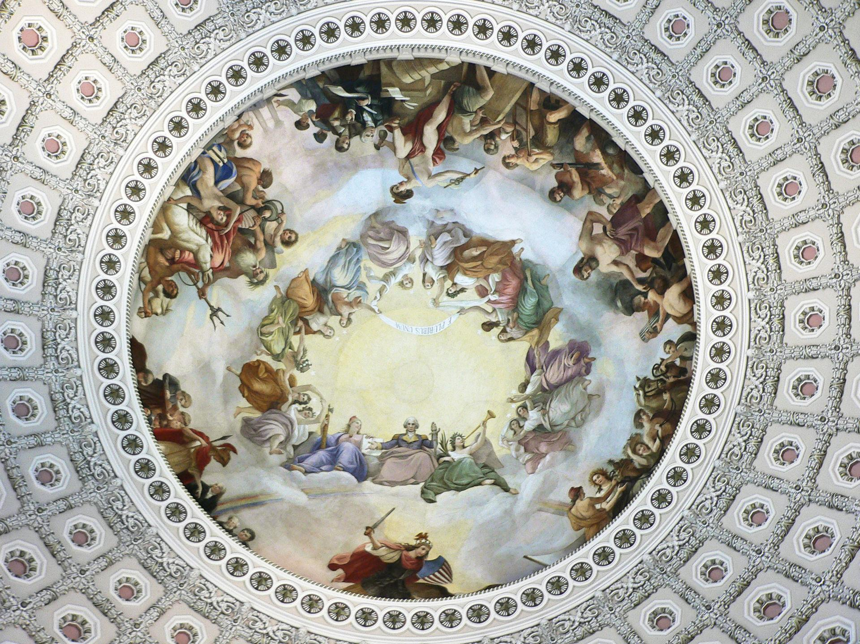
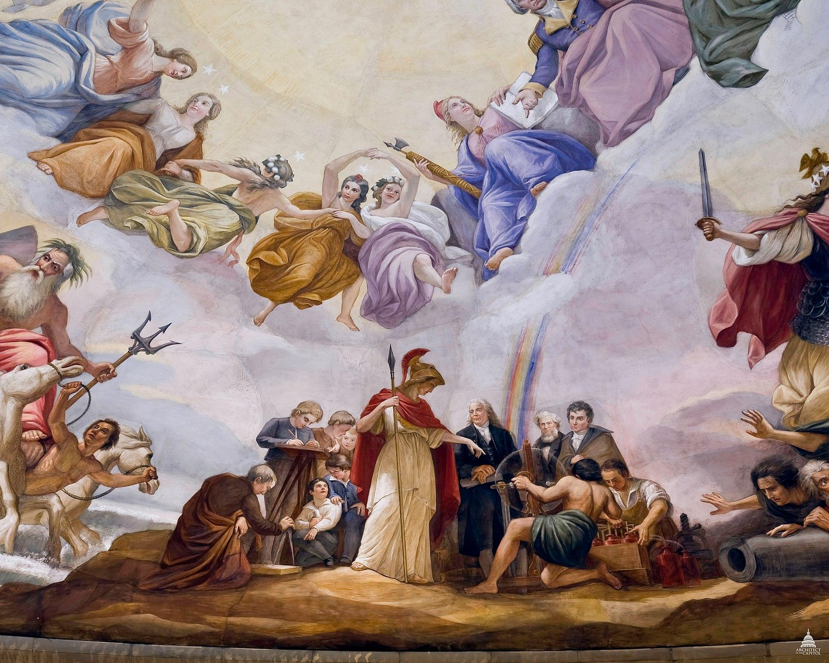
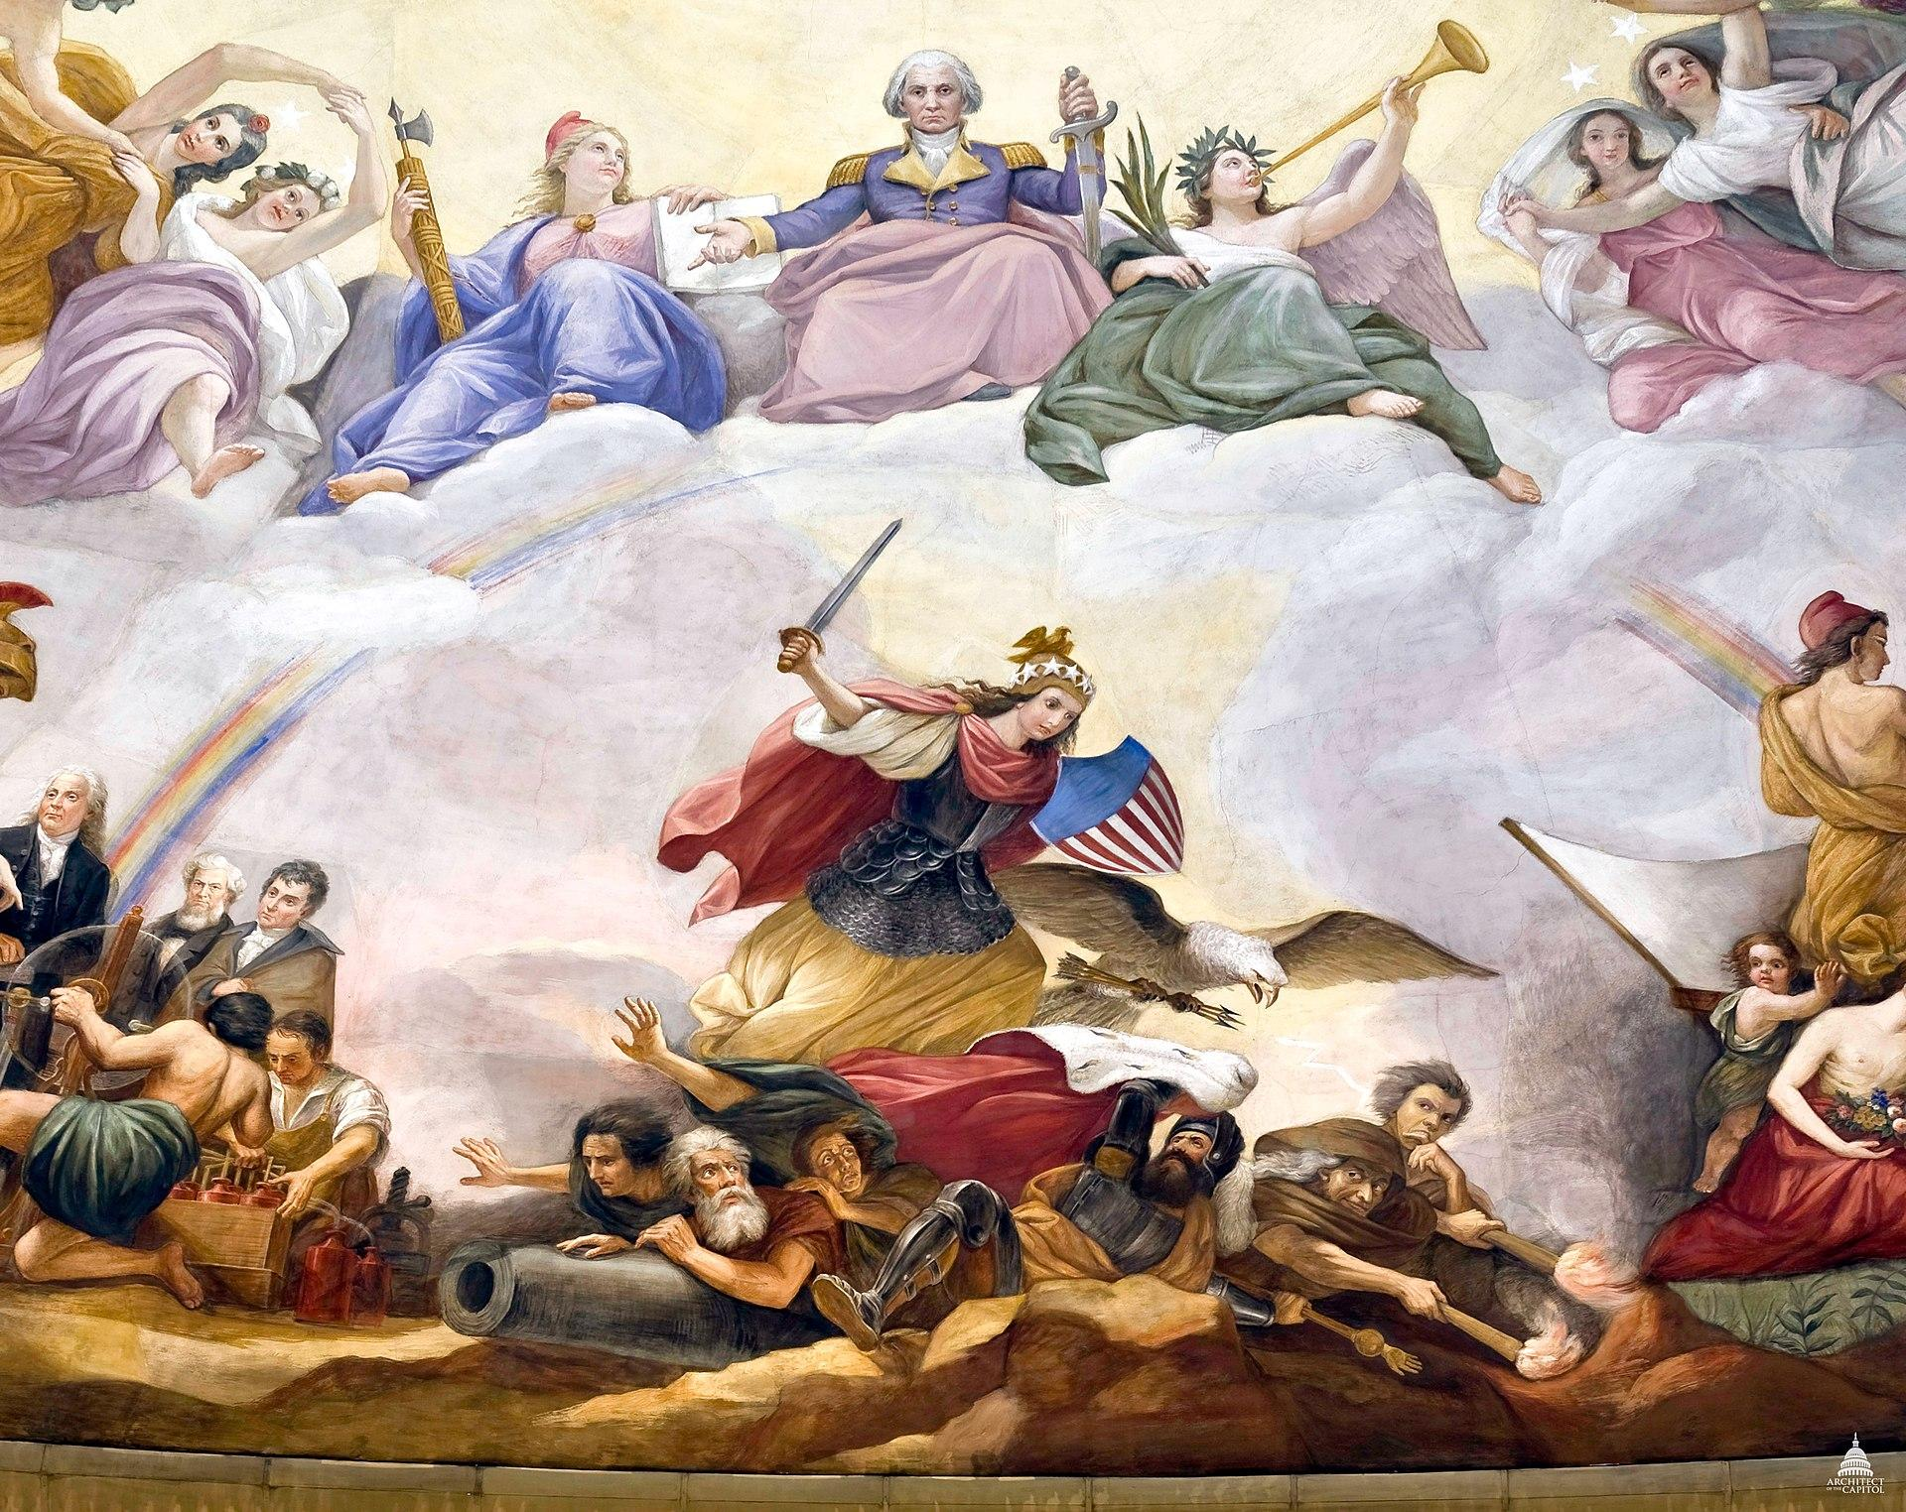
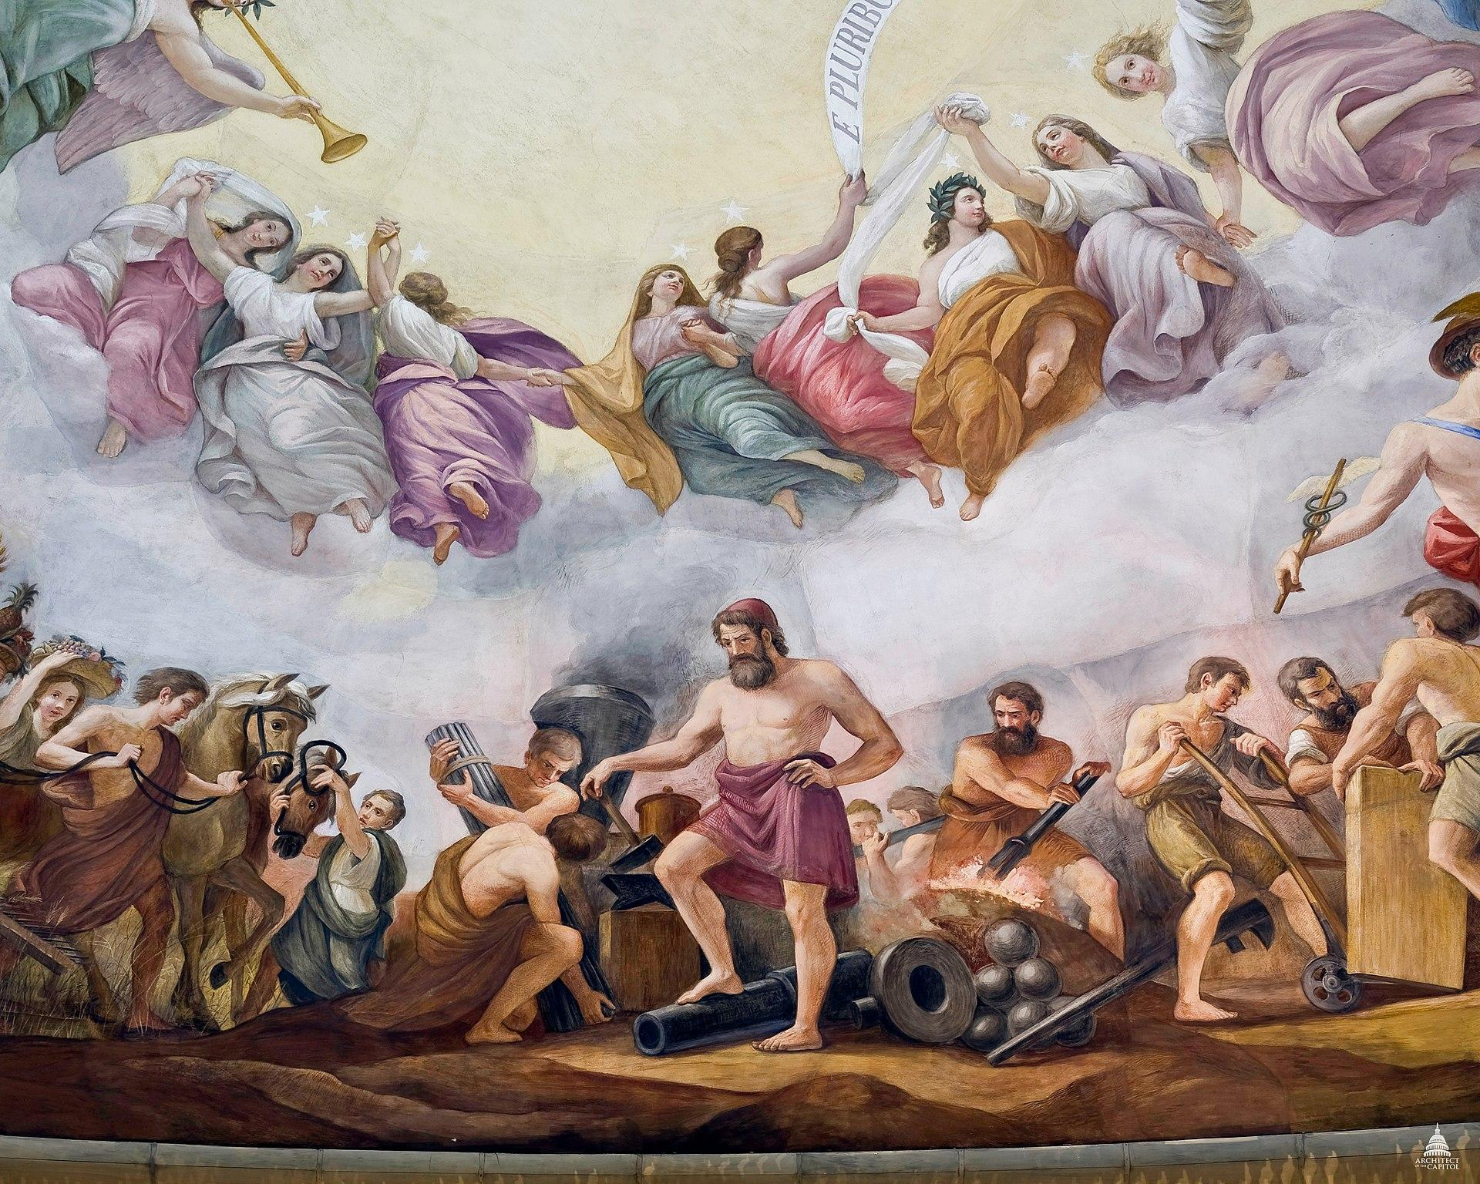
The Apotheosis of Washington, US Capitol
Constantino Brumidi
1865
Notes:
https://en.wikipedia.org/wiki/The_Apotheosis_of_Washington

Slide 12
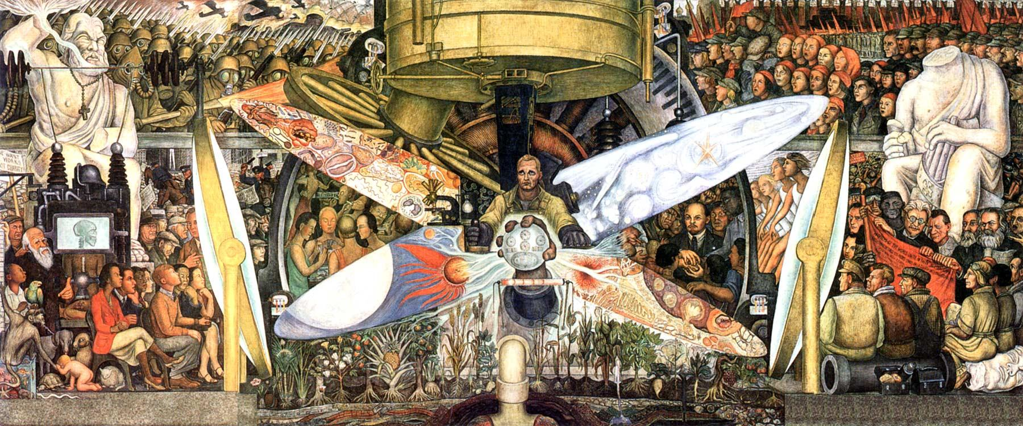
Man at the Crossroads, New York City
Diego Rivera
1933
Notes:
https://en.wikipedia.org/wiki/Man_at_the_Crossroads

Slide 13
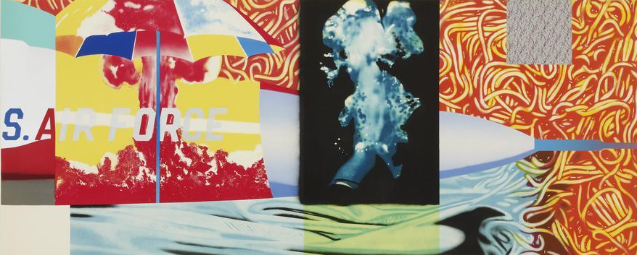
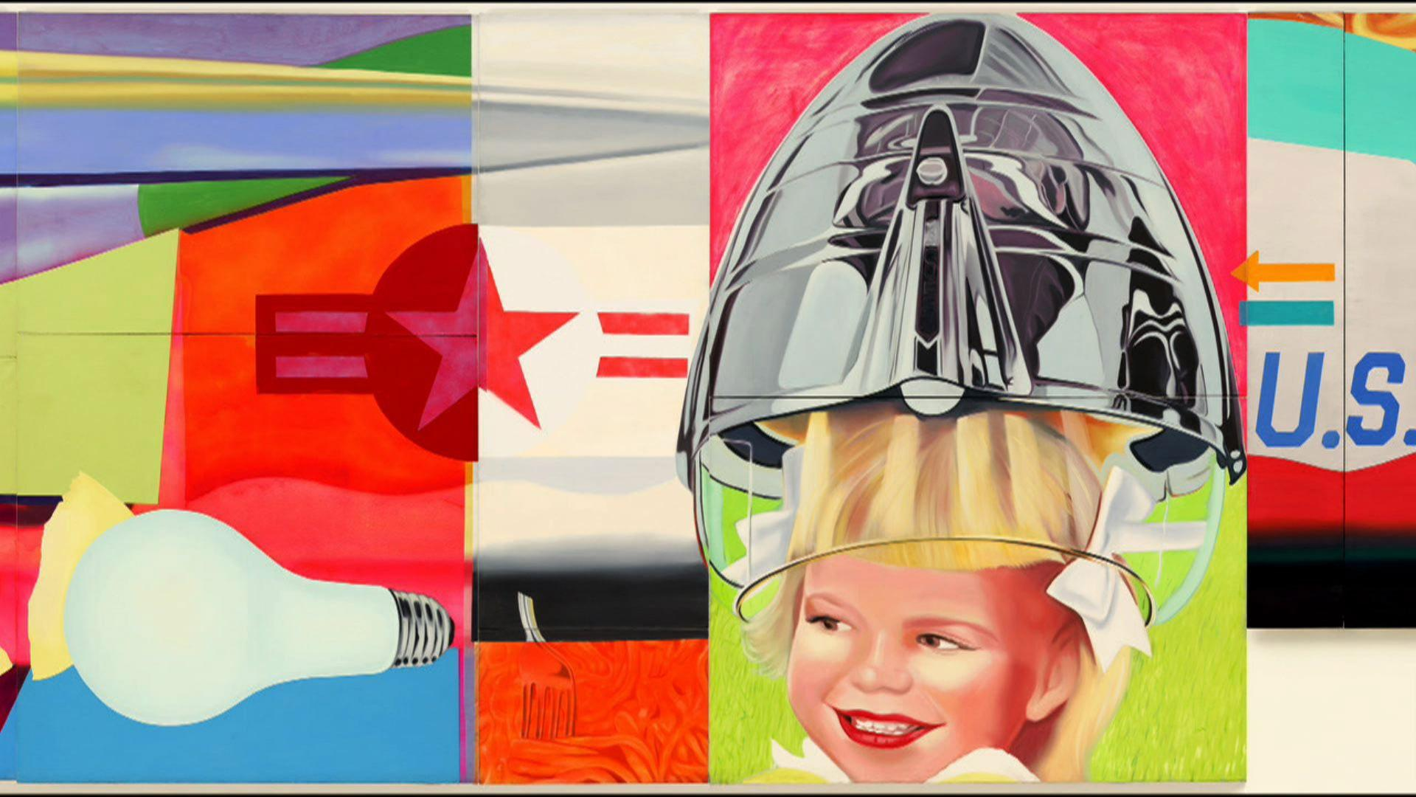
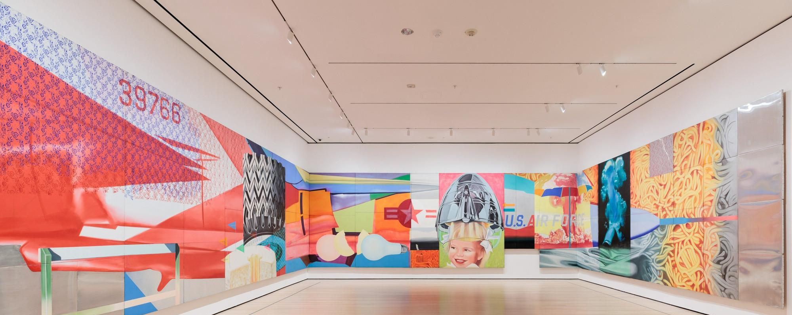
F-111, MoMA
James Rosenquist
1974
Notes:
https://www.moma.org/calendar/galleries/5512

Slide 14
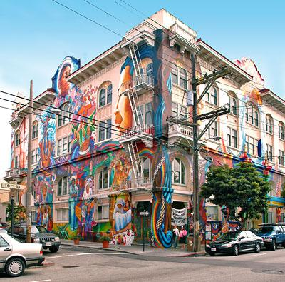
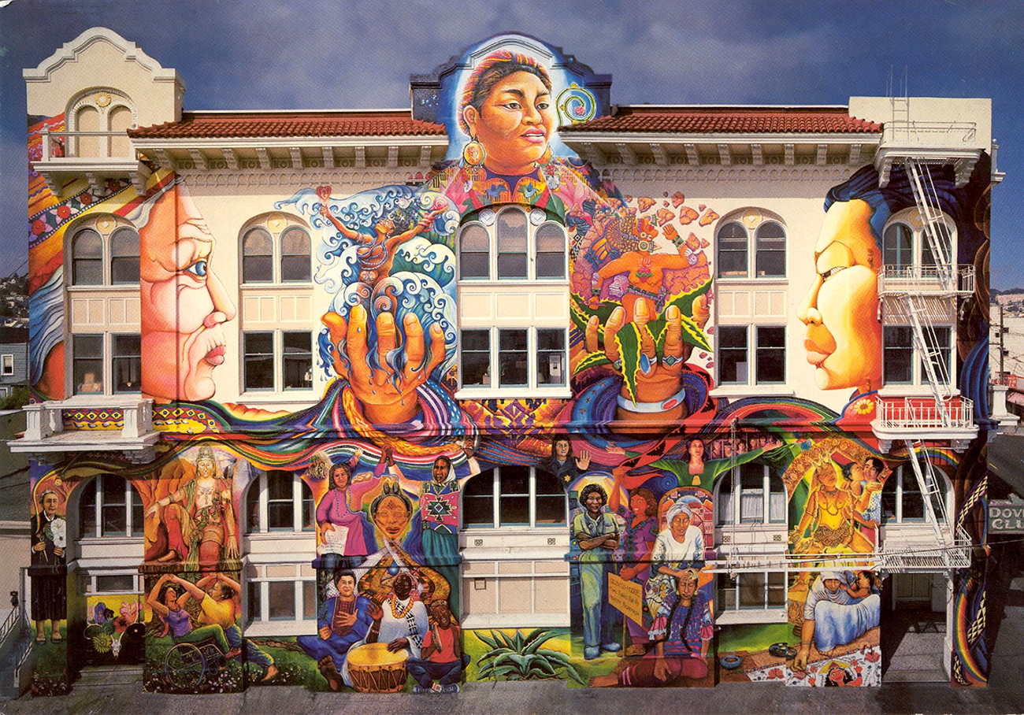
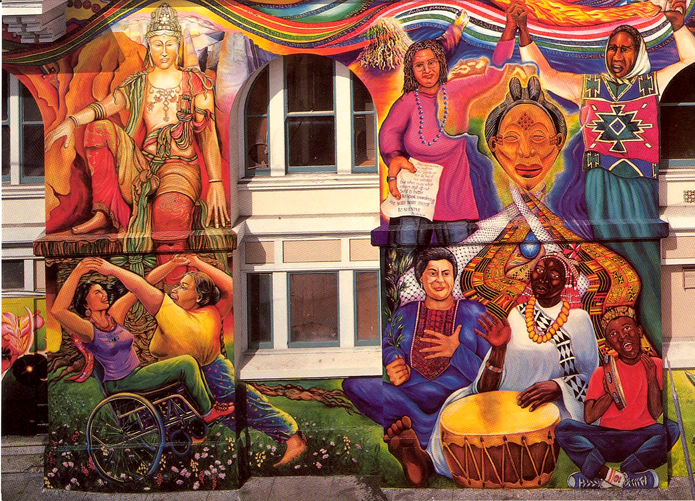
MAESTRAPEACE, San Francisco
Susan Cervantes, Meera Desai, Yvonne Littleton and Irene Perez, © 1994, 2000, 2010
Notes:
https://noehill.com/sf/landmarks/sf178.asp
https://womensbuilding.org/the-mural/

Slide 15
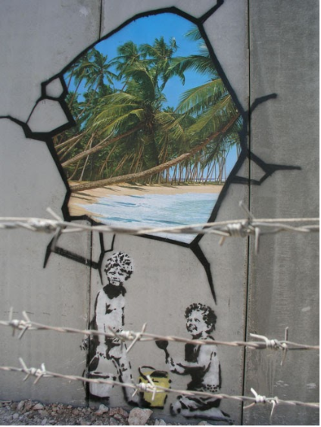
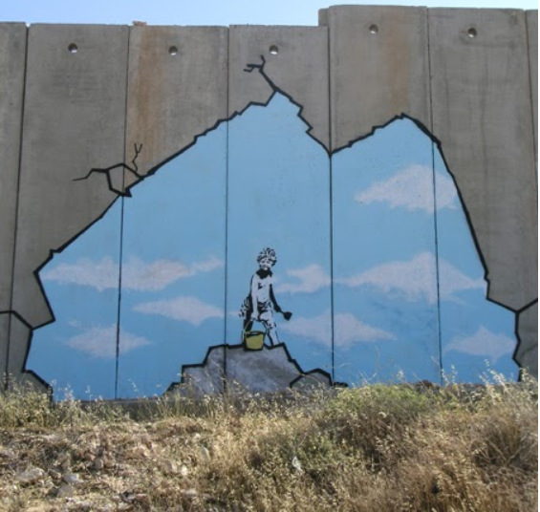
The Segregation Wall,
Palestine
Banksy
2005
Notes:
https://banksyexplained.com/the-segregation-wall-palestine-2005/

