Slide 1
Think Big Picture
Mural Art History, Technique, and Concept Development

Slide 2
Essential Questions
What are the defining qualities of the mural art form?
How does large-scale public art serve as a canvas for community and cultural expression?

Slide 3
Lesson Objectives
Students will understand the historical development and significance of mural art.
Students will analyze values, meaning, and message conveyance through mural art.
Students will collaboratively develop a proposal to paint a mural in their school.

Slide 4
Word Splash
Use all of these words to write a brief statement about graffiti.
Art
Expression
Vandalism
Colorful
Rebellion
Symbols
Messages
Voice
Community
Values

Slide 6
Honeycomb Harvest
Make a copy of the activity slides using this url:
k20.ou.edu/bigpicture
Notes:
https://docs.google.com/presentation/d/14dG6M-k5mzOCy4ygdVjYcUASn4TUNX7lRgNtn_PEeT0/copy

Slide 7
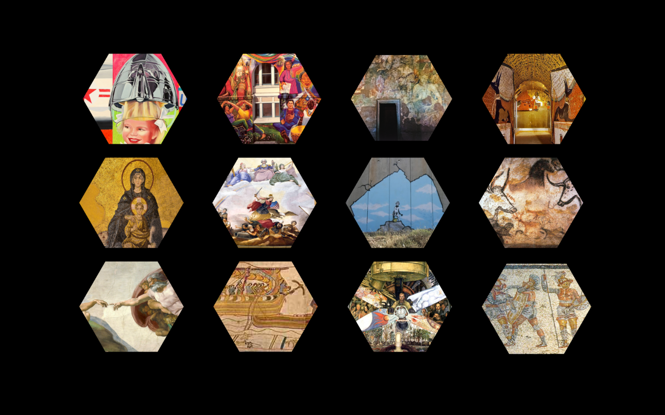
Timeline
Sort the hexagon images on slide 1
into chronological order.

Slide 8
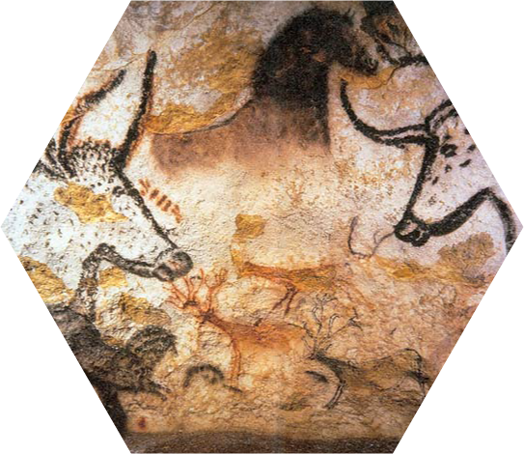
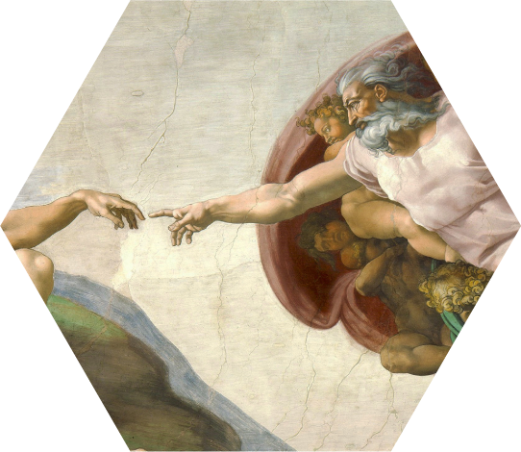
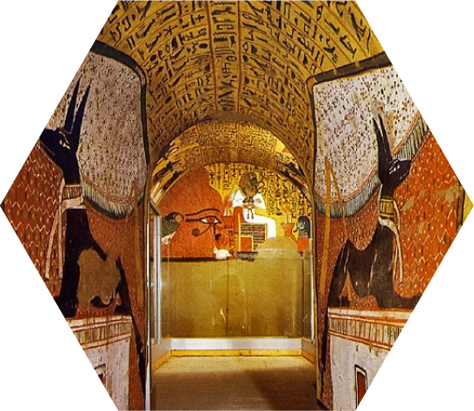
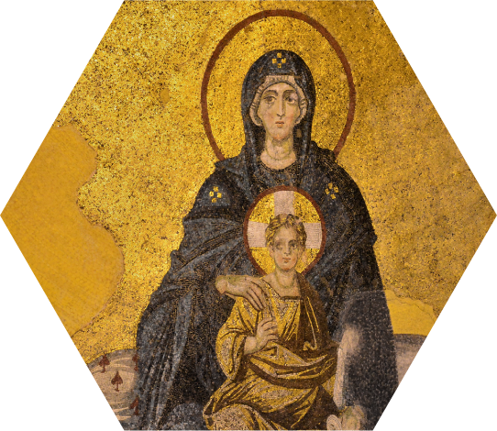
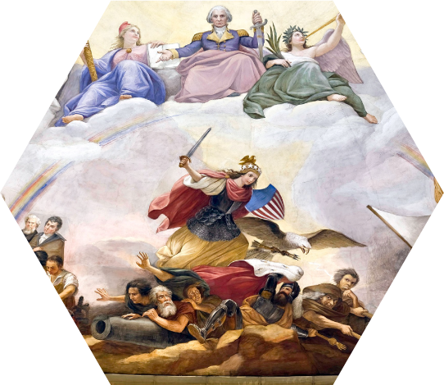
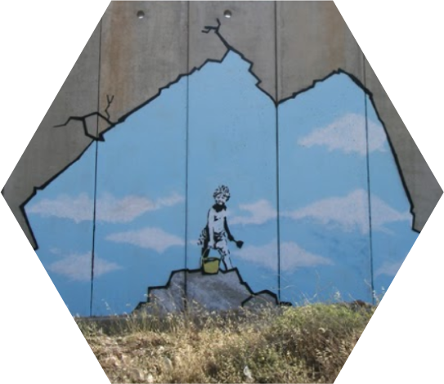
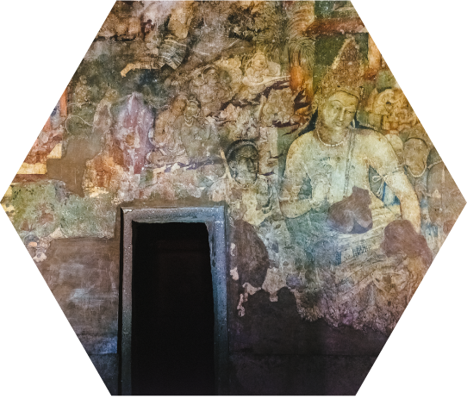
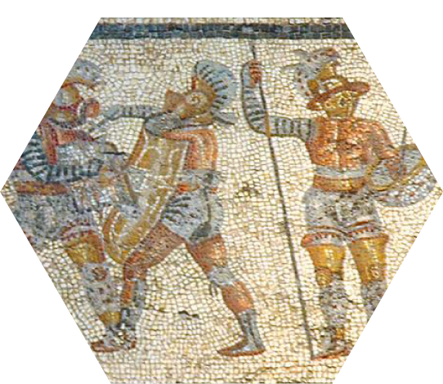
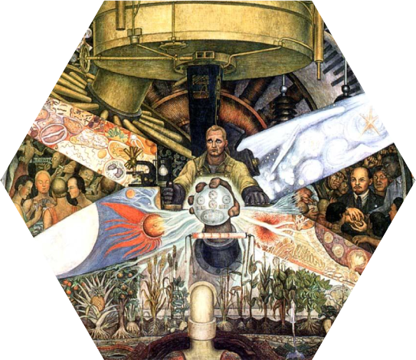
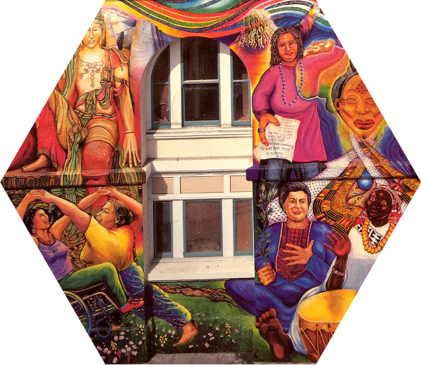
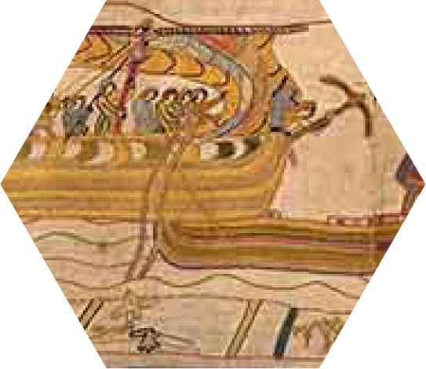
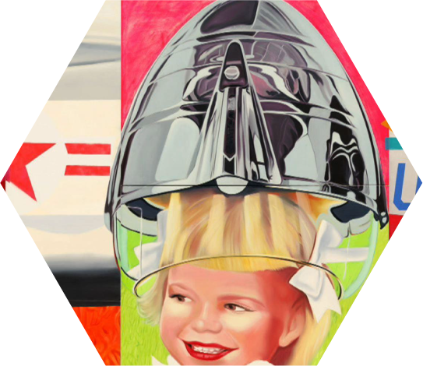
Notes:
Timeline Key

Slide 9
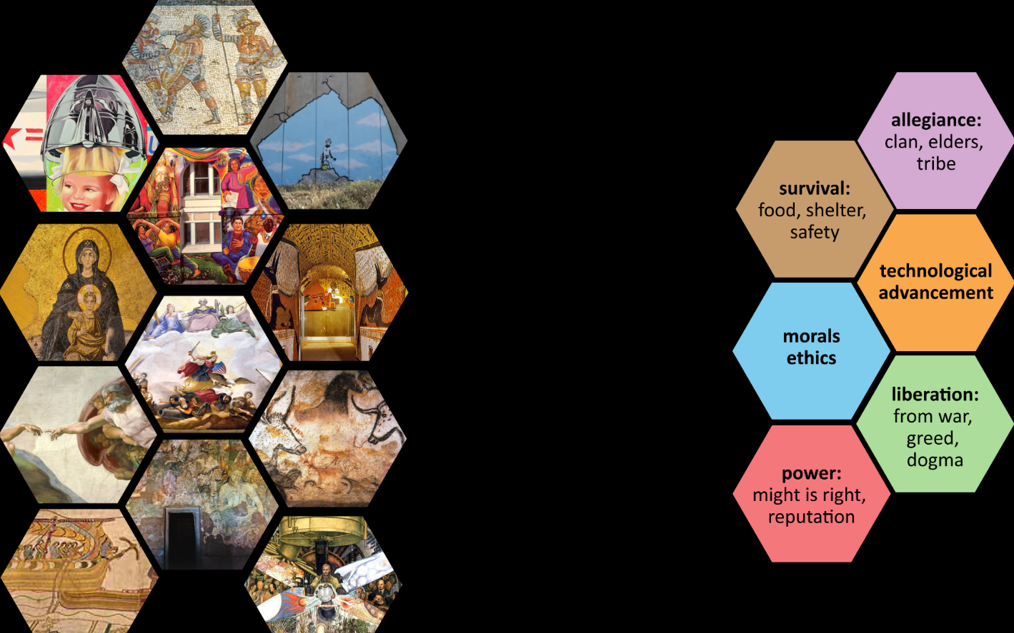
Themes
Arrange the images on slide 2 by shared themes. Place images with a common theme so that they they share sides with the hexagon that names that theme.

Slide 10
Theme Discussion
Share how you chose to sort with an elbow partner.
Discuss what is similar and what is different about how you sorted.
Why did you make the choices you made?

Slide 11
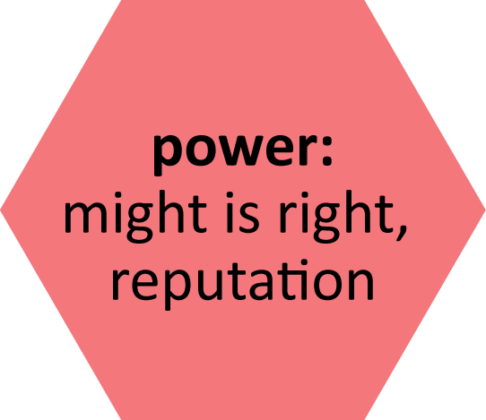
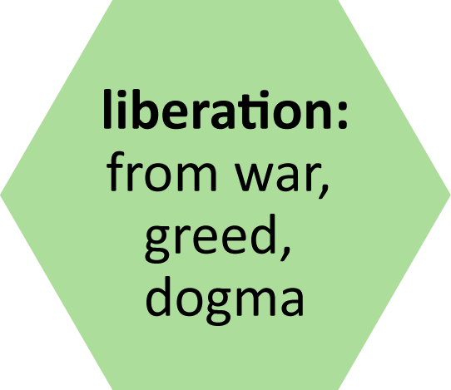
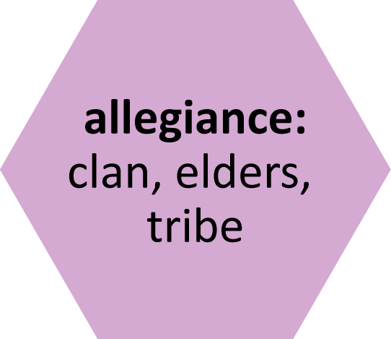
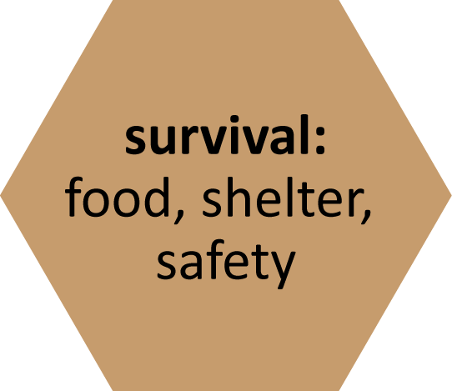
Notes:
Share this example, but not as the only “right” answer
The themes used here are pulled from those associated with human development over time as named by spiral dynamics theory. This isn’t a detail that we need to go into with students so much as a guide for how we selected themes to use and determined which pieces fall into themes based on the timeline associated with those themes. This theory states that themes that were dominating in prehistory such as survival don’t go away, but persist as a base layer as new themes begin to layer over them. Same is true as each layer builds on. Moral and religion as authority were the most dominant theme in the middle ages, but around the globe these themes are dominant for different cultures at different times and all of themes persist today and shine through based on living conditions for different people in different places. We see survival/safety, for example, as very strong in Palestine due to the war/conflict and living conditions there at this time.

Slide 12
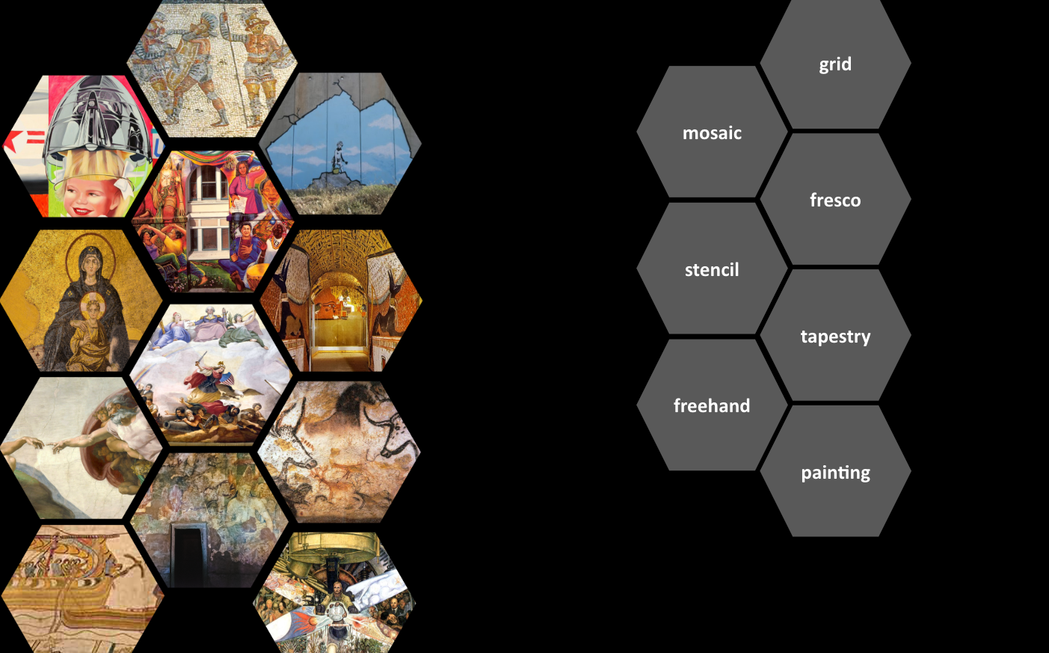
Technique
Sort the hexagon images on slide 3
by what technique/s you think might have been used.

Slide 13
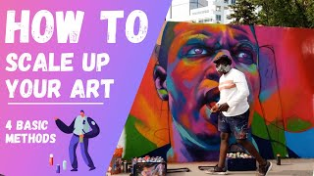

Slide 14
fresco
mosaic
freehand
grid
stencil
tapestry
Notes:
Example
It’s not always easy to find information about which artists used a grid, freehand, or other scaling technique. Sometimes many artists work on one mural over a long period of time and different artist may use different strategies, such as in the Maestrapeace. The same artist may use a grid for one work of art and freehand another. It’s generally accepted as knowledge that Egyptians used the grid method for scaling art into murals. We also know that Rosenquist is a fan of using the grid method and in a way that mimics the Egyptian methods by using chalk and string. We know that Rivera used fresco on many of his murals and that many 9th century chapel artworks employ a combination of fresco and mosaic techniques.

Slide 15
Word Splash
Use all of these words to write a new brief statement about graffiti now that you have explored more of the history of mural as an art form.
Art
Expression
Vandalism
Colorful
Rebellion
Symbols
Messages
Voice
Community
Values

Slide 16
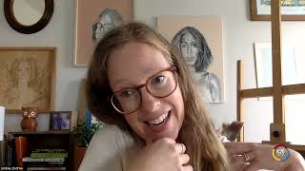

Slide 17
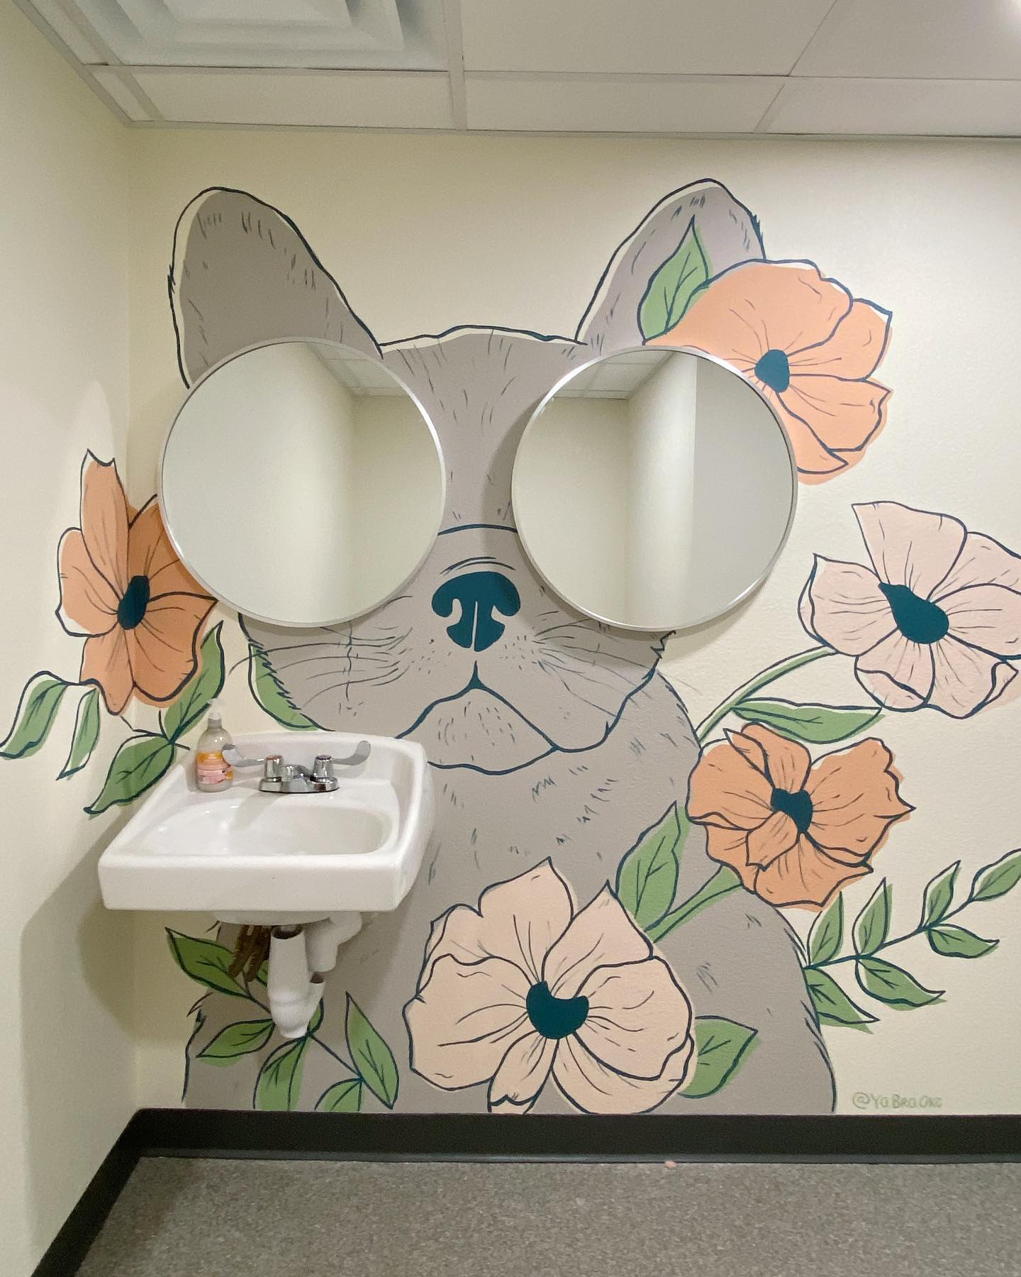
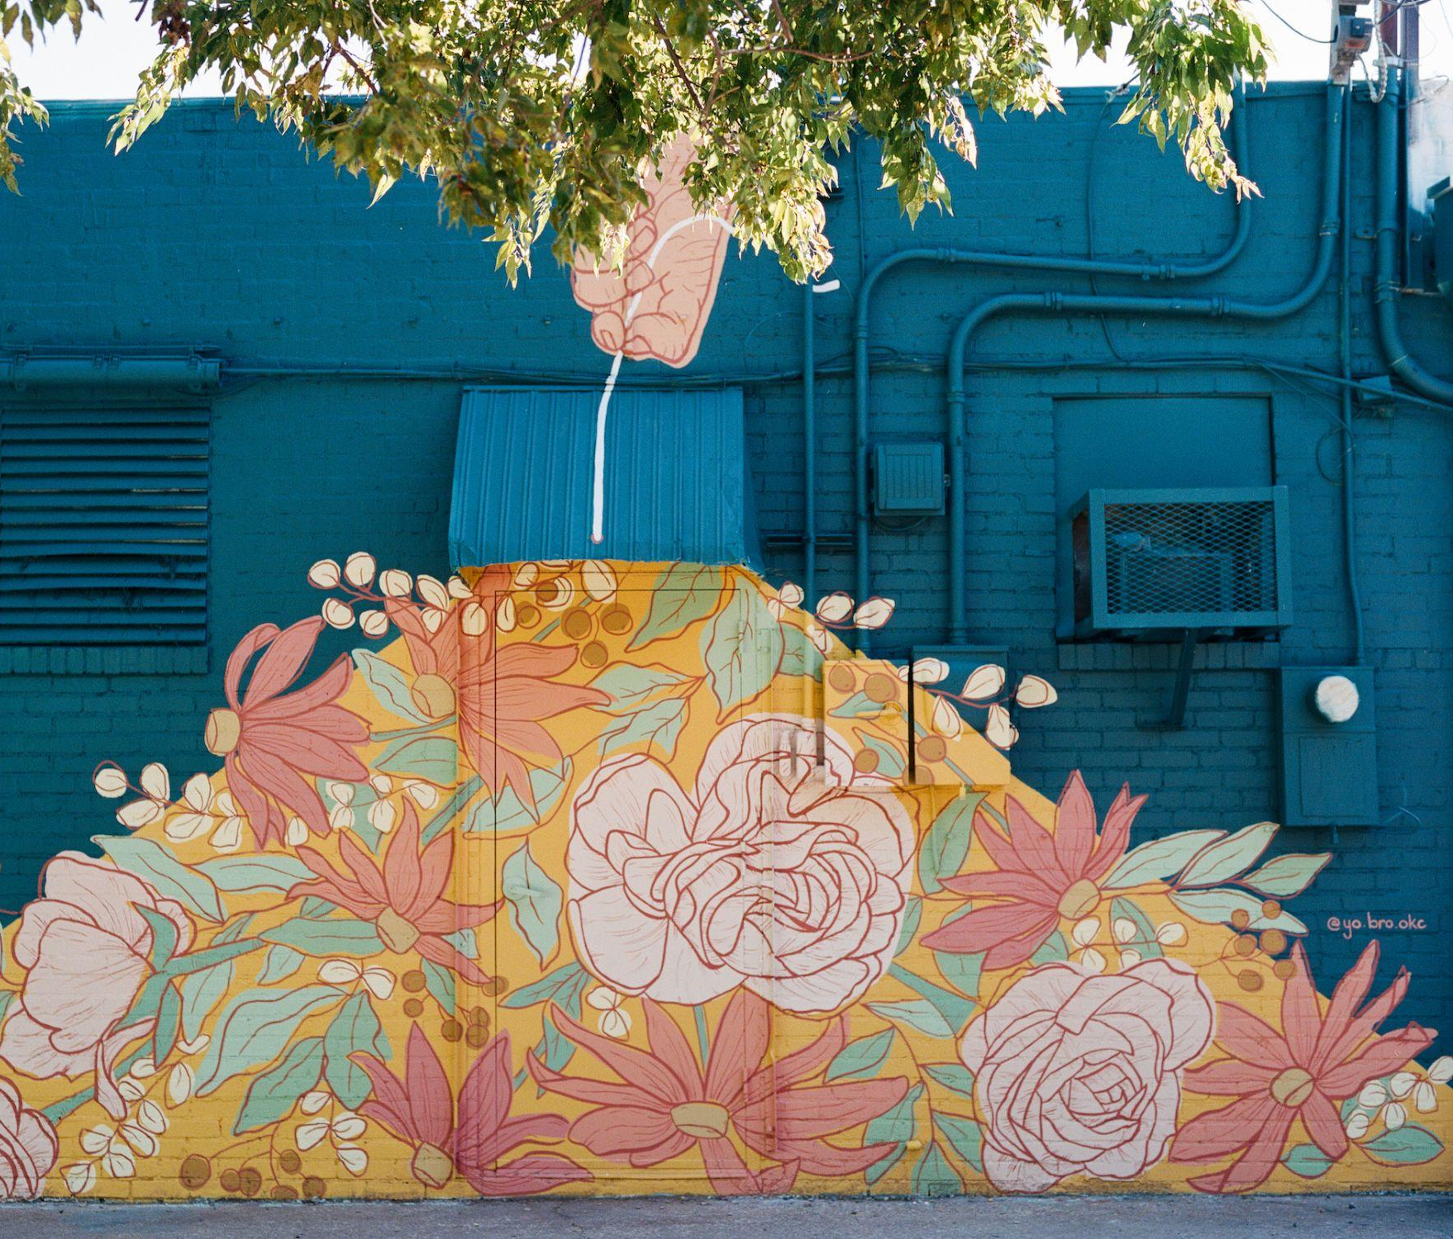
Notes:
Before students get started on the design sketching activity, review these examples of Lindsay Zodrow’s work that take the space into consideration for inspiration in the work.

Slide 18
Get to know your client
Where do they want a mural?
What are their goals for the mural?
What themes could we use in our design?
What features of the space could be used in our design?
Notes:
At this point if you have a school space or community space that is already planned for the lesson, you could introduce that here. If you don’t have a client and will be doing a cold proposal, perhaps just talk about the space where you want to propose putting a mural and who would be in charge of reviewing and approving your proposal. How would you convince them?

Slide 19
4-2-1 Sketch Ideas
Create ONE sketch of a design idea for the mural.

Slide 20
4-2-1 Sketch Ideas
In groups of four, share your sketches.
Then, come up with two new sketches for ideas that emerged from looking at your four individual ideas.

Slide 21
4-2-1 Sketch Ideas
Find another group of four to make a group of 8.
Share your sketches (4 total).
Come up with ONE new sketch idea that emerges from the ideas you see in you four sketches.

Slide 22
4-2-1 Sketch Ideas
Each group, share your one new idea with the whole class.

Slide 23
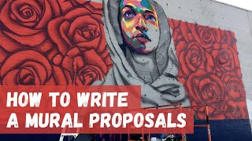

Slide 24
Write your own proposal
Executive summary (1-2 paragraphs): Who you are, what is the mural, when will you do it, where will it be, why do you want to make this mural here, how will you make the mural?
Two concept sketches/mock-ups
Brief artistic narrative describing the intent, style, colors, media, and how the design meets the client’s needs
Preparation needs, how the space needs to be prepared to begin work budget
Timeline, outlines start date, milestones, and completion date, total hours needed to complete work
Maintenance needs/plan
Artist/s resume and portfolio

Slide 25
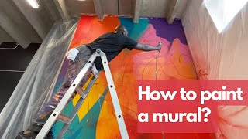
Notes:
Go paint it!

Slide 26
Rose, Bud, and Thorn
Rose: What aspects of the mural creation process were most rewarding?
Bud: What skills do you look forward to developing in the future as a result of having worked on this project?
Thorn: What was biggest obstacle you faced while working on the mural?

