Slide 2

Go, Car, Go
Newton’s 2nd Law of Motion

Slide 3
Learning Objectives
Investigate and analyze how changes in force and mass affect the acceleration of an object.
Explain and justify the relationship between force, mass, and acceleration using experimental data and the equation F=ma.
Apply Newton’s Second Law to create and solve real-world problems involving motion.

Slide 4
Essential Question
How do mass and speed affect each other?

Slide 5

Hero Boy Lifts Car Off Dad
Notes:
East Idaho News. (2017, March 3). Idaho boy says angels helped him save his dad after a car fell on him [Video]. YouTube. https://www.youtube.com/watch?v=I_dDPNOwx3U

Slide 6

Preflection
How does this video relate to Newton’s Second Law?
Notes:
K20 Center. (n.d.). Preflections. Strategies. https://learn.k20center.ou.edu/strategy/191

Slide 7
Guided Inquiry Lab
Determine the mathematical relationship between the force applied to an object and the object’s acceleration.
Example questions:
  If you change the force, will it affect its acceleration?
  If you double the force, will it decrease the acceleration?

Slide 8
Guided Inquiry Lab
Use the handout to guide your lab.
Expectations:
  Work collaboratively.
  Make careful measurements.
  Record data accurately.
  Take thorough notes on observations and analysis.

Slide 9
Open Inquiry Lab
Your goal is to determine the relationship between force, mass, and acceleration.
Use the supplies available to you to construct an experiment that produces data that will determine that relationship.

Slide 10
Open Inquiry Lab
Develop the following within your groups:
Your Hypothesis
Procedures and Materials
Data Tables
Data Analysis
Conclusion

Slide 11
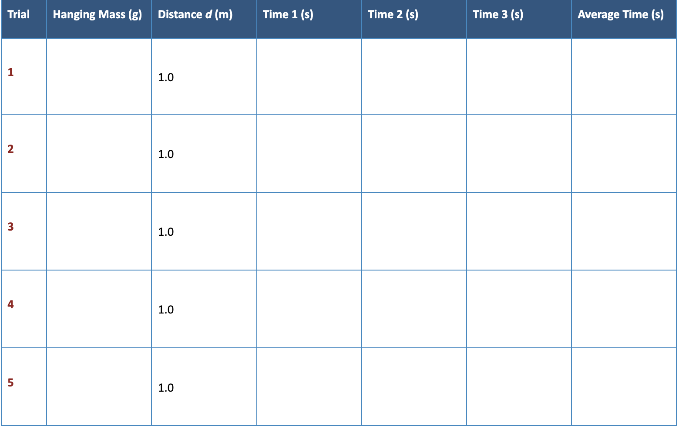
Data Table 1

Slide 12
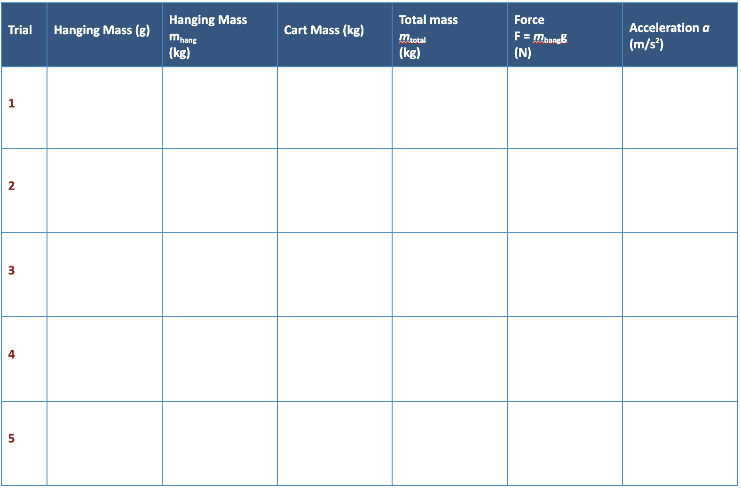
Data Table 2

Slide 13
Sample Calculations: Grams into Kilograms
Converting hanging mass to kilograms:
m_{hang} (kg) = hanging mass (g) / 1000
Trial 1 Example: 25 g
m_{hang} (kg) = 25g / 1000 = 0.025 kg
m_{hang} (kg) = 0.025 kg

Slide 14
Sample Calculations: Average Time (t_{avg})
Calculating the Average Time (t_{avg}):
(t₁+ t₂ +t₃)/ 3 = t_{avg}
Example:
(1.70s + 1.68s +1.72s) / 3 = 1.70s
t_{avg}= 1.70s

Slide 15
Sample Calculations: Measured Acceleration (a)
Calculating the acceleration (a) (starting from rest)
a = 2d / t_{avg}²
Example:
a = 2 (1.0) / 1.70² = 0.69
a = 0.69 m/s²

Slide 16
Sample Calculations: Force
Calculating the force produced by the hanging mass
F = m_{hang} x g
g = 9.8 m/s²
m_{hang}= 0.025 kg
Example:
F = 0.025 x 9.8 = 0.245 N (Newtons)

Slide 17
Sample Calculations: Percent Difference
Calculating the percent difference between your measured acceleration (a) and your predicted acceleration (a_{theory})
Percent difference (% diff) = ( a - a_{theory} ) / a_{theory} x 100
= |(0.754 - 0.693)| / 0.754 X 100 =
(0.061/0.754) x 100 =
0.08 x 100 = 8.0%

Slide 18

Research Poster
Your poster should include:
Title
Goal
Hypothesis
Procedure
Data Tables
Analysis
Conclusion
Notes:
K20 Center. (n.d.). Research poster. Strategies. https://learn.k20center.ou.edu/strategy/49

Slide 19
Research Poster
Share the following from your poster:
Main findings
Conclusions
Notes:
K20 Center. (n.d.). Research Poster. Strategies. https://learn.k20center.ou.edu/strategy/49

Slide 20

CER (Claim-Evidence-Reasoning)
Using the CER Strategy, answer the following:
What does your experiment show about the relationship between force, mass, and acceleration?
  C - Make a claim.
  E - Provide evidence to back your claim.
  R - Provide reasoning that supports your claim.
Notes:
K20 Center. (n.d.). CER. Strategies. https://learn.k20center.ou.edu/strategy/156

Slide 21
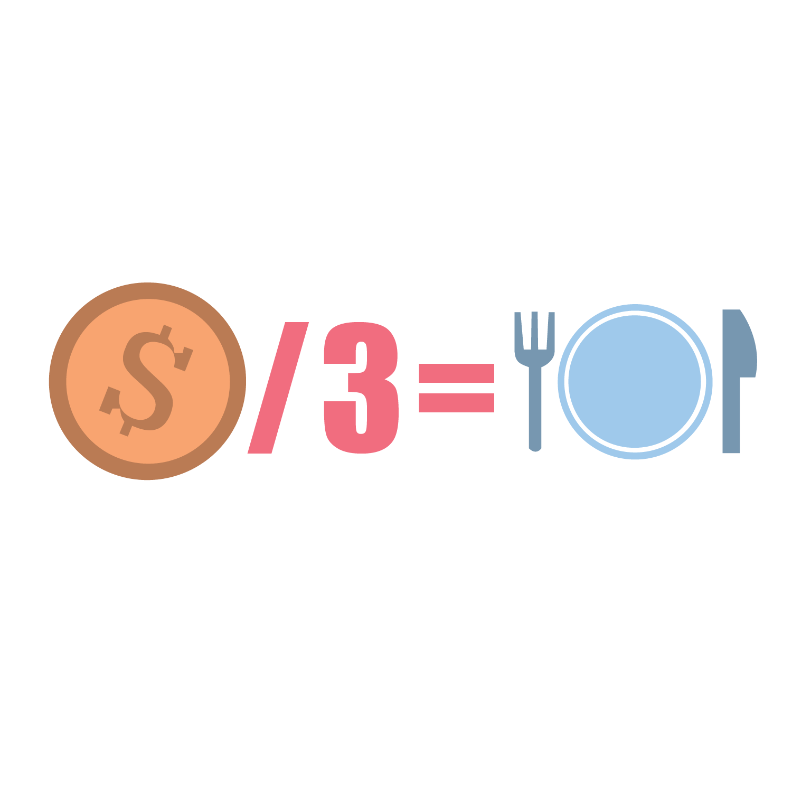
Create the Problem
The problem should include:
  The mass of an object
  Acceleration OR Force
  Real context (a cart, bike, or ball)
Notes:
K20 Center. (n.d.). Create the problem. Strategies. https://learn.k20center.ou.edu/strategy/149

Slide 22
Create the Problem
Solve your own problem to make sure it works!
Then, provide an explanation of how your problem demonstrates Newton’s Second Law.
  Connect your problem to force, mass, and acceleration.
Notes:
K20 Center. (n.d.). Create the problem. Strategies. https://learn.k20center.ou.edu/strategy/149

Slide 23
Create the Problem
Trade your problem with a partner.
Solve each other’s scenarios.
Notes:
K20 Center. (n.d.). Create the problem. Strategies. https://learn.k20center.ou.edu/strategy/149

