Slide 2

Too Late to Apologize

Slide 3
Essential Question
What conditions cause citizens to rebel against their government?

Slide 4
Learning Objectives
Develop an understanding of the grievances of the American colonists.
Consider how those grievances led to the American Revolution.

Slide 5
Too Late to Apologize
As you watch the video, think about these questions:
Who is the author of this song, or “declaration?” (Who do the singers represent?)
What is the main idea of the song, or “declaration?”
Who is the audience? In other words, for whom is the song or “declaration” created?
What is the significance of the main idea of this song, or “declaration?”

Slide 6
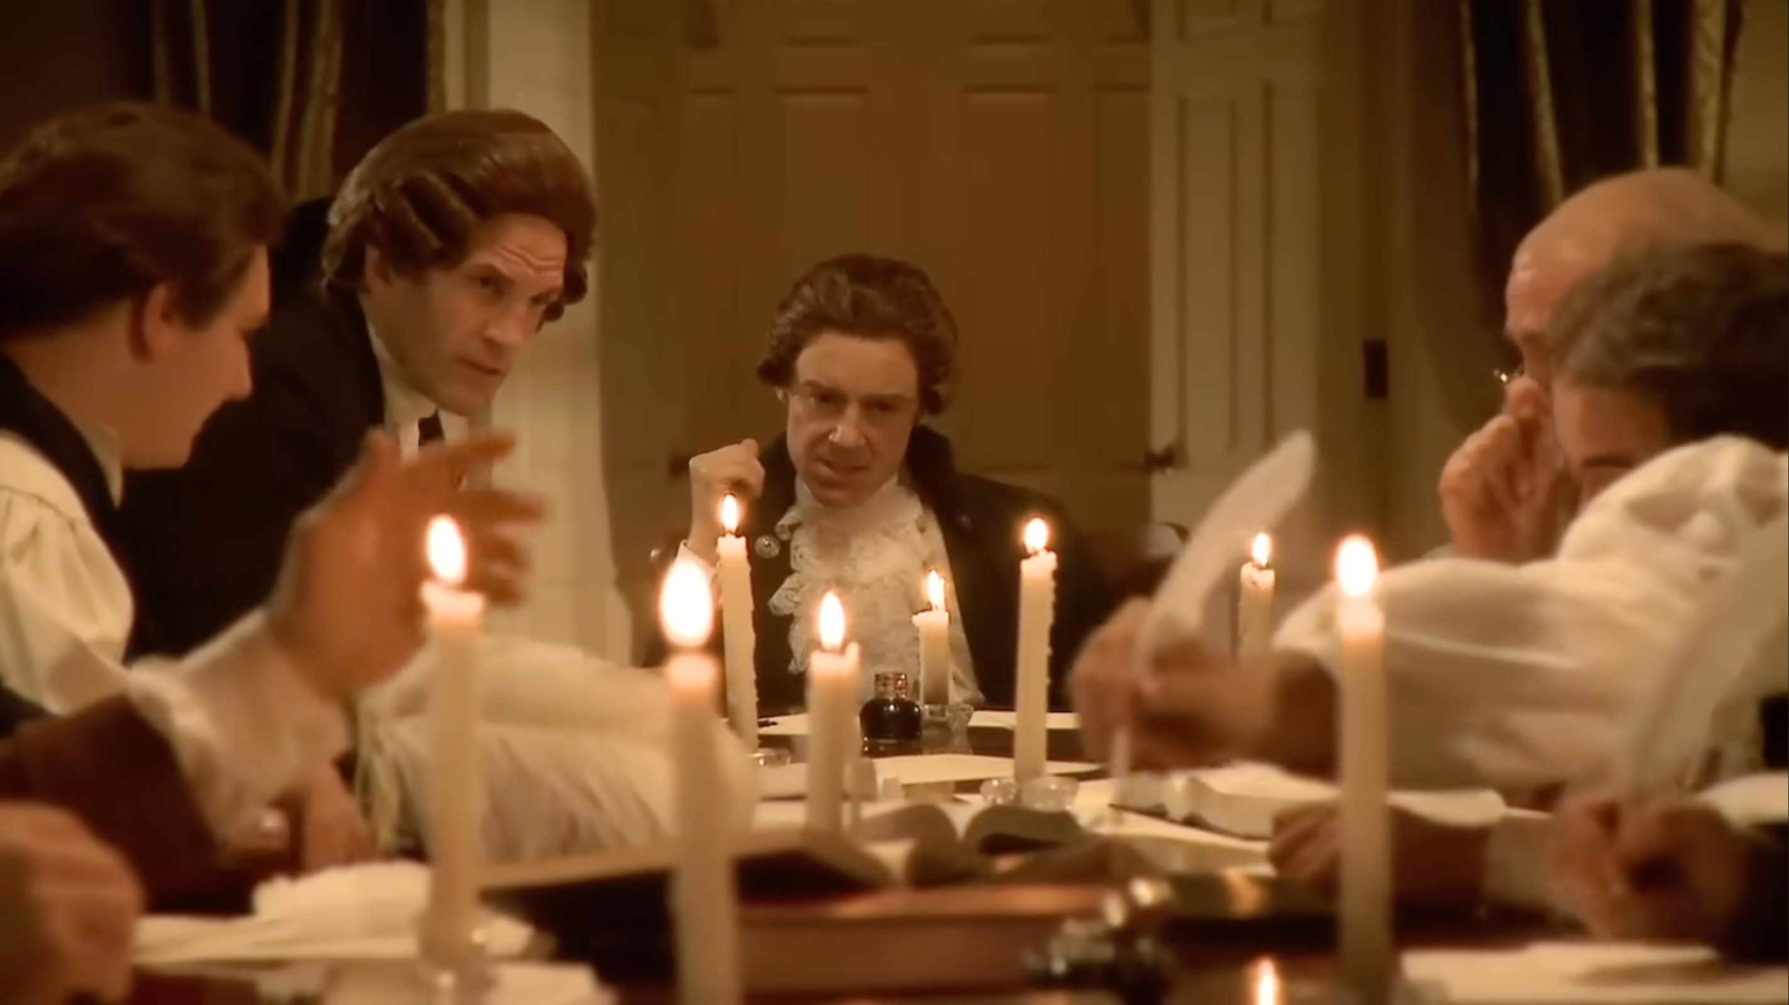
Too Late To Apologize
Notes:
Soomo. (2010). Too late to apologize: A declaration [Video]. YouTube. https://www.youtube.com/watch?v=uZfRaWAtBVg

Slide 7

Card Sort Activity
Match the Four Principles of Government with their definitions.
Notes:
K20 Center. (n.d.). Card sort. Strategies. https://learn.k20center.ou.edu/strategy/147

Slide 8

Categorical Highlighting
As a group, choose one color for each of the Four Principles of Government.
Highlight the grievances or complaints you find in the lyrics of "Too Late to Apologize.”
For each grievance, use the color that matches the Principle of Government to which it connects.
Notes:
K20 Center. (n.d.). Categorical highlighting. Strategies. https://learn.k20center.ou.edu/strategy/192

Slide 9
Four Principles of Government
Popular Sovereignty | The powers of government come from the people and the consent of the governed.
Inalienable Rights | Every person has the right to life, liberty, and the pursuit of happiness.
Equality and Justice | All people are created equal and receive equal treatment under the law.
Abolishment | When a government becomes destructive, it is the right of the people to change or remove it.

Slide 10

Anchor Chart
Select one of the Principles of Government.
The names of the Principles are already written at the top of the page for your convenience.
List the grievances connected to that Principle on the chart. Arrange them in order from the most upsetting for the colonists to the least upsetting.
Include a full-color illustration of the Principle you have chosen to highlight.
Notes:
K20 Center. (n.d.). Anchor charts. Strategies. https://learn.k20center.ou.edu/strategy/58

Slide 11

What Did I Learn Today?
Reflect on the following questions and
explain your reasoning.
Summarize the reasons the American colonists gave for declaring independence from England.
Were the colonists justified in declaring independence? Support your answer with at least one grievance from the Declaration and the Principle of Government it violated.
Notes:
K20 Center. (n.d.). What did I learn today? Strategies. https://learn.k20center.ou.edu/strategy/d9908066f654727934df7bf4f5078797

