Slide 2
Too Late to Apologize
U.S. History
8th Grade

Slide 3
Essential Questions
Why do citizens rebel against a government?
What would cause citizens to rebel against a government?

Slide 4
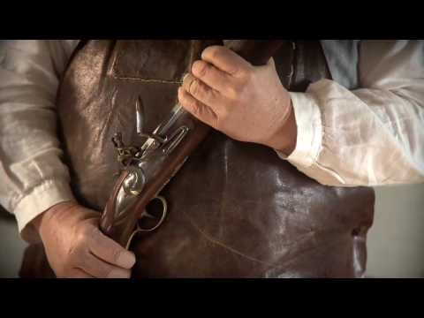
As you watch the video, think about these questions:
Too Late To Apologize
Who is the author of this song, or “declaration”? (Who do the singers represent?)
What is the main idea of the song, or “declaration”?
Who is the audience? In other words, for whom is the song or “declaration” created?
What is the significance of the main idea of this song, or “declaration”?

Slide 5
Card Sort Activity
Match the four principles of government with their definitions.

Slide 6
Card Sort Activity
Highlight or Circle the grievances or complaints in the lyrics of “Too Late to Apologize.
Identify which principle of government addresses each grievance.

Slide 7
Four Principles of Government
The powers of government come from the people and the consent of the governed.
Every person has the right to life, liberty, and the pursuit of happiness.
All people are created equal and receive equal treatment under the law.
When a government becomes destructive, it is the right of the people to change or remove it.
Popular Sovereignty
Inalienable Rights
Equality & Justice
Abolishment

Slide 8

Socratic Seminar Preparation

Slide 9
Socratic Seminar
1. Using the text of the Declaration of Independence, answer this question as a group:
Were the colonists justified in their decision to declare independence? Why or why not?
Use text and your understanding of the principles of government to explain your reasoning.

Slide 10
Socratic Seminar
2. Create two higher order thinking (HOT)* questions about the text of the Declaration of Independence to discuss with other groups.

Slide 11
*HOT Questions
Higher order thinking questions ask for more than recalling the facts.
They are used to
APPLY knowledge gained from reading,
ANALYZE what was read, EVALUATE its meaning, and
CREATE new ideas from the reading.
Examples
Not HOT Question: (Recall, Level 1) Who wrote the Declaration of Independence?
HOT Question: (Evaluate, Level 5)
What grievances were probably MOST upsetting to the colonists?

Slide 12
What Did I Learn Today?
Write for five minutes about ONE of these topics:
Summarize the seminar topic. Were the colonists justified in declaring their independence? Why or why not?
If you had a list of grievances for your government, what would they be? How should they be addressed by the government?
Could a war between the colonists and England have been prevented? Why or why not?

