Slide 2
Just a Dash of Punctuation
The Weirdest Sentence I’d Ever Heard

Slide 3
Essential Question
How do dashes impact writing?

Slide 4
Lesson Objectives
Students will identify dashes.
Students will create a paragraph using dashes.

Slide 5

Serve Up Some Punctuation
Work with partner to add punctuation to your recipe.
You have 5 minutes to add as much punctuation as you think is necessary.
  Try your best.
  Remember, you can add a period and capitalize the next word to break apart 2 sentences.
Notes:
K20 Center. (2021, September 21). K20 Center 5 minute timer. [Video]. YouTube. https://youtu.be/EVS_yYQoLJg?si=fJvuvFWH3vJ3B0z9

Slide 6

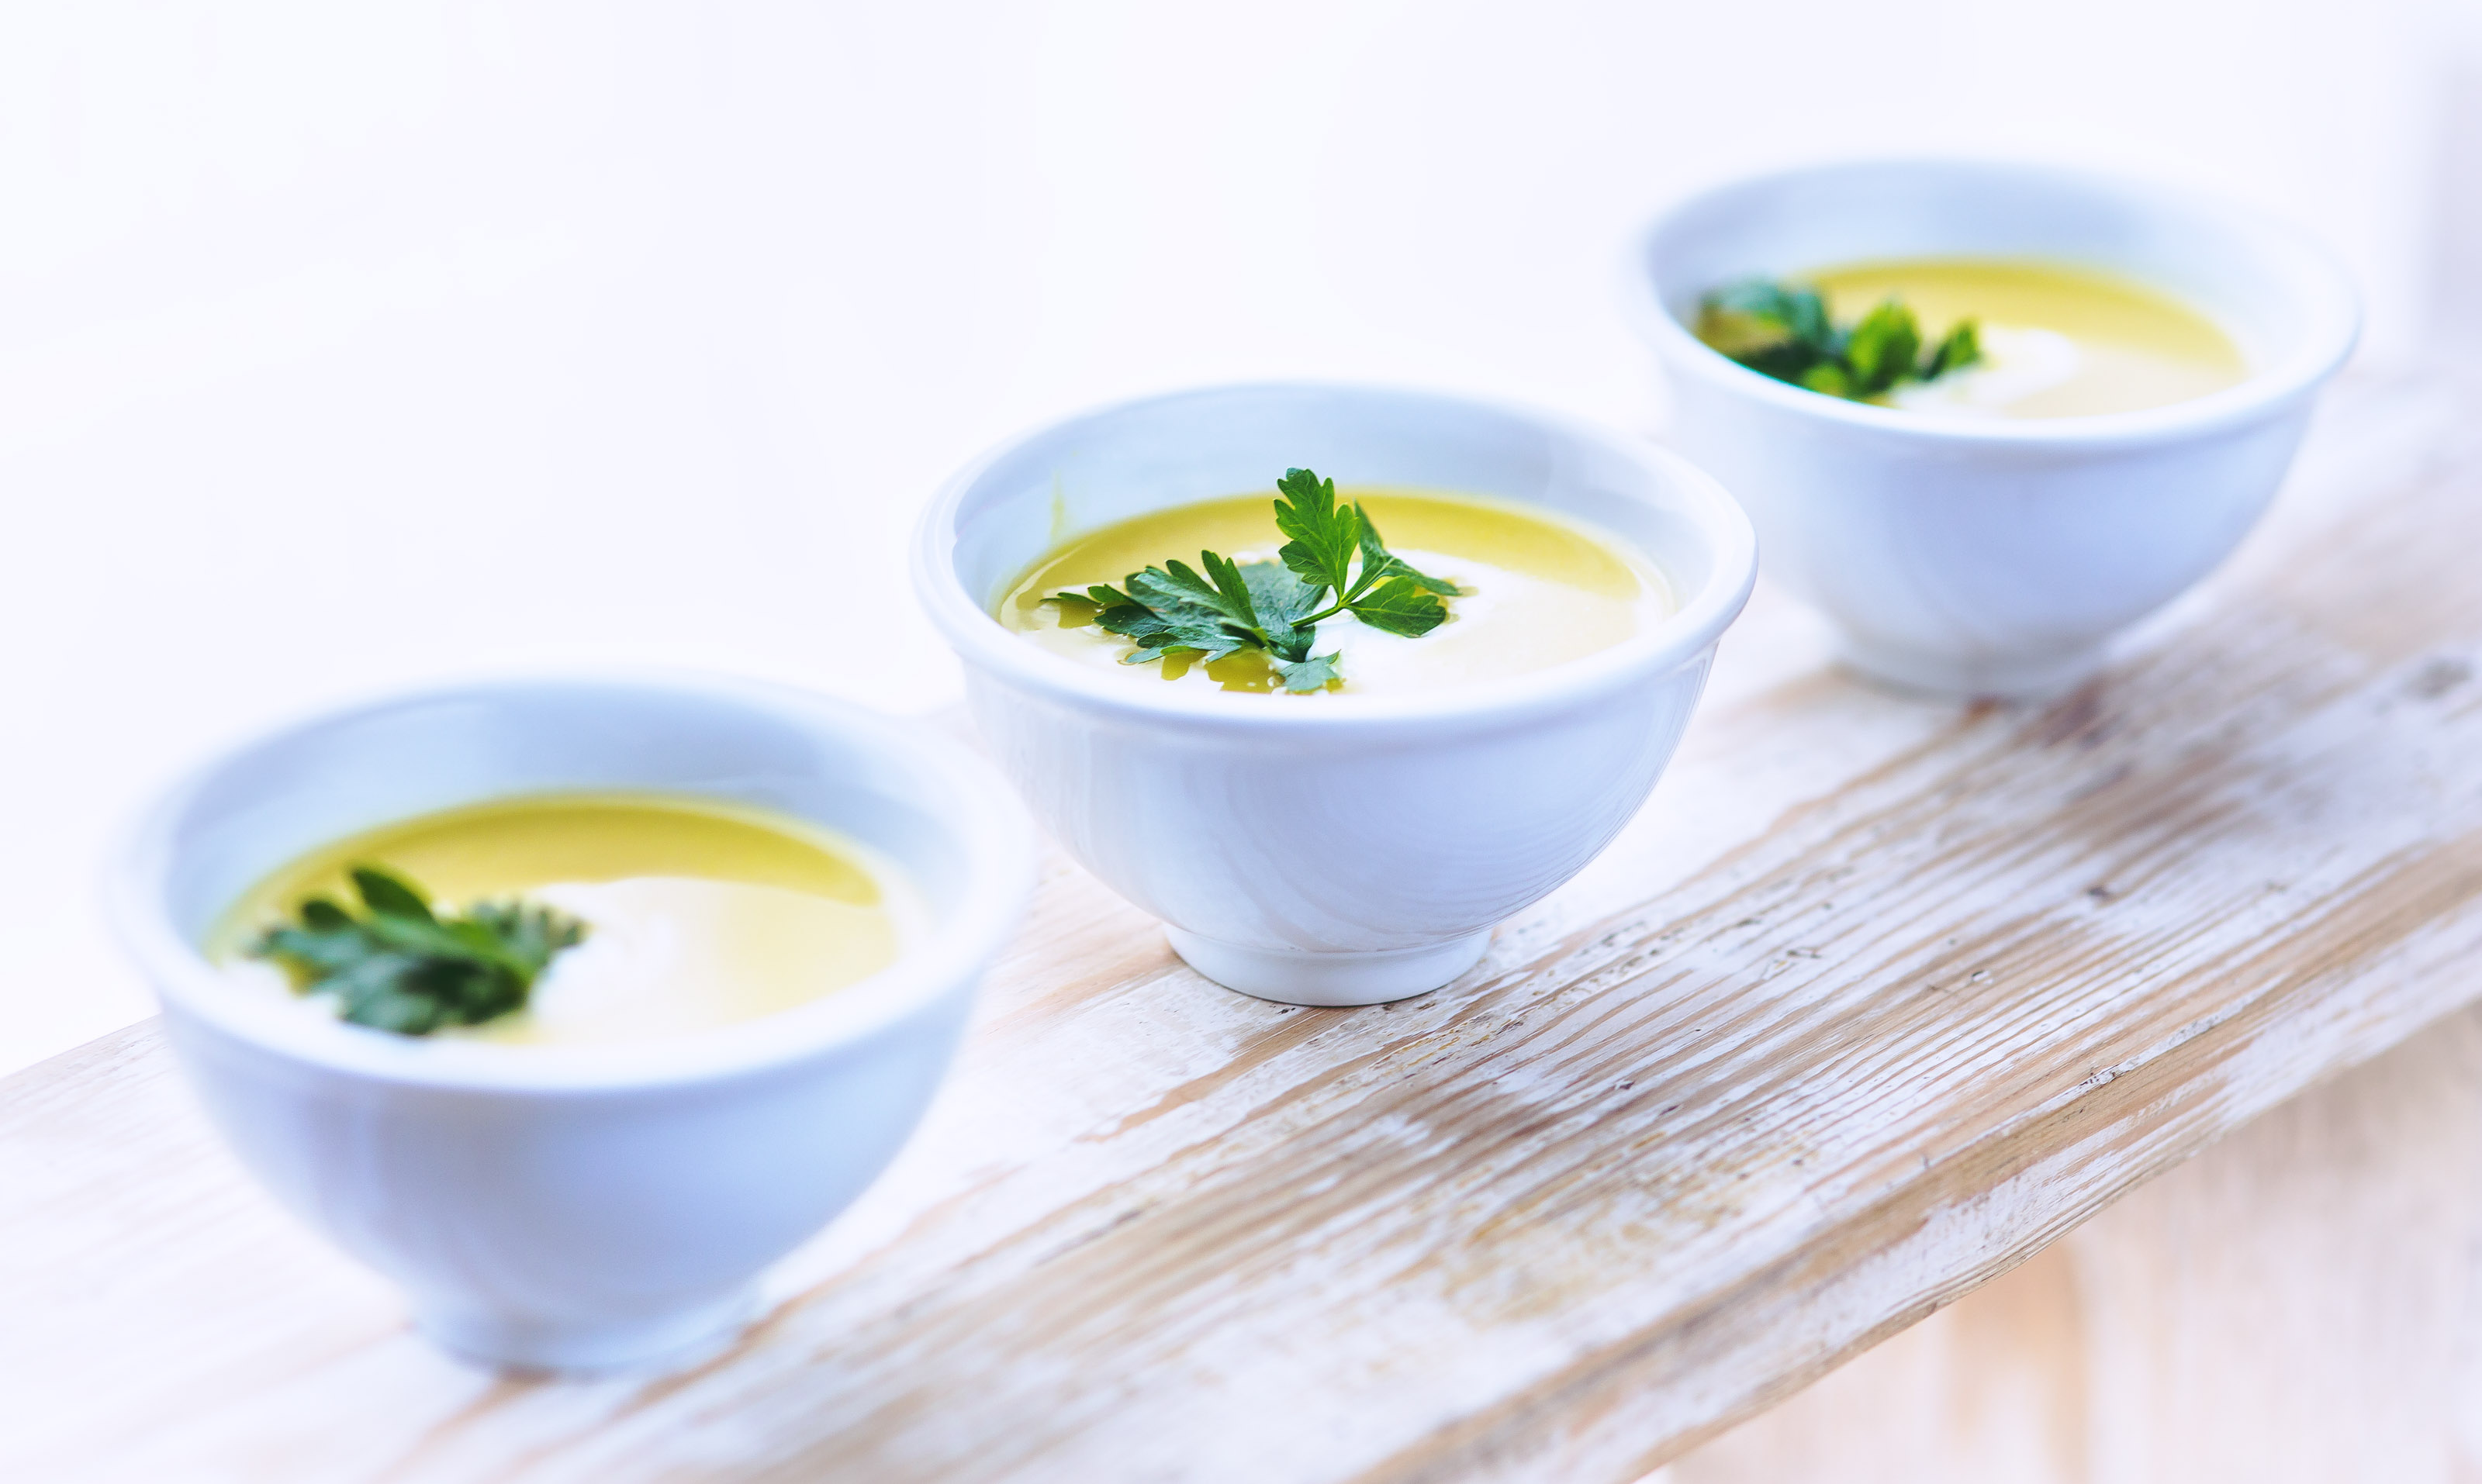
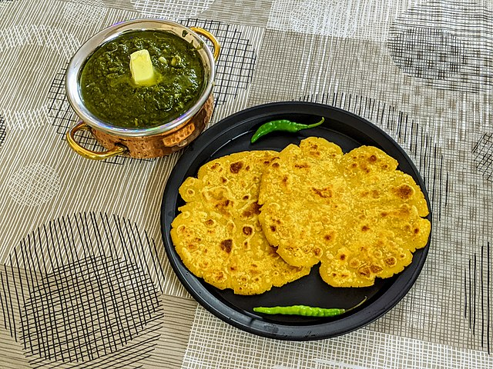
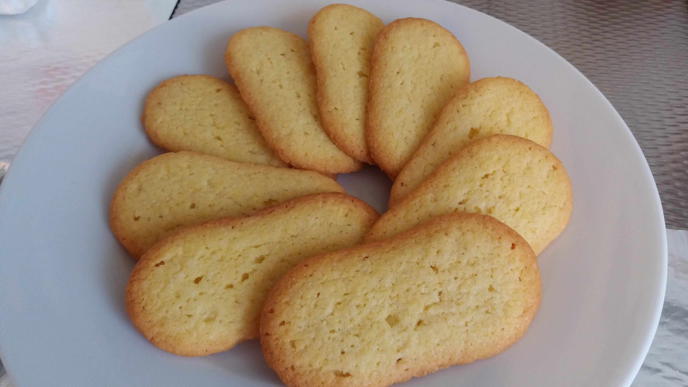
Serve Up Some Punctuation
Quail Consommé
5-Minute Timer
Sarson ka Saag
Langues de Chat
Makki ki Roti
Notes:
K20 Center. (2021, September 21). K20 Center 5 minute timer. [Video]. YouTube. https://youtu.be/EVS_yYQoLJg?si=fJvuvFWH3vJ3B0z9
Arya, G. (2022, December 18). Makki ki Roti & Sarso ka Saag [Online image]. March 4, 2024 from https://commons.wikimedia.org/wiki/File:Makki_ki_Roti_%26_Sarso_ka_Saag.jpg
Bukietowa, H. (February 19, 2022). Cattongues. [Photograph]. Wikimedia Commons. https://commons.wikimedia.org/wiki/File:Cattongues.jpg
Kaboompics. (n.d.). Soup. [Photograph]. Freerange Stock. https://freerangestock.com/photos/77824/photo-details.html

Slide 7
Marinate on the Story
As you read Cooking Time, highlight or circle each dash that you come across.
Try to notice a pattern of how the dashes are used.
Notes:
K20 Center. (n.d.). Inverted Pyramid. Strategies. https://learn.k20center.ou.edu/strategy/173

Slide 8

Whip Up Some Rules
Find a partner.
Discuss what you think about how different dashes are being used.
  What, if anything, are they replacing?
  How do they add to the meaning of the sentence or story?
  Was there anything predictable about how they were used?
Notes:
K20 Center. (n.d.). Inverted Pyramid. Strategies. https://learn.k20center.ou.edu/strategy/173

Slide 9
Whip Up Some Rules
Hyphens: -
En Dashes: –
Em Dashes: —
Other than their length, what are their other differences?
  How are they used differently?
Notes:
K20 Center. (n.d.). Inverted Pyramid. Strategies. https://learn.k20center.ou.edu/strategy/173

Slide 10
Now We’re Cooking
Hyphen
-
En Dash
–
Em Dash
—

Slide 11
Now We’re Cooking: Note Catcher
Hyphen
-
Used to join words together
to create compound words
short-lived
En Dash
–
Used in a range of numbers or dates
1985–2003
Em Dash
—
Used to separate sets of words—such as interjections or parenthetical phrases—for emphasis
Knowing how to use these—these important punctuation marks—will help your writing stand out.

Slide 12
Now We’re Cooking: Note Catcher
N
The en dash is the width of an “N.”
M
The em dash is the width of an “M.”

Slide 13
Now We’re Cooking: Which Dash?
Which dash is used to denote the beginning and end dates of an historical period?
Notes:
en dash

Slide 14
Now We’re Cooking: Which Dash?
Which dash is used in place of a colon or semicolon to link clauses when the following clause explains, summarizes, or expands upon the preceding clause in a dramatic way?
Notes:
em dash

Slide 15
Now We’re Cooking: Which Dash?
Which dash is used to set off illustrative or amplifying material introduced by phrases such as for example, namely, and that is, when the break in continuity is greater than what a comma can do?
Notes:
em dash

Slide 16
Now We’re Cooking: Which Dash?
Which dash is used to replace the word versus?
Notes:
en dash

Slide 17
Now We’re Cooking: Which Dash?
Which dash is used for a range of numbers or dates?
Notes:
en dash

Slide 18
Now We’re Cooking: Which Dash?
Which dash is used in place of commas or parentheses to emphasize or draw attention to the parenthetical material?
Notes:
em dash

Slide 19
Now We’re Cooking: Which Dash?
Which dash is used to introduce a summary statement that follows a series of words or phrases?
Notes:
em dash

Slide 20
Sprinkle in Some Punctuation
On the back of your handout, rewrite the following sentence without the dashes.
It was that episode when they went back to ancient Crete and had a pressure test for calamari dolmas on a bed of rocket and cilantro salad, and at the end of it, Mandy turned to me and said — and I remember this clearly, ‘cause it was just the weirdest sentence I’d ever heard — “I would have caramelized squid ink for the vinaigrette.”
Notes:
Roy, A. (2014) Cooking Time.CommonLit.

Slide 21
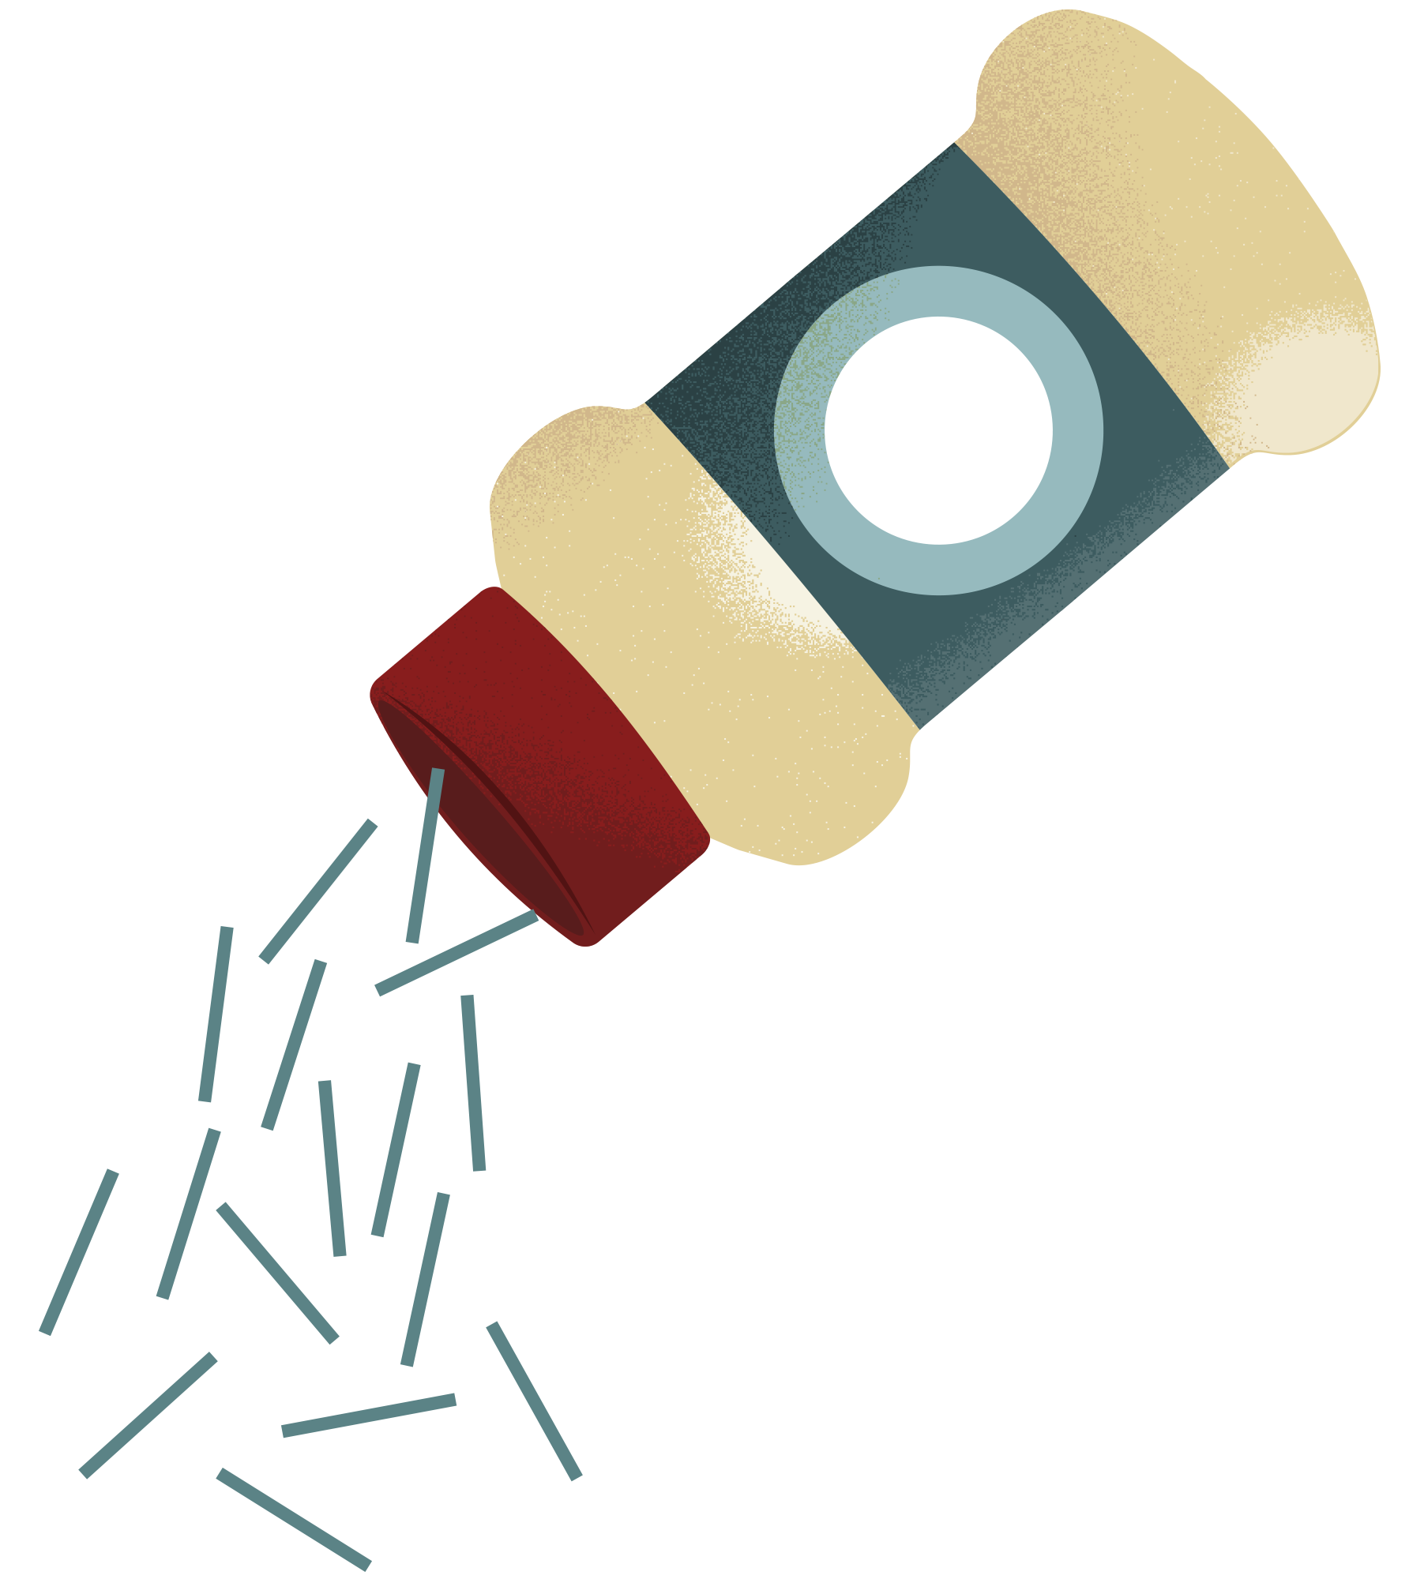
Sprinkle in Some Punctuation
Rewrite each sentence to demonstrate your understanding of dashes.

Slide 22
Food for Thought
Think about the Cooking Time story you read earlier.
What do you think led up to this situation in “Cooking Time?”
What logically follows the end of “Cooking Time?”
Write a paragraph response to one of the prompts above using at least 4 dashes.

Slide 23

Food for Thought: Lesson Reflection
How would you rate your level of comfort when using dashes?
At the top of your paper, write one of the following numbers.
  0 – I am lost.
  1 – I understand a little.
  2 – I understand but need some help.
  3 – I have basic knowledge about this.
  4 – I know how to use them and do not need help.
  5 – I could teach a friend how to use dashes.
Notes:
K20 Center. (n.d.). Fist to Five. Strategies. Retrieved from https://learn.k20center.ou.edu/strategy/68

