Slide 2

Screaming into the Void
Existentialism

Slide 3
Essential Questions
How do you find purpose and meaning in life?
Does purpose give you motivation, or does motivation give you purpose?

Slide 4
Learning Objectives
Students will be able to:
Understand existentialism.
Represent their purpose in life (at this point in time).
Research existentialism in modern art.

Slide 5

Notes:
Holland, Dean. (Director & Producer). (2018, July 4). The good place. (Season 2, Episode 1).. YouTube. (https://youtu.be/bbcAPxQ3YLA?si=1CS2SZ69vCnxC4rf

Slide 6

Notes:
YouTube. (2016, November 21). Westworld - consciousness does not exist, Anthony Hopkins. YouTube. https://www.youtube.com/watch?v=S94ETUiMZwQ
Season 1, Episode 8.

Slide 7
Define Existentialism
If these two clips were all the information you had on existentialism, how would you define it?
Write your own definition of existentialism on a sticky note.

Slide 8

It’s OPTIC-al
On your paper, write OPTIC down the left side.
O- Write observations about the visuals you see.
P- List the parts, or details, you notice.
T- Assess the title.
  How does it relate?
  If there is no title, give it one.
I- Determine the interrelationships of the visuals.
  How do they work together?
C- Come to a conclusion about the image.
Notes:
K20 Center. (n.d.). It’s OPTIC-AL. Strategies. Retrieved from https://learn.k20center.ou.edu/strategy/99

Slide 9
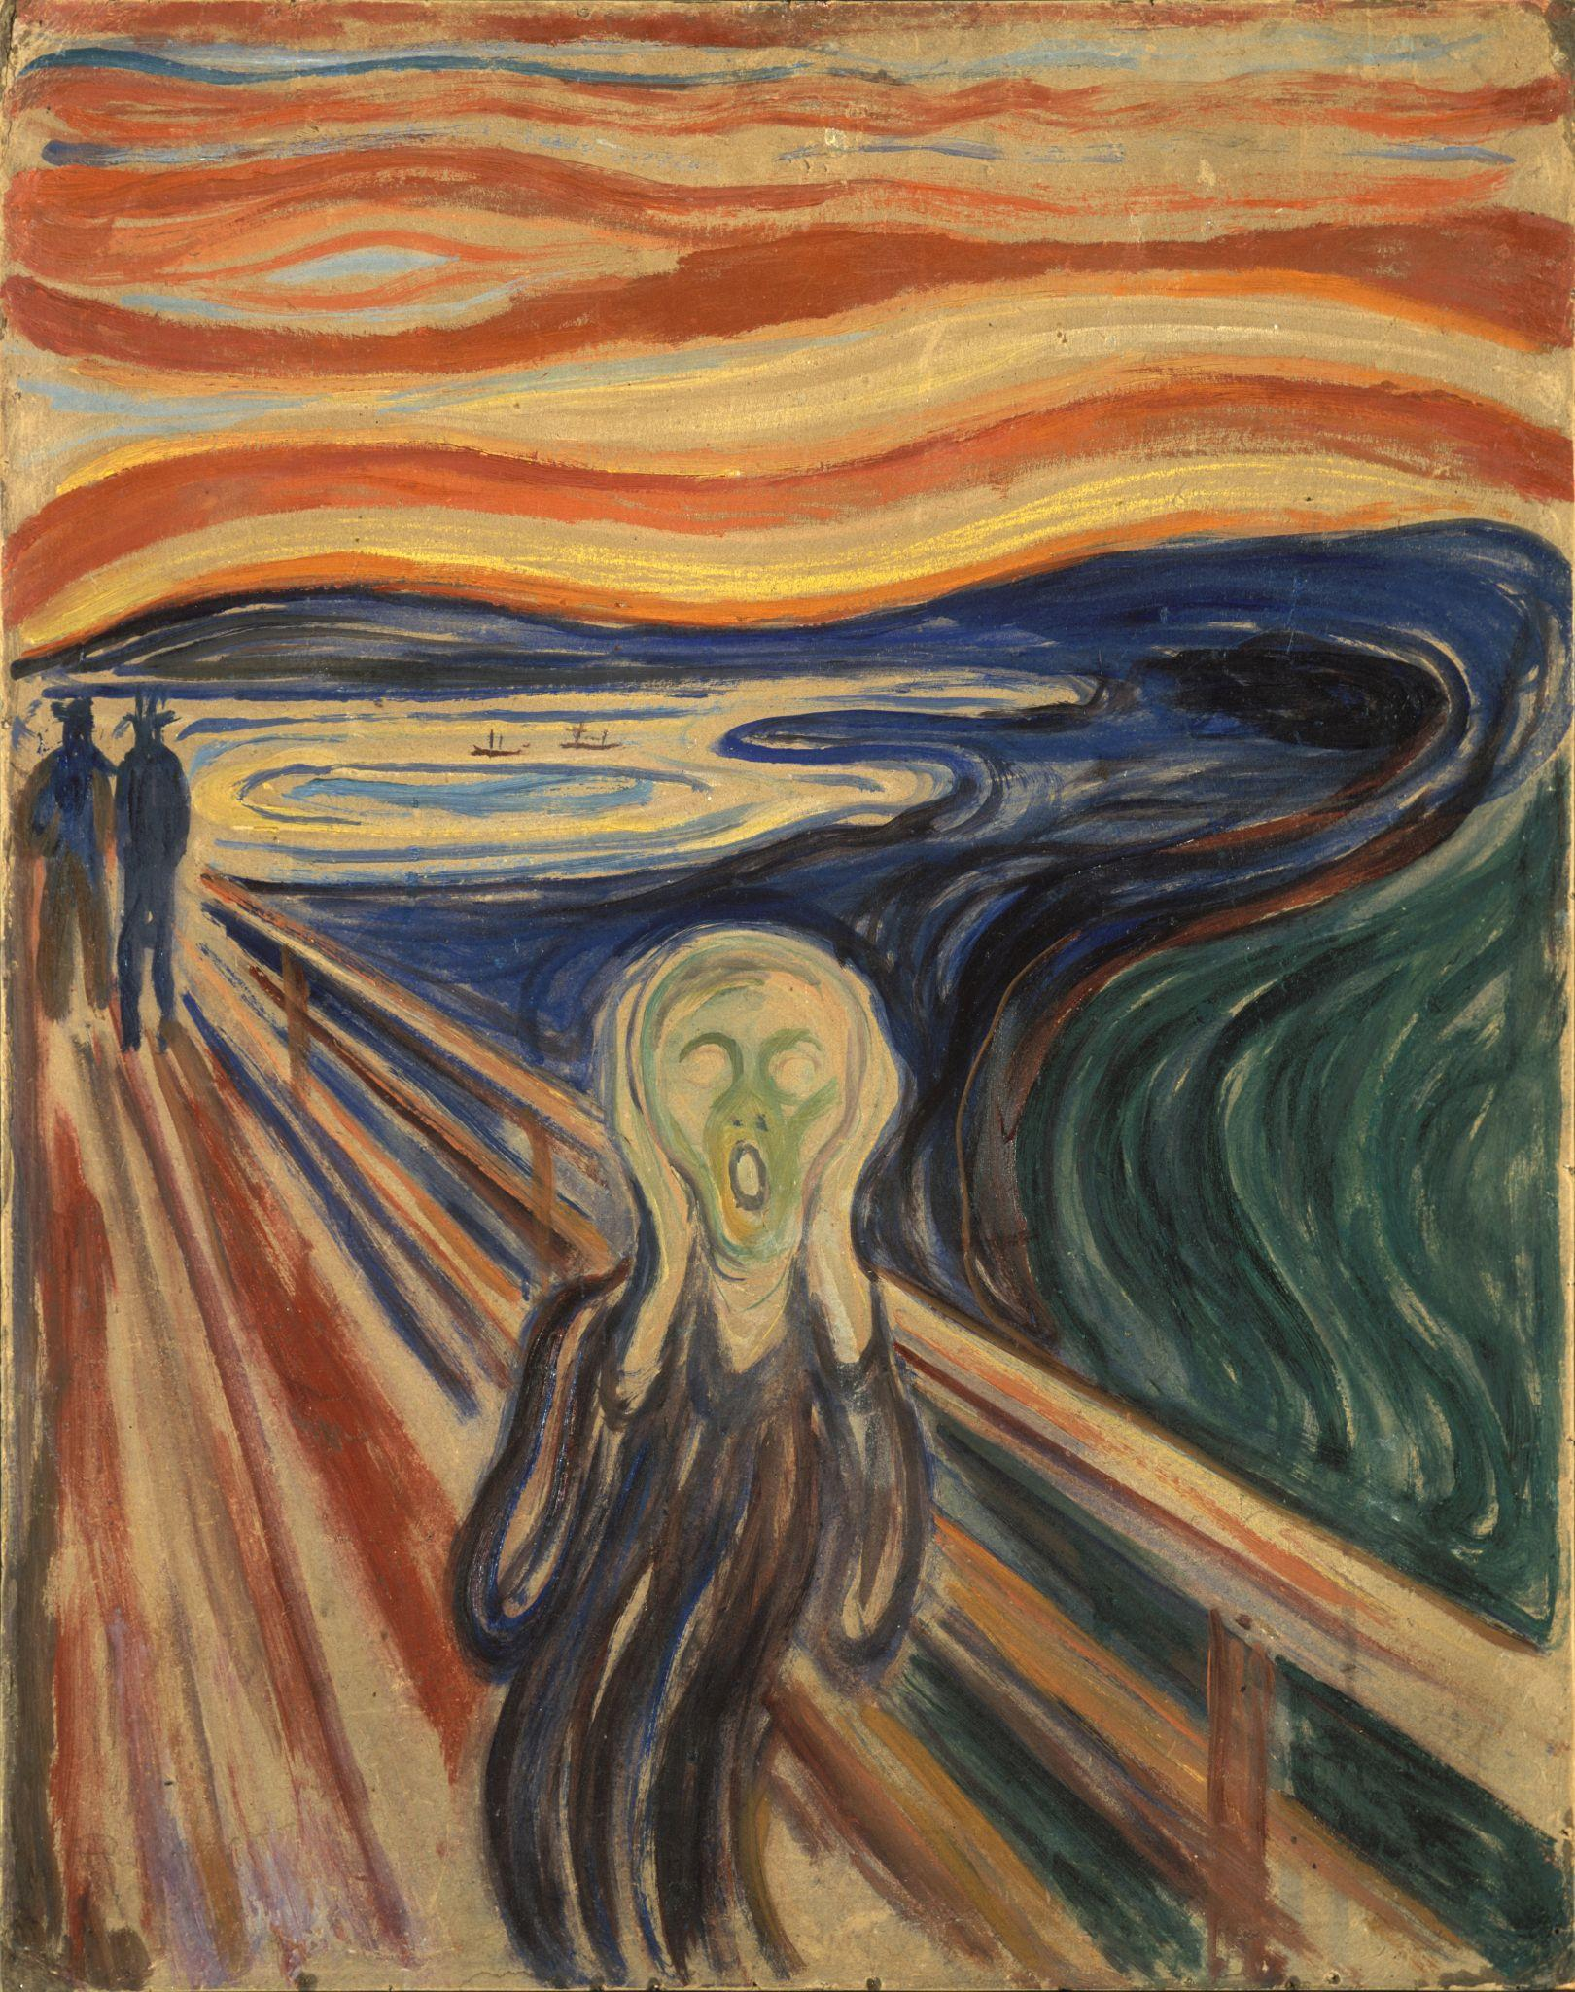
O- Write observations about the visuals you see.
P- List the parts, or details, you notice.
T- Assess the title.
  How does it relate?
  If there is no title, give it one.
I- Determine the interrelationships of the visuals.
  How do they work together?
C- Come to a conclusion about the image.
Munch, E. (2021). Edvard Munch - The Scream - Google Art Project. Wikimedia Commons. Retrieved February 2, 2024, from https://commons.wikimedia.org/wiki/File:Edvard_Munch_-_The_Scream_-_Google_Art_Project.jpg.
Notes:
Munch, E. (2021). Edvard Munch - The Scream - Google Art Project. Wikimedia Commons. Retrieved February 2, 2024, from https://commons.wikimedia.org/wiki/File:Edvard_Munch_-_The_Scream_-_Google_Art_Project.jpg.

Slide 10
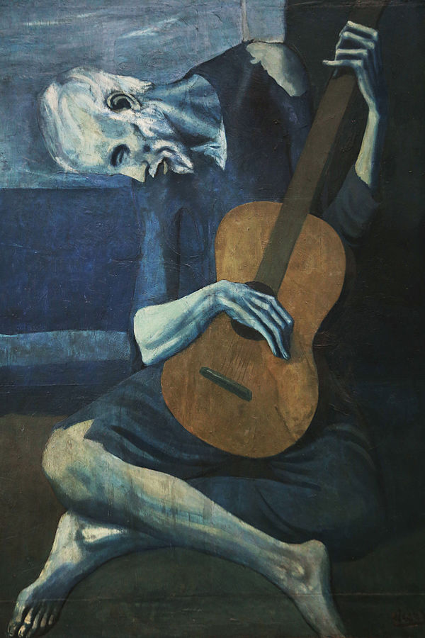
O- Write observations about the visuals you see.
P- List the parts, or details, you notice.
T- Assess the title.
  How does it relate?
  If there is no title, give it one.
I- Determine the interrelationships of the visuals.
  How do they work together?
C- Come to a conclusion about the image.
Picasso, P. (1904). The Old guitarist [Online image]. Retrieved June 18, 2020 from https://en.wikipedia.org/wiki/The_Old_Guitarist
Notes:
Picasso, P. (1904). The Old guitarist [Online image]. Retrieved June 18, 2020 from https://en.wikipedia.org/wiki/The_Old_Guitarist

Slide 11
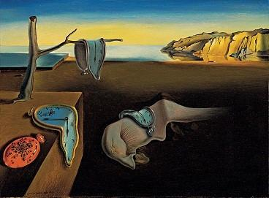
O- Write observations about the visuals you see.
P- List the parts, or details, you notice.
T- Assess the title
  How does it relate?
  If there is no title, give it one.
I- Determine the interrelationships of the visuals.
  How do they work together?
C- Come to a conclusion about the image.
Dali, S. (1931). The Persistence of memory [Online image]. Retrieved June 18, 2020 from https://en.wikipedia.org/wiki/The_Persistence_of_Memory
Notes:
Dali, S. (1931). The Persistence of memory [Online image]. Retrieved June 18, 2020 from https://en.wikipedia.org/wiki/The_Persistence_of_Memory

Slide 12
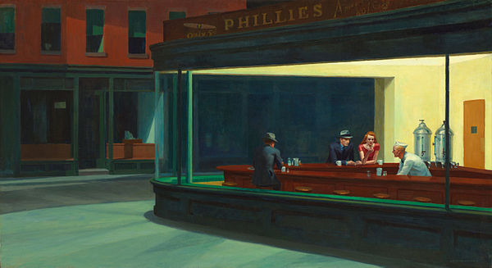
O- Write observations about the visuals you see.
P- List the parts, or details, you notice.
T- Assess the title.
  How does it relate?
  If there is no title, give it one.
I- Determine the interrelationships of the visuals.
  How do they work together?
C- Come to a conclusion about the image.
Hopper, E. (1942). Nighthawks [Online image]. Retrieved June 18, 2020 from https://en.wikipedia.org/wiki/Nighthawks_(painting)
Notes:
Hopper, E. (1942). Nighthawks [Online image]. Retrieved June 18, 2020 from https://en.wikipedia.org/wiki/Nighthawks_(painting)

Slide 13
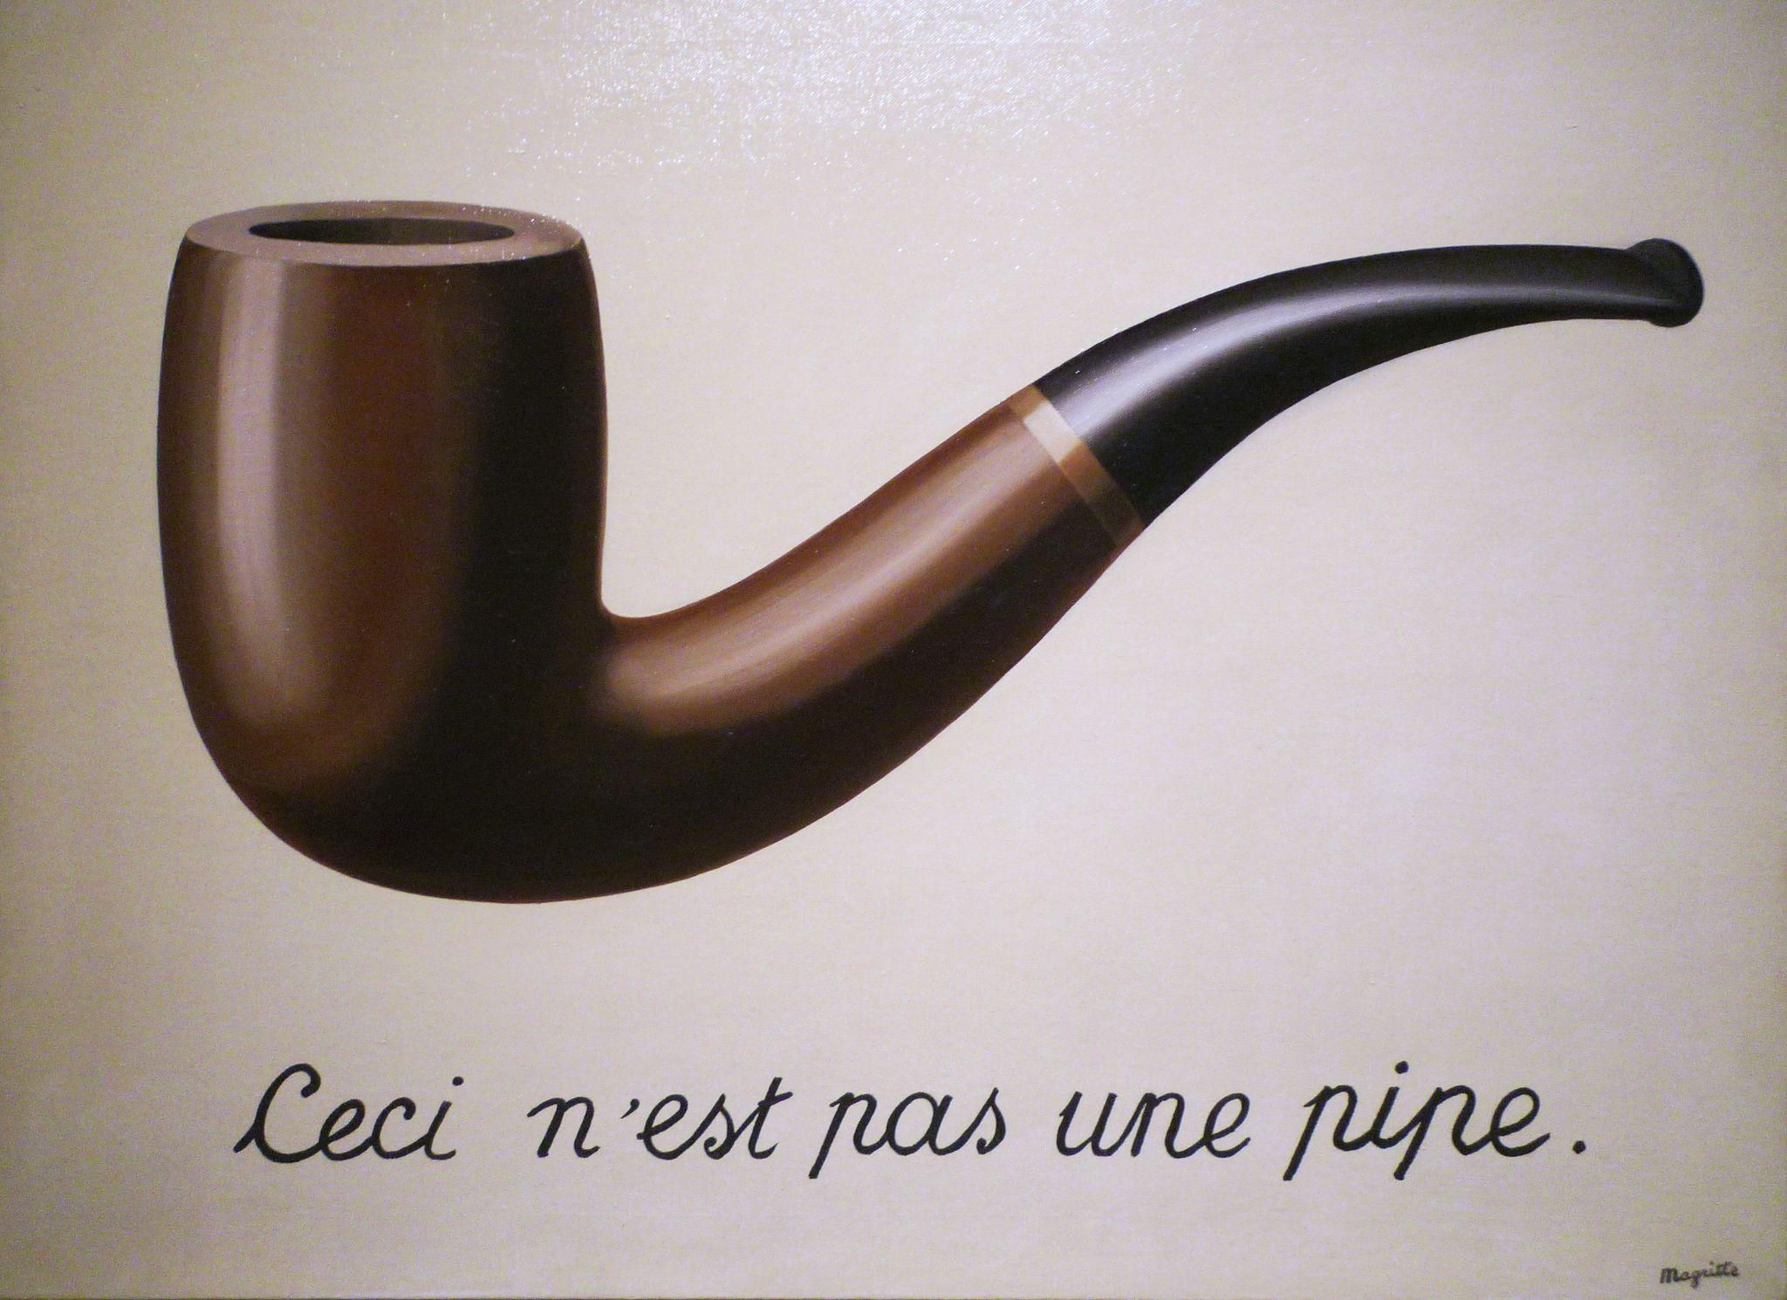
O- Write observations about the visuals you see.
P- List the parts, or details, you notice
T- Assess the title.
  How does it relate?
  If there is no title, give it one.
I- Determine the interrelationships of the visuals.
  How do they work together?
C- Come to a conclusion about the image.
Magritte, R. (2009). Magritte, The Treachery of Images. flickr. Retrieved February 2, 2024, from https://www.flickr.com/photos/profzucker/3320751204.
Notes:
Magritte, R. (2009). Magritte, The Treachery of Images. flickr. Retrieved February 2, 2024, from https://www.flickr.com/photos/profzucker/3320751204.

Slide 14
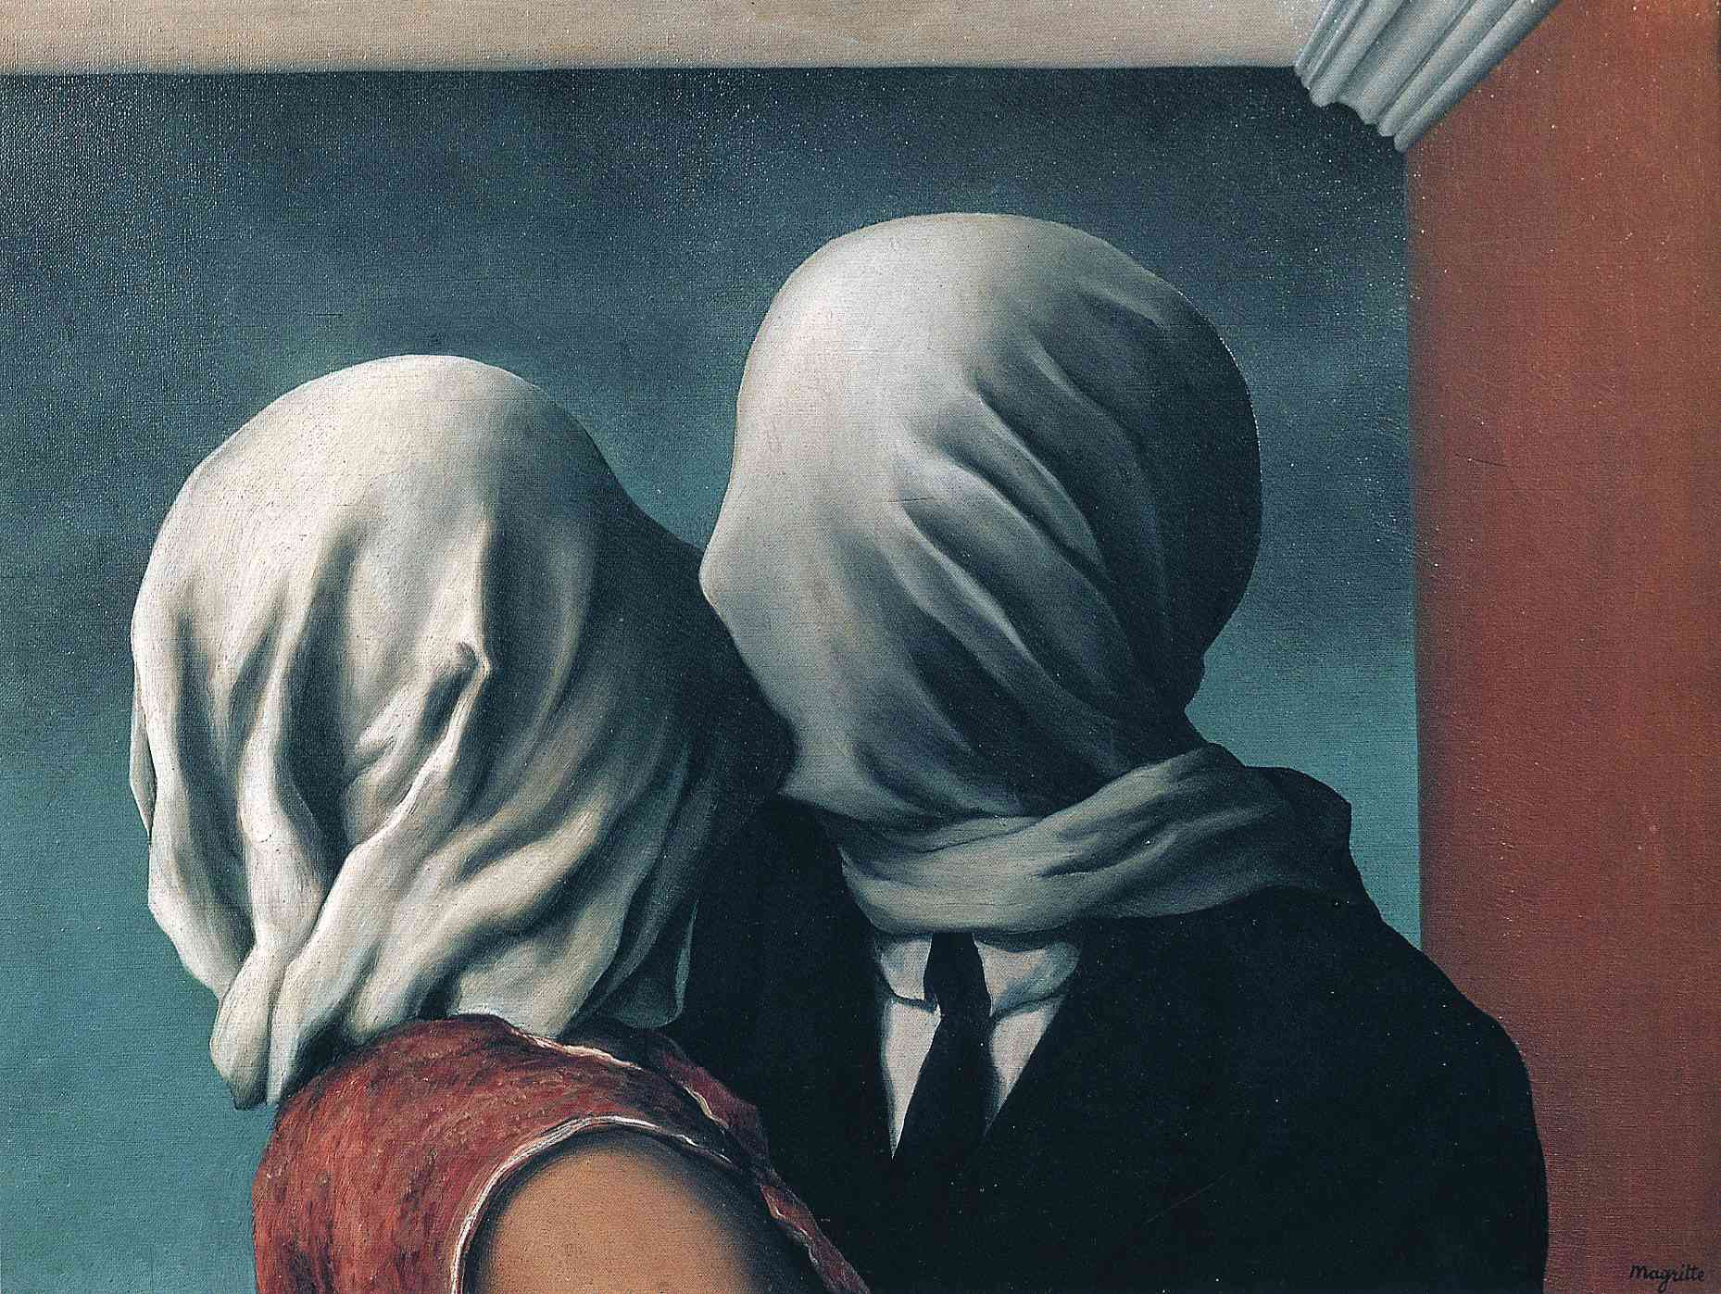
O- Write observations about the visuals you see.
P- List the parts, or details, you notice.
T- Assess the title.
  How does it relate?
  If there is no title, give it one.
I- Determine the interrelationships of the visuals.
  How do they work together?
C- Come to a conclusion about the image.
Magritte, R. (2012). René Magritte - The Lovers [1928]. flickr. Retrieved February 2, 2024, from https://www.flickr.com/photos/gandalfsgallery/7341046518.
Notes:
Magritte, R. (2012). René Magritte - The Lovers [1928]. flickr. Retrieved February 2, 2024, from https://www.flickr.com/photos/gandalfsgallery/7341046518.

Slide 15
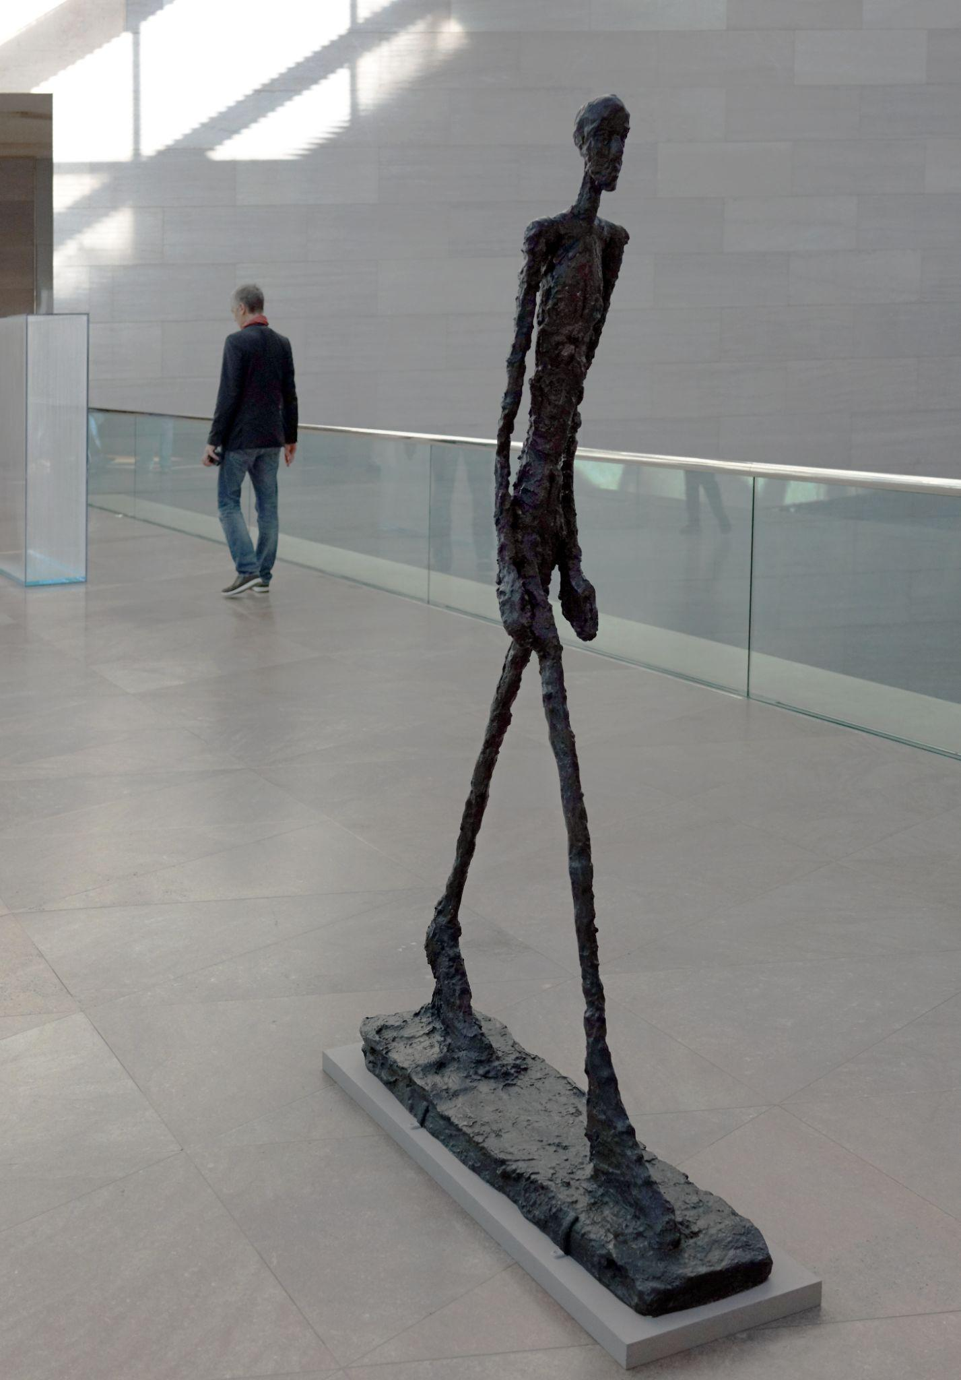
O- Write observations about the visuals you see.
P- List the parts, or details, you notice.
T- Assess the title.
  How does it relate?
  If there is no title, give it one.
I- Determine the interrelationships of the visuals.
  How do they work together?
C- Come to a conclusion about the image.
Giacometti, A. (2018). Giacometti, Walking Man II. flickr. Retrieved February 2, 2024, from https://www.flickr.com/photos/profzucker/39022546625.
Notes:
Giacometti, A. (2018). Giacometti, Walking Man II. flickr. Retrieved February 2, 2024, from https://www.flickr.com/photos/profzucker/39022546625.

Slide 16

Honeycomb Harvest
Each hexagon has one of the following on it:
  Theme of Existentialism
  Description
  Philosopher
  Quotes
  Images
With your group, organize these into groups to determine their relationships and how they all connect with each other.

Slide 17






Example Honeycomb Harvest
e
food
d
B
a
b
D
c
apple
f
F
C
Egg-
plant
banana
E
cookie
donut
A
Notes:
https://pixabay.com/illustrations/teacher-apple-school-elementary-1202735/
https://pixabay.com/vectors/banana-bunch-fruit-food-bananas-25339/
https://pixabay.com/vectors/cookie-dessert-snack-biscuits-6035822/
https://pixabay.com/vectors/donut-snack-dessert-sweet-sugary-5985274/
https://pixabay.com/vectors/aubergine-egg-plant-food-greens-1298730/
https://pixabay.com/vectors/vegetables-fruits-food-artichoke-155616/

Slide 18
Egg-
plant
cookie
A
E
c
apple
e
C
a
donut
D
d
banana
f
B
F
b
food

Slide 19
Honeycomb Harvest
Each hexagon has one of the following on it:
  Theme of Existentialism
  Description
  Philosopher
  Quotes
  Images
With your group, organize these into groups to determine their relationships and how they all connect with each other.

Slide 20
Themes of Existentialism
Philosophy as a Way of Life
Anxiety and Authenticity
Freedom
Situatedness
Existence
Irrationality and Absurdity
The Crowd

Slide 21
Philosophy as a Way of Life
Advocates for the active engagement and full integration of philosophical principles, focusing on the importance of individual choice, authenticity, and personal responsibility while shaping one’s own life and searching for meaning.

Slide 22
Anxiety and Authenticity
The knowledge of personal freedom and the responsibility to make honest choices can cause discomfort. However, it is important to support the discomfort in order to live a sincere life and find meaning in individual experiences and decisions.

Slide 23
Freedom
Highlights people's ability to share their lives through autonomous decision-making, focusing on the responsibility built into creating personal meaning and identity.

Slide 24
Situatedness
Draws attention to the very deep influence of individual conditions, contexts, and experiences on human existence, highlighting the importance of acknowledging and confronting these factors in navigating freedom and responsibility to find real meaning and purpose.

Slide 25
Existence
Emphasizes the need to confront life’s uncertainties authentically and to create personal meaning through active engagement with existence. This central theme in existentialism focuses on the individual's experience of being and the profound questions of meaning, freedom, choice, and responsibility that arise from it.

Slide 26
Irrationality and Absurdity
Examines the contradictions in human existence, highlighting the sense of meaninglessness that results from confronting life’s uncertainties. This theme advocates for individuals to confront these difficulties while trying to find purpose in the middle of the mystery of life.

Slide 27
The Crowd
Grapples with the idea of conformity and the erosion of individuality, highlighting the two-headed problem created by yielding to societal norms and pressures, which goes against the focus on authenticity and personal responsibility.

Slide 28
Existential Philosophers
Søren Kierkegaard
Friedrich Nietzsche
Martin Heidegger
Jean-Paul Sartre
Simone de Beauvoir
Albert Camus

Slide 29
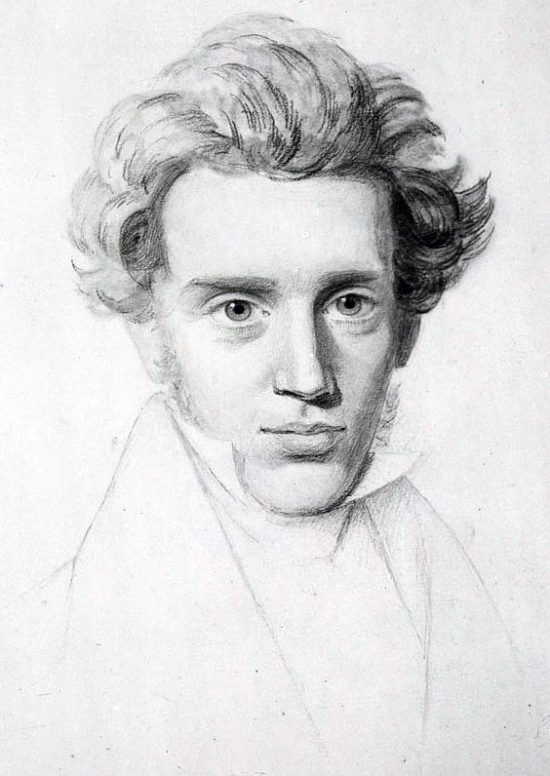
Søren Kierkegaard (1813-1855)
Themes present in his work:
Anxiety and Authenticity
Existence
Notes:
Hijazo, A. (2019b). Søren Kierkegaard (1813-1855) - (cropped). Wikimedia Commons. Retrieved February 16, 2024, from https://commons.wikimedia.org/wiki/File:S%C3%B8ren_Kierkegaard_(1813-1855)_-_(cropped).jpg.

Slide 30
Søren Kierkegaard (1813-1855)
Søren Kierkegaard explored the individual’s personal experience, emphasizing the existential angst, stress, worry, originality, and the creation of personal meaning in the middle of life’s uncertainties with a particular focus on fear and stress and the complexities of existence.
Notes:
Hijazo, A. (2019b). Søren Kierkegaard (1813-1855) - (cropped). Wikimedia Commons. Retrieved February 16, 2024, from https://commons.wikimedia.org/wiki/File:S%C3%B8ren_Kierkegaard_(1813-1855)_-_(cropped).jpg.

Slide 31
It is better to try something and fail than to try nothing and succeed. The result may be the same, but you won't be. We always grow more through defeats than victories.
~ Søren Kierkegaard

Slide 32
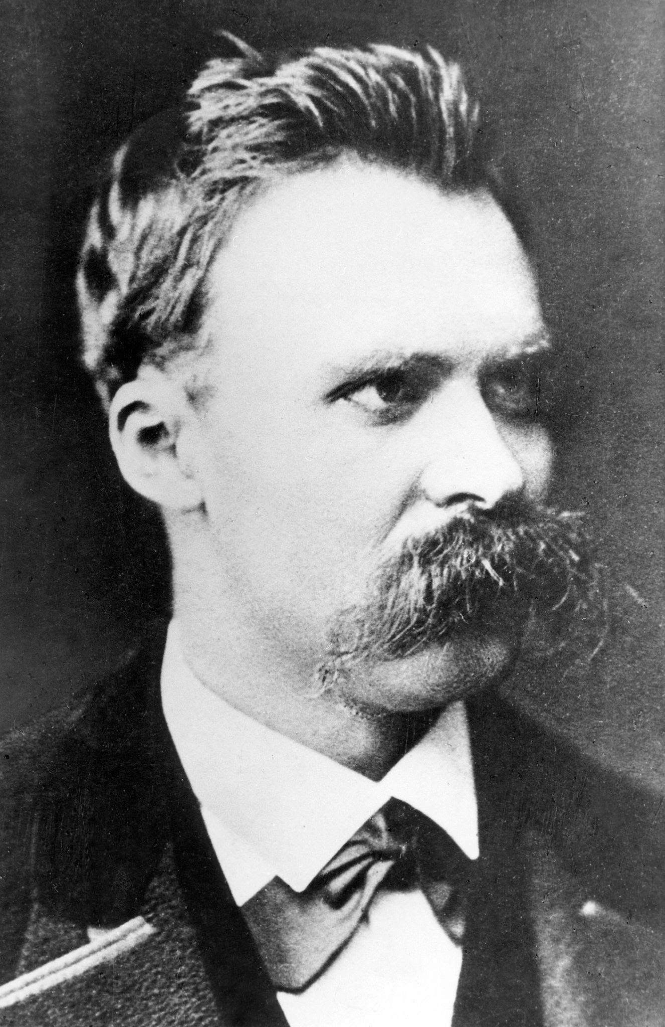
Friedrich Nietzsche (1844-1900)
Themes present in his work:
Philosophy as a Way of Life
Notes:
Volpagoe. (2023). Friedrich Wilhelm Nietzsche. Wikimedia Commons. Retrieved February 16, 2024, from https://commons.m.wikimedia.org/wiki/File:Friedrich_Wilhelm_Nietzsche.jpg.

Slide 33
Friedrich Nietzsche (1844-1900)
Friedrich Nietzsche’s concept of “becoming who you are” emphasized his belief in the transformative power of living philosophically, believing that philosophy should shape one’s life and not be abstract.
Notes:
Volpagoe. (2023). Friedrich Wilhelm Nietzsche. Wikimedia Commons. Retrieved February 16, 2024, from https://commons.m.wikimedia.org/wiki/File:Friedrich_Wilhelm_Nietzsche.jpg.

Slide 34
There will always be rocks in the road ahead of us. They will be stumbling blocks or stepping stones; it all depends on how you use them.
~ Friedrich Nietzsche

Slide 35
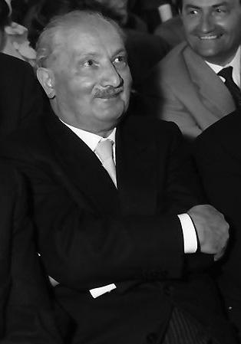
Martin Heidegger (1889-1976)
Themes present in his work:
Existence
Notes:
Racconish. (2014). Heidegger 3 (1960). Wikimedia Commons. Retrieved February 16, 2024, from https://commons.wikimedia.org/wiki/File:Heidegger_3_%281960%29.jpg.

Slide 36
Martin Heidegger (1889-1976)
Martin Heidegger’s philosophy focused on human existence within the world, emphasizing the interconnectedness of individuals with their environment and the significance of their existence within it.
Notes:
Racconish. (2014). Heidegger 3 (1960). Wikimedia Commons. Retrieved February 16, 2024, from https://commons.wikimedia.org/wiki/File:Heidegger_3_%281960%29.jpg.

Slide 37
How one encounters reality is a choice.
~ Martin Heidegger

Slide 38
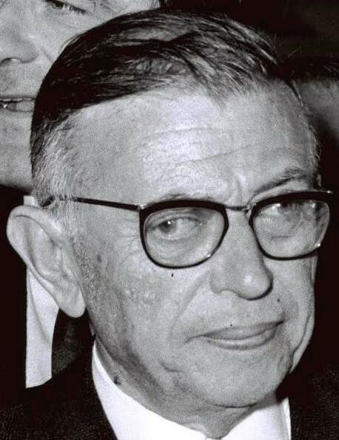
Jean-Paul Sartre (1905-1980)
Themes present in his work:
Freedom
Anxiety and Authenticity
Notes:
MRCLD. (2022). Flickr - Government Press Office (GPO) - Jean Paul Sartre and Simone De Beauvoir welcomed by Avraham Shlonsky and Leah Goldberg (cropped) . Wikimedia Commons. Retrieved February 16, 2024, from https://commons.wikimedia.org/wiki/File:Flickr_-_Government_Press_Office_%28GPO%29_-_Jean_Paul_Sartre_and_Simone_De_Beauvoir_welcomed_by_Avraham_Shlonsky_and_Leah_Goldberg_%28cropped%29_%28cropped%29.jpg.

Slide 39
Jean-Paul Sartre (1905-1980)
Jean-Paul Sartre claims that humans are free and must take full responsibility for their choices in a world without meaning. He argues that individuals struggle with the weight of their freedom and the responsibility to create their own values and meaning, but the only way to overcome this is to embrace it and take ownership of their existence.
Notes:
MRCLD. (2022). Flickr - Government Press Office (GPO) - Jean Paul Sartre and Simone De Beauvoir welcomed by Avraham Shlonsky and Leah Goldberg (cropped) . Wikimedia Commons. Retrieved February 16, 2024, from https://commons.wikimedia.org/wiki/File:Flickr_-_Government_Press_Office_%28GPO%29_-_Jean_Paul_Sartre_and_Simone_De_Beauvoir_welcomed_by_Avraham_Shlonsky_and_Leah_Goldberg_%28cropped%29_%28cropped%29.jpg.

Slide 40
Freedom is what you do with what's been done to you.
~ Jean-Paul Sartre

Slide 41
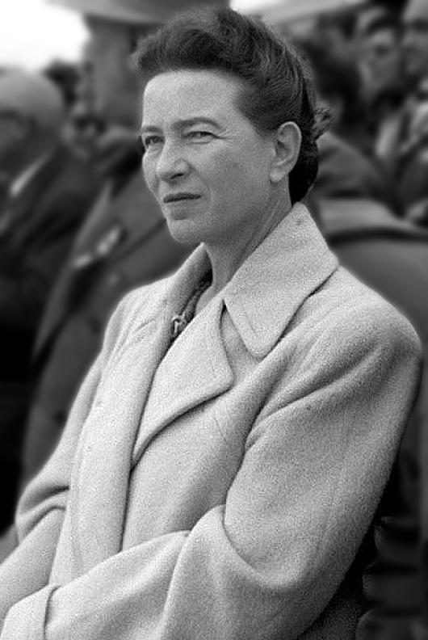
Simone de Beauvoir (1908-1986)
Themes present in her work:
Freedom
Situatedness
Notes:
Hijazo, A. (2019a). Simone de Beauvoir in Beijing 1955. Wikimedia Commons. Retrieved February 16, 2024, from https://commons.wikimedia.org/wiki/File:Simone_de_Beauvoir_in_Beijing_1955.jpg.

Slide 42
Simone de Beauvoir (1908-1986)
Simone de Beauvoir argues that a person must assert themselves in order to overcome societal expectations and create a meaningful life. She also highlights ways that social, cultural, and historical contexts shape a person’s experiences and possibilities.
Notes:
Hijazo, A. (2019a). Simone de Beauvoir in Beijing 1955. Wikimedia Commons. Retrieved February 16, 2024, from https://commons.wikimedia.org/wiki/File:Simone_de_Beauvoir_in_Beijing_1955.jpg.

Slide 43
The point is not for women simply to take power out of men’s hands since that wouldn’t change anything about the world. It’s a question precisely of destroying that notion of power.
~ Simone de Beauvoir

Slide 44
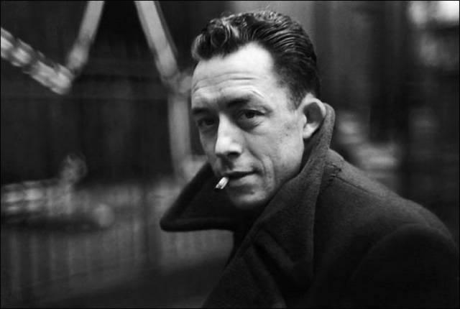
Albert Camus (1913-1960)
Themes present in his work:
Irrationality and Absurdity
Notes:
DietrichLiao. (2008). Albert Camus. flickr. Retrieved February 19, 2024, from https://www.flickr.com/photos/mitmensch0812/2513316191.

Slide 45
Albert Camus (1913-1960)
Albert Camus highlights the inherent tension between humanity’s search for meaning in an indifferent world.
Notes:
DietrichLiao. (2008). Albert Camus. flickr. Retrieved February 19, 2024, from https://www.flickr.com/photos/mitmensch0812/2513316191.

Slide 46
Life is meaningless, but worth living, provided you recognize it's meaningless.
~ Albert Camus

Slide 47

Web Inquiry
Research at least three (3) examples of modern existentialism media and include the following information:
Name
Artist
Media
Description
How does the art exemplify existentialism?

Slide 48

Bento Box
Select one (1) piece of artwork that you researched.
Translate the information that you gathered into images, words, phrases, and sentences.
For example, Karl Marx was a key figure in critical theory.
  Raised fist image could represent the challenge to power structures.

Slide 49

Chat Stations
Take turns presenting your Bento Box with your small group.
After everyone has presented, discuss your original definition of existentialism.
  Do you still agree with this definition?
  Why or why not?

Slide 50
Define Existentialism
Look back at your original definition. Would you change anything?

