Slide 2
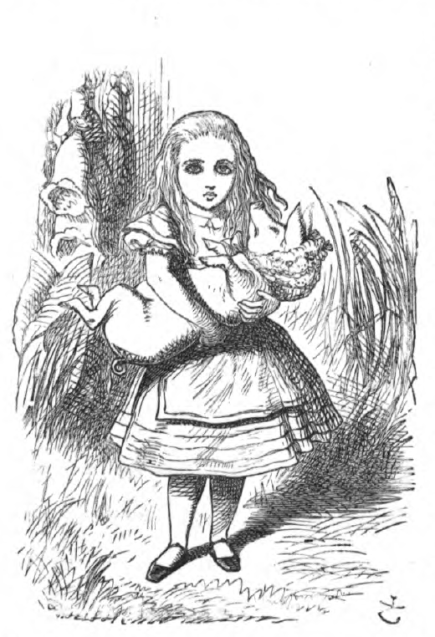
Semicolons in Wonderland
Pigs, Pepper, and Punctuation

Slide 3
Essential Question
How does grammar enhance your writing?
How can you use this punctuation in your own writing?

Slide 4
Lesson Objectives
Use semicolons to enhance my writing while adhering to its grammatical rules.

Slide 5
Examples / Non-Examples Strategy
We will review several examples and non-examples of how semicolons are used.
Examples will be labeled YES.
Non-Examples will be labeled NO.
As you read each sentence, observe how the semicolon is used and make an educated guess to determine whether it is a YES or a NO.
Notes:
K20 Center. (n.d.). Examples and Non-Examples. Strategies. Retrieved from https://learn.k20center.ou.edu/strategy/163

Slide 6
YES or NO?
They were not prepared for an overnight stay; that is, they had not brought a change of clothes.
Notes:
K20 Center. (n.d.). Examples and Non-Examples. Strategies. Retrieved from https://learn.k20center.ou.edu/strategy/163

Slide 7
YES
They were not prepared for an overnight stay; that is, they had not brought a change of clothes.
Notes:
K20 Center. (n.d.). Examples and Non-Examples. Strategies. Retrieved from https://learn.k20center.ou.edu/strategy/163

Slide 8
YES or NO?
Check back with me next week; I will have a better idea of the schedule by then.
Notes:
K20 Center. (n.d.). Examples and Non-Examples. Strategies. Retrieved from https://learn.k20center.ou.edu/strategy/163

Slide 9
YES
Check back with me next week; I will have a better idea of the schedule by then.
Notes:
K20 Center. (n.d.). Examples and Non-Examples. Strategies. Retrieved from https://learn.k20center.ou.edu/strategy/163

Slide 10
YES or NO?
He is unable to attend; however, his representative will attend in his place.
Notes:
K20 Center. (n.d.). Examples and Non-Examples. Strategies. Retrieved from https://learn.k20center.ou.edu/strategy/163

Slide 11
YES
He is unable to attend; however, his representative will attend in his place.
Notes:
K20 Center. (n.d.). Examples and Non-Examples. Strategies. Retrieved from https://learn.k20center.ou.edu/strategy/163

Slide 12
YES or NO?
He missed the bus; because he arrived late to the meeting.
Notes:
K20 Center. (n.d.). Examples and Non-Examples. Strategies. Retrieved from https://learn.k20center.ou.edu/strategy/163

Slide 13
NO
He missed the bus; because he arrived late to the meeting.
Notes:
K20 Center. (n.d.). Examples and Non-Examples. Strategies. Retrieved from https://learn.k20center.ou.edu/strategy/163

Slide 14
YES or NO?
After finishing the project; she went out for lunch.
Notes:
K20 Center. (n.d.). Examples and Non-Examples. Strategies. Retrieved from https://learn.k20center.ou.edu/strategy/163

Slide 15
NO
After finishing the project; she went out for lunch.
Notes:
K20 Center. (n.d.). Examples and Non-Examples. Strategies. Retrieved from https://learn.k20center.ou.edu/strategy/163

Slide 16
YES or NO?
This assignment is extra credit only; but we still need to hand it in.
Notes:
K20 Center. (n.d.). Examples and Non-Examples. Strategies. Retrieved from https://learn.k20center.ou.edu/strategy/163

Slide 17
NO
This assignment is extra credit only; but we still need to hand it in.
Notes:
K20 Center. (n.d.). Examples and Non-Examples. Strategies. Retrieved from https://learn.k20center.ou.edu/strategy/163

Slide 18
YES or NO?
In her suitcase, she carefully packed the essentials: a swimsuit for the beach; comfortable, breathable clothing for hiking; and a lightweight jacket for cool evenings.
Notes:
K20 Center. (n.d.). Examples and Non-Examples. Strategies. Retrieved from https://learn.k20center.ou.edu/strategy/163

Slide 19
YES
In her suitcase, she carefully packed the essentials: a swimsuit for the beach; comfortable, breathable clothing for hiking; and a lightweight jacket for cool evenings.
Notes:
K20 Center. (n.d.). Examples and Non-Examples. Strategies. Retrieved from https://learn.k20center.ou.edu/strategy/163

Slide 20
YES or NO?
The cat sat peacefully on the windowsill; curled up in a cozy ball.
Notes:
K20 Center. (n.d.). Examples and Non-Examples. Strategies. Retrieved from https://learn.k20center.ou.edu/strategy/163

Slide 21
NO
The cat sat peacefully on the windowsill; curled up in a cozy ball.
Notes:
K20 Center. (n.d.). Examples and Non-Examples. Strategies. Retrieved from https://learn.k20center.ou.edu/strategy/163

Slide 22
YES or NO?
She was hesitant about accepting the job offer; yet, the opportunity was too good to pass up.
Notes:
K20 Center. (n.d.). Examples and Non-Examples. Strategies. Retrieved from https://learn.k20center.ou.edu/strategy/163

Slide 23
YES
She was hesitant about accepting the job offer; yet, the opportunity was too good to pass up.
Notes:
K20 Center. (n.d.). Examples and Non-Examples. Strategies. Retrieved from https://learn.k20center.ou.edu/strategy/163

Slide 24
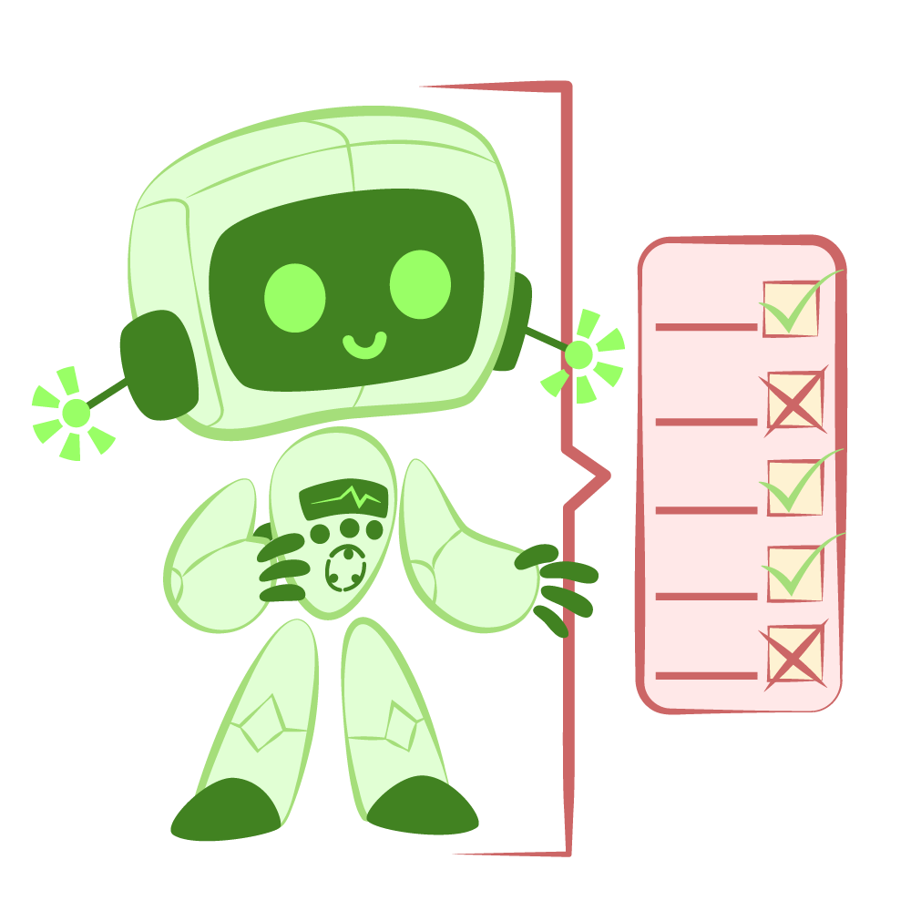
Critique the Bot
Practice giving feedback to a writer…who happens to be a robot!
Upload a writing prompt to a chatbot.
Read and analyze the bot’s response.
Determine how the bot used semicolons in its writing.
What possible rules was it following…or breaking!
Why do you think it used semicolons the way it did?
What feedback would you give the bot on its writing?
Notes:
K20 Center. (n.d.). Critique the Bot. Strategies. Retrieved from https://learn.k20center.ou.edu/strategy/3491

Slide 25
Chat GPT Directions
Using your device, go to chat.openai.com/
Type in the following and choose one of the topics below.
“Create a paragraph about _____ that uses semicolons.”
Potential Topics:
Ducks Team Sports A.I. Vampires
Dogs Influencers Dance Yoga
Cars Football Skin Care Celebrities
Notes:
K20 Center. (n.d.). Critique the Bot. Strategies. Retrieved from https://learn.k20center.ou.edu/strategy/3491

Slide 26
What did we notice about Semicolons?
What possible rules did the bot follow…or break?
Why do you think they used semicolons the way they did?
What feedback would you give the bot on their writing?
Notes:
K20 Center. (n.d.). Critique the Bot. Strategies. Retrieved from https://learn.k20center.ou.edu/strategy/3491

Slide 27
What do we think of AI?
Did the ChatGPT paragraph use semicolons correctly?
Were the way semicolons used similar to how they were used in the examples we previously reviewed?
Are the semicolons used by the chatbot similar to some of the examples we had looked at earlier?
Notes:
K20 Center. (n.d.). Critique the Bot. Strategies. Retrieved from https://learn.k20center.ou.edu/strategy/3491

Slide 28
Semicolon Rules
Use semicolons to join two clearly related independent clauses in place of a comma and a coordinating conjunction.
Use a semicolon to replace a comma when you use a coordinating conjunction to link independent clauses.
Use a semicolon between related sentences when the second sentence starts with either a conjunctive adverb or a transitional expression.
Use semicolons to replace commas when individual items in a series are long or contain commas.

Slide 29
This or That?
With a partner, or by yourself, complete the handout.
You have 10 minutes to complete this worksheet.
Be prepared to discuss.

Slide 30
This or That?
Which rule is most confusing to understand?
Which rule is easiest to understand?
What rules are we still questioning?

Slide 31
Conjunctive Adverbs
Shows a connection between two independent clauses in one sentence
I wanted to go to the concert; however, I had to finish my work before I could leave.
Links ideas in two or more sentences
She was exhausted after a long day at work. Nevertheless, she decided to attend the evening class.
Shows relationships between ideas within an independent clause
The student, however, maintains that he deserves full credit even though he has twenty absences.
Notes:
University of Wisconsin-Madison. (n.d.). Using conjunctive adverbs. The Writing Center. https://writing.wisc.edu/handbook/grammarpunct/conjadv/

Slide 32
Conjunctive Adverbs
Also
However
Otherwise
Consequently
Indeed
Similarly
Finally
Likewise
Then
Furthermore
Moreover
Therefore
Nevertheless
Hence
Thus
Nonetheless
Notes:
University of Wisconsin-Madison. (n.d.). Using conjunctive adverbs. The Writing Center. https://writing.wisc.edu/handbook/grammarpunct/conjadv/

Slide 33
Transitional Expressions
Includes conjunctive adverbs used to join or connect independent clauses
I wanted to attend the lecture; however, I had a previous commitment
Aids in transitioning between ideas and is not limited to connecting independent clauses
The article outlined the challenges of climate change; on the other hand, it highlighted initiatives and solutions aimed at mitigating environmental impact.
Can be used in the beginning, middle, or ends of sentences
Additionally, the scholarship program aims to support students pursuing degrees in STEM fields.
Because of the recent rains, the hiking trail was, in fact, closed due to flooding.
I have heard of the new changes in hiring processes unfortunately.
Notes:
Dr. Murray and Anna C. Rockowitz Writing Center. (n.d.). Grammar and Mechanics: Using Transitional Expressions. [PDF]. New York; Hunter College. https://www.hunter.cuny.edu/rwc/repository/files/grammar-and-mechanics/sentence-structure/Using-Transitional-Expressions.pdf

Slide 34
Transitional Expressions
Meanwhile
As a result
On the other hand
For example
In addition
Although
In contrast
In spite of that
On the contrary
By comparison
In other words
For instance
Beyond
In the meantime
Unfortunately
To summarize
Notes:
University of Wisconsin-Madison. (n.d.). Using conjunctive adverbs. The Writing Center. https://writing.wisc.edu/handbook/grammarpunct/conjadv/

Slide 35
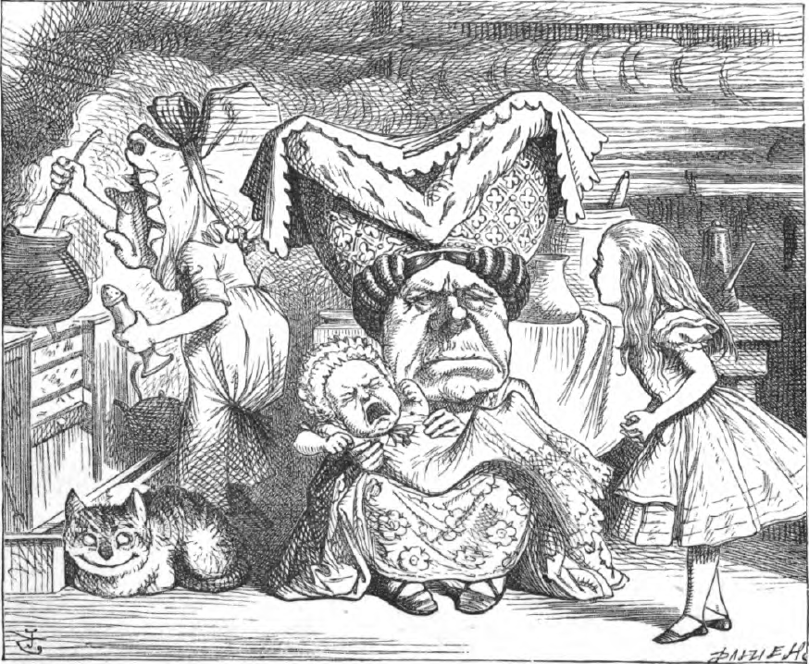
Pigs and Semicolons
As we read the passage aloud, highlight where semicolons are used throughout the text.
At the ,“Stop and Jot” what you’re noticing about semicolons so far.
Notes:
K20 Center. (n.d.). Stop and jot. Strategies. Retrieved from https://learn.k20center.ou.edu/strategy/d9908066f654727934df7bf4f5077921

Slide 36
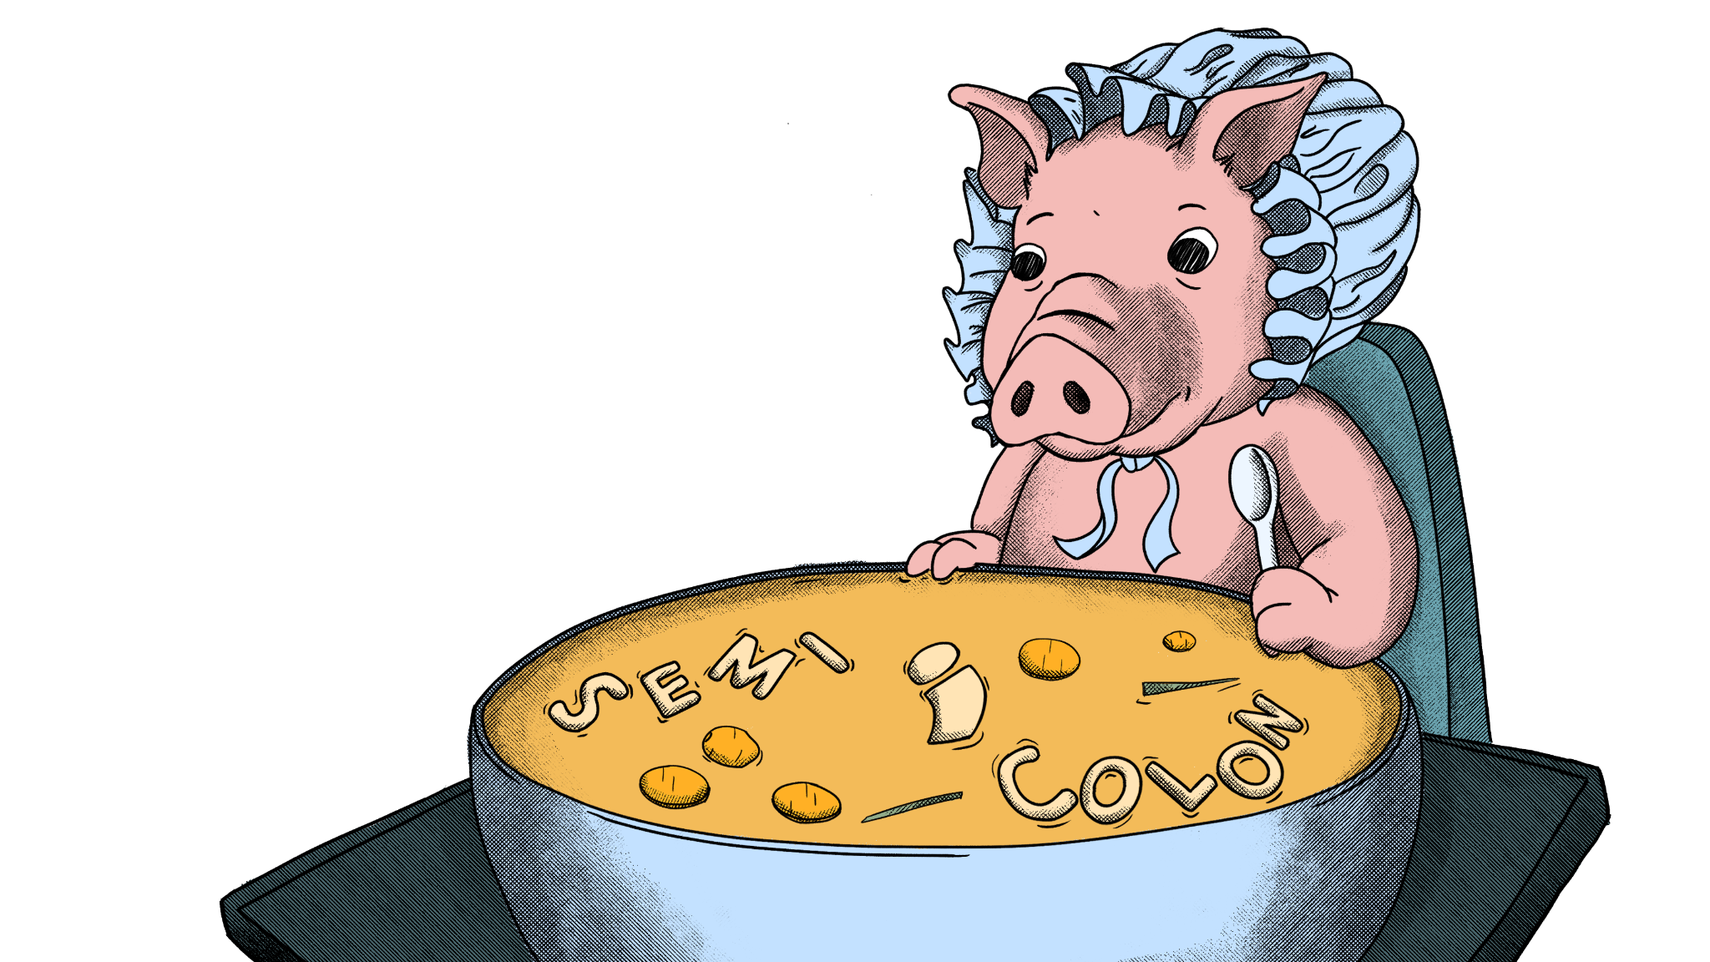
Pigs and Semicolons
What rules are the semicolons following?
How does the use of semicolons affect the style of the text? What about the readability or rhythm?
If the semicolon was replaced with a conjunction/comma/period, how would it affect the readability of rhythm of the text?
What was the author trying to accomplish by using semicolons instead of other forms of punctuation?

Slide 37
Narrative Writing Using Semicolons
Write a narrative essay (4-5 paragraphs) describing a memory where you cooked or watched someone cook your favorite dish.
Use semicolons throughout your essay and in every paragraph.
Try to have at least 1 example per rule.

Slide 38
Practice ACT Question
In a world full of contradictions, I am no different. Our individual quirks are what make each of us special, even when they make no sense. I love tomato soup but I won’t eat tomatoes on a sandwich I love being a teacher but I was always a terrible student and I love working out but I hate getting sweaty. I know it can be confusing, but these quirks make me who I am.
No Change
I love tomato soup, but I won’t eat tomatoes on a sandwich, I love being a teacher, but I was always a terrible student, and I love working out, but I hate getting sweaty.
I love tomato soup; but I won’t eat tomatoes on a sandwich; I love being a teacher; but I was always a terrible student; and I love working out; but I hate getting sweaty.
I love tomato soup, but I won’t eat tomatoes on a sandwich; I love being a teacher, but I was always a terrible student; and I love working out, but I hate getting sweaty.
K20 Center 1 minute timer
Notes:
Adapted from: Varsity Tutors. (n.d.). Semicolon errors - act English. Private Tutoring. https://www.varsitytutors.com/act_english-help/semicolon-errors
K20 Center. (2021, September 21). K20 Center 1 minute timer. YouTube. https://www.youtube.com/watch?v=6ilD555O_RE

Slide 39
Practice ACT Question | Answer
Answer | Explanation
D. I love tomato soup, but I won’t eat tomatoes on a sandwich; I love being a teacher, but I was always a terrible student; and I love working out, but I hate getting sweaty. | The correct choice is D because it follows the rule: “replace commas when individual items in a series are long or contain commas.” Without semicolons, it would be difficult to see what part of the list goes with what.
Notes:
Adapted from: Varsity Tutors. (n.d.). Semicolon errors - act English. Private Tutoring. https://www.varsitytutors.com/act_english-help/semicolon-errors

