Slide 2
Shaping Soundscapes
ADSR in Ensemble Performance

Slide 3
Essential Question
How can music production concepts be applied to a traditional ensemble setting?

Slide 4
Lesson Objectives
Define “attack” and “release” and apply them to both ensemble and music production settings.

Slide 5

Bell Ringer
Answer the following questions using the assigned colored sticky notes:
  1) What does the word “attack” mean in music?
  2) What does the word “release” mean in music?
When you have answered both questions, go to the white board and add your answers.
Notes:
K20 Center. (n.d.). Bell ringers and exit tickets. Strategies. https://learn.k20center.ou.edu/strategy/125

Slide 6

Justified List
Look at the answers that have been provided for both questions.
Combine related answers into common terms.
If your answer is left outside the other combinations, take a moment to defend your answer and explain why you chose it.
Notes:
K20 Center. (n.d.). Justified list. Strategies. https://learn.k20center.ou.edu/strategy/164

Slide 7

Mentimeter
Go to menti.com
Enter the code
Answer the question on your screen
Notes:
Mentimeter https://learn.k20center.ou.edu/tech-tool/645
https://www.mentimeter.com/

Slide 8
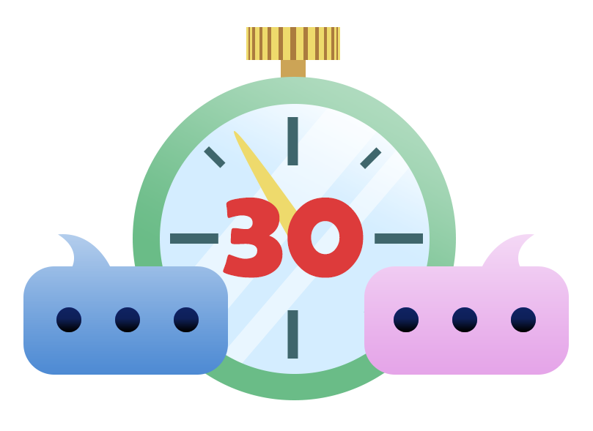
30-Second Expert
Decide with your partner who will read which article.
Read your chosen article and summarize it in your T-chart under the column titled, “What I know about this topic.”
With your partner, decide who will be the first speaker and who will be the first listener.
Notes:
K20 Center. (n.d.). 30-second expert. Strategies. https://learn.k20center.ou.edu/strategy/1048

Slide 9

30-Second Expert
When the timer starts, the first speaker will have 30 seconds to to share what they know about their article starting with, “ I am the expert on this topic because I know…”
The listener will then respond by saying , “According to you…” and repeating what they learned.
The listener will then write down what they learned from the speaker in their T-chart under the column titled “What I learned from my partner.”
Switch roles and repeat the process.
Notes:
K20 Center. (n.d.). 30-second expert. Strategies. https://learn.k20center.ou.edu/strategy/1048
K20 Center. (2021, September 21). K20 Center 30 second timer [Video]. YouTube. https://youtu.be/o9ViOMe_Wnk?si=-yRJtvsGtKgzoYX8

Slide 10
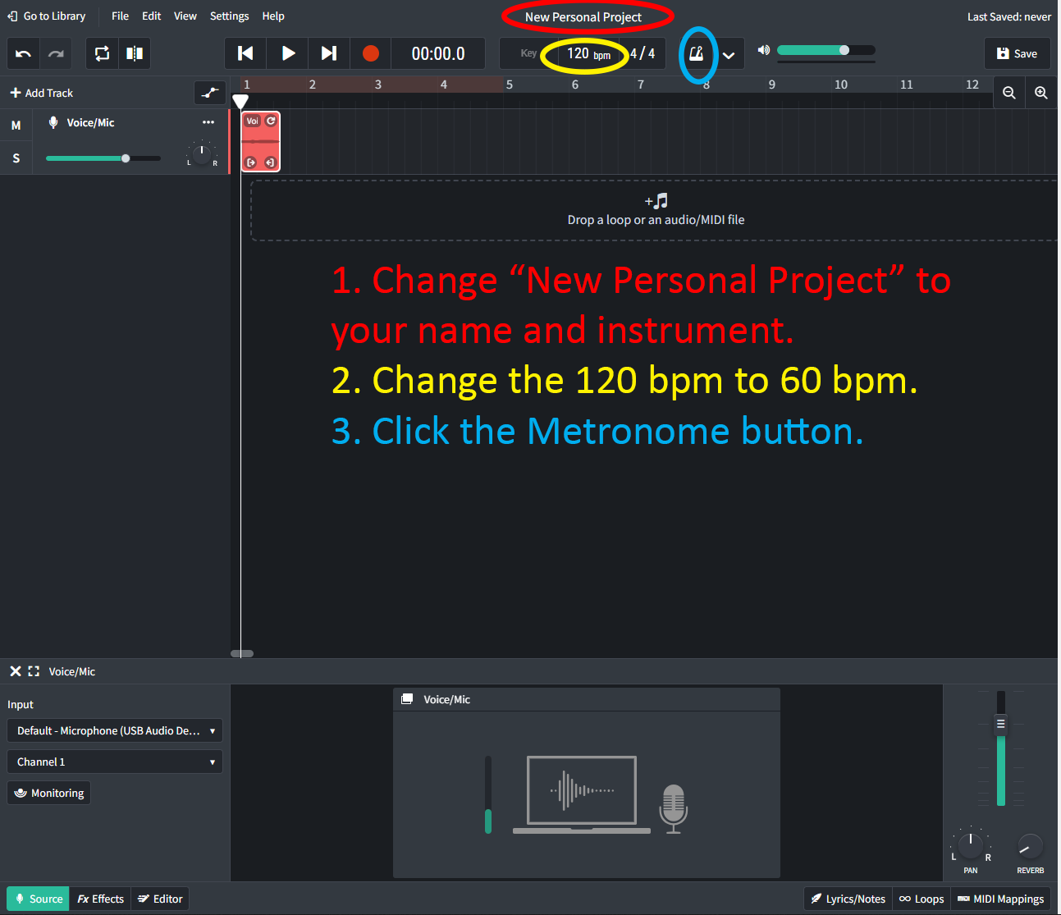
BandLab
Make a new BandLab project, selecting the “Voice/Mic” option.
Click the text at the top of the screen that says, “New Personal Project” and rename it to your name and instrument.
Directly below is a setting that says “120 bpm.” Change the number to 60.
Turn on the metronome by clicking the button that looks like one.
Click the “Record” button. You will be given four clicks and then the recording will start. Record a concert F on your instrument lasting for one quarter note at 60 bpm.
Notes:
K20 Center. (n.d.) BandLab for Education. Tech Tools. https://learn.k20center.ou.edu/tech-tool/2235

Slide 11
BandLab Tips
To prevent the attack of the note from being clipped off, wait an additional four clicks before playing so you can capture the entirety of the waveshape.
If you want to examine the waveshape more closely, double-click on the red box that is made in the track after you have recorded.

Slide 12
Attacks and Releases in Band
“Attack” refers to the start of the note.
  How do you start a note on your instrument?
“Release” refers to stopping a note.
  How do you stop a note on your instrument?

Slide 13
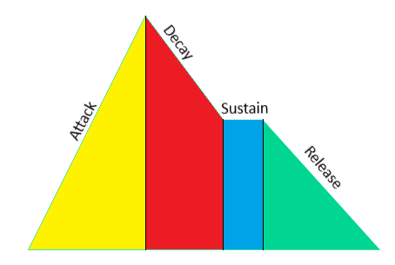
ADSR
Attack: Sets the time it takes for the signal to rise from an amplitude of 0 to 100% (full amplitude).
Decay: Sets the time it takes for the signal to fall from 100% amplitude to the designated sustain level.
Sustain: Sets the steady amplitude level produced when a [note] is held down.
Release: Sets the time it takes for the sound to decay from the sustain level to an amplitude of 0 when the [note] is released (Apple, 2020).
Notes:
Login Pro User Guide for Mac. (2020). Attack, decay, sustain, and release. Apple Support. https://support.apple.com/guide/logicpro/attack-decay-sustain-and-release-lgsife419620/mac

Slide 14
BandLab
Make a new BandLab project, selecting the “Voice/Mic”option.
Click the text at the top of the screen that says “New Personal Project” and rename it to your name and instrument.
Directly below is a setting that says “120 bpm.” Change the number to 60.
Turn on the metronome by clicking the button that looks like one.
Click the “Record” button. You will be given four clicks and then the recording will start. Record a concert F on your instrument lasting for one quarter note at 60 BPM.
Notes:
K20 Center. (n.d.) BandLab for Education. Tech Tools. https://learn.k20center.ou.edu/tech-tool/2235

Slide 15
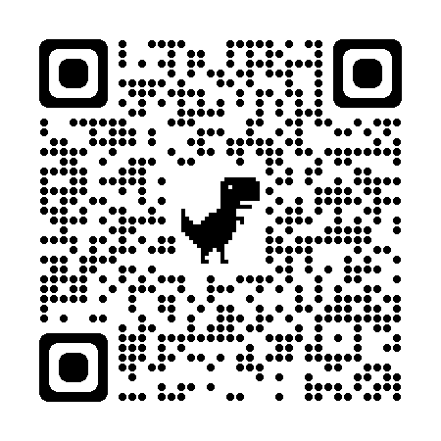
Creating Envelopes
Take out your internet-connected device and navigate to learningsynths.ableton.com/en/playground
Notes:
Learning Synths. (n.d.). Playground. Ableton.com. https://learningsynths.ableton.com/en/playground

Slide 16

Creating Envelopes
Notes:
K20 Center. (2024, April 24). Shaping Soundscapes - Learning Synths Playground Tutorial [Video]. YouTube. https://www.youtube.com/watch?v=UPCJ5XrkVrg

Slide 17
Creating Envelopes
Use the ADSR tool to make an attack and release that matches the ADSR of your recording, which you made on your instrument earlier.
When you think it is correct, record the sound for one quarter note at 60 bpm using the record function.
Submit both your instrument recording and your synth recording to the teacher.

Slide 18
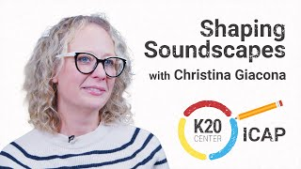
ICAP-Shaping Soundscapes
Notes:
K20 Center. (2024, April 23). K20 ICAP - Music Producer, Recording Engineer, and Professor - Shaping Soundscapes [Video]. YouTube. https://www.youtube.com/watch?v=Mdq93vdSQEU

Slide 19


I Used to Think… But Now I Know
Take a moment to reflect on what you learned.
  On your sticky note, write a statement beginning with, “I used to think ADSR was…”
  Now, write a statement beginning with, “Now I know ADSR is...”
Put your sticky note on the board before you leave, making sure your name is on the back.
Notes:
K20 Center. (n.d.). I used to think . . . but now I know. Strategies. https://learn.k20center.ou.edu/strategy/137
K20 Center. (n.d.). Bell ringers and exit tickets. Strategies. https://learn.k20center.ou.edu/strategy/125

