Slide 2
Diggin’ Deeper: Poetry Made Relevant
Poetry and poetic devices

Slide 3
Essential Question
How is poetry relevant in life today?

Slide 4
Why do we listen to music?

Slide 5
Lesson Objectives
Explore song lyrics.
Analyze poetry recognizing poetic devices and format.
Write poetry using poetic devices and format.

Slide 6
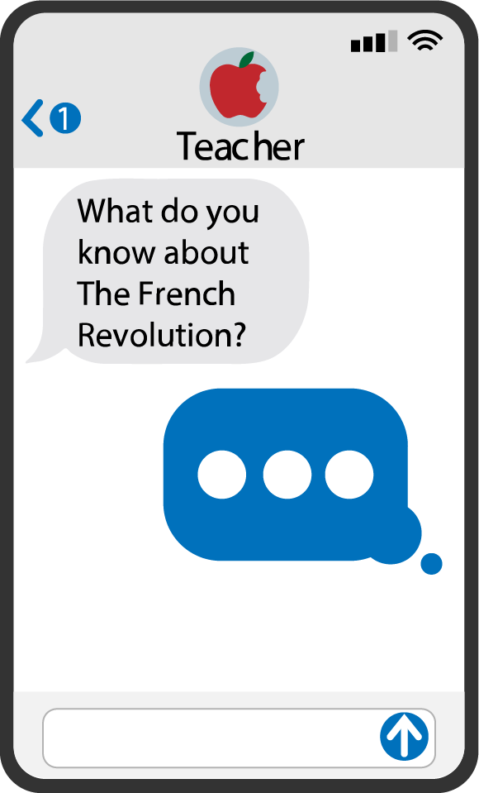
Quick Write
Listen to the music that is about to play. As you listen, describe how you feel. You may also describe whatever comes into your thoughts about the song. Try to write for the entire time.
Do not wait until the music is over.
Do not confer with your classmates during the music!
Notes:
K20 Center. (n.d.). Quick Write. Strategies. https://learn.k20center.ou.edu/strategy/1127

Slide 7
Notes:
Bennet, Evan. (2010, December 22). Symphony No. 9 by Beethoven [Video]. YouTube. https://www.youtube.com/watch?v=t3217H8JppI&t=2s

Slide 8
Notes:
YouTube. (n.d.-b). The Rolling Stones - Just Like a Rolling Stone. YouTube. https://www.youtube.com/watch?v=FZHicx2TLrI

Slide 9
Notes:
AnimeOracle. (2014, January 12). Pharrell Williams - Happy (Lyrics) [Video]. YouTube. https://www.youtube.com/watch?v=jv-pYB0Qw9A

Slide 10
Consider These Questions…
Think about these questions as you look at what you wrote during the songs.
Use a different color highlighter to highlight words/phrases you wrote that answer the questions.
What does it sound like? (pink)
What emotions does it evoke? Why? (blue)
What does it make you think of? Why? (green)
Does it bring back any memories? If so, what? (yellow)
Notes:
K20 Center. (n.d.). Categorical Highlighting. Strategies.https://learn.k20center.ou.edu/strategy/192

Slide 11
Think-Pair-Share
Discuss your answers to the questions with your partner.
Your commonalities
Your differences
The varying emotional connotations
How the words influenced your choices
Notes:
K20 Center. (n.d.). Think-pair-share. Strategies.https://learn.k20center.ou.edu/strategy/139
K20 Center. (n.d.). K20 timer. [Web app].https://www.youtube.com/watch?v=9gy-1Z2Sa-c&list=PL-aUhEQeaZXLMF3fItNDxiuSkEr0pq0c2&index=12

Slide 12
Bob Dylan’s “Blowin’ in the Wind”
How many roads must a man walk down
Before you call him a man?
Yes, ’n’ how many seas must a white dove sail
Before she sleeps in the sand?
Yes, ’n’ how many times must the cannonballs fly
Before they’re forever banned?
The answer, my friend, is blowin’ in the wind
The answer is blowin’ in the wind
How many years can a mountain exist
Before it’s washed to the sea?
Yes, ’n’ how many years can some people exist
Before they’re allowed to be free?
Yes, ’n’ how many times can a man turn his head
Pretending he just doesn’t see?
The answer, my friend, is blowin’ in the wind
The answer is blowin’ in the wind
How many times must a man look up
Before he can see the sky?
Yes, ’n’ how many ears must one man have
Before he can hear people cry?
Yes, ’n’ how many deaths will it take till he knows
That too many people have died?
The answer, my friend, is blowin’ in the wind
The answer is blowin’ in the wind
Dylan, B. (1962). Blowin’ in the wind [Lyrics]. Special Rider Music.
https://bobdylan.com/songs/blowin-wind/
Notes:
Dylan, B. (1962). Blowin’ in the wind [Lyrics]. Special Rider Music.
https://bobdylan.com/songs/blowin-wind/

Slide 13
I Think/We Think
I Think
Answer the following questions on your handout:
What did the poet mean when he said “the answer is blowin’ in the wind”?
What does the use of repetition do for the reader?
What is the overall message of the poem?
We Think
Discuss your answers with your partner.
Add any combined thoughts to your handout.
Notes:
K20 Center. (n.d.). I Think / We Think. Strategies.https://learn.k20center.ou.edu/strategy/141

Slide 14
NPR Article
‘Blowin’ in the Wind” Still Asks the Hard Questions
Notes:
Naylor, B. (2000). 'Blowin' in the wind' still asks the hard questions. NPR. http://www.npr.org/2000/10/21/1112840/blowin-in-the-wind

Slide 15
Your Favorite Song
Look up the lyrics to your favorite song
Write the lyrics. Think about the format as you write.
Meter
Rhyme
Punctuation
Identify the poetic devices used by the songwriter.
Label the poetic devices such as rhyme, repetition, assonance, consonance, alliteration, imagery, rhythm.

Slide 17
Essential Question
How is poetry relevant in life today?

Slide 18
Write Your Own Poem
Construct a poem that is similar to your favorite song.
Use one of your responses from the Quickwrite as your subject matter for your poem.

Slide 19
Poetry Cafe
Share your poem with the class.

