Slide 2
Oklahoma and Segregation
Oklahoma History

Slide 3
Essential Question
How can individual rights be protected within the context of majority rule?

Slide 4
Lesson Objectives
Students will analyze the evolution of segregation in Oklahoma.

Slide 5

Democratic Voting
Independently, consider each question on the Classroom Ballot and cast your vote for each question.
When you are finished, turn your ballot back in.
Notes:
https://learn.k20center.ou.edu/strategy/195

Slide 6
Democratic Voting Results & Debrief
How do you feel about the new rules and your ability to have a say in the voting process?
How would you feel if you had been denied the right to cast your vote knowing the rules directly affected you and your voice was not heard?

Slide 7
KWL Chart
What I Know (K):
What were some of the discriminatory practices occurring during the Jim Crow Era?
Take a moment to jot down all you can think of and elaborate.
Notes:
https://learn.k20center.ou.edu/strategy/127

Slide 8
Plessy v Ferguson 1896
Today we will be going over the landmark Supreme Court Case Plessy v Ferguson.
Homer Plessy challenges the constitutionality of the “separate car” law in Louisiana.

Slide 9
KWL Chart
What I Want to know (W):
Did the separate car law violate the rights of the freed people?
Write this question in the W section of your chart, and as you watch the video look for evidence to answer the question.

Slide 10
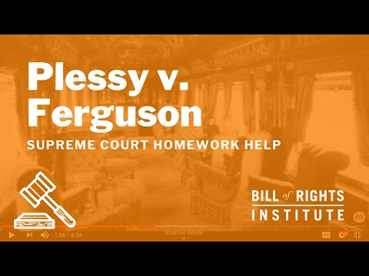

Slide 11
KWL Chart
What I Learned (L)
What did I learn about the Supreme Court Case Plessy v Ferguson and the landmark decision?

Slide 12
H-Chart
Left side:
Write all your information from the video.
Right side:
Write all your information from the article.
Middle section:
How do both sources compare? Is there an overlap in information?
Notes:
https://learn.k20center.ou.edu/strategy/132

Slide 13
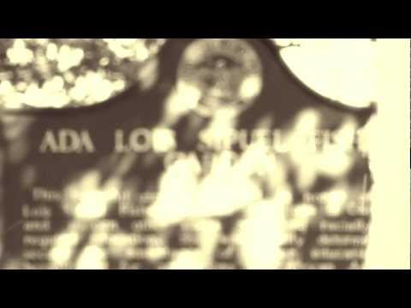

Slide 14

I Notice…I Wonder
What did you notice from the the University of Oklahoma School of Law's tribute video for Ada Lois Sipuel Fisher?
What do you still wonder about?
Notes:
https://learn.k20center.ou.edu/strategy/180

Slide 15

Two-Minute Paper
You will have 2 minutes to write out all your thoughts about everything discussed today. Use the following questions to help guide your writing.
Do you think that all Oklahomans (or Americans) are equal in the eyes of the law? Why or why not?
What do you think school would be like today if these cases never happened?
Do you think Oklahoma has played a major role in any other important cases? Which ones?
Do you think Ada Lois Sipuel's fight was similar to that of Justice Harlan's dissent of Plessy v Ferguson? Why or why not?
Notes:
https://learn.k20center.ou.edu/strategy/152

