Slide 2
Banking on Bedford Falls: It's a Wonderful Life
Real Interest Rates and Financial Institutions

Slide 3
Essential Questions
What did it take to own a home during the booms and busts of the 1920s-1940s?

Slide 4
Lesson Objectives
Examine how interest rates affect spending decisions.
Identify different types of financial institutions, including banks, building and loan associations, mortgage companies, and credit unions.
Identify the home-buying process in George Bailey’s time (1920s-1940s) and compare it to the home-buying process today.

Slide 5

Looks Like, Sounds Like, Feels Like
You will be watching a clip from the 1946 film, It’s a Wonderful Life.
After watching the clip, you will analyze the image on slide 7.
Reflect on the film and image by filling in the 3 columns for both questions on your handout.
Notes:
K20 Center. (n.d.). Looks like, sounds like, feels like. Strategies. https://learn.k20center.ou.edu/strategy/88

Slide 6
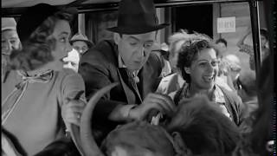
It’s a Wonderful Life
Notes:
Sara. (2013, July 23). It’s a wonderful life house welcoming for Mr Martini [Video]. YouTube. https://www.youtube.com/watch?v=uNQGmJbriHY

Slide 7
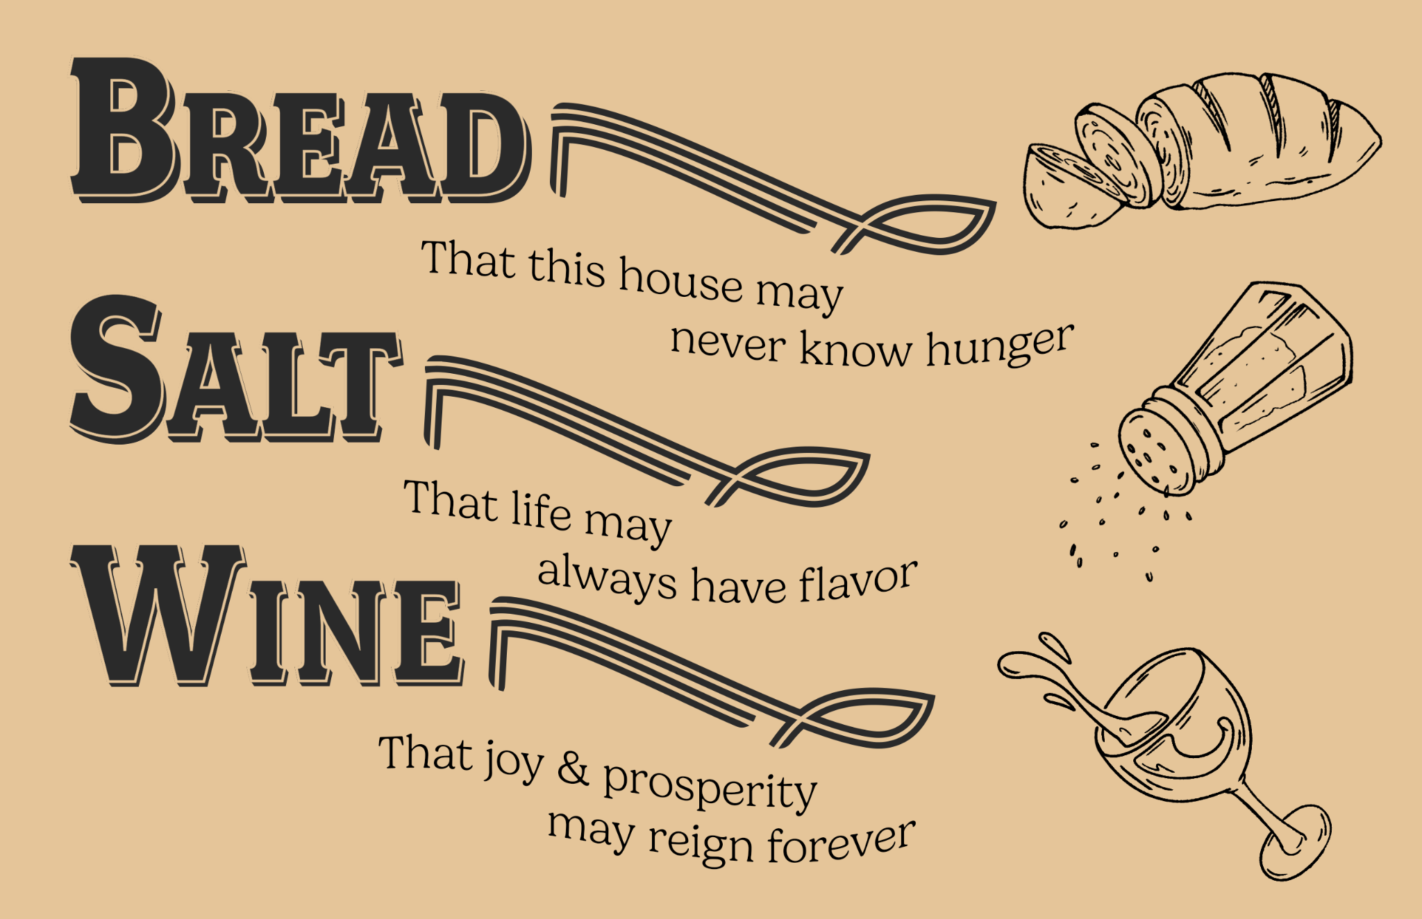

Slide 8

Painting a Picture
Review the vintage ads in the provided Painting a Picture Document Packet.
As you go through each image, record any observations/inferences and the purpose of each item in the Painting a Picture Chart that is also provided.
  Observation: What do you see?
  Inferences: Based on what you see, what can you conclude about this item?
Notes:
K20 Center. (n.d.). Painting a picture. Strategies. https://learn.k20center.ou.edu/strategy/1331

Slide 9
Painting a Picture
How do these advertisements compare to what you
would see today if you were looking to purchase a home
or vehicle?
How would you describe the buying process of homes and vehicles back then?
What are some ways that buying processes may have changed since?
Notes:
K20 Center. (n.d.). Painting a picture. Strategies. https://learn.k20center.ou.edu/strategy/1331

Slide 10

CUS and Discuss
As you read through the article What Did It Take to Own a Home, complete the following:
CIRCLE the main idea(s) of the article.
UNDERLINE the different types of financial institutions and concepts mentioned in the article and
their definitions.
STAR any new information from the article that stands out to you.
Notes:
K20 Center. (n.d.). CUS and discuss. Strategies. https://learn.k20center.ou.edu/strategy/162

Slide 11

Historical Mingle
Each of you will be playing the role of a person who lived and worked during the time when the movie takes place.
You will each receive an occupation card that lists the salaries of a particular occupation during the 1920s and today.
You will need to use the salary info to determine how much it would have cost to buy a home in George Bailey’s day.
Notes:
K20 Center. (n.d.). Historical mingle. Strategies. https://learn.k20center.ou.edu/strategy/184

Slide 12
Historical Mingle (continued)
Visit Zillow, Realtor, or another home-buying website.
Calculate how much money you would need to spend on a monthly mortgage.The mortgage payment should be no more than 30% of your monthly income.
Once you’ve chosen a house, “mingle” with another classmate – discuss the advantages and disadvantages of your occupation and sum up the home-buying process.
Continue mingling with other classmates for 2 minutes each.
Notes:
K20 Center. (n.d.). Historical mingle. Strategies. https://learn.k20center.ou.edu/strategy/184

Slide 13

2-Minute Timer
Notes:
K20 Center. (2021, September 21). K20 Center 2 minute timer [Video]. YouTube. https://www.youtube.com/watch?v=HcEEAnwOt2c

Slide 14

One-Pager
Reflecting on what you’ve learned, create a One-Pager that includes the following:
  Title
  Border including something related to the lesson
  Image representing the home-buying experience
  Answers to the following questions:
    What did it take to own a home during the booms and busts of the 1920s-1940s?
    Describe your ideal home-buying experience.
    What do you think the current home-buying experience is like?
Notes:
K20 Center. (n.d.). One-pager. Strategies. https://learn.k20center.ou.edu/strategy/72

Slide 15


