Slide 2
Rebel Rhymes
Exploring the Influence of Protest Music
on Social Change

Slide 3
Essential Question
How does music impact society?

Slide 4
Learning Objectives
Students will draw conclusions about a variety of foreign and domestic issues through an analysis of lyrics found in popular protest music of their time.

Slide 5
Quarter Peeks
Analyze the section of photo you have been assigned
List all the details you observe
Make a hypothesis of what the full image looks like

Slide 6
Quarter Peeks
DO NOT SHARE YOUR IMAGES WITH YOUR GROUP MEMBERS
Take turns sharing the details you listed and what you predicted the entire photo looks like

Slide 7
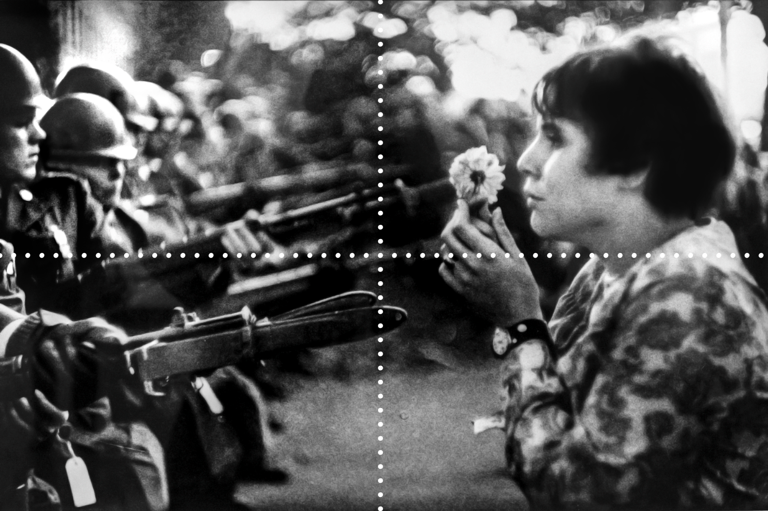
Quarter Peeks
What words come to mind when you view this image?
What was the photographer trying to capture in this moment?

Slide 8
Protest Music Jigsaw
In your group, split up the Protest Music Cards and music selections
There are 5 artists and 8 songs to choose from:
Bob Dylan
The Times They are A-Changin’
All Along the Watchtower
Masters of War
Creedence Clearwater Revival (CCR) - Fortunate Son
Crosby, Stills, Nash, and Young (CSNY) - Ohio
John Lennon
Imagine
Give Peace a Chance
Barry McGuire - Eve of Destruction

Slide 9
Protest Music Jigsaw
In your group, each person should share what was learned during the activity. Use the discussion questions to guide your share out.
What are personal takeaways from the music?
What foreign or domestic issue was discussed in the song?
How did the artist address the issue, directly or indirectly?

Slide 10
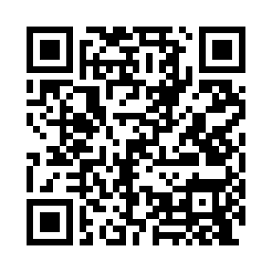
Chalk Talk
As you listen to the song, draw pictures or write words that represent the tone/feelings that are evoked.
http://k20.ou.edu/pom
Notes:
YouTube. (2012, June 26). Hey, hey, LBJ (Bill Frederick). YouTube. https://www.youtube.com/watch?v=J_krQH_zZqE

Slide 11
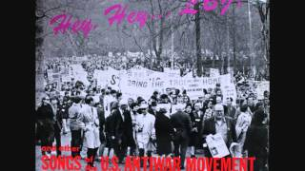
Chalk Talk
As you listen to the song, draw pictures or write words that represent the tone/feelings that are evoked.
Notes:
YouTube. (2012, June 26). Hey, hey, LBJ (Bill Frederick). YouTube. https://www.youtube.com/watch?v=J_krQH_zZqE

Slide 12
Chalk Talk
As you listen to the song, draw pictures or write words that represent the tone/feelings that are evoked.
Notes:
The Rolling Stones - Paint It, black (official lyric video). YouTube. (2015, November 19). https://youtu.be/O4irXQhgMqg

Slide 13
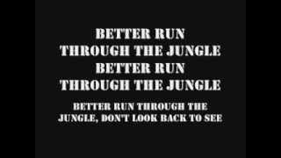
Chalk Talk
As you listen to the song, draw pictures or write words that represent the tone/feelings that are evoked.
Notes:
CCR run through the Jungle w/ Lyrics. YouTube. (2013, July 19). https://youtu.be/LwHqi-qOCZg

Slide 14
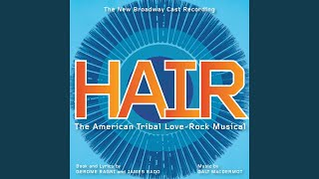
Chalk Talk
As you listen to the song, draw pictures or write words that represent the tone/feelings that are evoked.
Notes:
Aquarius. YouTube. (20017, November 14). https://youtu.be/5F79l--dNbA?si=ONjlLRV0k_bHQT3C

Slide 15
Chalk Talk Discussion
What were some common themes or messages found in these songs?
How do these songs reflect the social and political movements of that era?
Can music effectively bring about social or political change? Why or why not?

Slide 16
Student Song Comparisons
Find an artist and song that evoke political or social change or evoke an emotion towards something happening in your life.
Using the template, create a profile about the artist you chose. Include the following:
Quote/Lyric: What is a quote or lyric from this artist that stands out to you the most?
Artist Summary: What are five key pieces of information about the artist? Highlight these using brief bullet points.
Importance: Why is the figure important in your life? How have they evoked change or feelings?
Image: What does this artist figure look like? Draw or print a picture of your figure in the large oval.
Symbols: Based on your research, what four symbols are most associated with your artist? Draw these symbols in the small square boxes.

Slide 17
ARTIST PROFILE RUBRIC
Required Items | Points Possible | Your Score
Name and Picture | 5
Quote | 5
Fast Facts (5 total) | 30
Importance | 30
Symbols (4 total) | 20
Quote/Lyric | 10
Total | 100

Slide 18
Mirror, Microscope, Binoculars
Reflect individually on what you have learned in this lesson.
Mirror: How has this changed your thinking on the power of music?
Microscope: How can music invoke change in a society?
Binoculars: How does music impact society?

