Slide 2
Ace in the Hole
Newton’s First Law of Motion

Slide 3
Essential Question
How do forces change a projectile’s trajectory?

Slide 4
Learning Objectives
Design and conduct a demonstration to show how objects will remain at rest or in uniform motion unless acted upon by another force.
Identify instances of Newton’s law in everyday phenomena.

Slide 5
https://www.youtube.com/watch?v=L62ueMB0E5E
Notes:
YouTube. (2015, May 8). Second chance. YouTube. https://www.youtube.com/watch?v=L62ueMB0E5E

Slide 6
I Think/We Think
How does the video demonstrate Newton’s first law and inertia?
Record your observations in the “I Think” column.
After writing your “I Think” observations, discuss it with your elbow partner.
After discussing, with your partner, fill in the “We Think” column.
Notes:
K20 Center. (n.d.). I think / we think. Strategies. Retrieved from https://learn.k20center.ou.edu/strategy/141

Slide 7
Newton’s first law
An object remains in motion or remains at rest until an unbalanced force is applied to the object, causing it to change its motion or state of rest.

Slide 8
Inertia
An object’s tendency to resist changing its motion or its state of rest.

Slide 9
https://www.youtube.com/watch?v=L62ueMB0E5E
Notes:
YouTube. (2015, May 8). Second chance. YouTube. https://www.youtube.com/watch?v=L62ueMB0E5E

Slide 10
Tennis Ball and Target
You and your group will try to drop a tennis ball, while running passed into the middle bucket.
What challenges do you think you will face during this activity?
Create a list with your group.

Slide 11
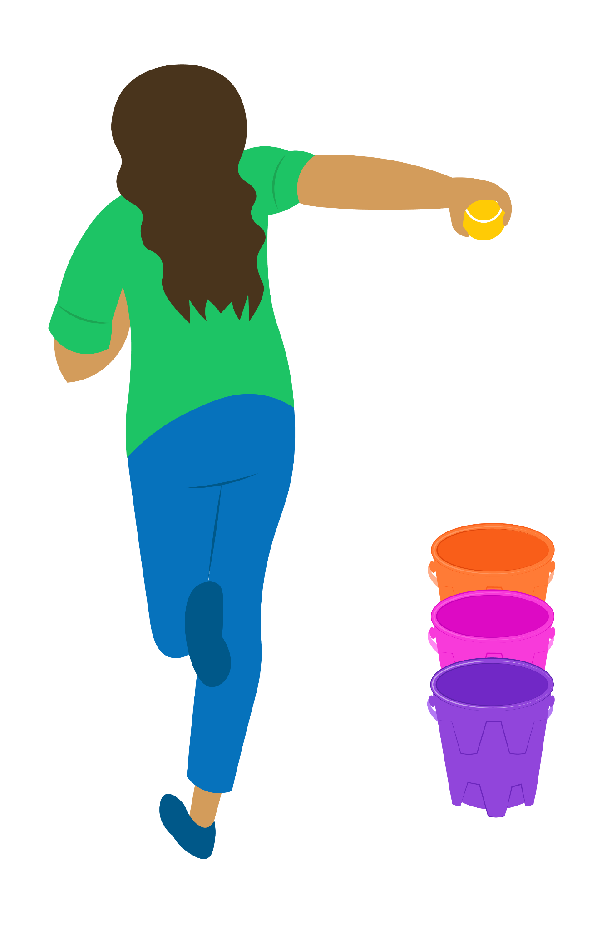
Tennis Ball and Activity Directions
Place the tennis ball in one hand stretched out to your side.
Have one person record as another runs to drop the ball in the middle bucket.
Each team member takes a turn, and record their points.
Add up each member's total after 4 rounds and calculate the group’s mean.
Notes:
Newton’s first law of Motion. (n.d.). https://physics.weber.edu/amiri/physicsvideos/part1/laws_of_motion/first_law/default.asp

Slide 12
Trajectory
The path taken by a flying projectile or an object moving on the action by a given force.

Slide 13
Projectile
Any object that is cast, fired, flung, heaved, hurled, pitched, tossed, or thrown and is influenced by its own interia and downward pull of gravity.

Slide 14
Reflecting
How is the inertia of the occupants inside the car related to the inertia of the ball in your hand?
How does your sketch of the man’s motion compare to the motion of the falling ball?
Are both the man and the ball considered projectiles?
What effect does gravity, paired with inertia, have on the motion of the man and falling ball?

Slide 15
Sketch
On your group’s poster, depict the comparison of the man in the car video to that of the tennis ball’s motion
Write a summary(3-5 sentences) stating how Newton’s first law and inertia apply to the tennis ball activity based on your responses from the analysis questions.

Slide 16
Gallery Walk
With your group, visit the other posters around the room.
How do they compare to yours?
What do you notice?
What do you wonder?
Using sticky notes, leave any comments or questions you have about the topic.
Rotate until you are back at your original model.
Notes:
K20 Center. (n.d.). Gallery walk / carousel. Strategies. Retrieved from https://learn.k20center.ou.edu/strategy/118

Slide 17
Beyond the Classroom
Where might you encounter or see a projectile that has similar motion to the man in the car and the falling ball?

Slide 18
Stop & Jot-World War II
Read “World War II Technology that Changed Warfare Radar and Bombsights”
Read only the Introduction and pages 11-15 (Bombsights-The Advancement of Bombsights)
In your group take turns sharing what you learned.
Use the Stop & Jot strategy by jotting down the main idea of each page after reading each one.
Notes:
K20 Center. (n.d.). Stop and Jot. Strategies. https://learn.k20center.ou.edu/strategy/168

Slide 19
Safety Engineering
Let’s learn about two professions that need to understand the physics of car crashes, but from two vastly different angles.
What kind of research would they need to do on Newton’s laws in order to be successful at these jobs?
https://www.youtube.com/watch?v=3OBNpJQxQrs&feature=youtu.be
Notes:
This slide is for the ICAP version of the lesson.
YouTube. (2020b, December 14). K20 ICAP - Attorney & Chemical Engineer - Buckle up. YouTube. https://www.youtube.com/watch?v=3OBNpJQxQrs

Slide 20
Safety First Engineering
Think of a job you are interested in pursuing or find fascinating.
How does that occupation institute safety procedures to reduce momentum on an object? Why are those safety precautions essential to that job?
Notes:
This slide is for the ICAP version of the lesson.

Slide 21
Reflect
How are the man, the ball, and the bombs from WWI and WWII all related? (use key terms from the lesson)
Before bomb sight technology and radar, what factors would have to be considered to get the falling projectile (the bomb) to hit its exact target?
In what situation is a projectile launched but the effect of gravity on the path is not easily observed, only its own inertia?

Slide 22
Reflect
How are the man and the ball related? Instruct students to use key terms from the lesson.
What factors would have to be considered to get a falling projectile, such as the ball, to hit its exact target?
In what situations is a projectile launched but the effect of gravity on the path is not easily observed, only its own inertia?

