Slide 2
Friends, Romans, Countrymen, Lend Me Your Emotions
Modes of Persuasion & William Shakespeare’s Julius Caesar
9th & 10th Grade ELA

Slide 3
With your partner, arrange the cards in a way that makes most sense to both of you.

Slide 4
Compare your honeycomb with a nearby group.
Did you sort some cards the same?
Did you sort any cards differently?
Explain to the other group why you sorted your cards the way you did.

Slide 5
I Notice
I Wonder
As you watch each commercial, write down your observations on the left side. Write any questions you have on the right.

Slide 6
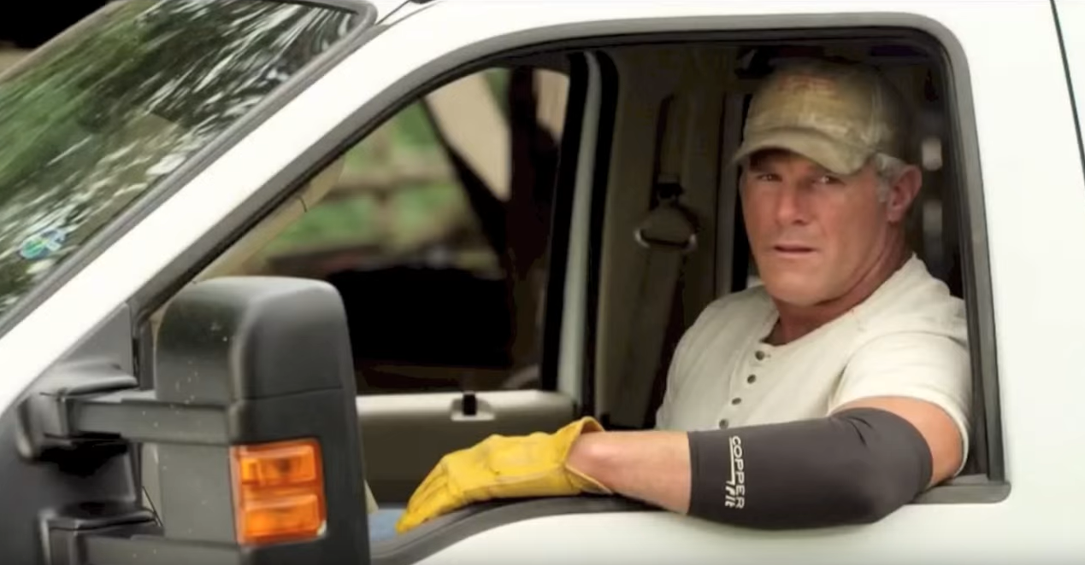
Commercials U.S. (2015, June 9). Brett Favre, Copper Fit Commercial. YouTube. Retrieved from https://youtu.be/L2HcwLgpBSY
Notes:
Tell students that they are going to watch three short commercials, and as they watch each commercial, they need to write down their observations and any questions they may have. Click the picture, the link in the citation, or this link (https://youtu.be/L2HcwLgpBSY) to watch the commercial.

Slide 7
What did you notice?
What did you wonder?
Notes:
Ask students to share out their observations. Allow time for student responses.
Ask students to share out any questions they may have. Allow time for student responses.
Ask students which of the three appeals was used in the commercial.
Note: This is an example of an ethos appeal, because they are relying on the credibility of Brett Favre. If it’s good enough for him, it’s good enough for me...

Slide 8
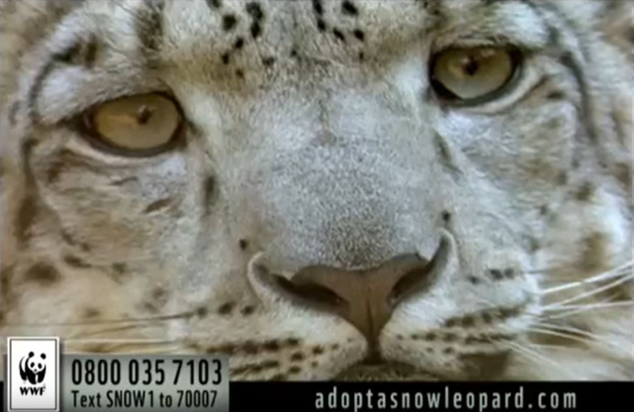
NiceCrane287 (2012, July 28). Adopt a wild snow leopard - WWF. YouTube. Retrieved from https://youtu.be/nvEgCg1yh30
Notes:
Tell students that they are going to watch three short commercials, and as they watch each commercial, they need to write down their observations and any questions they may have. Click the picture, the link in the citation, or this link (https://youtu.be/nvEgCg1yh30) to watch the commercial.

Slide 9
What did you notice?
What did you wonder?
Notes:
Ask students to share out their observations. Allow time for student responses.
Ask students to share out any questions they may have. Allow time for student responses.
Ask students which of the three appeals was used in the commercial.
Note: This is an example of a pathos appeal, because they describe the dire situation faced by snow leopards in order to elicit pity from viewers.

Slide 10
AdFreakOne (2009, Jan 8). Campbell's Soup | "Light Versus". YouTube. Retrieved from https://youtu.be/PplMjgh_QlM
Notes:
Tell students that they are going to watch three short commercials, and as they watch each commercial, they need to write down their observations and any questions they may have. Click the picture, the link in the citation, or this link (https://youtu.be/PplMjgh_QlM) to watch the commercial.

Slide 11
What did you notice?
What did you wonder?
Notes:
Ask students to share out their observations. Allow time for student responses.
Ask students to share out any questions they may have. Allow time for student responses.
Ask students which of the three appeals was used in the commercial.
Note: This is an example of a logos appeal, because they demonstrate that Campbell’s Select Harvest Light is better for you than Progresso Light.

Slide 12
Think about the play, Julius Caesar. Have any of the characters used these types of appeals (logos, pathos, ethos)?
Notes:
Note: It is not necessary for students to read Julius Caesar prior to completing this lesson, but you should only ask your students this question if they have read the play.

Slide 13
Why-Lighting
Read the speech.
Look for different modes of persuasion in the language. Highlight examples.
When you highlight, notate which mode the highlighted text represents and why.
Notes:
Pass the speech handouts to the students.
Number students off 1 through 3, and then assign the speech with the corresponding number. (If you have three colors of highlighters available, consider the Categorical Highlighting strategy discussed in the next slide.) Students will use this activity as a Jigsaw (see slide 15).

Slide 14
Categorical Highlighting
Read the speech.
Using three different colors (one for each mode of persuasion), highlight examples of each mode in the speech.
When you highlight, notate which mode the highlighted text represents and why.

Slide 15
Jigsaw
Find two classmates who read different speeches than you. Form a group of three.
Share what you read in your speech.
What was the mode of persuasion?
Which words or phrases used in the speech helped you determine the mode of persuasion?

Slide 16
Should Caesar have been assassinated? Persuade the citizens to join with Brutus and Cassius or with Mark Antony and the triumvirate.
Choose a mode of appeal (ethos, pathos, or logos).
Write a claim about whether Julius Caesar should have been assassinated or not.
Provide evidence from the play for your claim.
Provide your reasoning for how the evidence justifies the claim.

