Slide 2
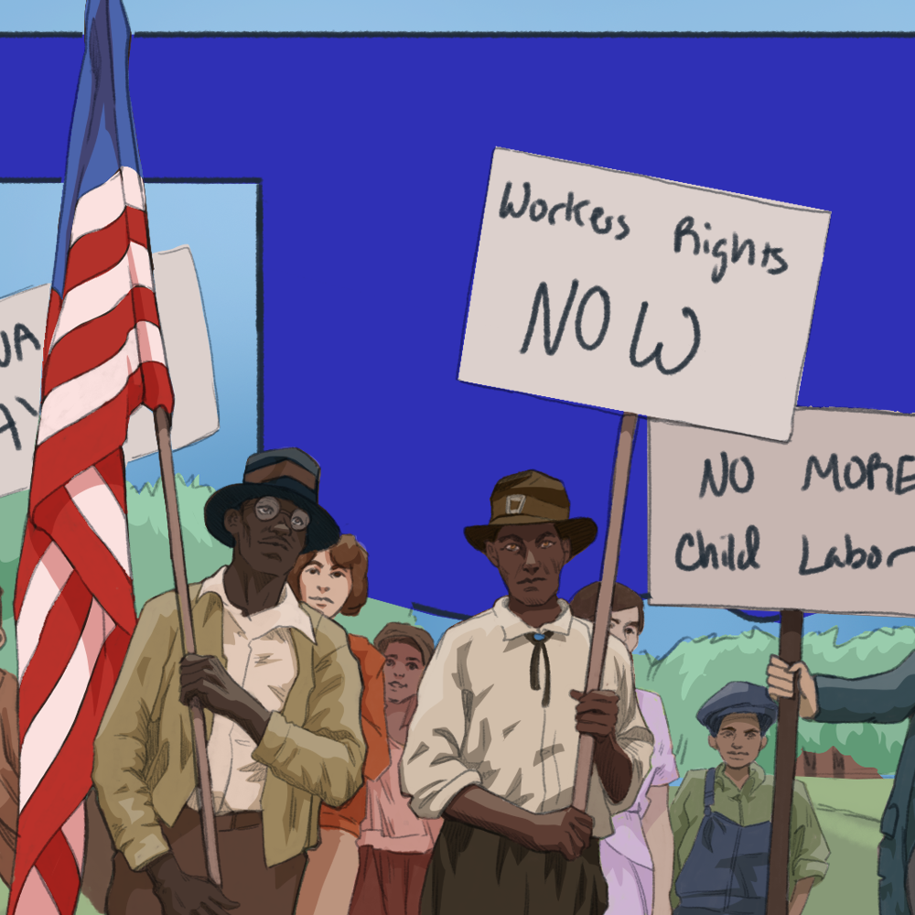
Progressivism, Organized Labor, and Oklahoma’s Constitution
The Progressive Era in Oklahoma

Slide 3
“The Shawnee Demands,” 1906
With your group, read through “The Shawnee Demands.”
Work with your group to answer this question: What do the “demands” on this list have in common?

Slide 4
Essential Questions
How do citizens, individually or collectively, influence government structure and policy?
Should governments regulate businesses to protect the rights of workers?

Slide 5
Learning Objectives
Describe the progressive and labor movements.
Explain how the progressive and labor movements influenced the creation of Oklahoma’s Constitution.

Slide 6

Window Notes
With your group, read “Progressive Era in Oklahoma.”
After reading the article, complete the Window Notes chart.
Notes:
K20 Center. (n.d.). Window notes. Strategies. https://learn.k20center.ou.edu/strategy/189

Slide 7
The Progressive Movement and Oklahoma’s Constitution
Using your knowledge of the progressive movement, work with your group to explain how each provision from “The Shawnee Demands” that was included in Oklahoma’s Constitution reflects the goals of the progressive movement.

Slide 8

Progressivism, Organized Labor, Oklahoma Constitution
Notes:
K20 Center. (2020, April 8). Progressivism, organized labor, Oklahoma constitution. YouTube. https://youtu.be/-klPc1uryrk

Slide 9
AFL-CIO and the Progressive Era
In Mr. Curry’s opinion, why is the AFL-CIO important?
How does the AFL-CIO relate to the Progressive Era and what was included in Oklahoma’s Constitution?

Slide 10

Point of Most Significance
What part of the lesson helped you to understand the way in which Oklahoma’s state constitution was influenced by the progressive and labor movement?
Notes:
K20 Center. (n.d.). POMS: point of most significance. Strategies. https://learn.k20center.ou.edu/strategy/101

