Slide 2
Progressivism, Organized Labor, and the Oklahoma Constitution
THE PROGRESSIVE ERA IN OKLAHOMA
Oklahoma History

Slide 3
“The Shawnee Demands,” 1906
With your group, read through “The Shawnee Demands.”
Next, work with your group to answer this question: What do the “demands” on this list have in common?

Slide 4
Essential Questions
How do citizens, individually or collectively, influence government structure and policy?
Should governments regulate businesses to protect the rights of workers?

Slide 5
Learning Objectives
Describe the progressive and labor movements.
Explain how the progressive and labor movements influenced the creation of Oklahoma’s Constitution.

Slide 6
Window Notes
With your group, read “The Progressive Era in Oklahoma.”
After reading the article, complete the Window Notes chart.

Slide 7
How the Progressive Movement Influenced Oklahoma’s Constitution
Using your knowledge of the progressive movement, work with your group to explain how each provision from “The Shawnee Demands” that was included in Oklahoma’s Constitution reflects the goals of the progressive movement.

Slide 8
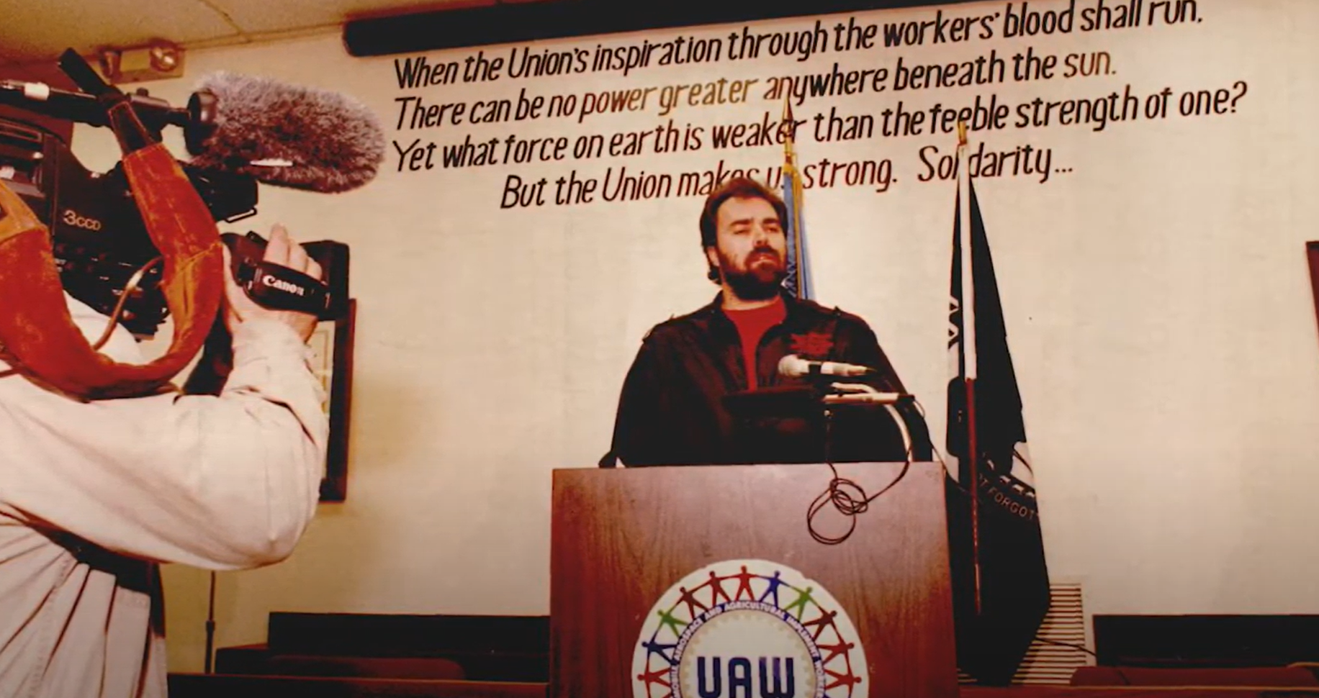
ICAP: Progressivism, Organized Labor, and the Oklahoma Constitution
K20 Center. (2020, April 8). Progressivism, organized labor, Oklahoma constitution. YouTube. https://youtu.be/-klPc1uryrk
Notes:
K20 Center. (2020, April 8). Progressivism, organized labor, Oklahoma constitution. YouTube. https://youtu.be/-klPc1uryrk

Slide 9
Class Discussion
How do citizens, individually and collectively, influence government structure and policy?
Should governments regulate businesses to protect the rights of workers?

