Slide 2
A Fuzzy Companion in the Void: Finding Meaning in Meaninglessness
Nihilism

Slide 3
Essential Question:
What does nihilism teach us about the search for meaning and purpose in our lives, and how can we reconcile existential questions with our own values and beliefs?
How does one find meaning, purpose, or value in a world seemingly devoid of inherent significance or objective truth?

Slide 4
Learning Objectives
Define nihilism.
Describe the characteristics of resilience and optimism.
Turn nihilistic song lyrics into optimistic poems.

Slide 5
Tug-of-War
Where would your quote fall on a continuum that included optimism and nihilism?
Optimism
Nihilism

Slide 6
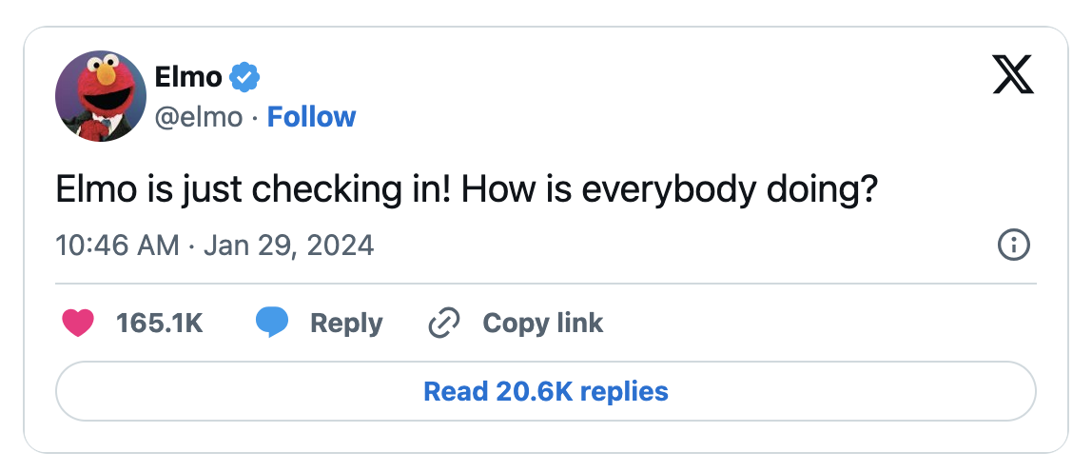
Elmo did what?
Notes:
Elmo on X: "Elmo is just checking in! How is everybody doing?" / X (twitter.com)

Slide 7
Categorical Highlighting with Elmo
As you read the article, highlight the following:
Feelings - Pink
Key Information - Yellow

Slide 8
Notes:
Today. (2024, February 1). Elmo opens up to today about tweet that sparked intense reaction. YouTube. https://youtu.be/xBidHiE2bzQ

Slide 9
Elmo did what?
What reaction did the world have?
What was Elmo’s response?
Does Elmo exhibit nihilism or optimism?
What advice do the Sesame Street characters give you about facing life?

Slide 10
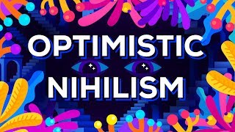
Notes:
Kurzgesagt -- In a Nutshell. (2017, July 26). Optimistic nihilism. YouTube. https://www.youtube.com/watch?v=MBRqu0YOH14

Slide 11
Elmo did what?
What connections can you make, if any, between the video and Elmo’s tweet?

Slide 12
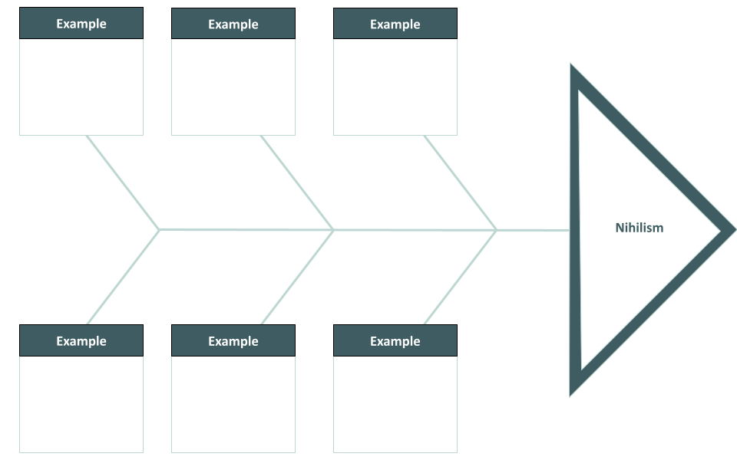
Fishbone
The effects -or- “fish head” – of Nihilism.
As you read the lyrics, look for examples of nihilism.
Add these to each of the six (6) “fishbones.”

Slide 13
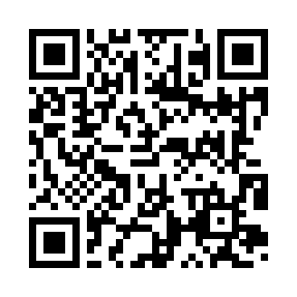
Lyrical Stylings of Nihilism
Access the Wakelet.
Select one of the following songs to analyze using the Fishbone strategy:
Still Haven’t Found What I’m Looking For by U2
Smells Like Teen Spirit by Nirvana
Losing my Religion by R.E.M.
Bullet with Butterfly Wings by Smashing Pumpkins
Undone (Sweater Song) by Weezer
In the End by Linkin Park
Leave Me Alone by NF
Notes:
Lyrical Stylings of Nihilism - Wakelet

Slide 14
Fishbone
The effect -or- “fish head” - Nihilism
As you read the lyrics, look for examples of nihilism.
Add these to each of the six (6) “fishbones.”

Slide 15
Notes:
YouTube. (2012). Famous Failures. YouTube. Retrieved July 27, 2022, from https://www.youtube.com/watch?v=zLYECIjmnQs&list=PL6P49nXsj_RyRa8udbr2ac_Xb9Sw4Pu5R&index=6.

Slide 16
Famous Failures
What did they have that pushed them?
What does it mean to be resilient?
What do you want to do in life?
Why don’t you quit?

Slide 17
Blackout Poetry
Read through the lyrics.
Lightly circle words that portray optimism or convey positivity.
Write those words down in order as you read them from top to bottom and left to right.
If you are happy with the words you chose and you feel as if they represent the piece, take a black permanent marker and place a box around each word. Leave the word itself untouched.
Finally, go back through the piece of writing and black out the rest of the words, leaving only the words you chose untouched.

Slide 18
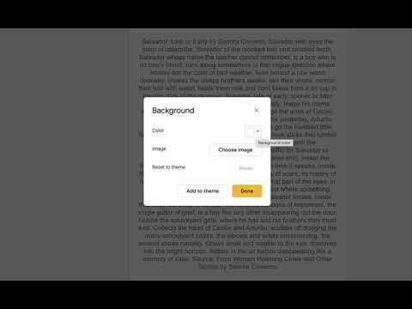
Notes:
YouTube. (2021). Blackout Poetry - Google Slides. YouTube. Retrieved February 24, 2023, from https://www.youtube.com/watch?v=ADnAmvqXMRU.

Slide 19
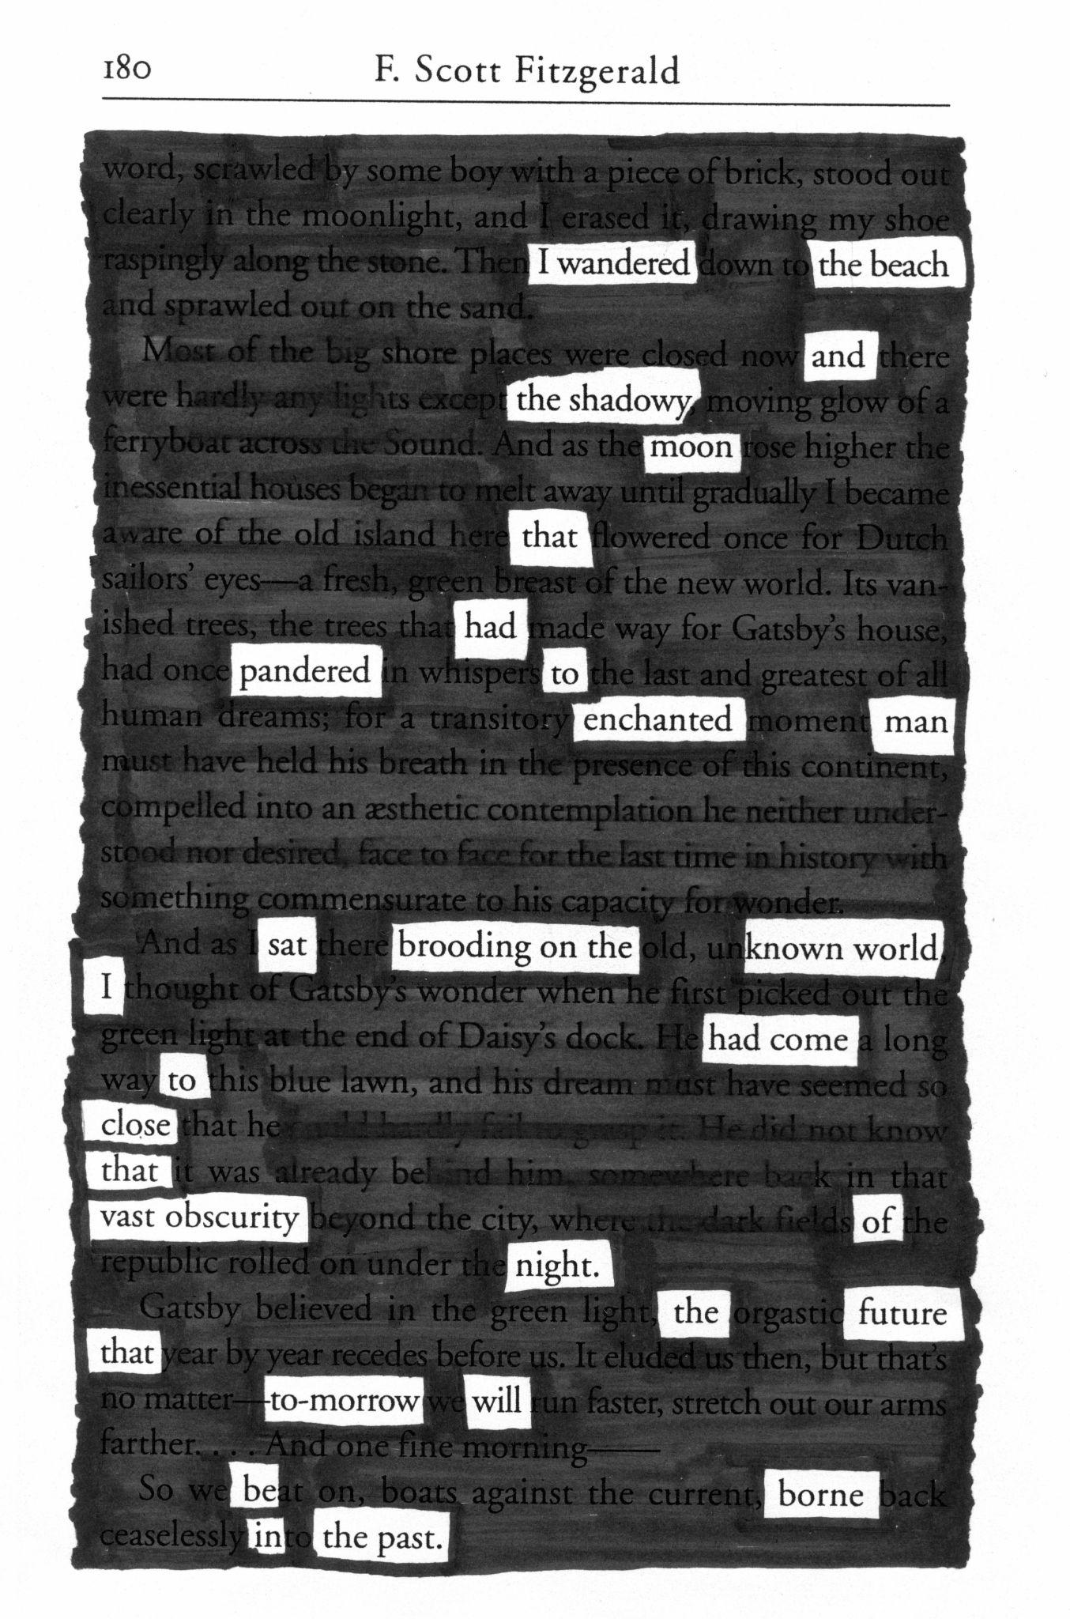
Notes:
https://www.flickr.com/photos/fncll/15474592616/in/photostream/

Slide 20
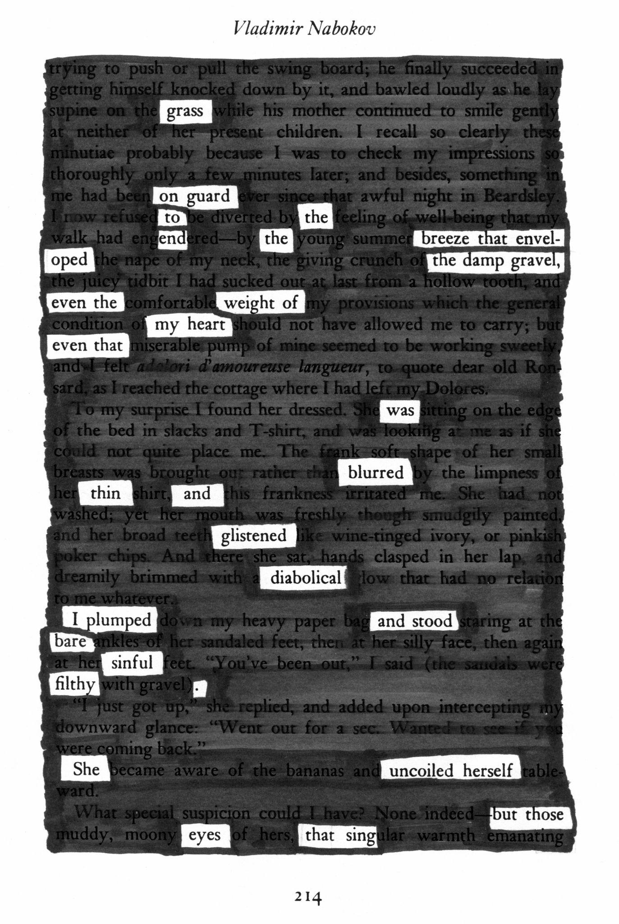
Notes:
https://www.flickr.com/photos/fncll/15474595366

Slide 21
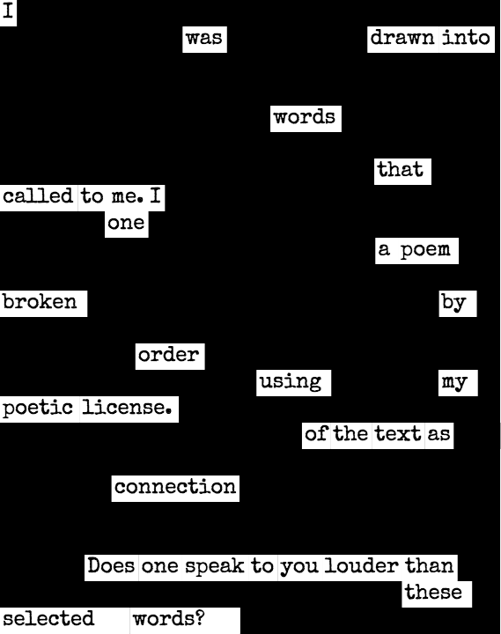
Notes:
https://commons.wikimedia.org/wiki/File:%D0%91%D0%BB%D0%B5%D0%BA%D0%B0%D1%83%D1%82_%D0%BF%D0%BE%D0%B5%D0%B7%D1%96%D1%8F.png

Slide 22
Blackout Poetry
Read through the lyrics.
Lightly circle the words that convey optimism or portray positivity.
Complete the Blackout Poetry process.

