Slide 1
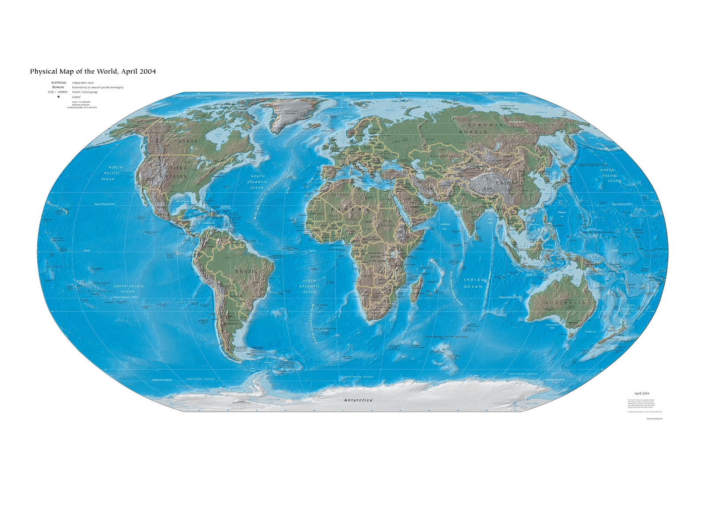
Notes:
CIA World Factbook. (2004, April 1). Physical world map. Wikimedia Commons. https://commons.wikimedia.org/wiki/File:World_map_2004_CIA_large_1.7m_whitespace_removed.jpg

Slide 2
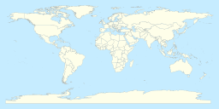
Notes:
Gringer. (2010, August 23). World map. Wikimedia Commons. https://commons.wikimedia.org/wiki/File:NED_worldmap_110m.svg

Slide 3
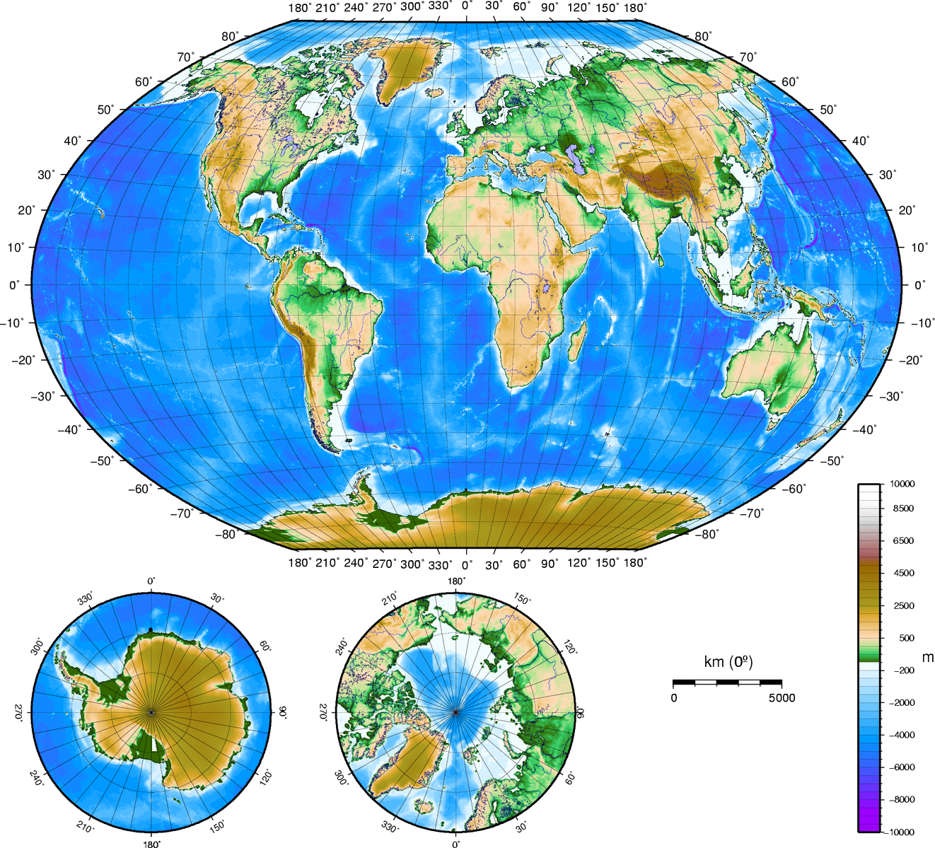
Notes:
Monniaux, D. (2005, May 28). World map. Wikimedia Commons. https://commons.wikimedia.org/wiki/File:World_map.png

Slide 4
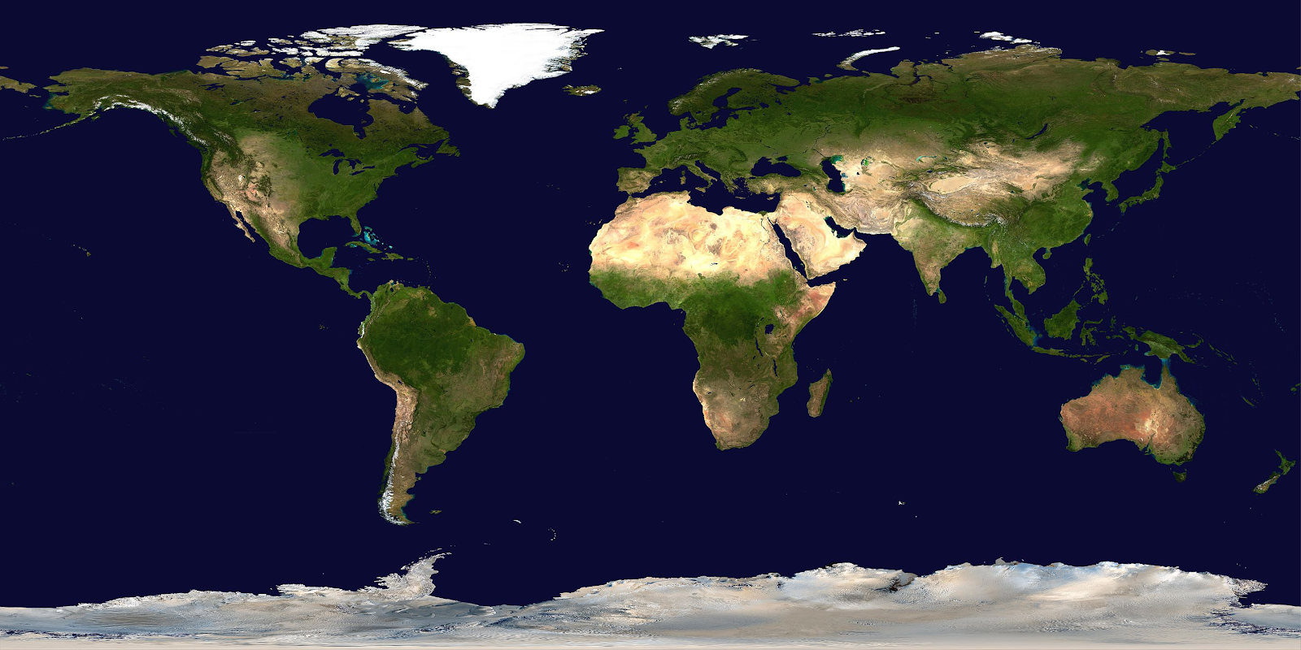
Notes:
NASA/Goddard Space Flight Center. (2002, February 11). Satellite composition of the whole Earth's surface. Wikimedia Commons. https://commons.wikimedia.org/wiki/File:Whole_world_-_land_and_oceans_12000.jpg

Slide 5
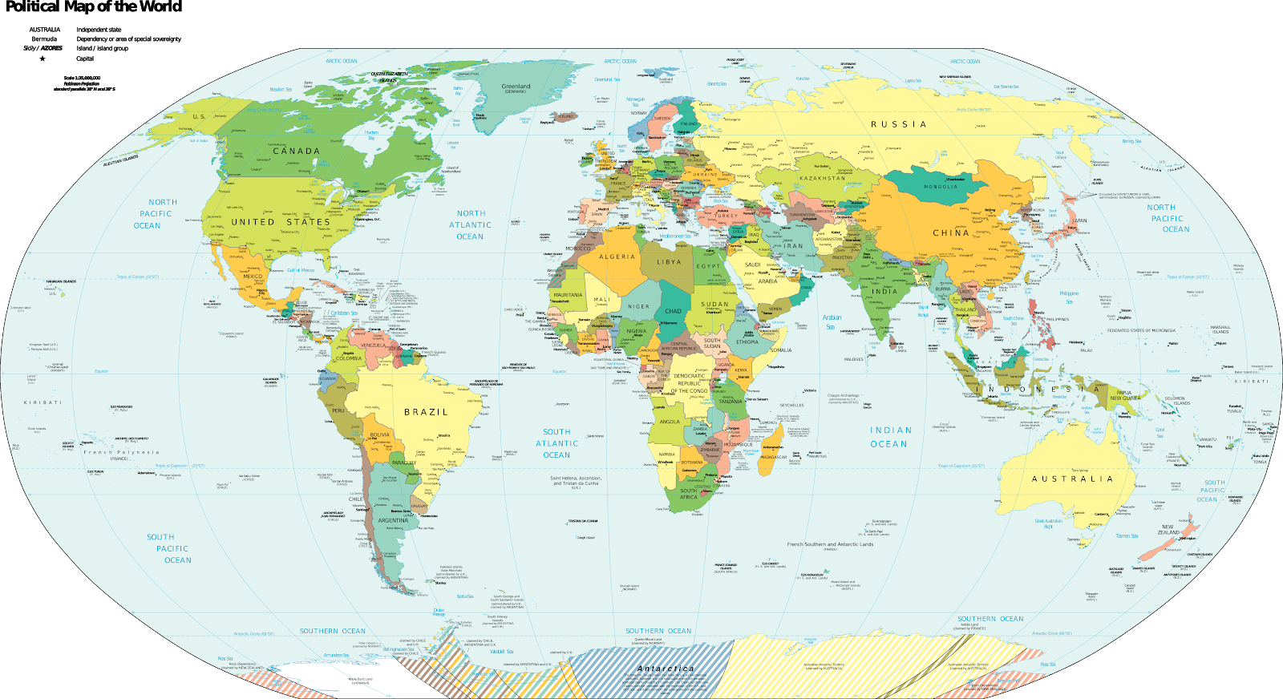
Notes:
CIA World Factbook. (2019, September 18). Political map of the world with territorial disputes included. Wikimedia Commons. https://commons.wikimedia.org/wiki/File:Political_World_Map_(with_disputed_territories).png

