Slide 2
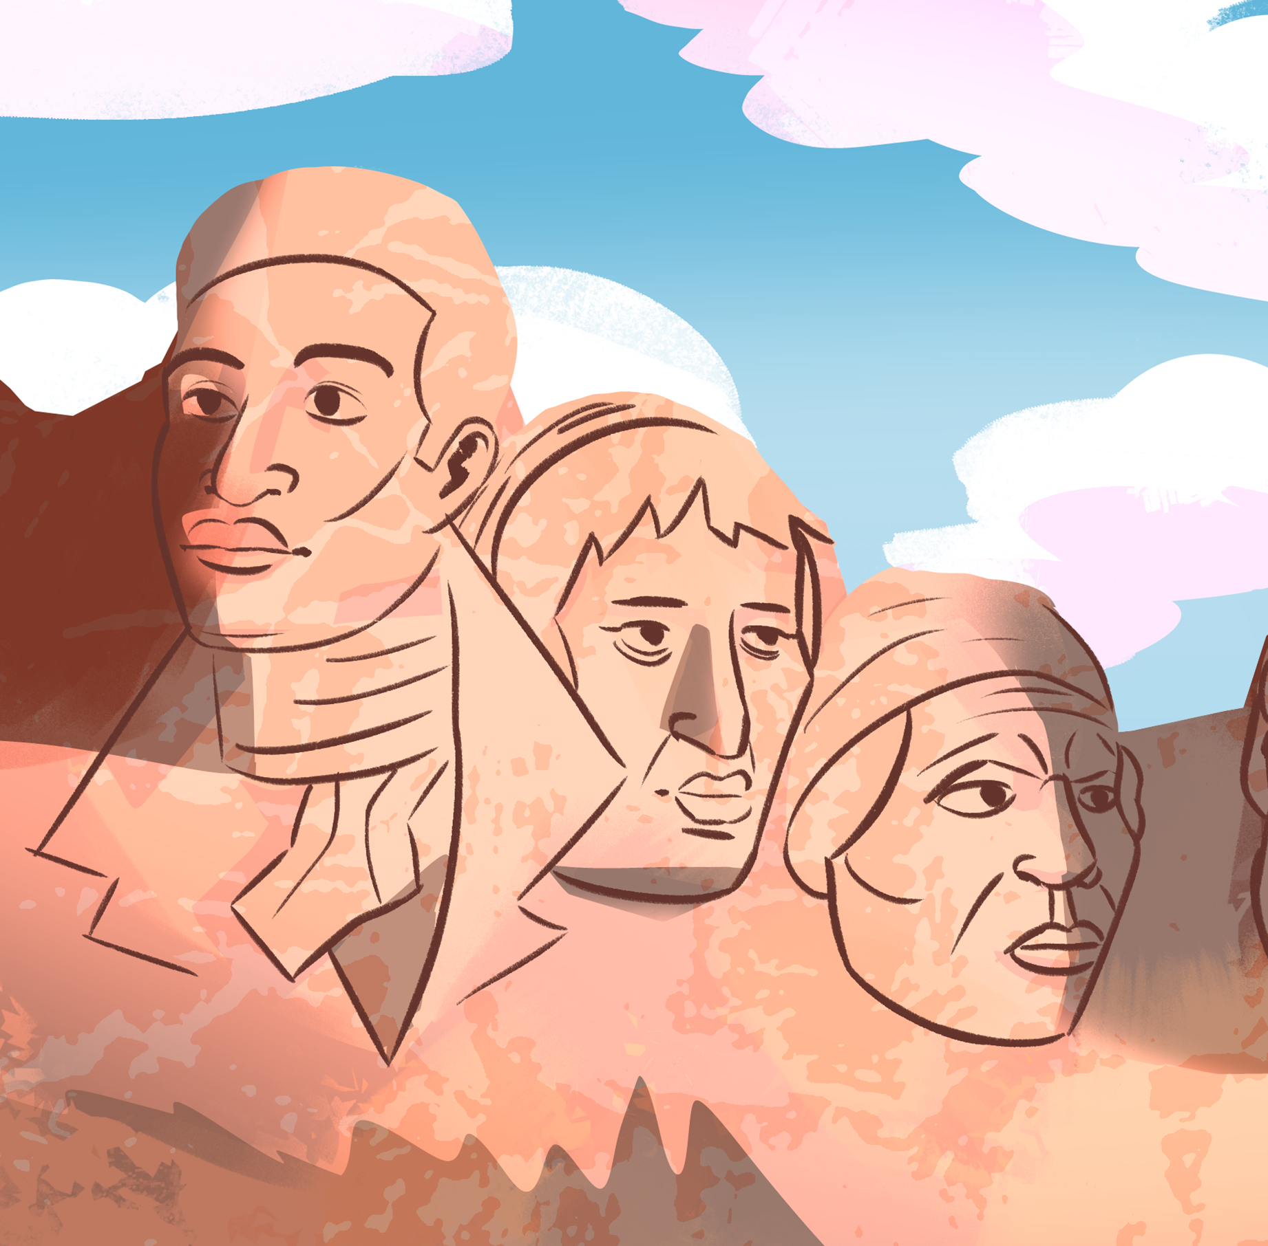
Analyzing Early American Figures
Analyzing History

Slide 3
Essential Question
Do people make history, or does history make people?

Slide 4
Lesson Objectives:
Analyze and summarize the impact of key historical figures in early American history.
Make connections between historical figures.

Slide 5


Tell Me Everything!
On your paper, tell me…
  every early American historical figure you can think of.
You have 1 minute.
Notes:
K20 Center. (n.d.). Tell me everything. Strategies. https://learn.k20center.ou.edu/strategy/107
https://www.youtubeeducation.com/watch?v=6ilD555O_RE

Slide 6
Tell Me More!
Using your list, tell me everything that you
know about the people on it.
You have 1 minute.
Notes:
K20 Center. (n.d.). Tell me everything. Strategies. https://learn.k20center.ou.edu/strategy/107
https://www.youtubeeducation.com/watch?v=6ilD555O_RE

Slide 7
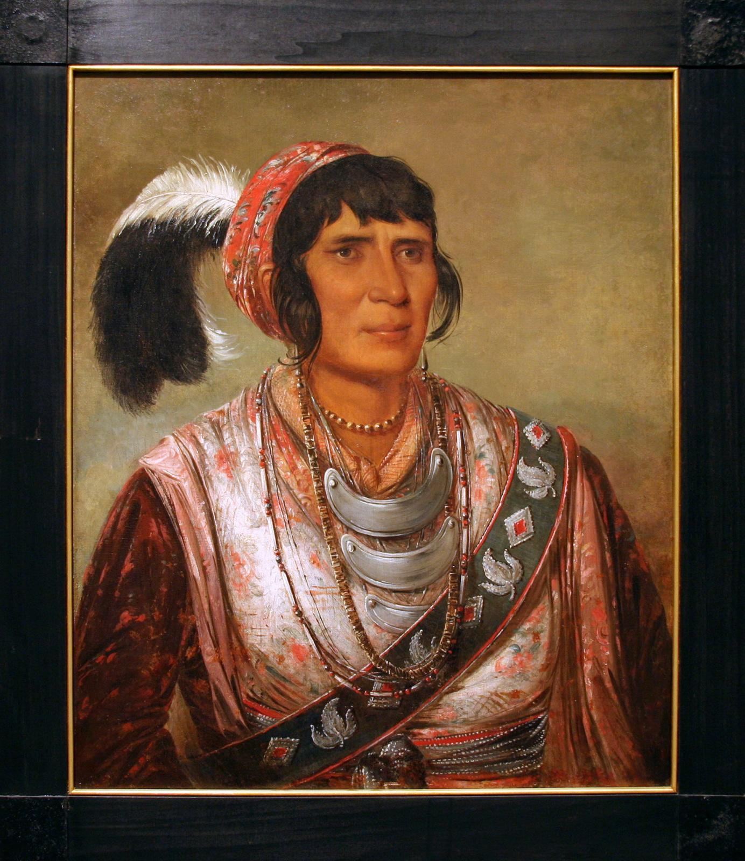
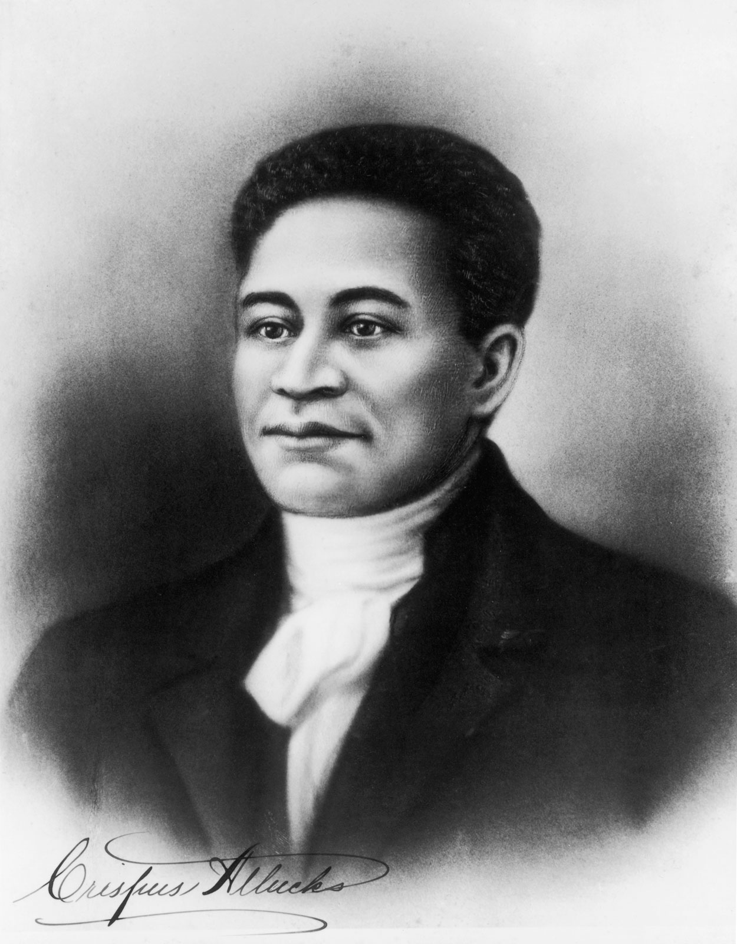
Early American Historical Figures
Who are these early American historical figures?
Were they included on your lists? Why or why not?
Osceola
Crispus Attucks
Notes:
Unknown. (c. 1854). Portrait of Crispus Attucks. Wikimedia Commons. https://commons.wikimedia.org/wiki/File:Crispus_Attucks.jpg
Catlin, G. (1838). Oil on canvas portrait of Osceola. Wikimedia Commons. https://commons.wikimedia.org/wiki/File:Osceola_by_Catlin.jpg

Slide 8
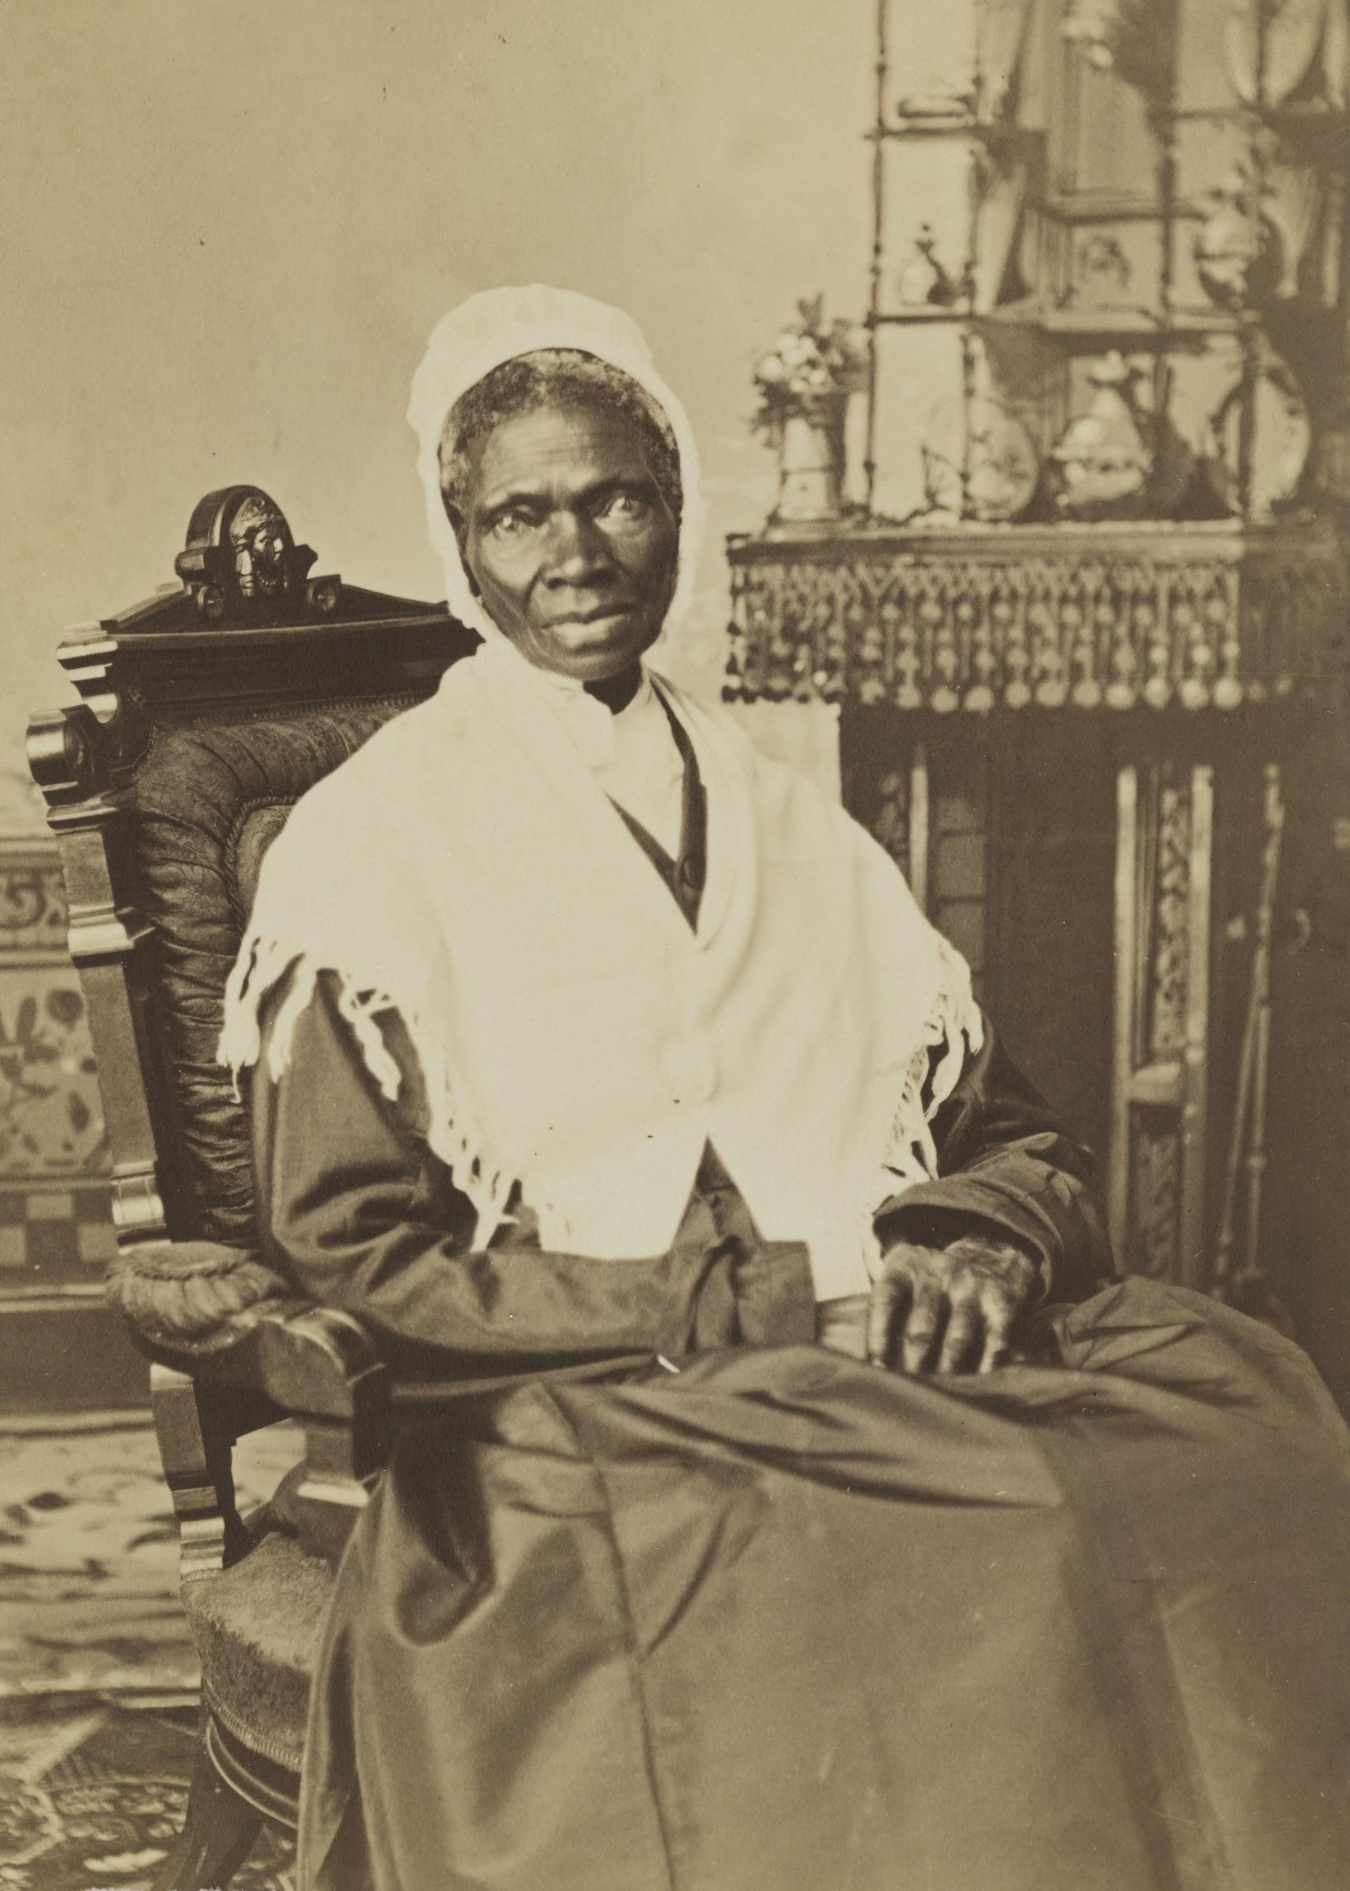
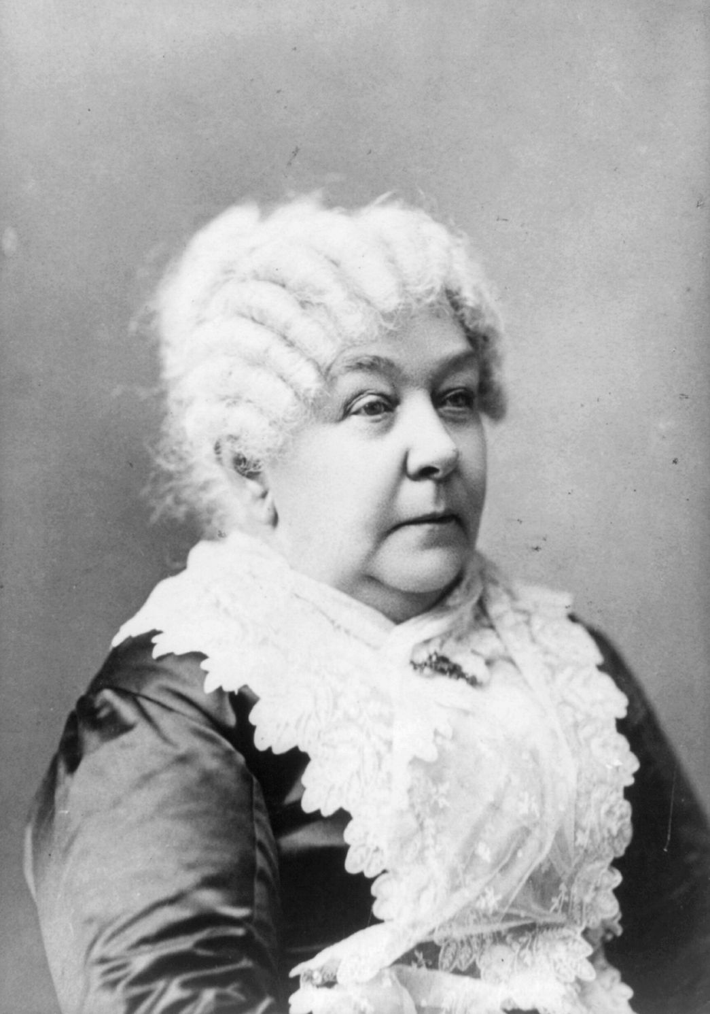
Early American Historical Figures
Who are these early American historical figures?
Were they included on your lists? Why or why not?
Sojourner Truth
Elizabeth Cady Stanton
Notes:
First Image: Randall Studio. (c. 1870). Sojourner Truth. Wikimedia Commons. https://commons.wikimedia.org/wiki/File:Sojourner_Truth,_NPG.79.220_(cropped).jpg
Second Image: Veeder. (n.d.). Stanton, Elizabeth (November 12, 1815–October 26, 1902). Wikipedia. https://en.wikipedia.org/wiki/File:Elizabeth_Cady_Stanton.jpg

Slide 9
Historical Figures
Draw a slip of paper.
The name on the paper will be the name of the person you will research for the project.

Slide 10

KWHL Chart
Write the name of your historical figure at the top of your KWHL Chart.
In the “K” box, fill in everything you know about your figure.
Notes:
K20 Center. (n.d.). KWHL graphic organizer. Strategies. https://learn.k20center.ou.edu/strategy/127

Slide 11
KWHL Chart
In the “W” box, write down everything you want to know about your figure.
Need help? Think about:
  What do I want to know?
  What would others want to know?
  For what is this person famous?
Notes:
K20 Center. (n.d.). KWHL graphic organizer. Strategies. https://learn.k20center.ou.edu/strategy/127

Slide 12
KWHL Chart
In the “H” box, write down ways you can find the information you listed in the “W” box.
For example:
  A focused Internet search
  Reading encyclopedia articles
What other resources could you use to
learn more about your figure?
Notes:
K20 Center. (n.d.). KWHL graphic organizer. Strategies. https://learn.k20center.ou.edu/strategy/127

Slide 13
Research
Using the “H” portion of your chart to guide you, research your assigned figure.
Some things to consider as you research:
  Notable accomplishments
  Education
  Connections to other historical figures
  Interests or hobbies
  Contributions to their field
  Interesting facts

Slide 14
Optional Weje.io Tech Integration
Go to Weje.io in your browser.
Select “Sign up” in the upper right-hand corner. If you have a Google account, you can sign up with Google.
Once you have signed in, go through the quick-start guide, then click on the “+” in the bottom left-hand corner and “Create empty board.”
Fill in your board, copying and pasting URLs and uploading files from your computer where appropriate.

Slide 15
Historical Figures Project
Using the template, create a project about your figure that includes each of the following:
Quote
Five fast facts
Historical importance
Six-word memoir
BFF
Worst enemy
Four symbols
Image

Slide 16
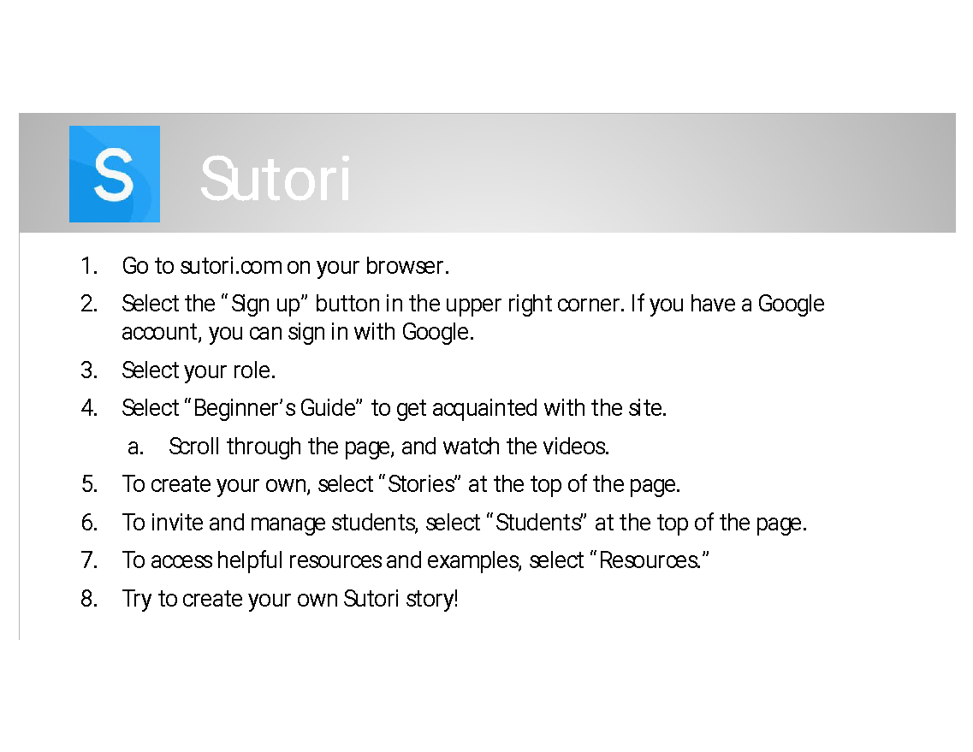

Optional Sutori Project How-To

Slide 17

Gallery Walk
Find a peer project to review.
  Only ONE person should view each project at a time.
Using sticky notes, write down any praise you have or any helpful tips.
  Did you like their image or symbols? Tell them!
  Did they use the wrong your/you’re? Tell them politely!
Rotate clockwise around the room to the next project.

Slide 18
Optional: Gallery Walk with Sutori
Share the link to your project in Google Classroom (or another collaborative workspace your teacher specifies).
Review and read through each peer project that you are assigned.
Comment on aspects you love, or politely offer advice if you notice any issues.

Slide 19
KWHL Chart
Fill in the “L” box on your chart with the information that you have learned about your historical figure.
Notes:
K20 Center. (n.d.). KWHL graphic organizer. Strategies. https://learn.k20center.ou.edu/strategy/127

