Slide 1
Examining the Boston Massacre Through Primary Sources
Social Studies
5th Grade

Slide 2
Essential Question
What role do perspective and propaganda play in the recounting of events like the Boston Massacre?

Slide 3
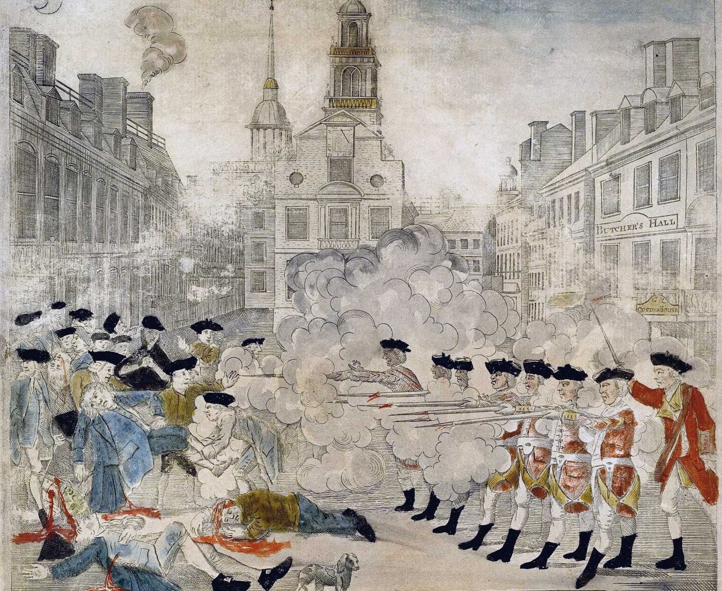
I Notice, I Wonder
Notes:
Image Source: Library of Congress. (1770). Boston Massacre as portrayed by Paul Revere [Image]. Wikimedia Commons. https://commons.wikimedia.org/w/index.php?title=File:Boston_Massacre_high-res.jpg&oldid=401629174. Public domain.

Slide 4
Boston Massacre Facts
The Boston Massacre occurred March 5, 1770 when British soldiers killed five protestors outside the Customs House in Boston.
The protest was against the British occupants who were sent to Boston to enforce taxation measures.
The British soldiers fired into the crowd, killing three people instantly. Two more later died from their wounds, while several others were injured.

Slide 5
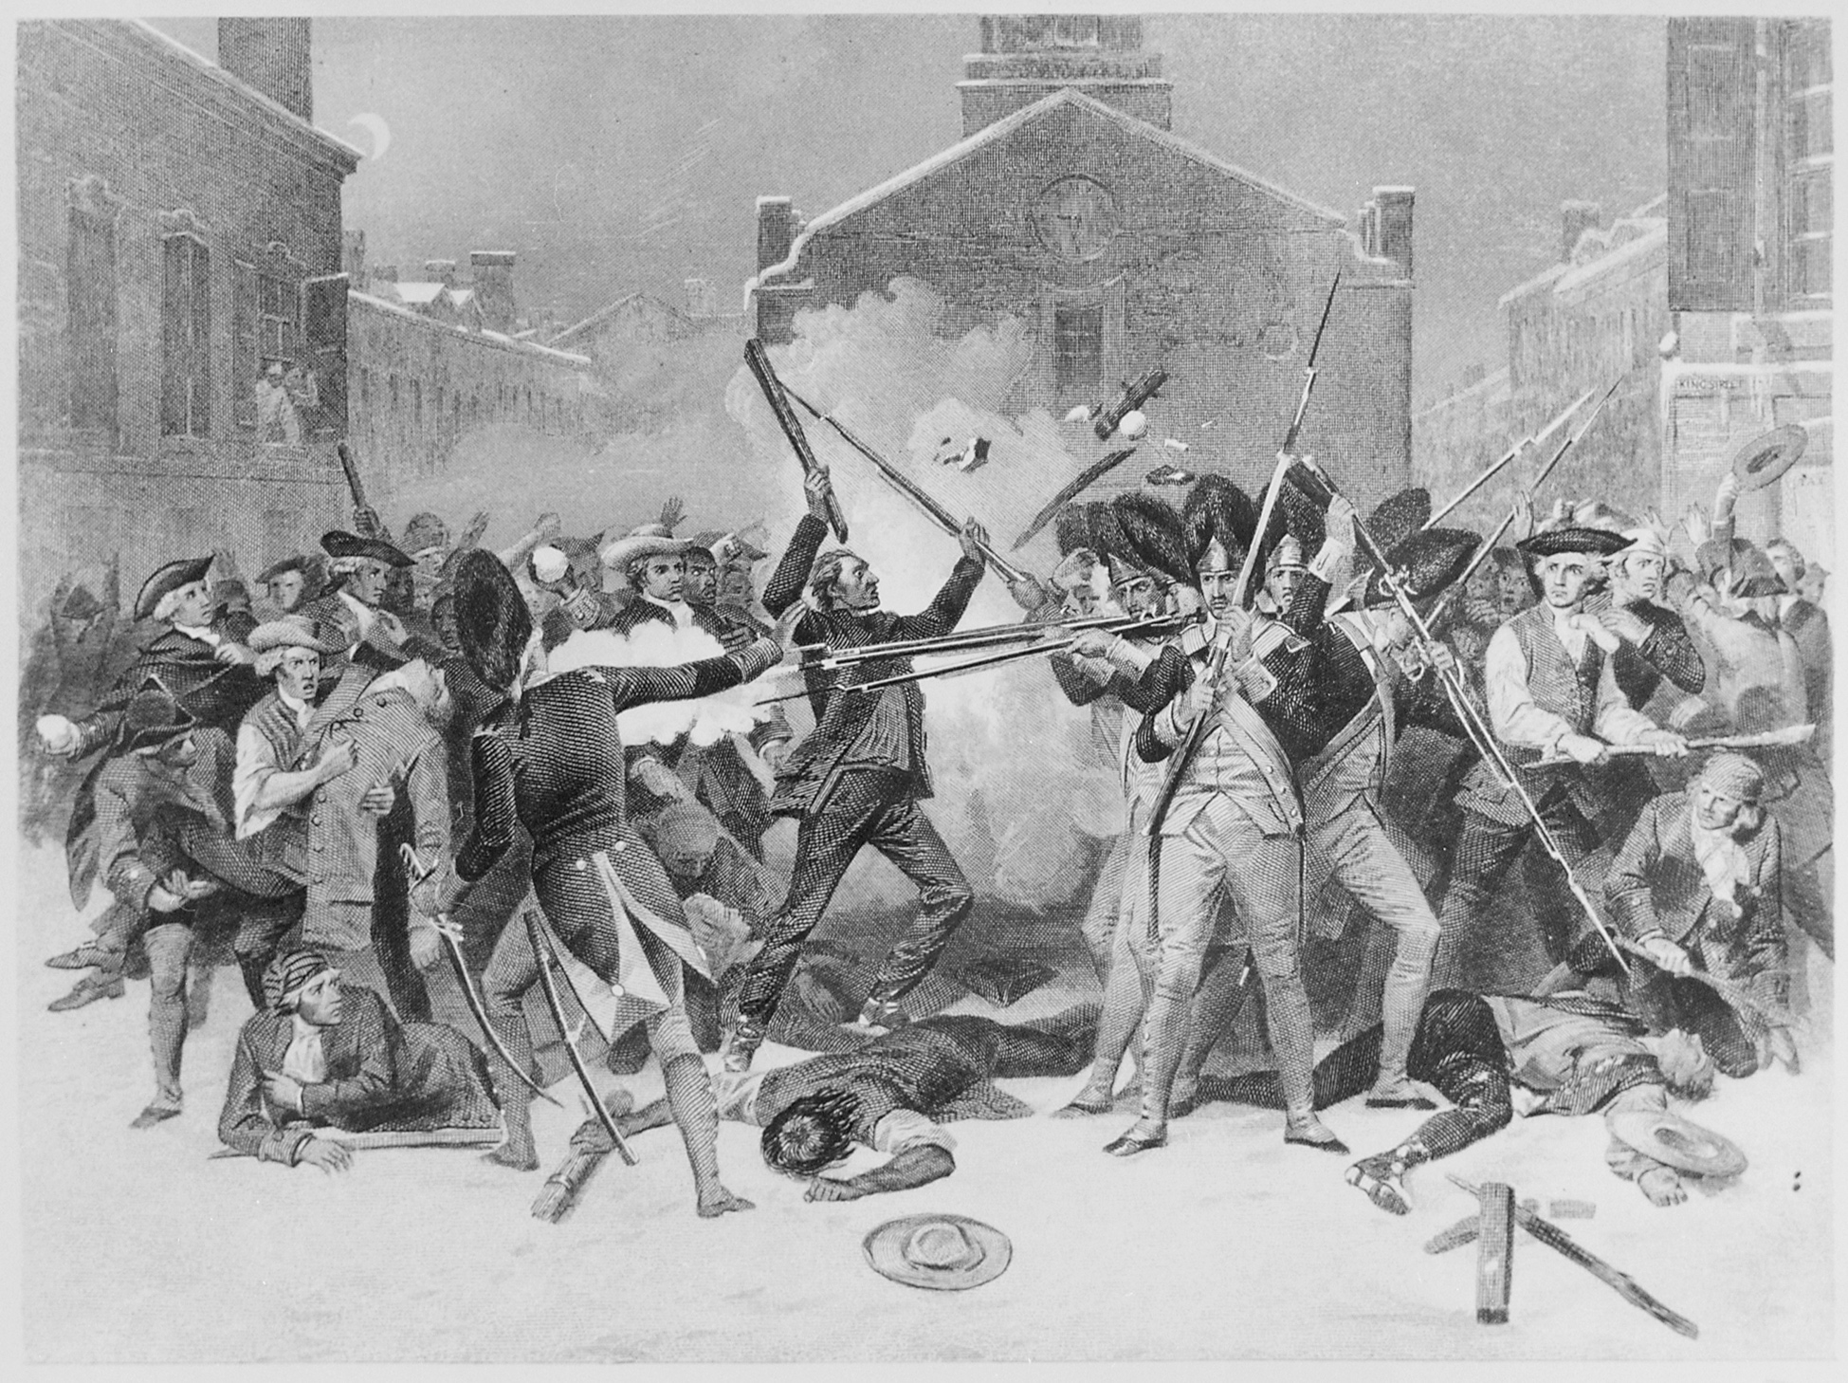
I Notice, I Wonder
Notes:
Image Source: National Archives at College Park. (1770). The Boston Massacre [Image]. Wikimedia Commons. https://commons.wikimedia.org/w/index.php?title=File:%22The_Boston_Massacre%22,_03-05-1770_-_NARA_-_513326.jpg&oldid=342540992

Slide 6
Deposition Documents
Read the first-person accounts from the Boston Massacre trial depositions.
How do the accounts in the depositions match what is depicted in the photos?
Whose accounts are being shared in the photos and in the depositions—Patriots or British soldiers?

Slide 7
Inverted Pyramid
Were the British soldiers provoked to fire and, therefore, acting in self-defense? Or were the colonists murdered?
How could two such different images exist of the same event?
How do the two images illustrate propaganda?

Slide 8
Reading Passage
Read the nonfiction account of the Boston Massacre.
With your group, plan a 5-minute skit of the event, as described in the passage.
Consider the perspective that your skit is taking: Loyalist, Patriot, or neutral.

Slide 9
Exit Ticket
Choose one of these three questions to answer:
What events occurred on March 5, 1770 that became known as the Boston Massacre?
What role did perspective and propaganda play in the recounting of the events of the Boston Massacre?
In what ways did the Boston Massacre lead to the outbreak of revolution in the colonies?

