Slide 1
Wild Angles: Acute and Obtuse and Right, Oh My!
Mathematics and Geometry

Slide 2
Card Sort
Sort the cards into groups that make sense to you.
Notes:
Instructor/Facilitator Notes:

Slide 3
Card Sort
Walk around the room and look at the way that other groups sorted their cards.
Notes:
Instructor/Facilitator Notes:

Slide 4
Essential Question
How does geometry help us describe objects all around us?

Slide 5
Learning Objectives
Classify and sort shapes based on their angle measurements.
Measure the size of angles in various objects.

Slide 6
Strategy Harvest
What are some different ways we can solve the problem?

Slide 7
Your bedroom door is open 66 degrees. To get your new bed inside you need it to be open an additional 31 degrees. To get your new dresser inside you need it to be open another 24 degrees beyond what you need for the bed. How wide, in degrees, does your door need to be open in order to get both your bed and your dresser in your room?
Notes:
OPTION 1

Slide 8
Your bedroom door is open 66 degrees, but in order to get your new bed inside you need it to be open 99 degrees. To get your new dresser in, you need it to be open 127 degrees. How much farther do you need to open your door to get your new bed and dresser inside?
Notes:
OPTION 2

Slide 9
Your bedroom door is open 66 degrees, but to get your new bed inside you need it to be open 99 degrees. To get your new dresser in, you need it to be open 127 degrees. How much farther do you need to open your door for it to make a straight angle?
Notes:
OPTION 3

Slide 10
STAR Notes
Take notes about each of these terms:
Right angle
Acute angle
Obtuse angle
Straight angle
Protractor
Include an example and an image for each one.

Slide 11
The Angles Song

Slide 12
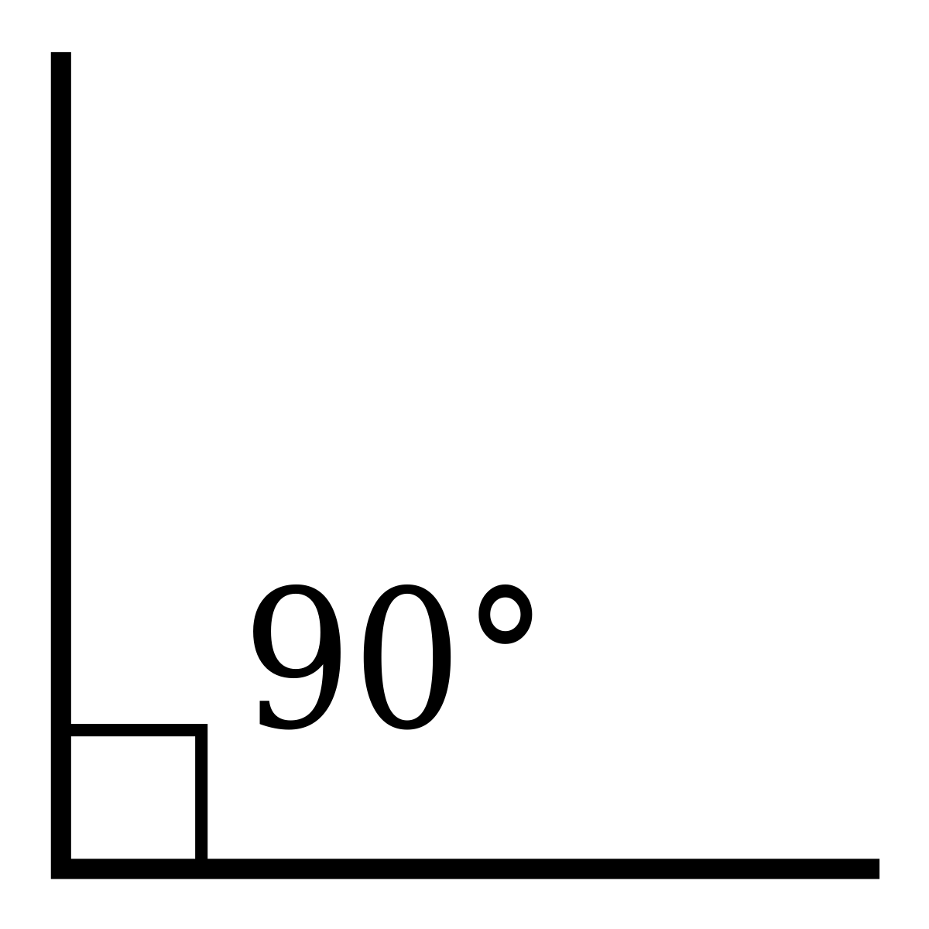
Right Angle
An angle that measures exactly 90 degrees.
Notes:
Lasunncty. (2019, August 10). Right angle [Digital image]. Retrieved May 27, 2020, from https://commons.wikimedia.org/wiki/File:Right_angle.svg#file

Slide 13
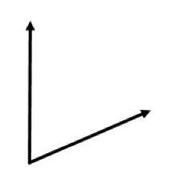
Acute Angle
An angle that measures between 0 and 90 degrees.
Notes:
Tladie. (2020, March 22). Basic acute angle [Digital image]. Retrieved May 27, 2020, from https://commons.wikimedia.org/wiki/File:Acute_Angle.png

Slide 14
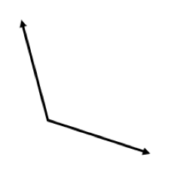
Obtuse Angle
An angle that measures between 90 and 180 degrees.
Notes:
Tladie. (2020, March 22). Basic obtuse angle [Digital image]. Retrieved May 27, 2020, from https://commons.wikimedia.org/wiki/File:Obtuse_Angle.png

Slide 15
Straight Angle
An angle that measures exactly 180 degrees, as in a straight line.
Notes:
Eddideigel. (2005, September 2). Angle straight [Digital image]. Retrieved May 27, 2020, from https://commons.wikimedia.org/wiki/File:Angle_straight.png

Slide 16
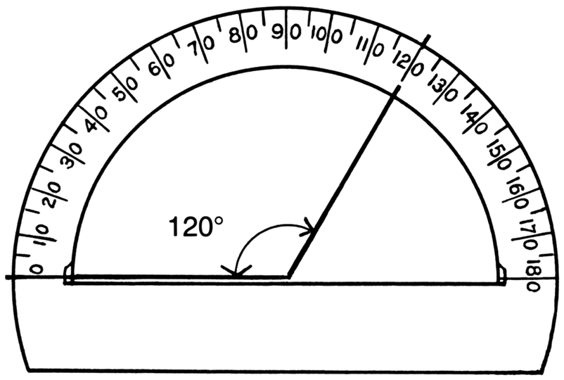
Protractor
Measures the angles in degrees.
Notes:
Pearson Scott Foresman. (2008, April 26). Protractor [Line art drawing of protractor]. Wikimedia Commons. Retrieved May 27, 2020, from https://commons.wikimedia.org/wiki/File:Protractor_(PSF).png

Slide 17
STAR Notes
Review your notes as you work through the next activities.

Slide 18
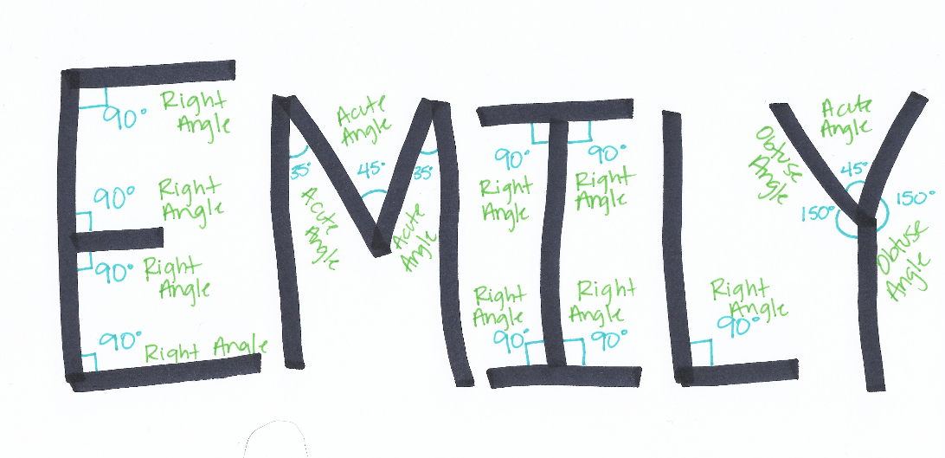
Measure Your Name
Write your name in all capital letters.
Find where each letter in your name makes an angle.
Label the angle.
Measure the angle in degrees.

Slide 19
Choice Board
Choose one of the activities to complete independently.

Slide 20
Choice Board
Spaghetti Geometry Make a model of each type of angle using spaghetti noodles and marshmallows. Label each angle with its measurement and type. | Angles of a Home Draw a house that includes each angle type. Provide a separate answer sheet that has each angle labeled with its measurement and type.
Search for each type of angle in the classroom. With your tablet, take a photo and create a presentation. In the presentation, label each angle’s measurement and type. Scavenger Hunt | Write a test question For each type of angle. It can be fill-in-the-blank, multiple-choice, matching, etc. Provide a separate answer sheet. Create-A-Test
Chant It, Sing It, Rap It
Write a song that you will perform for the class that describes each of the different angles and their measurements.

