Slide 2
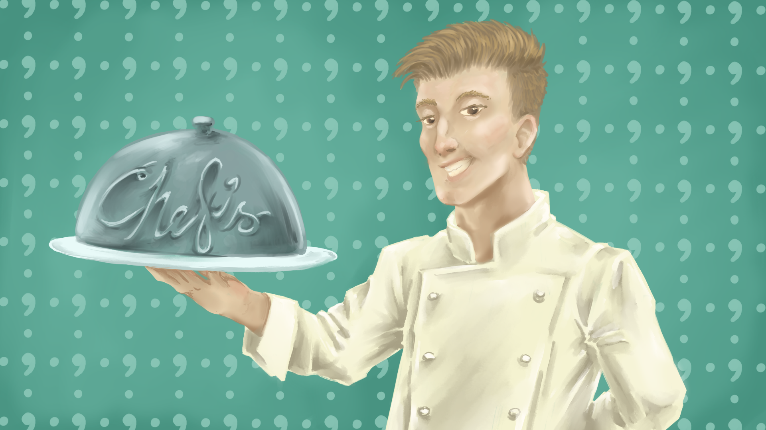
Mastering the Art of Apostrophes
Grammar

Slide 3
Essential Question
How should apostrophes be used correctly in sentence?

Slide 4
Learning Objectives
Students will be able to perform the following:
Identify the apostrophe rules.
Revise writing to include the appropriate uses of an apostrophe.

Slide 5

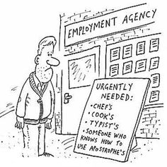
Notes:
Jolley, Richard. (1998, 7 July). Someone who knows apostrophes.. https://www.cartoonstock.com/cartoon?searchID=CS269414

Slide 6
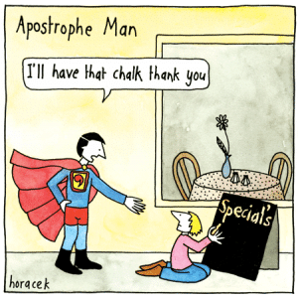
Notes:
Rooks, S. (2024, March 16). No apostrophes in plurals!. Grammar Goddess Communication. https://grammargoddess.com/no-apostrophes-in-plurals-2/

Slide 7
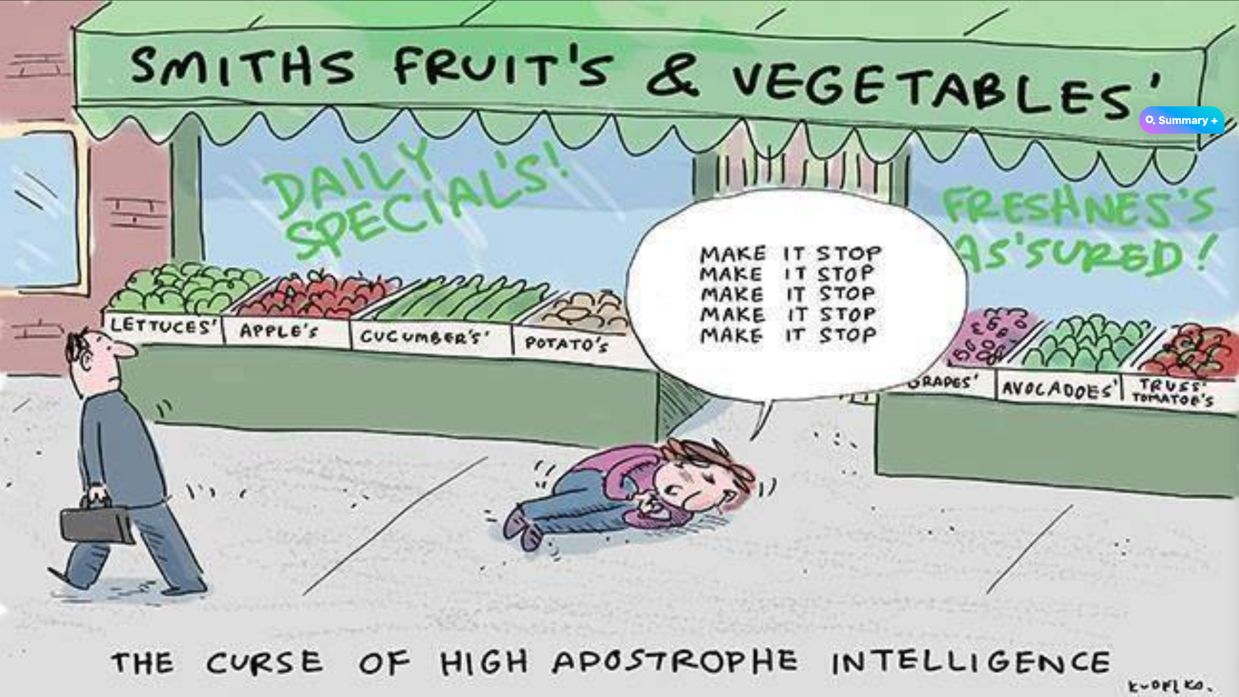
Notes:
Rutkowski, A. (2015, September 30). The apostrophe (yawn!). No Harm Spilt. https://noharmspilt.com/2015/09/30/the-apostrophe-yawn/

Slide 8
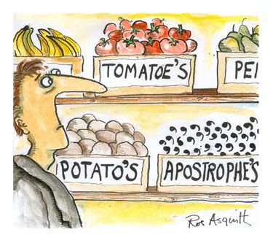
Notes:
Greengrocers. (n.d.). Apostrophes. https://4.bp.blogspot.com/-6mzXOB7Fyp4/UeGbdVNYLQI/AAAAAAAAAG8/I09WTGBr_C4/s1600/Greengrocers%2527_Apostrophe.jpg

Slide 9

Notes:
Oysterville Daybook (blog) " Sydney of Oysterville. Sydney of Oysterville. (n.d.). https://sydneyofoysterville.com/oysterville-daybook/page/3/?wpmp_switcher=desktop

Slide 10

Notes:
The grammar vandal. (n.d.). https://thegrammarvandal.wordpress.com/page/8/

Slide 11
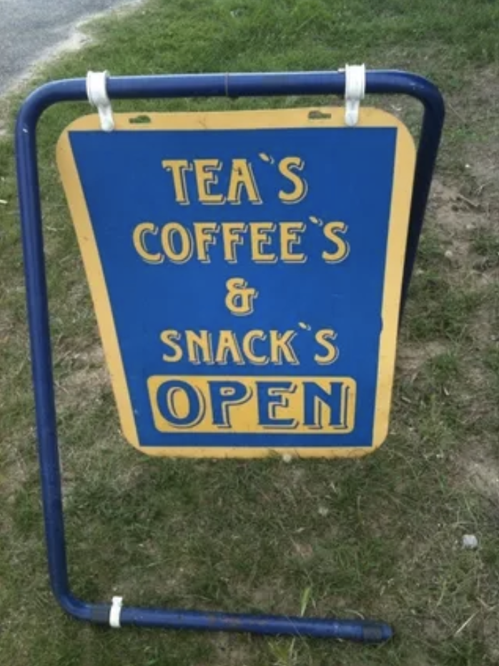
Notes:
Linton, B. (2021, March 21). Punctuation made easy – apostrophes: Beth Linton. Beth Linton - Helen. https://www.bethlinton.co.uk/post/punctuation-made-easy-apostrophes

Slide 12

Notes:
Miller, A. (2014, September 25). Home. bigwords101. https://bigwords101.com/2014/blog/its-well-it-was-national-punctuation-day/

Slide 13

Card Matching
Match the rule with the example sentence.
Notes:
K20 Center. (n.d.). Card matching. Strategies. https://learn.k20center.ou.edu/strategy/1837

Slide 14
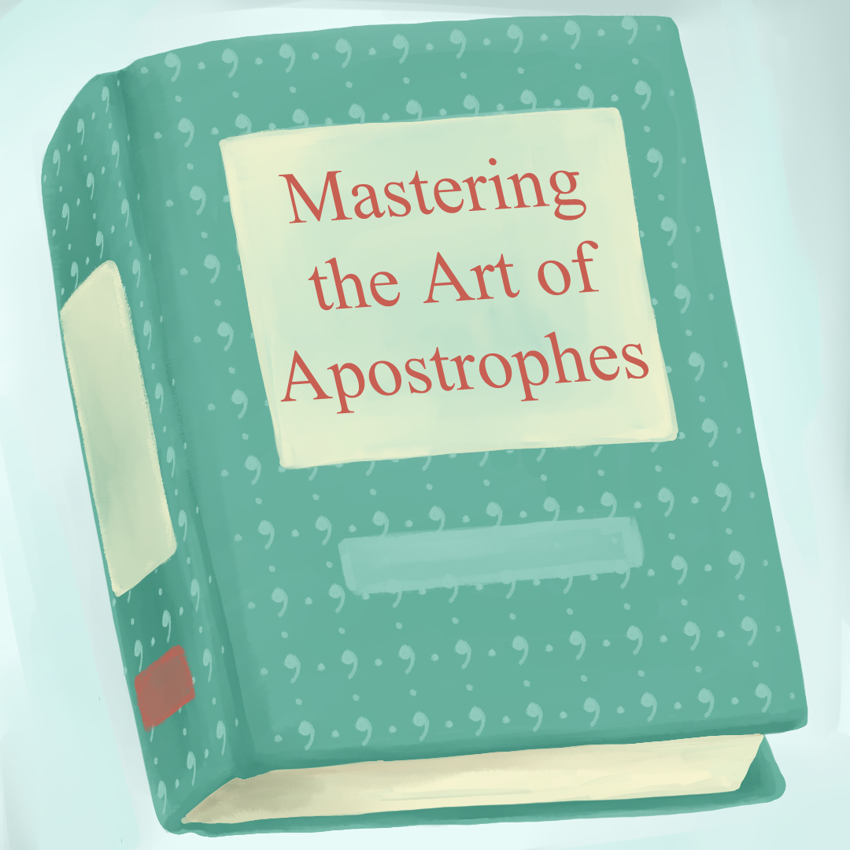
Rules for Using Apostrophes
Rule
Example
Use an apostrophe to show possession with a singular noun by adding an apostrophe plus the letter “s.”
Gordon Ramsay's restaurants sometimes reflect the different cultures he has experienced.

Slide 15
Rules for Using Apostrophes
Rule
Example
Use an apostrophe to show possession with a common noun by adding an apostrophe plus the letter “s.”
The restaurant’s hours changed when the chef’s hat caught on fire.

Slide 16
Rules for Using Apostrophes
Rule
Example
Use an apostrophe to show possession with a common noun that ends in “s,” by adding a stand-alone apostrophe.
The chef had to remove the apricots’ pits before chopping them up.

Slide 17
Rules for Using Apostrophes
Rule
Example
Use an apostrophe to show plural possession with a regular noun by adding the letters “s” or “es” plus an apostrophe.
Chef Nobu Matsuhisa's restaurants' menus showcase a fusion of traditional Japanese cuisine and innovative techniques, drawing food enthusiasts worldwide.

Slide 18
Rules for Using Apostrophes
Rule
Example
Use an apostrophe to show plural possession with irregular nouns by writing out the entire irregular plural noun before adding an apostrophe or an apostrophe + “s.”
The knives’ handles are made from green pakkawood-handled Japanese Damascus steel and offer an elegant and timeless design for chefs to use when cooking.

Slide 19
Rules for Using Apostrophes
Rule
Example
Use an apostrophe to show plural possession of proper names ending in “s,” “ch,” and “z” by adding “es,” plus an apostrophe.
Aarón Sánchezes’ cooking offers spicy flavors of Mexico in shows like, “Melting Pot,” “Heat Seekers,” “Taco Trip,” and “Chopped.”

Slide 20
Rules for Using Apostrophes
Rule
Example
Use an apostrophe to show possession of a singular compound noun by adding an apostrophe plus the letter “s.”
The cookbook’s recipes offer a delightful array of culinary delights for any home chef.

Slide 21
Rules for Using Apostrophes
Rule
Example
Use an apostrophe to show possession of the same item by two people by adding an apostrophe plus the letter “s” after the second name only.
Richard Blais and Gordon Ramsay’s teams are always coming behind Nyesha Arrington’s team on the show “Next Level Chef.”

Slide 22
Rules for Using Apostrophes
Rule
Example
Use an apostrophe to show possession of the same item by two people–when the first is named and the second is a pronoun–by adding an apostrophe plus the letter “s” after the proper name only.
Vianney Massot is one of the youngest proteges of Chef Joël Robuchon. His and Robuchon’s contemporary French influence is leaving a mark in Singapore.

Slide 23
Rules for Using Apostrophes
Rule
Example
Use an apostrophe to show separate possession by using the possessive form by adding an apostrophe plus the letter “s” for both people.
At the dinner party, Sarah's and David's desserts delighted the guests with their exquisite flavors and presentation.

Slide 24
Rules for Using Apostrophes
Rule
Example
Use an apostrophe to combine two words in a contraction, placing the apostrophe where a letter or letters have been removed.
“It's not something I really wanted; I didn't say to my chef, 'OK you have to recruit only women;' it's a fact that there are more and more women in the culinary world and it's good.” - Hélène Darroze

Slide 25
Rules for Using Apostrophes
Rule
Example
Use an apostrophe for plural single letter abbreviations by adding an apostrophe plus the letter “s.”
Receiving a Michelin Star is like getting all A’s on the toughest final exams.

Slide 26
Rules for Using Apostrophes
Rule
Example
Use an apostrophe to show possession of multiple letter abbreviations and/or acronyms by adding an apostrophe plus the letter “s.”
There are only 11 Certified Master Pastry Chefs® (CMPC®). CMPC®'s hold the highest degree of professional culinary knowledge, skill, and mastery of cooking and baking techniques.

Slide 27
Rules for Using Apostrophes
Rule
Example
Use an apostrophe when amounts of time or money are used as possessive adjectives by adding an apostrophe after the letter “s.”
TikTok chefs often challenge themselves to create gourmet dishes with just five dollars’ worth of ingredients.

Slide 28
Rules for Using Apostrophes
Rule
Example
Use an apostrophe before a shortened word or number. Take care that it is an apostrophe and not a single quotation mark.
“In France in the '80s when you were a good student you didn't go in the kitchen for an apprenticeship -- in fact only the bad boys learned how to be a chef!” - Hélène Darroze

Slide 29

Pass the Problem
Read the paragraph you have been assigned.
Make appropriate revisions in the time given with the color pen you have been assigned.
Notes:
K20 Center. (n.d.). Pass the Problem. Strategies. https://learn.k20center.ou.edu/strategy/151

Slide 30
Pass the Problem
Pass your paragraph to the next person in your group.
Read the paragraph and review the revisions the previous student made.
Continue to make appropriate revisions to the paragraph in the time given with the color pen you have been assigned.
Notes:
K20 Center. (n.d.). Pass the Problem. Strategies. https://learn.k20center.ou.edu/strategy/151

Slide 31
The Great Chefs: Masters of the Culinary Arts
In the world of gastronomy, famous chefs like Gordon Ramsay and Julia Child’s have captured the hearts and taste buds of food enthusiasts worldwide. These culinary maestro's have a way of transforming simple ingredients into exquisite dishes that leave diners craving for more. They weave their culture’s culinary art’s into their dishes’. Despite their busy schedules and demanding kitchens, each chef's passion for cooking drives them to create memorable dining experiences that keep patrons coming back for seconds. From signature dishes to innovative cooking techniques, these chefs' dedication to their craft sets them apart in the competitive culinary world.
Notes:
K20 Center. (n.d.). Pass the Problem. Strategies. https://learn.k20center.ou.edu/strategy/151

Slide 32
The Great Chefs: Masters of the Culinary Arts
In the world of gastronomy, famous chefs like Gordon Ramsay and Julia Child’s have captured the hearts and taste buds of food enthusiasts worldwide. These culinary maestro's have a way of transforming simple ingredients into exquisite dishes that leave diners craving for more. They weave their culture’s culinary art’s into their dishes’. Despite their busy schedules and demanding kitchens, each chefs passion for cooking drives them to create memorable dining experiences that keep patrons coming back for seconds. From signature dishes to innovative cooking techniques, these chefs dedication to their craft sets them apart in the competitive culinary world.
“Julia Child’s” should be “Julia Child”
“maestro’s” should be “maestros”
“art’s” should be “arts”
“dishes’” should be “dishes”
“chefs” should be “chef’s”
“chefs” should be “chefs’”
Notes:
K20 Center. (n.d.). Pass the Problem. Strategies. https://learn.k20center.ou.edu/strategy/151

Slide 33
Famous Chefs: A Culinary Journey of Success
Today, we delve into the fascinating world of famous chef’s and their culinary adventures. From mastering the art of cooking to running renowned restaurants, these exceptional individuals’ have truly made their mark in the gastronomic realm.
One of the most renowned chefs in the industry is Gordon Ramsay. Known for his fiery personality and exceptional culinary skills, Ramsay has earned multiple Michelin stars for his restaurants worldwide. His dedication to perfection in the kitchen has inspired aspiring chefs around the globe.
Another legendary chef is Julia Child’s. With her groundbreaking TV show and bestselling cookbooks, Child introduced French cuisine to American households. Her passion for cooking and unique cooking techniques revolutionized the way people approached food.
Notes:
K20 Center. (n.d.). Pass the Problem. Strategies. https://learn.k20center.ou.edu/strategy/151

Slide 34
Famous Chefs: A Culinary Journey of Success
Today, we delve into the fascinating world of famous chef’s and their culinary adventures. From mastering the art of cooking to running renowned restaurants, these exceptional individuals’ have truly made their mark in the gastronomic realm.
One of the most renowned chefs in the industry is Gordon Ramsay. Known for his fiery personality and exceptional culinary skills, Ramsay has earned multiple Michelin stars for his restaurants worldwide. His dedication to perfection in the kitchen has inspired aspiring chefs around the globe.
Another legendary chef is Julia Child’s. With her groundbreaking TV show and bestselling cookbooks, Child introduced French cuisine to American households. Her passion for cooking and unique cooking techniques revolutionized the way people approached food.
“chef’s” should be “chefs”
“individuals’” should be “individuals”
“Julia Child’s” should be “Julia Child”
Notes:
K20 Center. (n.d.). Pass the Problem. Strategies. https://learn.k20center.ou.edu/strategy/151

Slide 35
Famous Chefs: A Culinary Journey of Success
On the other hand, lets not forget the importance of using apostrophes correctly. Incorrect usage can lead to confusion and misunderstanding. For example, "chef's" indicates possession, while "chefs" simply refers to multiple chefs. Its essential to pay attention to these details to communicate effectively.
In conclusion, the world of famous chefs is a vibrant tapestry of talent, creativity, and innovation. As we celebrate their culinary achievements, lets also remember the importance of mastering the basics, including the proper use of apostrophes. Stay tuned for more exciting culinary adventures!
Notes:
K20 Center. (n.d.). Pass the Problem. Strategies. https://learn.k20center.ou.edu/strategy/151

Slide 36
Famous Chefs: A Culinary Journey of Success
On the other hand, lets not forget the importance of using apostrophes correctly. Incorrect usage can lead to confusion and misunderstanding. For example, "chef's" indicates possession, while "chefs" simply refers to multiple chefs. Its essential to pay attention to these details to communicate effectively.
In conclusion, the world of famous chefs is a vibrant tapestry of talent, creativity, and innovation. As we celebrate their culinary achievements, lets also remember the importance of mastering the basics, including the proper use of apostrophes. Stay tuned for more exciting culinary adventures!
“lets” should be “let’s”
“its” should be “it’s”
“lets” should be “let’s”
Notes:
K20 Center. (n.d.). Pass the Problem. Strategies. https://learn.k20center.ou.edu/strategy/151

Slide 37
The Culinary Legends: Famous Chefs Making Their Mark
Today, we dive into the fascinating world of renowned chef’s who have left an indelible mark on the culinary landscape. From creating mouthwatering dishes to revolutionizing the way we think about food, these culinary geniuses’ have truly elevated the art of cooking to new heights.
One of the most iconic chefs of our time is Gordon Ramsay. Known for his fiery personality and exceptional culinary skills, Ramsay has earned multiple Michelin stars for his world-class restaurants. However, not all chefs restaurants receive such prestigious awards.
Notes:
K20 Center. (n.d.). Pass the Problem. Strategies. https://learn.k20center.ou.edu/strategy/151

Slide 38
The Culinary Legends: Famous Chefs Making Their Mark
Today, we dive into the fascinating world of renowned chef’s who have left an indelible mark on the culinary landscape. From creating mouthwatering dishes to revolutionizing the way we think about food, these culinary geniuses’ have truly elevated the art of cooking to new heights.
One of the most iconic chefs of our time is Gordon Ramsay. Known for his fiery personality and exceptional culinary skills, Ramsay has earned multiple Michelin stars for his world-class restaurants. However, not all chefs restaurants receive such prestigious awards.
“chef’s” should be “chefs”
“geniuses’” should be “geniuses”
“chefs” should be “chefs’”
Notes:
K20 Center. (n.d.). Pass the Problem. Strategies. https://learn.k20center.ou.edu/strategy/151

Slide 39
The Culinary Legends: Famous Chefs Making Their Mark
Another chef who has captured the hearts and taste buds of many is Julia Child. Her groundbreaking TV show and cookbooks have inspired countless home cooks around the globe. But, some chefs’ struggle to find their footing in the competitive culinary world.
Furthermore, we cannot talk about famous chefs without mentioning Bobby Flay. His innovative approach to Southwestern cuisine has made him a household name. Yet, its essential for chefs to remember the humble beginnings that shaped their culinary journey.
In conclusion, these famous chefs serve as an inspiration to aspiring culinary artists everywhere. Their dedication, creativity, and passion for food have solidified their rightful place in the pantheon of culinary legends. So, whether youre perfecting a signature dish or experimenting with new flavors, remember that the world of gastronomy is as vast as your imagination allows.
Notes:
K20 Center. (n.d.). Pass the Problem. Strategies. https://learn.k20center.ou.edu/strategy/151

Slide 40
The Culinary Legends: Famous Chefs Making
Their Mark
Another chef who has captured the hearts and taste buds of many is Julia Child. Her groundbreaking TV show and cookbooks have inspired countless home cooks around the globe. But, some chefs’ struggle to find their footing in the competitive culinary world.
Furthermore, we cannot talk about famous chefs without mentioning Bobby Flay. His innovative approach to Southwestern cuisine has made him a household name. Yet, its essential for chefs to remember the humble beginnings that shaped their culinary journey.
In conclusion, these famous chefs serve as an inspiration to aspiring culinary artists everywhere. Their dedication, creativity, and passion for food have solidified their rightful place in the pantheon of culinary legends. So, whether youre perfecting a signature dish or experimenting with new flavors, remember that the world of gastronomy is as vast as your imagination allows.
“chefs’” should be “chefs”
“its” should be “it’s”
“youre” should be “you’re”
Notes:
K20 Center. (n.d.). Pass the Problem. Strategies. https://learn.k20center.ou.edu/strategy/151

Slide 41
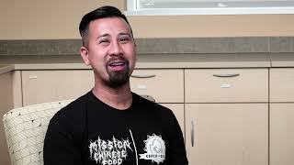
Notes:
K20 Center. (n.d.). Taking a bite. Interview with entrepreneur (Restaurant Owner). K20 ICAP - Entrepreneur (Restaurant Owner) - Taking a Bite (youtube.com)

Slide 42


Synectics Example
The Constitution is like a tricycle because it divides the government into three branches and because a tricycle has three wheels.
Notes:
K20 Center. (n.d.). Synectics. Strategies. Retrieved from https://learn.k20center.ou.edu/strategy/120
Tricycle. (n.d.). https://clipartcraft.com/images/bike-clipart-tricycle-3.png

Slide 43
Synectics
Complete the analogy:
  “Cooking is like grammar because __________.”
Write three (3) unique synectics statements comparing cooking and grammar -or- cooking and apostrophes.
Notes:
K20 Center. (n.d.). Synectics. Strategies. Retrieved from https://learn.k20center.ou.edu/strategy/120

Slide 44

Critique the Bot
Read the article, “Tantalizing Tales: Culinary Titans’ Savory Success Stories” written by ChatGPT.
Highlight every apostrophe that you find.
Reflect on the overall paper and the use of apostrophes
  Are they used appropriately?
  Are they used correctly?
  How would you grade the paper?
Provide justification for the grade you would give the bot.

