Slide 2
Blackbirds in Little Rock
Exploring the History behind the Music

Slide 3
Essential Questions
How does the speaker impact the meaning of a text?
How can history influence art?
How is the Civil Rights Movement still relevant today?

Slide 4
Lesson Objectives
Analyze the speaker’s impact on the meaning of the text
Evaluate the impact the Civil Rights Movement has had on culture today

Slide 5
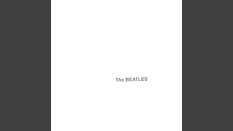
Blackbird by The Beatles
As you listen to Blackbird, read the lyrics and be prepared to discuss the meaning.
When the song ends, turn your lyric sheet over and answer questions 1–3 on the back.
Notes:
Beatles. (2018, June 17). Blackbird (Remastered 2009) [Video]. YouTube. https://youtu.be/Man4Xw8Xypo

Slide 6
Blackbird (1968)
“I was sitting around with my acoustic guitar and I’d heard about the civil rights troubles that were happening in the ’60s in Alabama, Mississippi, Little Rock in particular,” he told GQ. “So that was in my mind, and I just thought it would be really good if I could write something that if it ever reached any of the people going through those problems, it might give them a little bit of hope. So, I wrote ‘Blackbird.’ And in England, a bird is a girl, so I was thinking of a Black girl going through [this], you know, now’s your time to arise, set yourself free, and take these broken wings. One of the nice things about music is that you know a lot of people listening to you are going to take seriously what you’re saying in the song so I’m very proud of the fact that the Beatles’ output is always pretty positive.”
He added: “There’s people out there who are going through some problems. Hopefully, people out there will listen to it and think, ‘oh yeah, it’s not just me alone going through this. This is something and also something I can fix.’” —Paul McCartney
Notes:
Bailey, A. (2024, April 1). Beyoncé puts a poignant twist on the Beatles’ ‘Blackbird.’ Elle. https://www.elle.com/culture/music/a60359860/beyonce-blackbiird-song-lyrics-meaning-beatles/.

Slide 7
Let’s Reflect
What big events were happening during this time?
Why does he talk about Little Rock in particular?
Looking back at the reflection questions you answered, was anyone accurate with their initial thoughts about what the song was about or what blackbirds represented?
What do you know about the Civil Rights Movement? When did it begin?
What do you know about the Little Rock Nine?
Why was this a significant event in America?
What role did music have during the Civil Rights Movement?
What role does music play in historical events?

Slide 8

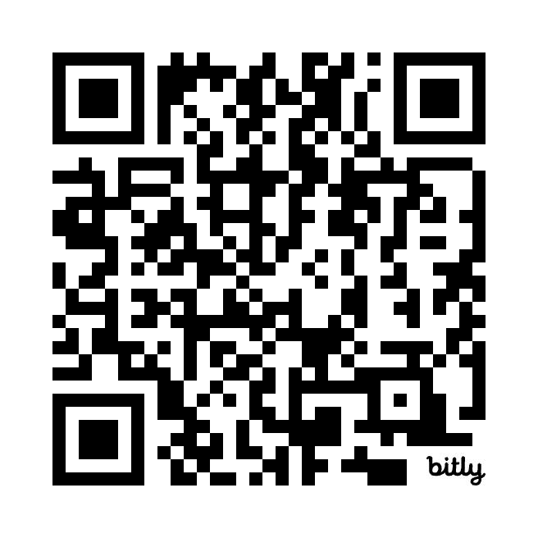
Tip of the Iceberg
On your handout, write down all you know about the Civil Rights Movement on the portion of the iceberg that is above the “water” (line).
Take out your internet-capable device and explore the Civil Rights Music Timeline.
Link: https://bit.ly/3WSbf1x
After reviewing the timeline, fill out the bottom of the iceberg with what you’ve learned so far.
Notes:
K20 Center. (n.d.). Tip of the iceberg. Strategies. https://learn.k20center.ou.edu/strategy/67
DeLoera, M., Finley, E., & Loughlin, L. (2024). Civil Rights Music Timeline by K20 Center. Infogram. https://infogram.com/civil-rights-music-timeline-1h7v4pdw787jj4k?live

Slide 9

Who are the Little Rock Nine?
As you review the newspaper headlines on the following slides, fill in the I Notice, I Wonder handout.
Be prepared to share your thoughts.
Notes:
K20 Center. (n.d.). I notice, I wonder. Strategies. https://learn.k20center.ou.edu/strategy/180

Slide 10
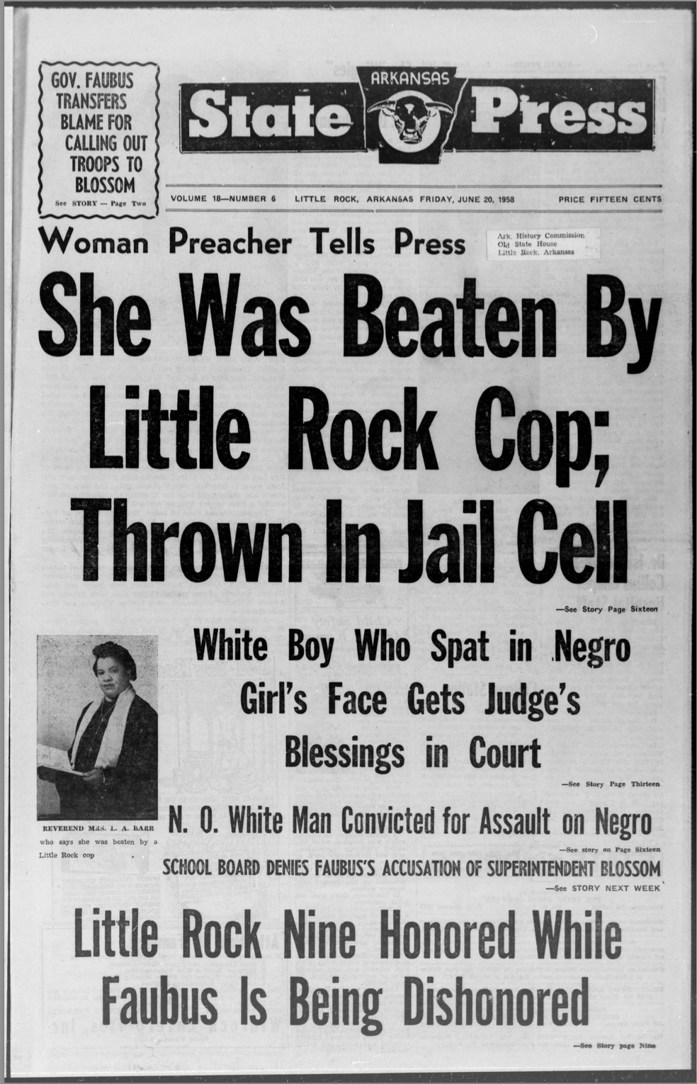
Image 1
Notes:
Arkansas State press (Little Rock, Ark.). (1958, June 20). Image 1 [Photograph]. Chronicling America: Historic American Newspapers. Library of Congress. https://chroniclingamerica.loc.gov/lccn/sn84025840/1958-06-20/ed-1/seq-1/

Slide 11
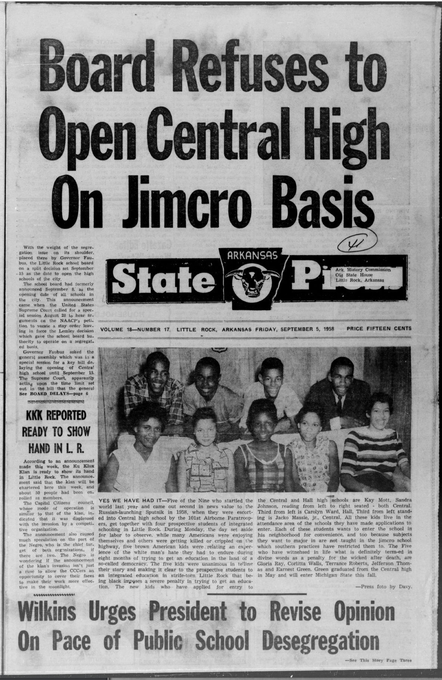
Image 2
Notes:
Arkansas State press (Little Rock, Ark.). (1958, September 5). Image 1 [Photograph]. Chronicling America: Historic American Newspapers. Library of Congress. https://chroniclingamerica.loc.gov/lccn/sn84025840/1958-09-05/ed-1/seq-1/

Slide 12
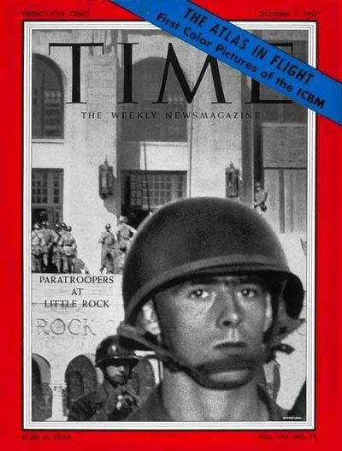
Image 3
Notes:
Time, Inc. (Magazine). (1957, October 7). Little Rock [Photograph]. Wikimedia Commons. https://commons.wikimedia.org/wiki/File:Little-Rock-TIME-1957.jpg

Slide 13
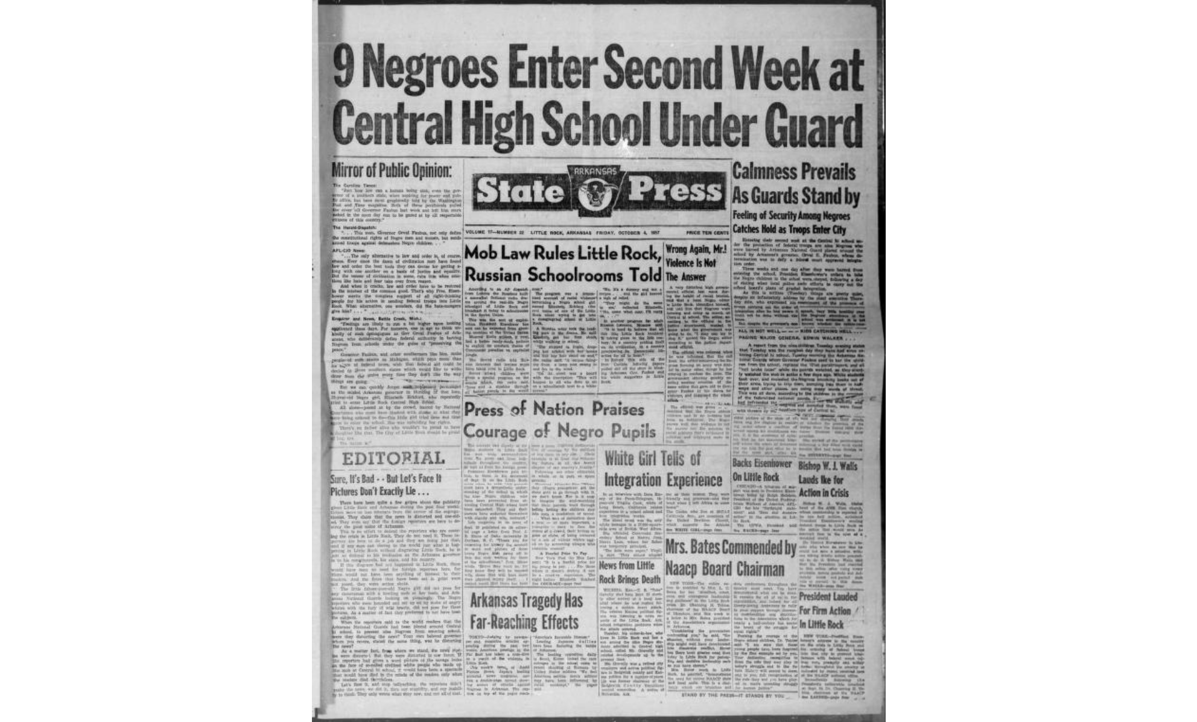
Image 4
Notes:
Arkansas State press (Little Rock, Ark.). (1957, October 4). Image 1 [Photograph]. Chronicling America: Historic American Newspapers. Library of Congress. https://www.loc.gov/item/sn84025840/1957-10-04/ed-1/

Slide 14
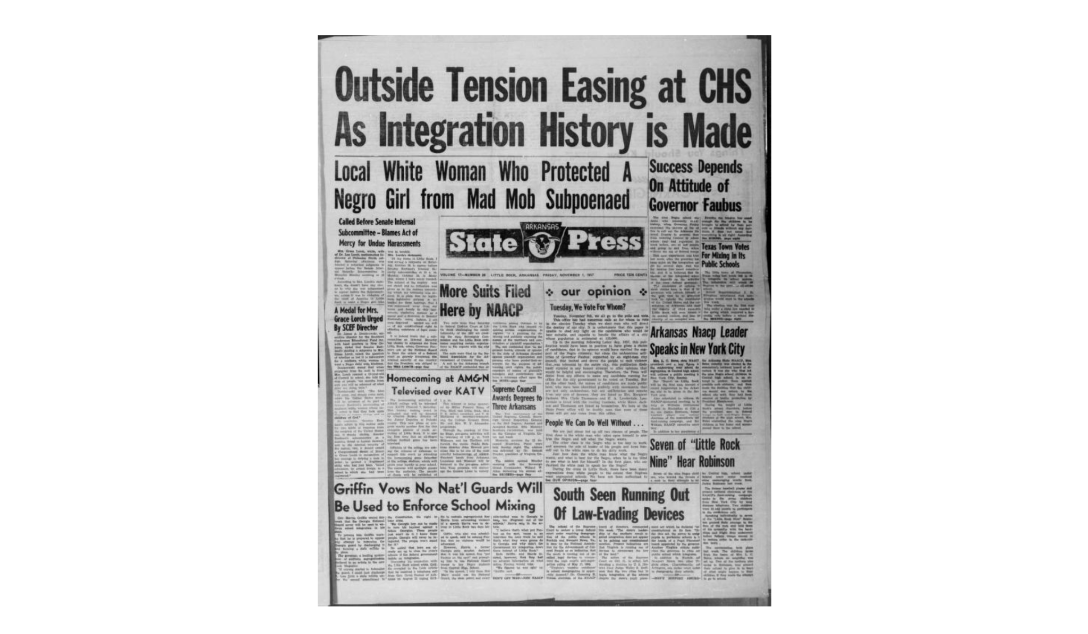
Image 5
Notes:
Arkansas State press (Little Rock, Ark.). (1957, November 1). Image 1 [Photograph]. Chronicling America: Historic American Newspapers. Library of Congress. https://www.loc.gov/item/sn84025840/1957-11-01/ed-1/

Slide 15
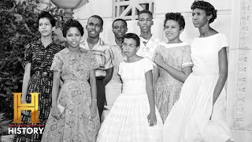
Who are the Little Rock Nine?
As you watch the video How the Little Rock 9 Impacted the Civil Rights Movement, fill in your guided notes handout.
Be ready to share.
Notes:
History. (2022, June 6). How the little rock 9 impacted the Civil Rights Movement | The American presidency w/ Bill Clinton [Video]. YouTube. https://www.youtube.com/watch?v=S0Dn3tOmyKk&t=1s

Slide 16

How Am I Feeling, What Am I Thinking?
On your sticky note, draw a line to divide it in half.
On one half, draw a picture depicting how you are feeling.
On the other half, write a sentence about what you are thinking.
Notes:
K20 Center. (n.d.). How am I feeling? What am I thinking?. Strategies. https://learn.k20center.ou.edu/strategy/187

Slide 17

“Blackbiird”
In 2024, Beyoncé released a version of Paul McCartney’s song on her album Cowboy Carter and titled it Blackbiird.
It features four Black country artists, Tanner Adell, Tiera Kennedy, Reyna Roberts, and Brittney Spencer.
Notes:
Beyoncé. (2024, March 28.) Blackbiird (Official Lyric Video) [Video]. YouTube. https://www.youtube.com/watch?v=xhempeEjGUA

Slide 18

Why-Lighting
As you read the article “What The Beatles and Beyoncé’s ‘Blackbird’ means to this Little Rock Nine member,” highlight anything you think is important to your understanding.
Explain your reasoning for highlighting in the margins of your paper.
Be prepared to share your thoughts.
Notes:
K20 Center. (n.d.). Why-lighting. Strategies. https://learn.k20center.ou.edu/strategy/128
Kim, J. (2024, April 2). What the Beatles and Beyoncé’s “Blackbird” means to this Little Rock Nine member. NPR. https://www.npr.org/2024/04/02/1242106502/beyonce-beatles-blackbird-little-rock-nine

Slide 19
Let’s Reflect
Why did Beyoncé’s version of “Blackbird” resonate with the Little Rock Nine member Melba Pattillo Beals?
What things did you highlight and why?
Why does learning the inspiration behind the songs that we listen to matter?
Are there other remakes of songs that you like better than the original?

Slide 20
“Blackbird” and “Blackbiird”
Now that you have a better understanding of Blackbird and Blackbiird, take a moment to answer questions 4 and 5 on the back of your lyric sheet.

Slide 21
Essay Choice Board
Choose one of the following prompts to respond to in an essay.
Prompt 1 | Prompt 2 | Prompt 3
How does the speaker impact the meaning of a text? | How can history influence art? | How is the Civil Rights Movement still relevant today? How has it influenced current American politics?
Notes:
K20 Center. (n.d.). Choice boards. Strategies. https://learn.k20center.ou.edu/strategy/73

Slide 22
Essay Requirements
Your essay should be 5–6 paragraphs in length.
Your essay should include 5–6 pieces of evidence. Evidence may include but is not limited to:
The song “Blackbird”
The NPR article “What The Beatles and Beyonce’s ‘Blackbird’ means to this Little Rock Nine Member”
The events surrounding the Little Rock Nine in 1958
An event/song from the Civil Rights Music Timeline
A separate historical event, text, or piece of art.
Your essay should include a “Works Cited” page.
Notes:
DeLoera, M., Finley, E., & Loughlin, L. (2024). Civil Rights Music Timeline by K20 Center. Infogram. https://bit.ly/3WSbf1x

Slide 23

Blackout Poetry
On the back of your lyric sheet, write down words you associate with the Civil Rights Movement.
Read through your song lyrics.
Circle any anchor words in your song that relate to the Civil Rights Movement.
On the back of your lyric sheet, write down the circled words in the order they appear in the song.
Study your list and select the final words for your poem.
Use your black marker to black out your song lyrics, line by line, excepting the words you’ve chosen for your poem.
The result should be a mostly blacked out page.
Be prepared to share your poem with the class.
Notes:
K20 Center. (n.d.). Blackout poetry. Strategies. https://learn.k20center.ou.edu/strategy/84

