Slide 2
Cooking with Colons: Using Colons to Enhance Your Writing

Slide 3
Essential Questions
How does grammar enhance your writing?
How can you use this punctuation in your own writing?

Slide 4
Lesson Objective
Use colons to enhance my writing while adhering to the grammatical rules that govern their use.

Slide 5
Fiction in the Facts
Read the following 3 statements and determine which 2 are true about colons and which is the lie.
Notes:
K20 Center. (n.d.). Fiction in the Facts. Strategies. Retrieved from https://learn.k20center.ou.edu/strategy/60

Slide 6
Fiction in the Facts
Colons are most often used to introduce lists.
Capitalize the first item after the colon.
Colons can be used before a noun or a noun phrase.
Notes:
K20 Center. (n.d.). Fiction in the Facts. Strategies. Retrieved from https://learn.k20center.ou.edu/strategy/60

Slide 7
Fiction in the Facts
Colons are most often used to introduce lists.
Ex: I know what I’m bringing to the party: caramel apples, crepe paper, and tablecloths.
Capitalize the first item after the colon.
Do NOT capitalize the first item after a colon unless it’s a proper noun.
Colons can be used before a noun or a noun phrase.
Ex: She possessed one quality above all else: kindness.
Notes:
K20 Center. (n.d.). Fiction in the Facts. Strategies. Retrieved from https://learn.k20center.ou.edu/strategy/60

Slide 8
Fiction in the Facts
Colons and semicolons can be used interchangeably.
Colons can introduce a quotation.
Colons are used to illustrate the author’s point by providing certain examples.
Notes:
K20 Center. (n.d.). Fiction in the Facts. Strategies. Retrieved from https://learn.k20center.ou.edu/strategy/60

Slide 9
Fiction in the Facts
Colons and semicolons can be used interchangeably.
Colons can introduce a quotation.
Ex: My dad always said: “You will never regret earning a diploma whether it’s from high school, college, or something in-between.”
Colons are used to illustrate their point by providing certain examples.
Ex: We wanted to make sure we had all the supplies we needed for the beach trip: sunscreen, umbrella, towels, and our lunch.
Notes:
K20 Center. (n.d.). Fiction in the Facts. Strategies. Retrieved from https://learn.k20center.ou.edu/strategy/60

Slide 10
Fiction in the Facts
Colons are used to separate units of time and ratios.
A colon can be used to separate a movie, book, or another piece of work’s title from its subtitle.
When listing things, use a colon after a verb or preposition.
Notes:
K20 Center. (n.d.). Fiction in the Facts. Strategies. Retrieved from https://learn.k20center.ou.edu/strategy/60

Slide 11
Fiction in the Facts
Colons are used to separate units of time and ratios.
Ex: We were supposed to leave at 12:30.
Ex: We had to use twice as much water as sugar or a 2:1 ratio.
A colon can be used to separate a movie, book, or another piece of work’s title from its subtitle.
Ex: Killers of the Flower Moon: The Osage Murders and the Birth of the FBI.
When listing things, use a colon after a verb or preposition.
DO NOT: For breakfast, I usually have: cereal, toast, or yogurt.
DO NOT: We wanted to go to: either the beach or the pool for a swim.
Notes:
K20 Center. (n.d.). Fiction in the Facts. Strategies. Retrieved from https://learn.k20center.ou.edu/strategy/60

Slide 12
Colon Rules
Colons are most often used to introduce lists.
Avoid using a colon before a list if it directly follows a verb or preposition that would ordinarily need no punctuation in that sentence.
Colons can be used before a noun or a noun phrase.
Colons can introduce a quote or other form of evidence.
Colons are used to illustrate the main point of the sentence by providing certain examples that restate or further explain the first clause.
Colons are used to separate units of time and ratios.
A colon can be used to separate a movie, book, or another piece of work’s title from its subtitle.

Slide 13
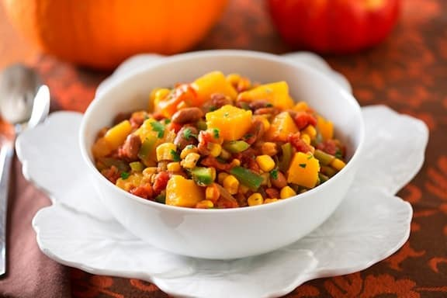
“Three Sisters”
Read the story.
Identify the colons.
Highlight what comes before the colon in one color.
Highlight what comes after the colon in another color.
Three Sisters stew recipe
Notes:
K20 Center. (n.d.). Categorical highlighting. Strategies. https://learn.k20center.ou.edu/strategy/192
VegKitchen. (n.d.). Three sisters stew. Recipe. https://www.vegkitchen.com/three-sisters-stew/

Slide 14
“Three Sisters”
Re-read the story.
In the margins, write down which rule the highlighted colons illustrate.
Mayan depiction of Huichol Maize Mother and her Five Daughters
Notes:
Torres, Ian. (n.d.). “The Three Sister Plot.” Heritage Garden. https://heritagegarden.uic.edu/the-three-sister-plot/

Slide 15
Colon Rules
Colons are most often used to introduce lists
Avoid using a colon before a list if it directly follows a verb or preposition that would ordinarily need no punctuation in that sentence.
Colons can be used before a noun or a noun phrase
Colons can introduce a quote or other form of evidence
Colons are used to illustrate the main point of the sentence by providing certain examples that restate or further explain the first clause.
Colons are used to separate units of time and ratios.
A colon can be used to separate a movie, book, or another piece of work’s title from its subtitle.

Slide 16
Four A’s of Analysis
Review your notes on colons used in the story.
Respond to the following:
What Assumptions does the author of the text hold?
What colon choices do you Agree with in the text?
What colon choices do you want to Argue with in the text?
What colon choices of the text do you want to Aspire to?
Notes:
K20 Center. (n.d.). Four A’s of Analysis. Strategies. Retrieved from https://learn.k20center.ou.edu/strategy/3579

Slide 17
Writing an Article
Choose one of the following news article styles of writing while incorporating colons:
Investigative Journalism - Researches and informs on a specific topic
Op-Ed - Expresses the opinion of an author
Feature - Covers a single topic in detail usually with anecdotal evidence
Notes:
K20 Center. (n.d.). Choice boards. Strategies. Retrieved from https://learn.k20center.ou.edu/strategy/73

Slide 18
Investigative Journalism
Op-Ed
Investigate a specific dish and its roots.
Describe the dish and its ingredients.
Where did it originate?
What makes it significant and/or how it impacts a specific culture?
Choose an unconventional dish to review.
Describe the dish and its ingredients.
Explain why you like or dislike it.
Explain what makes your opinion controversial compared to the general public.
Notes:
K20 Center. (n.d.). Choice boards. Strategies. Retrieved from https://learn.k20center.ou.edu/strategy/73

Slide 19
Writing an Article
Feature
Interview a person in your life who cooks or makes a favorite dish.
Provide a brief biography of the person being interviewed.
Describe how they cook the dish.
Transcribe your Q&A session.
Using AI
If time doesn’t permit a personal interview, interview a chatbot about your favorite dish instead.
Access Chatgpt (or another platform).
Type in a prompt similar to the following:
“Pretend to be a grandmother who loves to cook homemade tamales every year during Fiesta in San Antonio, TX. You are being interviewed for the school newspaper.
Here are a few questions…”

Slide 20
Using Canva
Your article must be 4-5 paragraphs long and include at least 2 photos.
Go to Canva.com or scan the QR code.
Sign in with your school email by selecting Continue with Google. Next, select your school email.
Go to the search bar and select Canva Templates. Next, type in Articles.
Choose an article template.
When completed, share your article (upper righthand corner) by downloading it and submit it to Canvas/Google Classroom

Slide 21
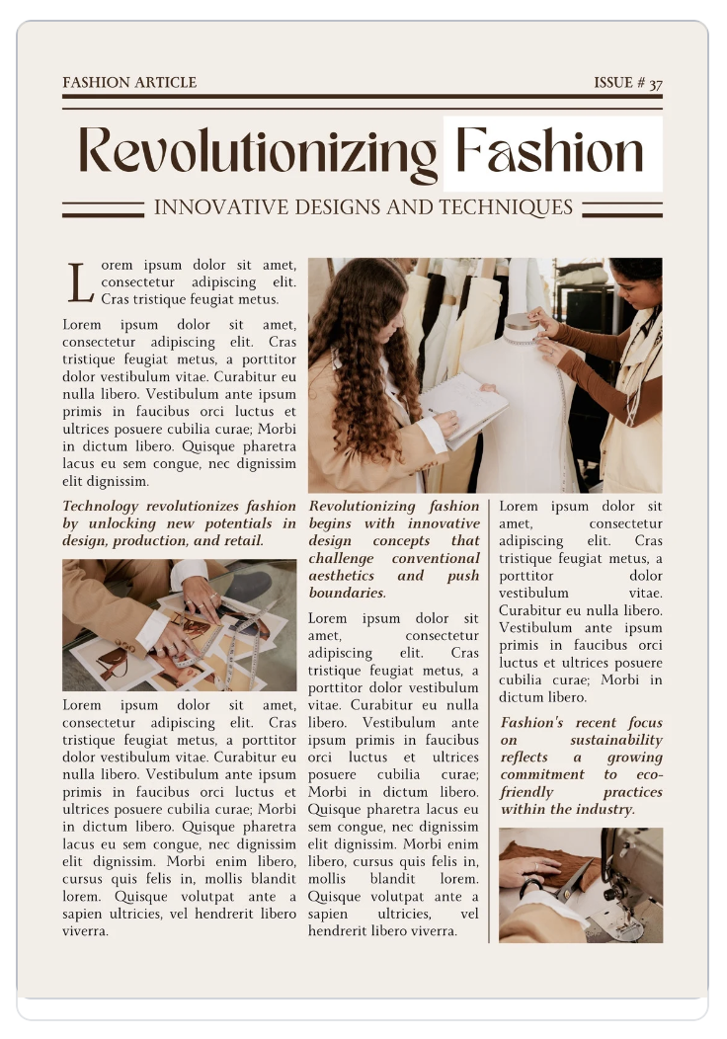
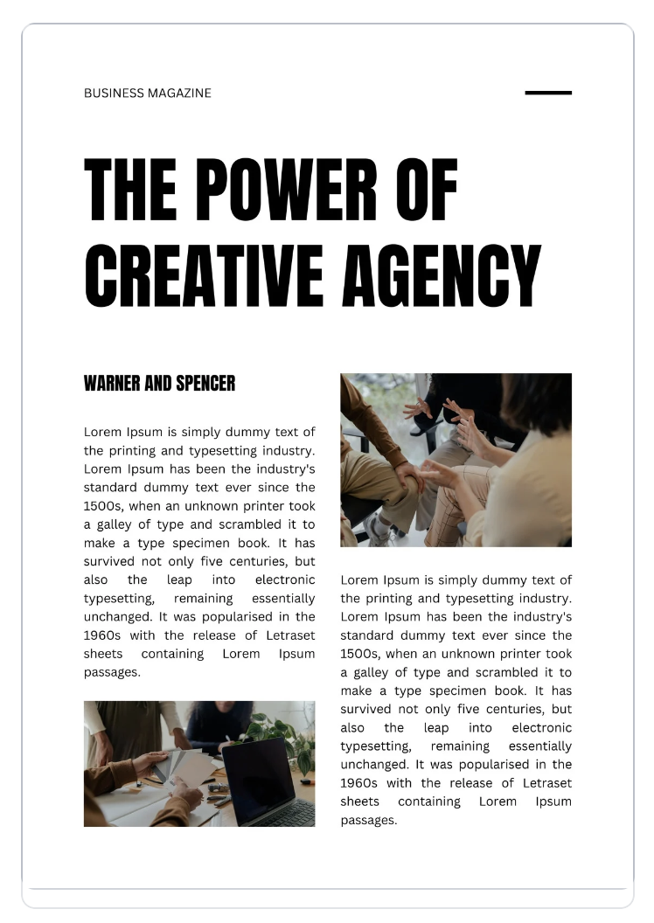
Canva Templates

Slide 22
Practice ACT Question
Talking on the phone in a public space is bad etiquette. There are always exceptions to this rule, but casual conversations should be saved for when you are alone or in the privacy of your own home. When I was waiting to check out at the local grocery store, the lady in front of me was loudly talking to a friend on the phone. I heard everything her dating woes, her work troubles, her financial issues, and her friend’s personal problems. It was uncomfortable for me, the cashier, and everyone else in line. When venting or discussing personal issues in public, opt for texting.
No Change
When I was waiting to check out at the local grocery store: the lady in front of me was loudly talking to a friend on the phone. I heard everything her dating woes, her work troubles, her financial issues, and her friend’s personal problems.
When I was waiting to check out at the local grocery store, the lady in front of me was loudly talking to a friend on the phone. I heard everything: her dating woes, her work troubles, her financial issues, and her friend’s personal problems
When I was waiting to check out at the local grocery store, the lady in front of me was loudly talking to a friend on the phone: I heard everything, her dating woes, her work troubles, her financial issues, and her friend’s personal problems.
Notes:
Colon errors - act English. Varsity Tutors. (n.d.). https://www.varsitytutors.com/act_english-help/colon-errors

Slide 23
Practice ACT Question | Answer
Answer | Explanation
C. When I was waiting to check out at the local grocery store, the lady in front of me was loudly talking to a friend on the phone. I heard everything: her dating woes, her work troubles, her financial issues, and her friend’s personal problems. | The correct choice is C because it follows the rule: “Colons are used to illustrate the main point of the sentence by providing certain examples that restate or further explain the first clause.”

